Slide 1
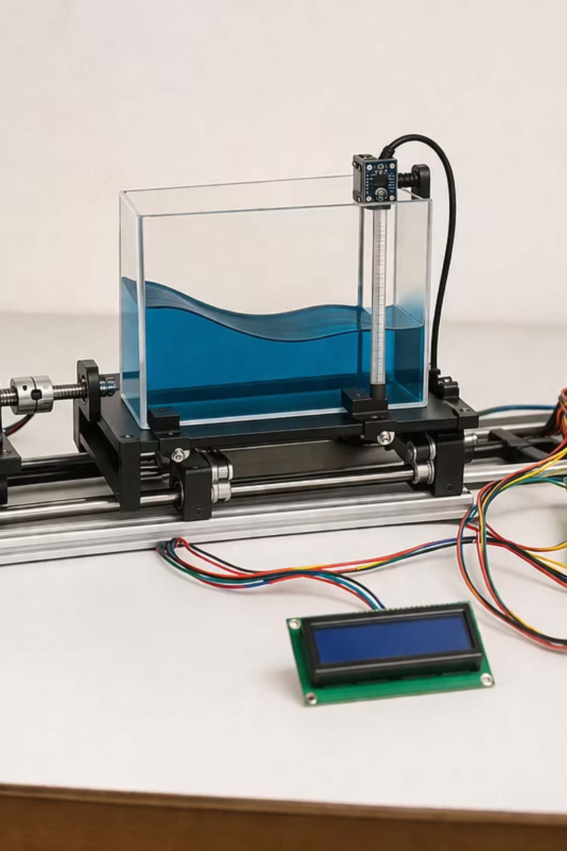
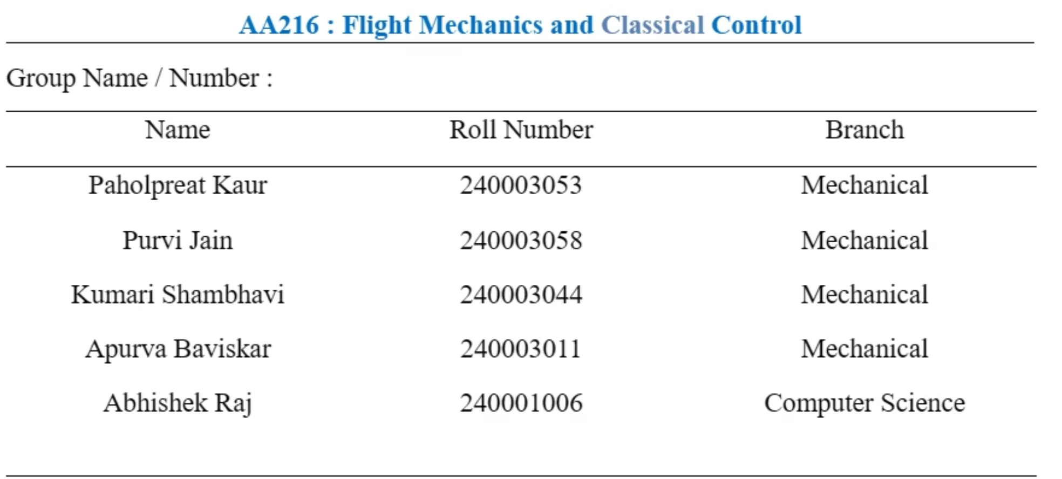
Sloshing Suppression in Liquid Transport Systems
PID Controller Design, Modeling & Experimental Setup

Slide 2
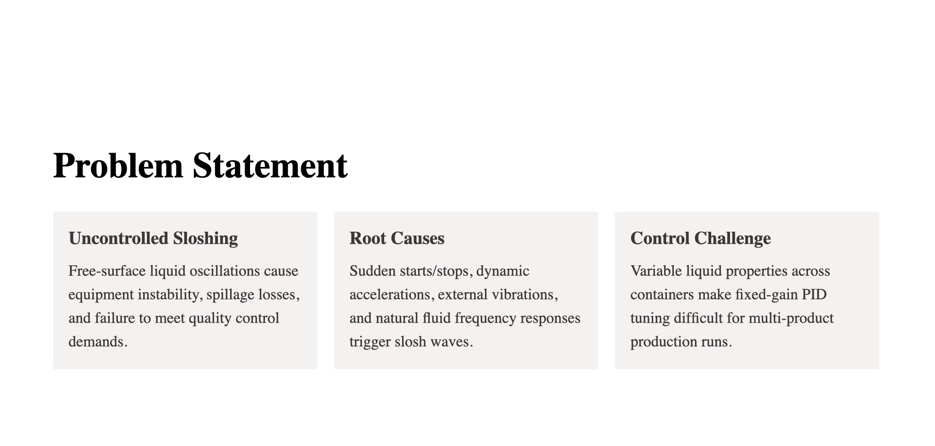
Problem Statement
Uncontrolled Sloshing
Free-surface liquid oscillations cause equipment instability, spillage losses, and failure to meet quality control demands.
Root Causes
Sudden starts/stops, dynamic accelerations, external vibrations, and natural fluid frequency responses trigger slosh waves.
Control Challenge
Variable liquid properties across containers make fixed-gain PID tuning difficult for multi-product production runs.

Slide 3
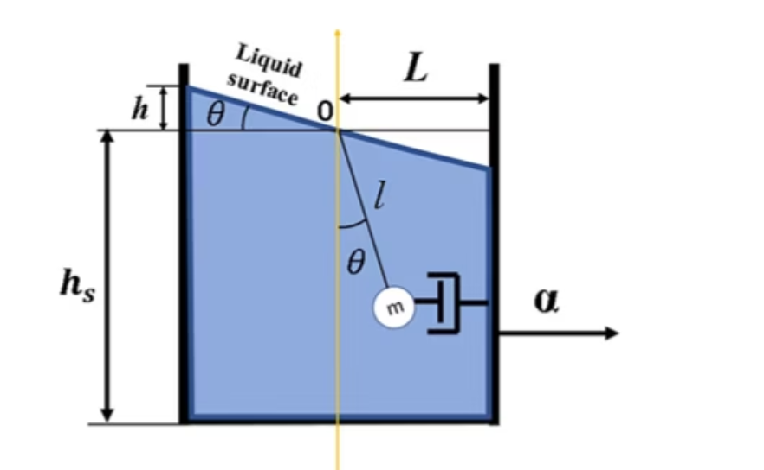

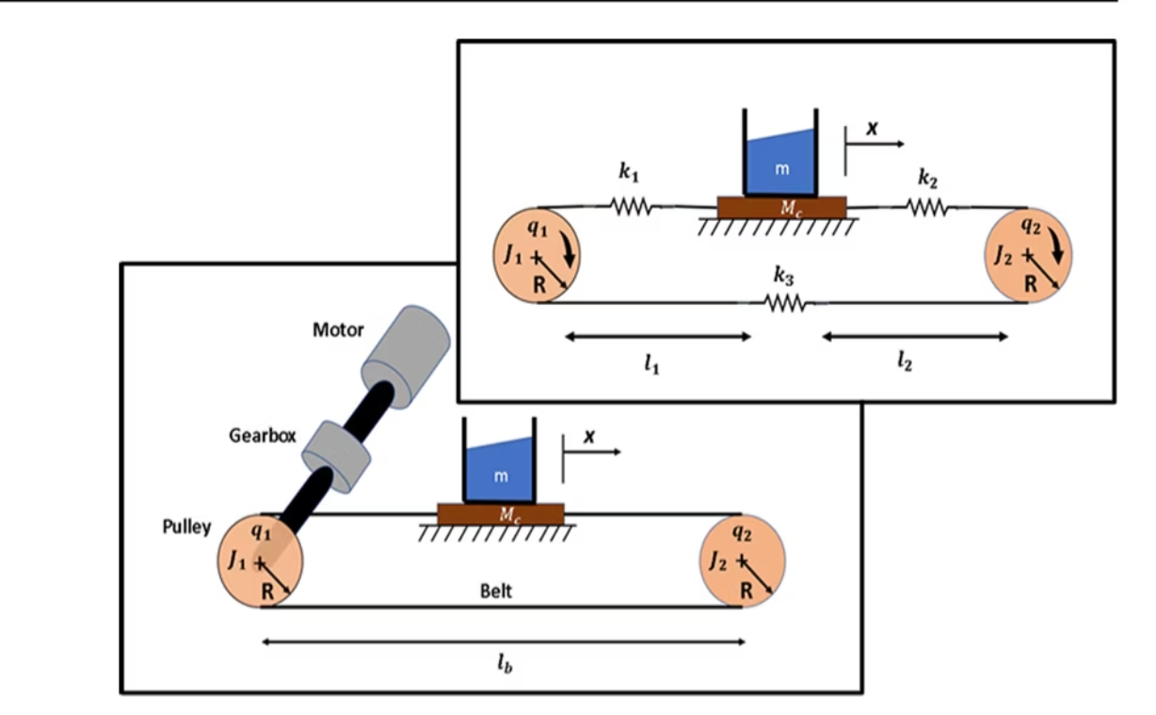
System Modeling
Liquid Model — Equivalent Pendulum
Liquid dynamics are represented by a 2D pendulum model. Linearized transfer function:
Pendulum model for liquid-filled container
Belt Drive & PMDC Motor
A PMDC motor (1 gearbox) drives a toothed belt carriage over a 1-m linear path. Motor dynamics include armature resistance, inductance, and back-EMF feedback.
Belt Drive System

Slide 4
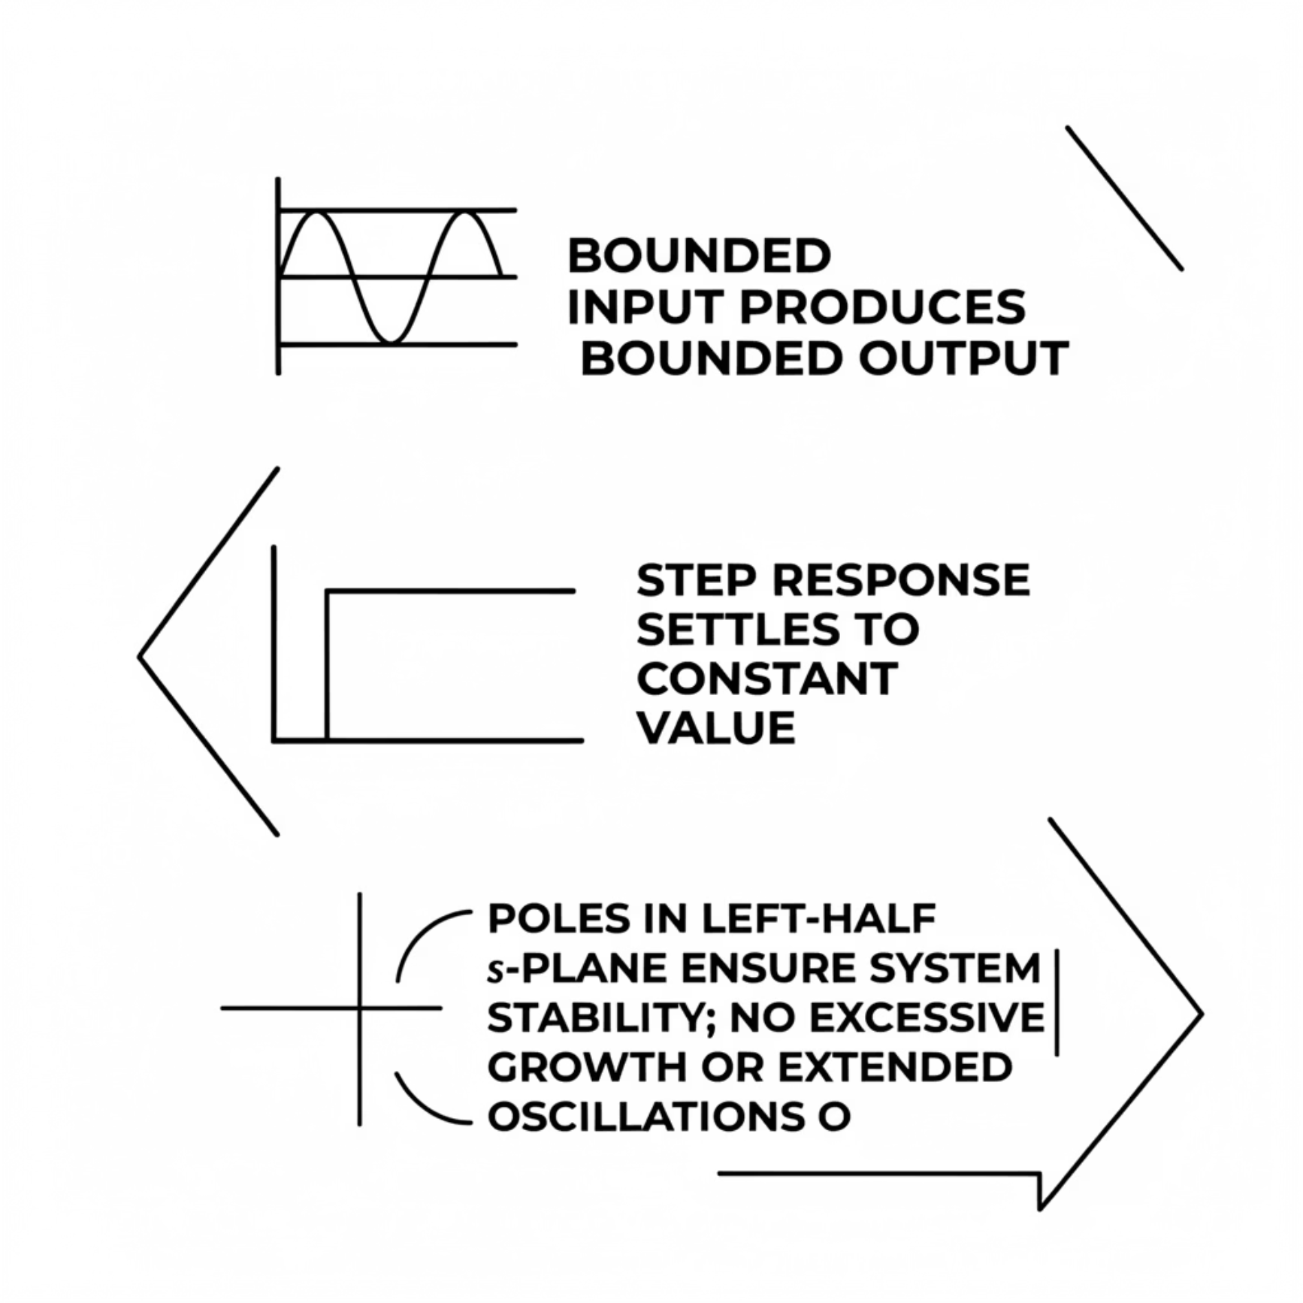

Stability Analysis
BIBO Stability — Bounded Input, Bounded Output
The closed-loop PID system is BIBO stable: bounded inputs produce bounded outputs with no unbounded growth.
Step response settles to a constant value without divergence
All closed-loop poles lie in the left-half plane
No excessive oscillations or instability under S-curve motion profiles
Stability confirmed via simulation and experimental validation

Slide 5
Where the Problem Exists ?
Sudden Acceleration/Deceleration
1
Rapid motion changes excite natural fluid frequencies, generating large slosh waves.
Variable Liquid Properties
2
Different viscosities and densities shift system dynamics, requiring retuning.
External Disturbances
3
Vibrational noise and sudden loads disrupt PID performance without adaptive compensation.
Fill Level Variations
4
Changing fill levels alter natural frequency, degrading fixed-gain PID effectiveness.
Pole Placement Sensitivity
5
Fixed PID gains place poles at specific locations; parameter shifts move poles toward instability.

Slide 6
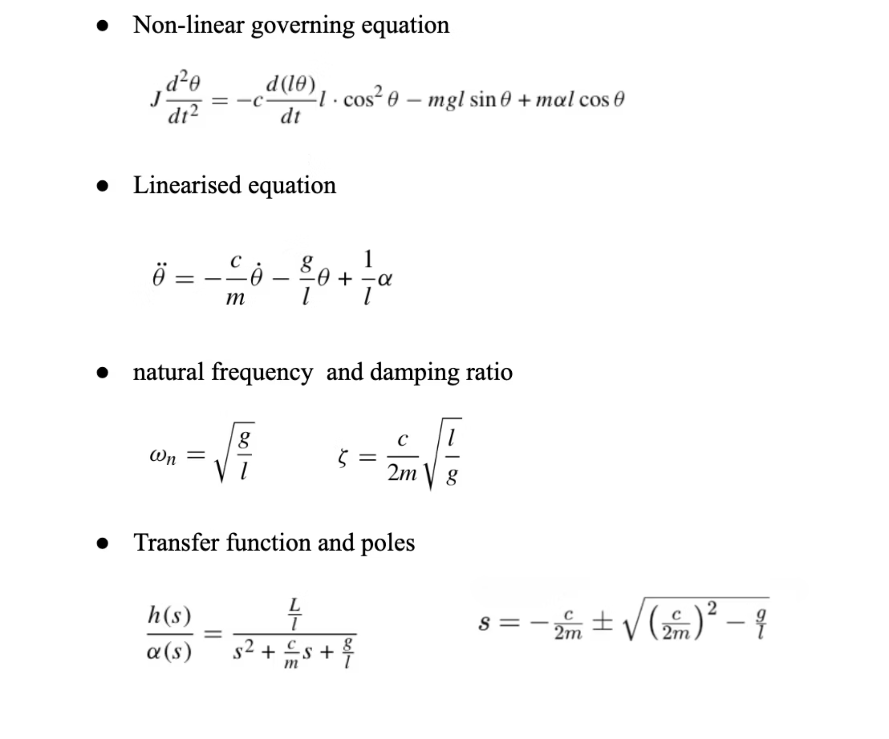
Solution: Mathematical Equations

Slide 7
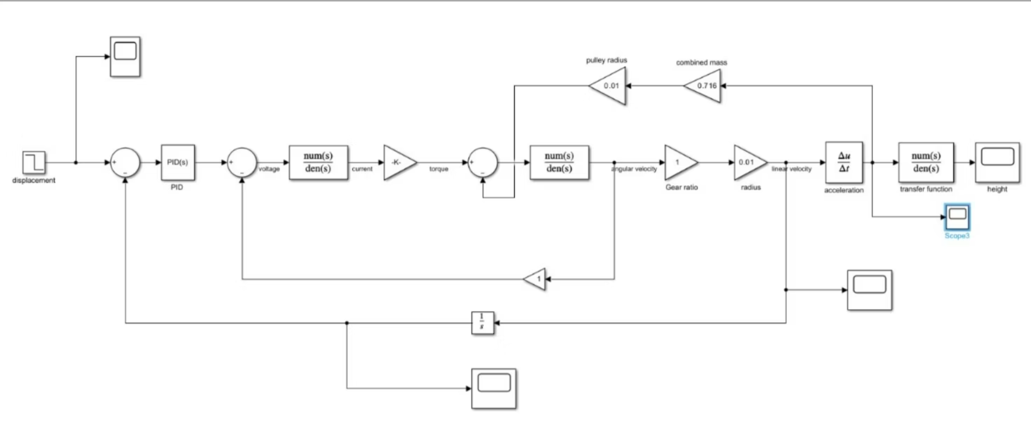
PID Controller — Solution & Performance

Slide 8
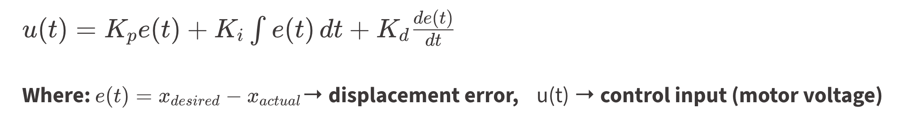
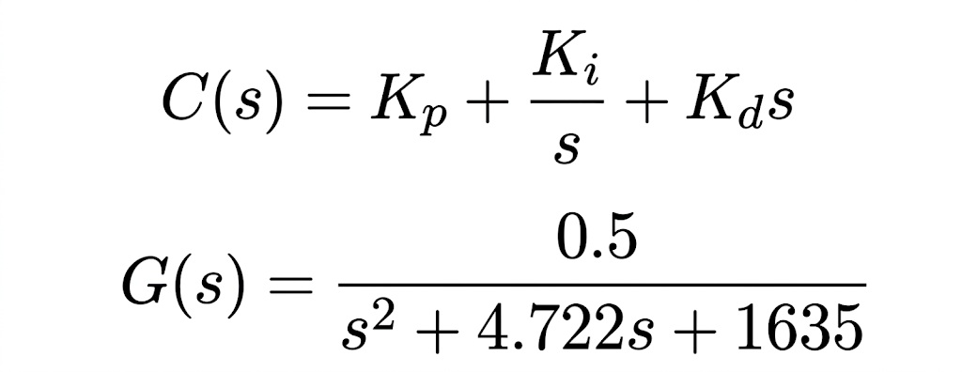
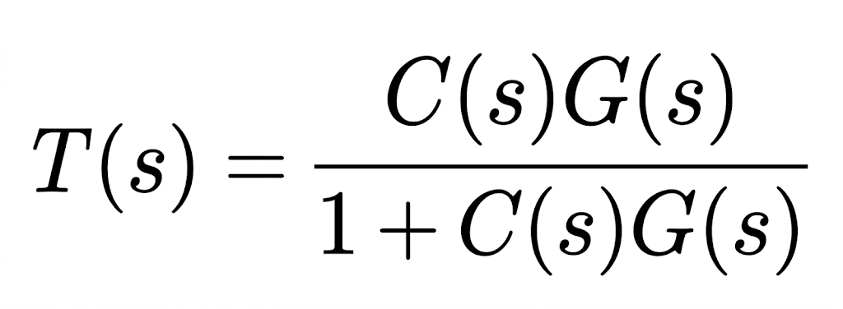
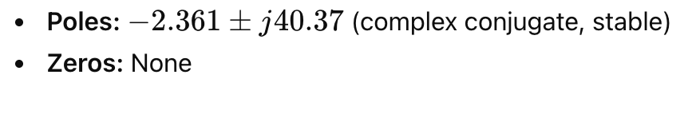
Proportional–Integral–Derivative Controller Solution
Control Law (Main Equation)
PID gains tuned via trial-and-error used for simulation and experimental analysis: Kp = 7, Ki = 5, Kd = 3. The controller uses encoder feedback to regulate PMDC motor voltage and counteract slosh resonance.
Closed Loop Transfer Function

Slide 9
Performance Highlights
Faster Response: PID significantly reduces rise time, so system reacts quickly.
Reduced Overshoot: Derivative action controls oscillations → less sloshing peaks.
Quick Settling: System reaches steady state faster → improved stability.
Zero Steady-State Error: Integral action ensures output reaches exact desired value.
Improved Damping: PID increases effective damping → less oscillatory behavior.
Better Control of Motion: Provides smooth acceleration/deceleration → reduces liquid sloshing.

Slide 10
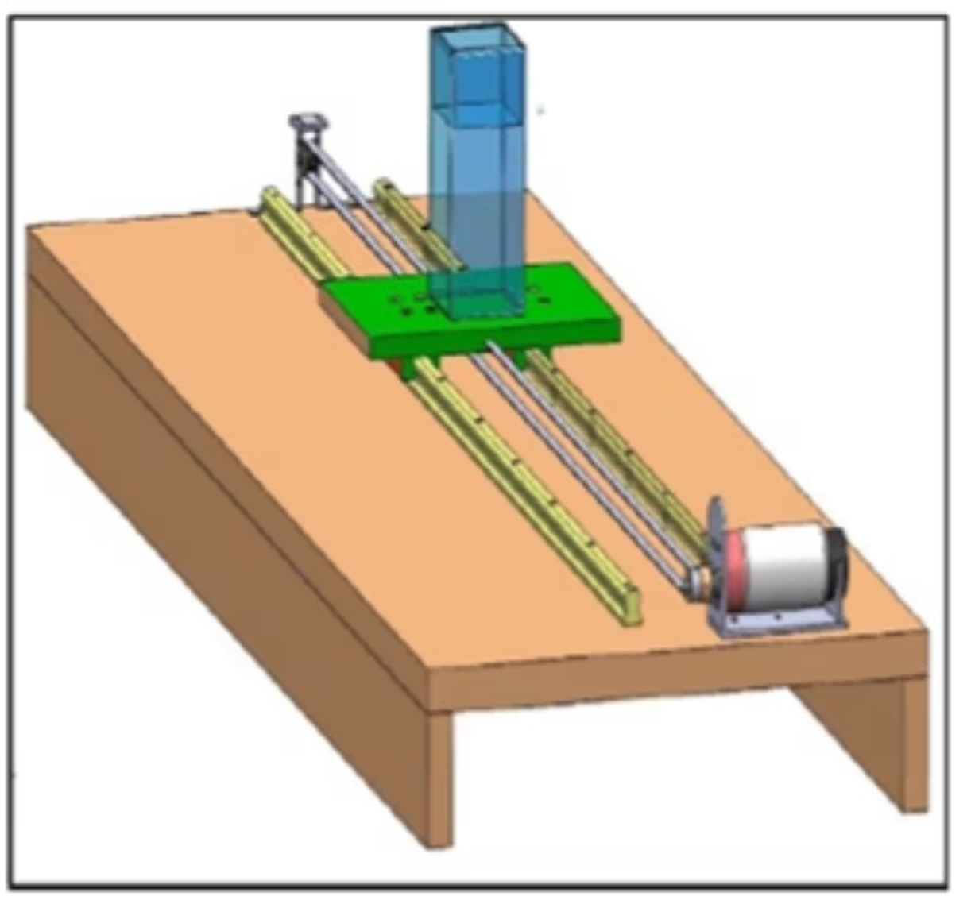
Experimental Setup & Validation
Physical Platform
HIWIN linear guide rails on wooden base — low friction, smooth motion
Container: 0.06 × 0.06 × 0.12 m, transported over 1-m path
PMDC motor with encoder + 1:10 reduction gearbox
High-speed camera for liquid surface visualization
Limit switches at rail ends for safety

Slide 11
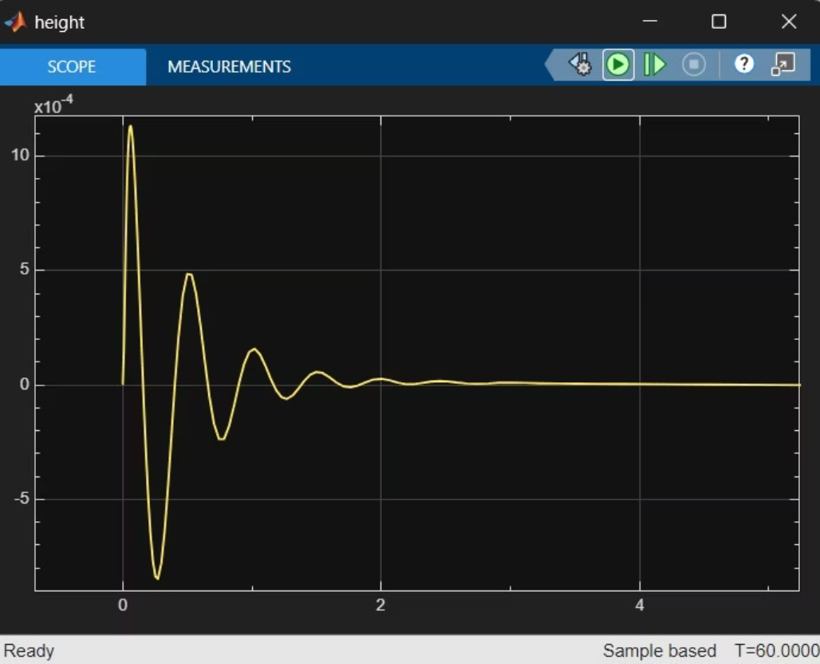
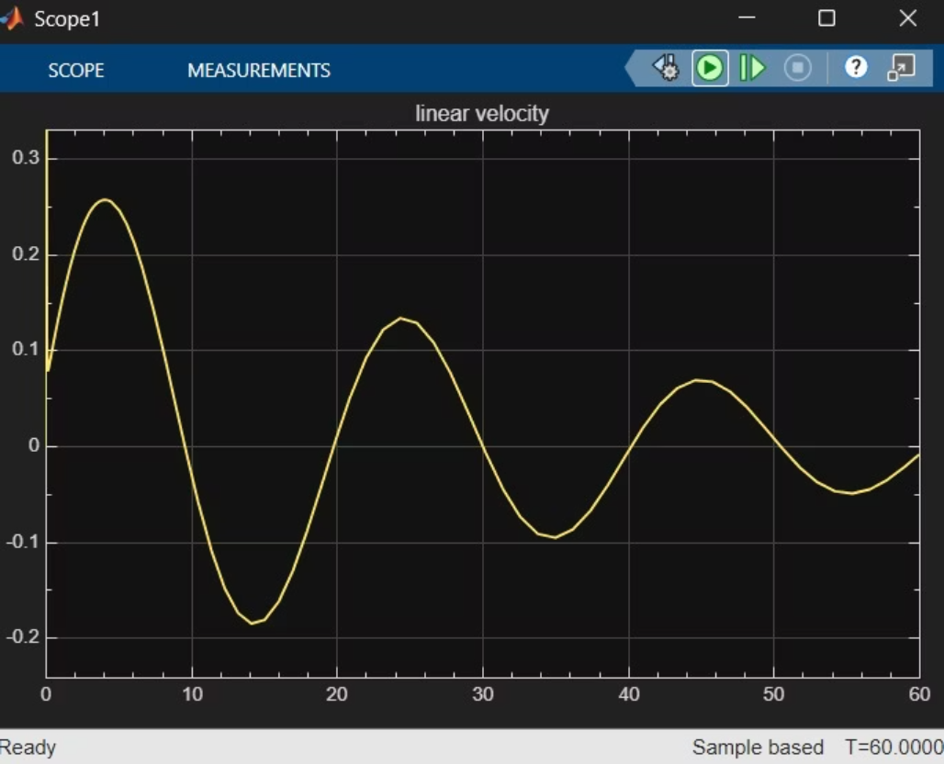
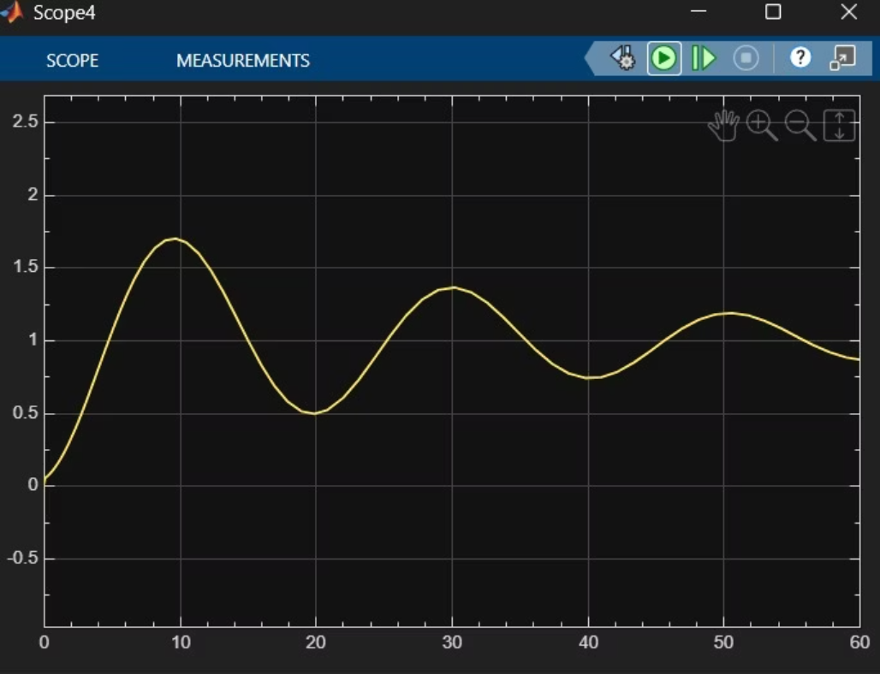
Validation Results
Simulink and experimental speed-tracking results show acceptable agreement. Minor deviations arise from sensor noise, friction, and real-world nonlinearities not captured in simulation.
Displacement
Height Sloshing
Velocity
Results obtained from Simulink for PID Controller

Slide 12



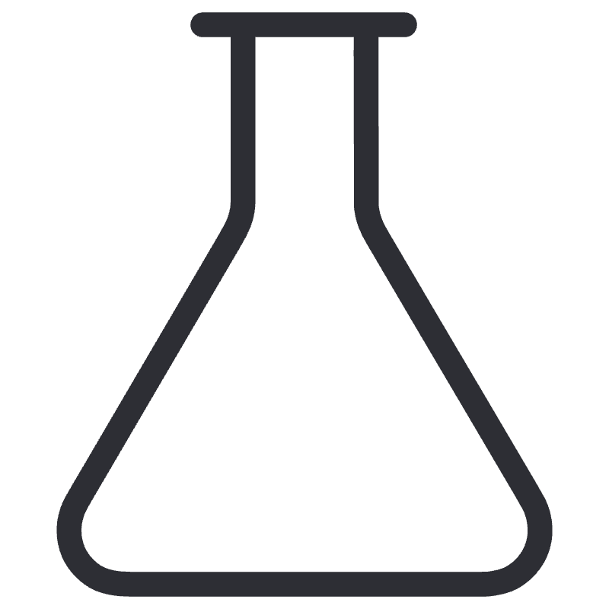
Applications and Physical Significance
Pharmaceuticals
Food & Beverage
Precision liquid drug filling and transport without contamination or spillage.
High-speed bottling and packaging lines requiring smooth, spill-free conveyance.
Aerospace
Paints & Chemicals
Fuel slosh suppression in spacecraft and launch vehicle tanks during maneuvers.
Safe transport of hazardous or viscous fluids in manufacturing environments.

Slide 13
Limitations & Future Scope
Current Limitations
Future Directions
PID requires retuning for each new liquid or fill level
Limited robustness to sudden external disturbances
Linear path only — no curved or 3D trajectories
Fixed-gain structure lacks adaptability to nonlinearities
Utilize the proposed approach with a curve path to transport the liquid-filled container considering the rotational sloshing.
Add tilting mechanism for increased flexibility
Integrate moving baffles for large-container transport
Compare the proposed controller performance with intelligent tuning PID controller.

Slide 14
Conclusion: Advancing Slosh-Free Liquid Transport
Main Accomplishment
Key Benefits
Broader Significance
Successful implementation and validation of a PID control system demonstrating effective slosh suppression in liquid-filled containers during high-speed transfer on a linear path.
Achieved significant improvements in system response, damping, and motion control, leading to reduced rise time, minimal overshoot, faster settling, and elimination of steady-state error.
This control adaptation solution increases efficiency, reduces loss of products, and promotes safety in different industries such as food packaging, pharmaceuticals, aerospace, and chemical industries through a lighter solution compared to existing techniques for preventing sloshing.

