Slide 1
Revenue Prediction & Customer Analytics for Supermarket Data
Data Science Capstone: DATS 6501_10
Presented By Purvi Jain Sowmya Maddali

Slide 2
OVERVIEW
Introduction
Objective
Literature review
Methodology
Project description
Dataset description
Data Augmentation
Exploratory Data Analysis (EDA)
Feature Engineering
Models
Results
References

Slide 3
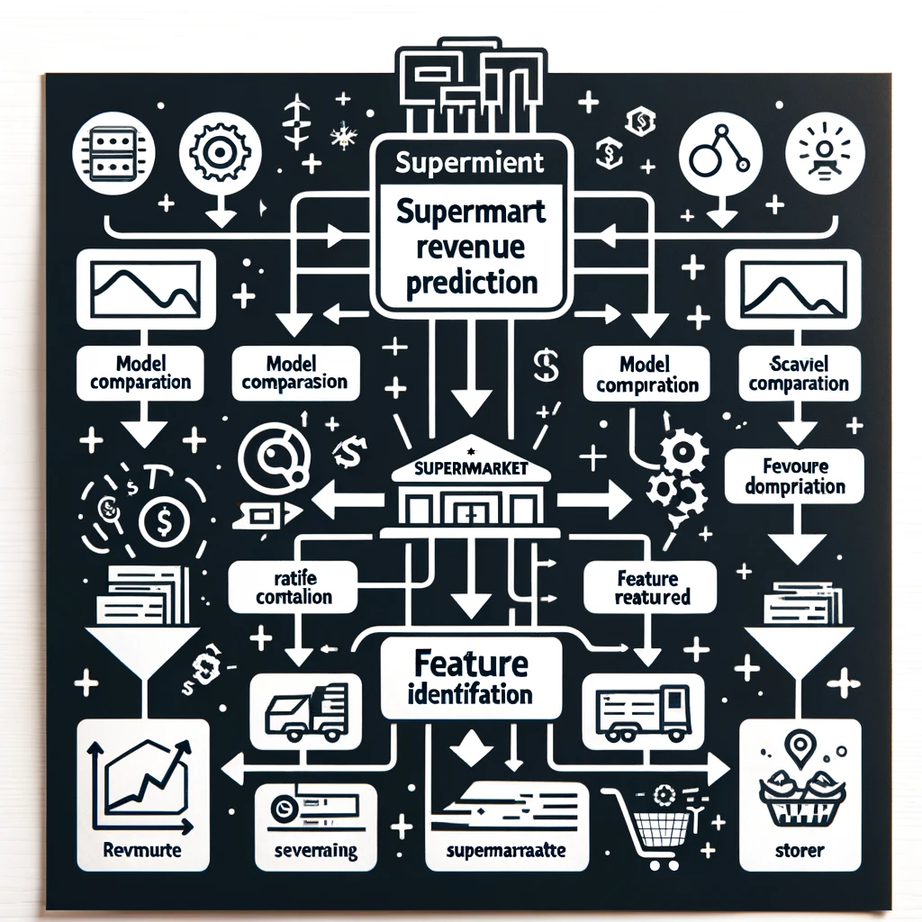
OBJECTIVE
Our project goal is to be able to accurately predict the revenue of each category in any supermarket the next day.

Slide 4
LITERATURE REVIEW
In time series analysis, ARIMA modeling is widely regarded as one of the most sophisticated techniques for time series forecasting within the realm of statistical learning tools. This methodology comprises three fundamental components: the Autoregressive (AR) part, the Moving Average (MA) part, and the pivotal requirement of ensuring the stationarity of the underlying time series. Assessing market efficiency is a crucial metric in determining the maturity of a given market.
The LGBM algorithm and the time series used in this paper has divided the data into different periods. The experiment obtained an accuracy of 0.35 when the dataset is huge. The disadvantage of this model is that training requires a very large dataset, but not all conditions can meet their requirement. In the case of fewer data, the author hypothesized that two problems occur. The training error is much smaller than the test error, the training error is similar to the test error, but the test error is very large.
The paper aims to utilize two years of sales data, yearly calendar events, and weather data to investigate which machine learning methods could forecast sales the best. The investigated methods were XGBoost, ARIMAX, LSTM and Facebook Prophet. Overall the XGBoost and LSTM models performed the best and had a lower MAE. The LSTM model however could easily adapt during the holiday season which ultimately improved performance. Including the weather furthermore did not improve the models significantly and in some cases the results were worsened. Ultimately the best model depended on the time period and goal for the forecast.

Slide 5
METHODOLOGY

Slide 6
PROJECT DESCRIPTION
Our project focuses on comprehensive analysis and forecasting of United Kingdom supermarket data to drive strategic decision-making and enhance business performance.
ML models are being used in a variety of industries including the retail sector where much can be done.
Using complex forecasting algorithms for retail sector can yield numerous benefits.
The stores can also benefit from a higher prediction accuracy in a variety of ways, such as:
Pricing strategies
Strategic Decision Making and
Enhancing Competitiveness

Slide 7
DATASET DESCRIPTION
The dataset used in our project comprises sales data from various supermarkets across the United Kingdom.
The major supermarkets considered for our project include Aldi, ASDA, Morrisons, Sainsbury and Tesco.
The original dataset consists of the following features:
Supermarket name 7. Category
Price of the product 8. Own Brand
Per unit price of the product 9. Revenue
Unit 10. Quantity
Name of the product
Date

Slide 8
DATA AUGMENTATION
To improve the dataset’s utility, the following steps were undertaken:
Handling missing values
Dealing with date
Lagged features: 4. Rolling Window
Revenue lag-1 a. Weekly Rolling average
Revenue lag-2 b. Weekly Rolling SD
Revenue lag-3
Sine day lag-1
Cosine day lag-1
Sine week lag-1
Cosine week lag-1

Slide 9
EDA

Slide 10
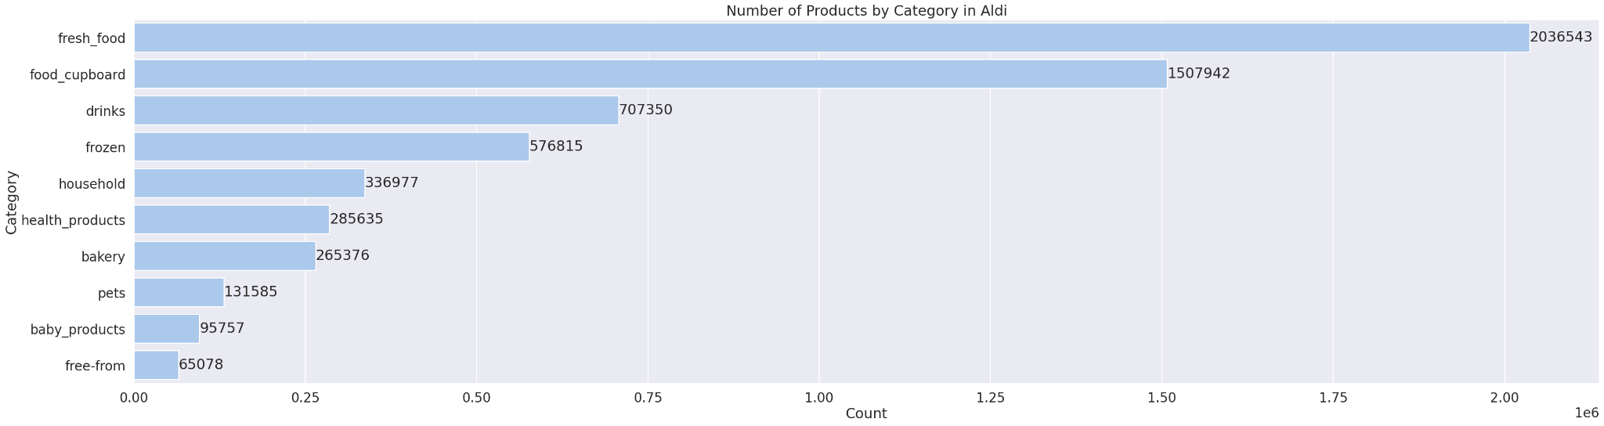
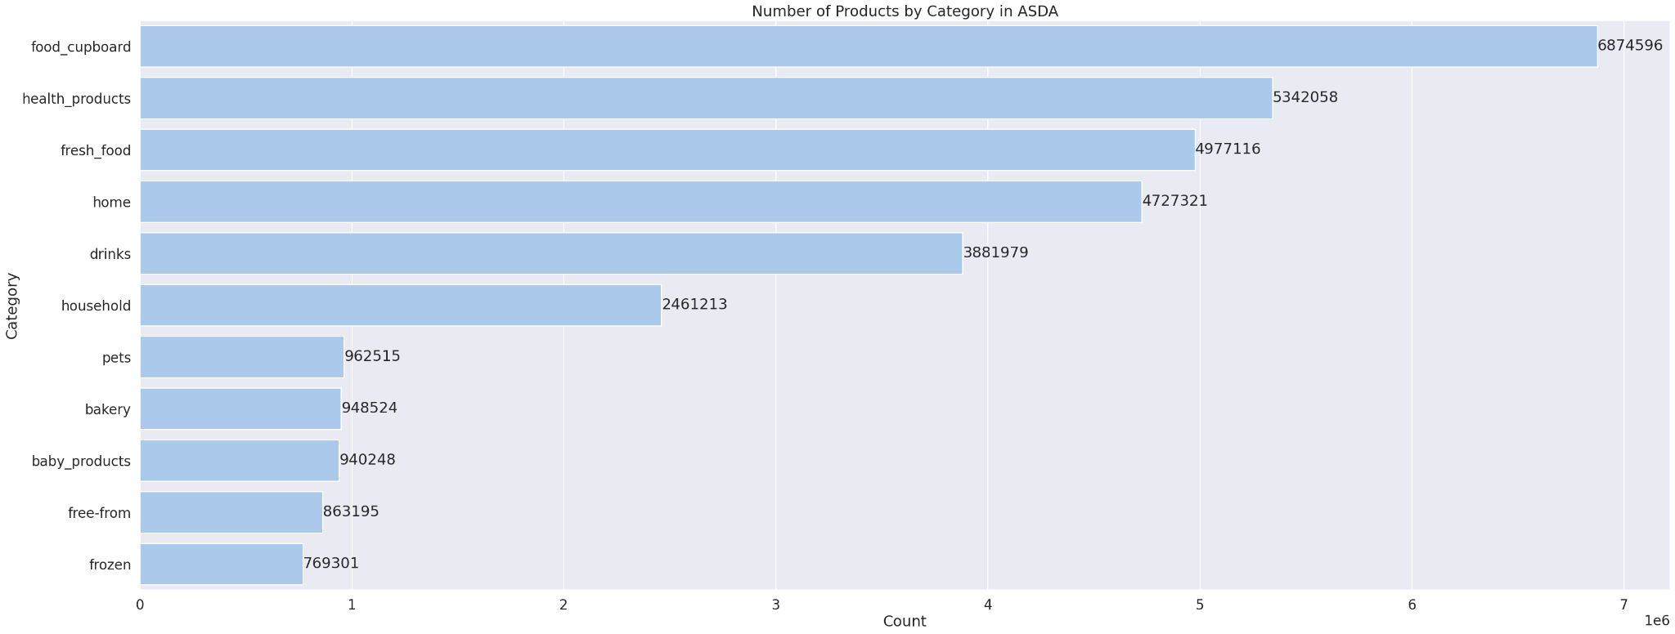
NUMBER OF PRODUCTS IN EACH CATEGORY
Number of products in Aldi supermarket
Number of products in ASDA supermarket

Slide 11
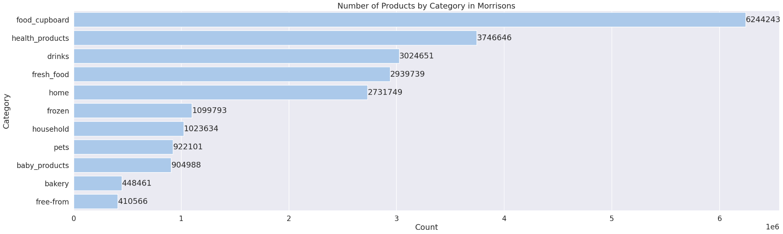
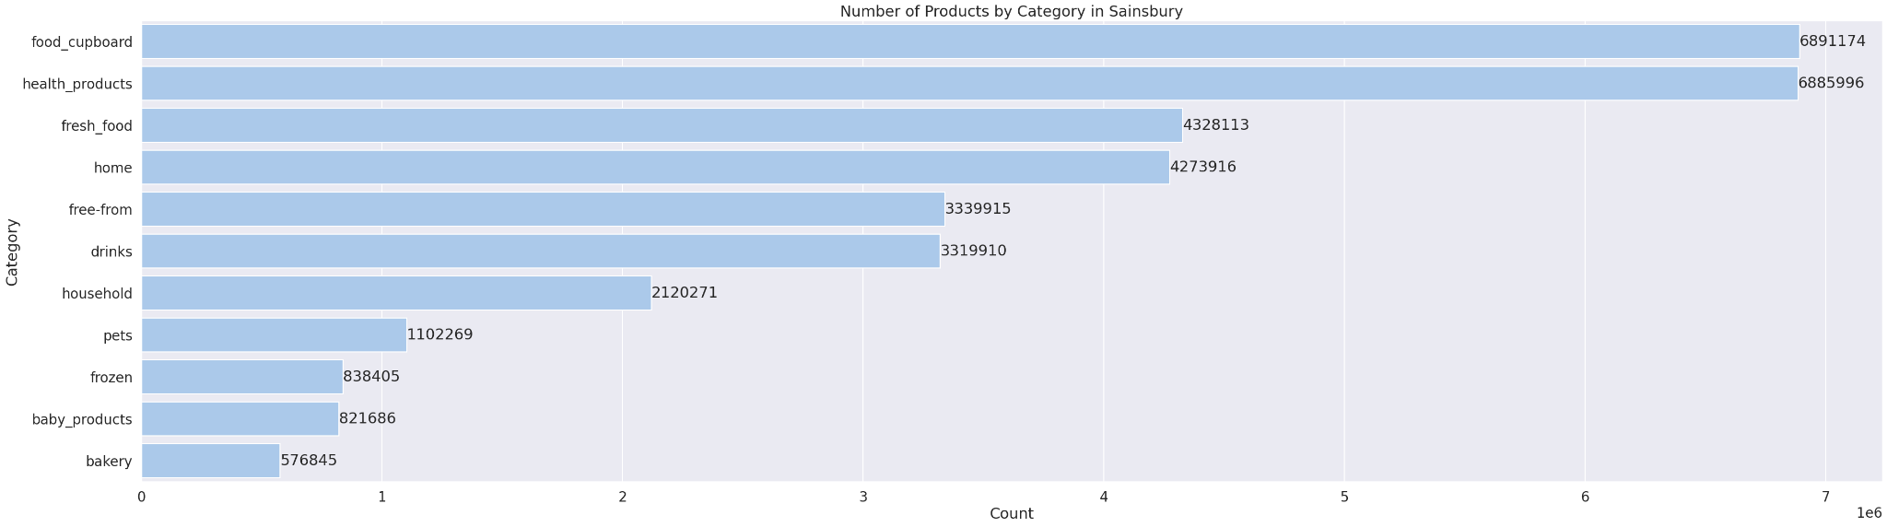
NUMBER OF PRODUCTS IN EACH CATEGORY
Number of products in Morrisons supermarket
Number of products in Sainsbury supermarket

Slide 12
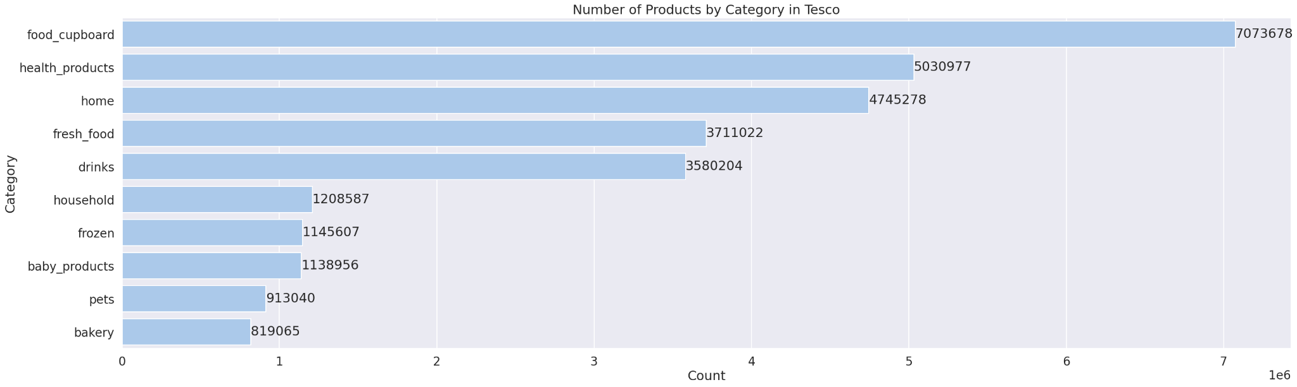
NUMBER OF PRODUCTS IN EACH CATEGORY
Number of products in Tesco supermarket

Slide 13
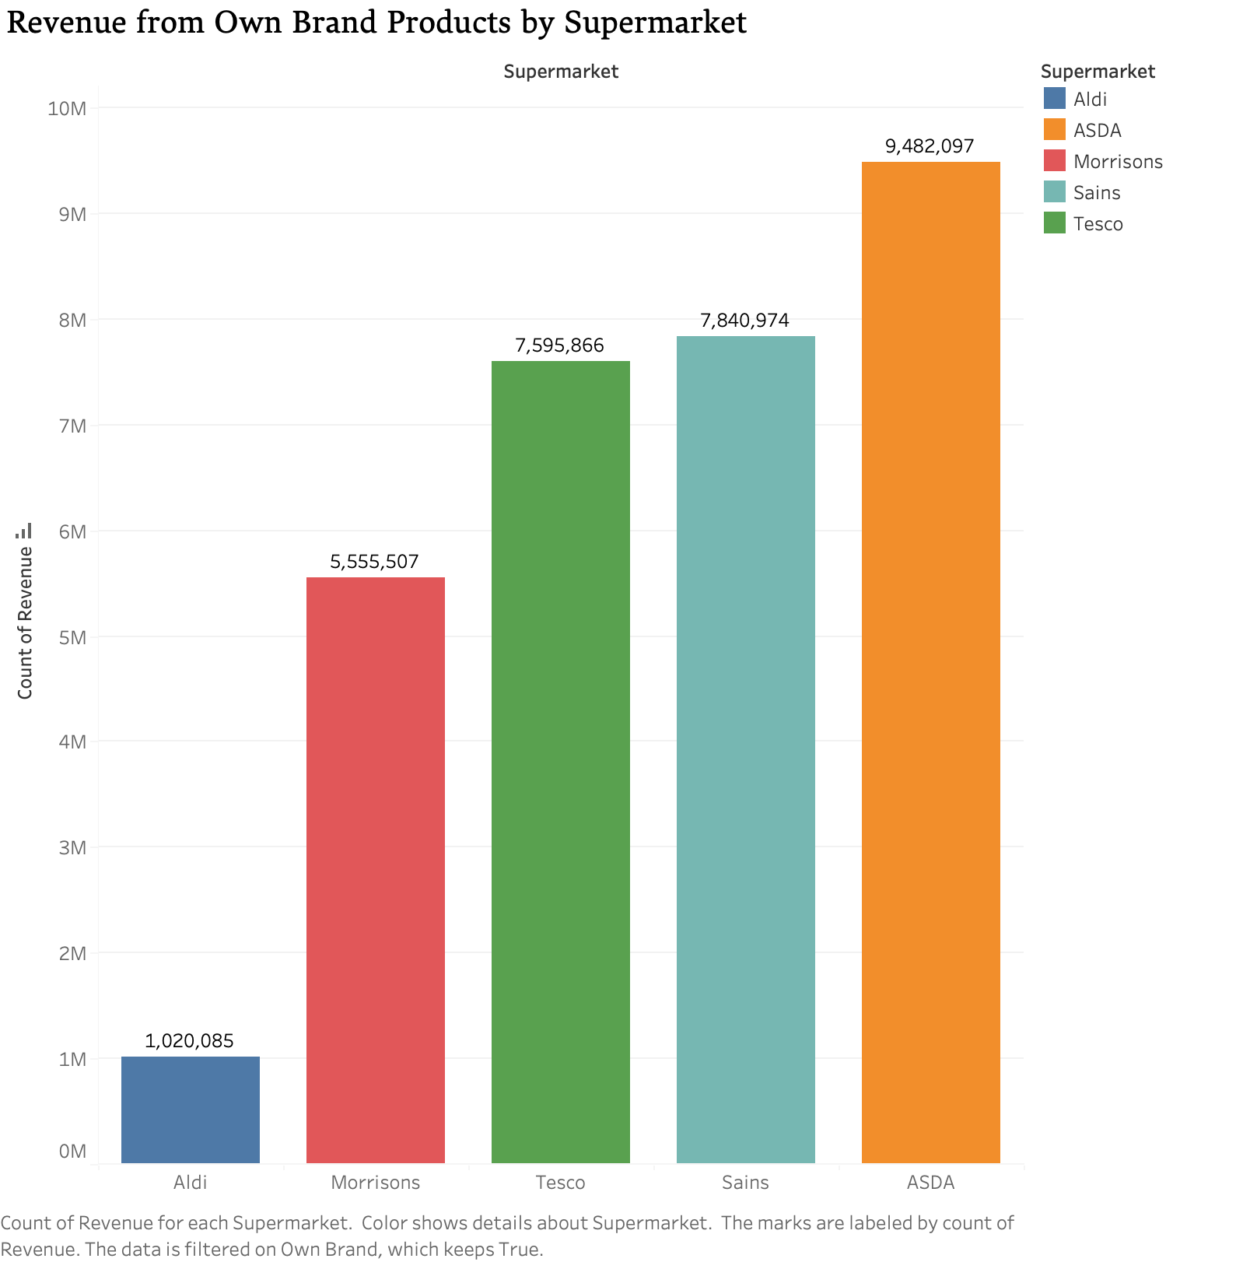
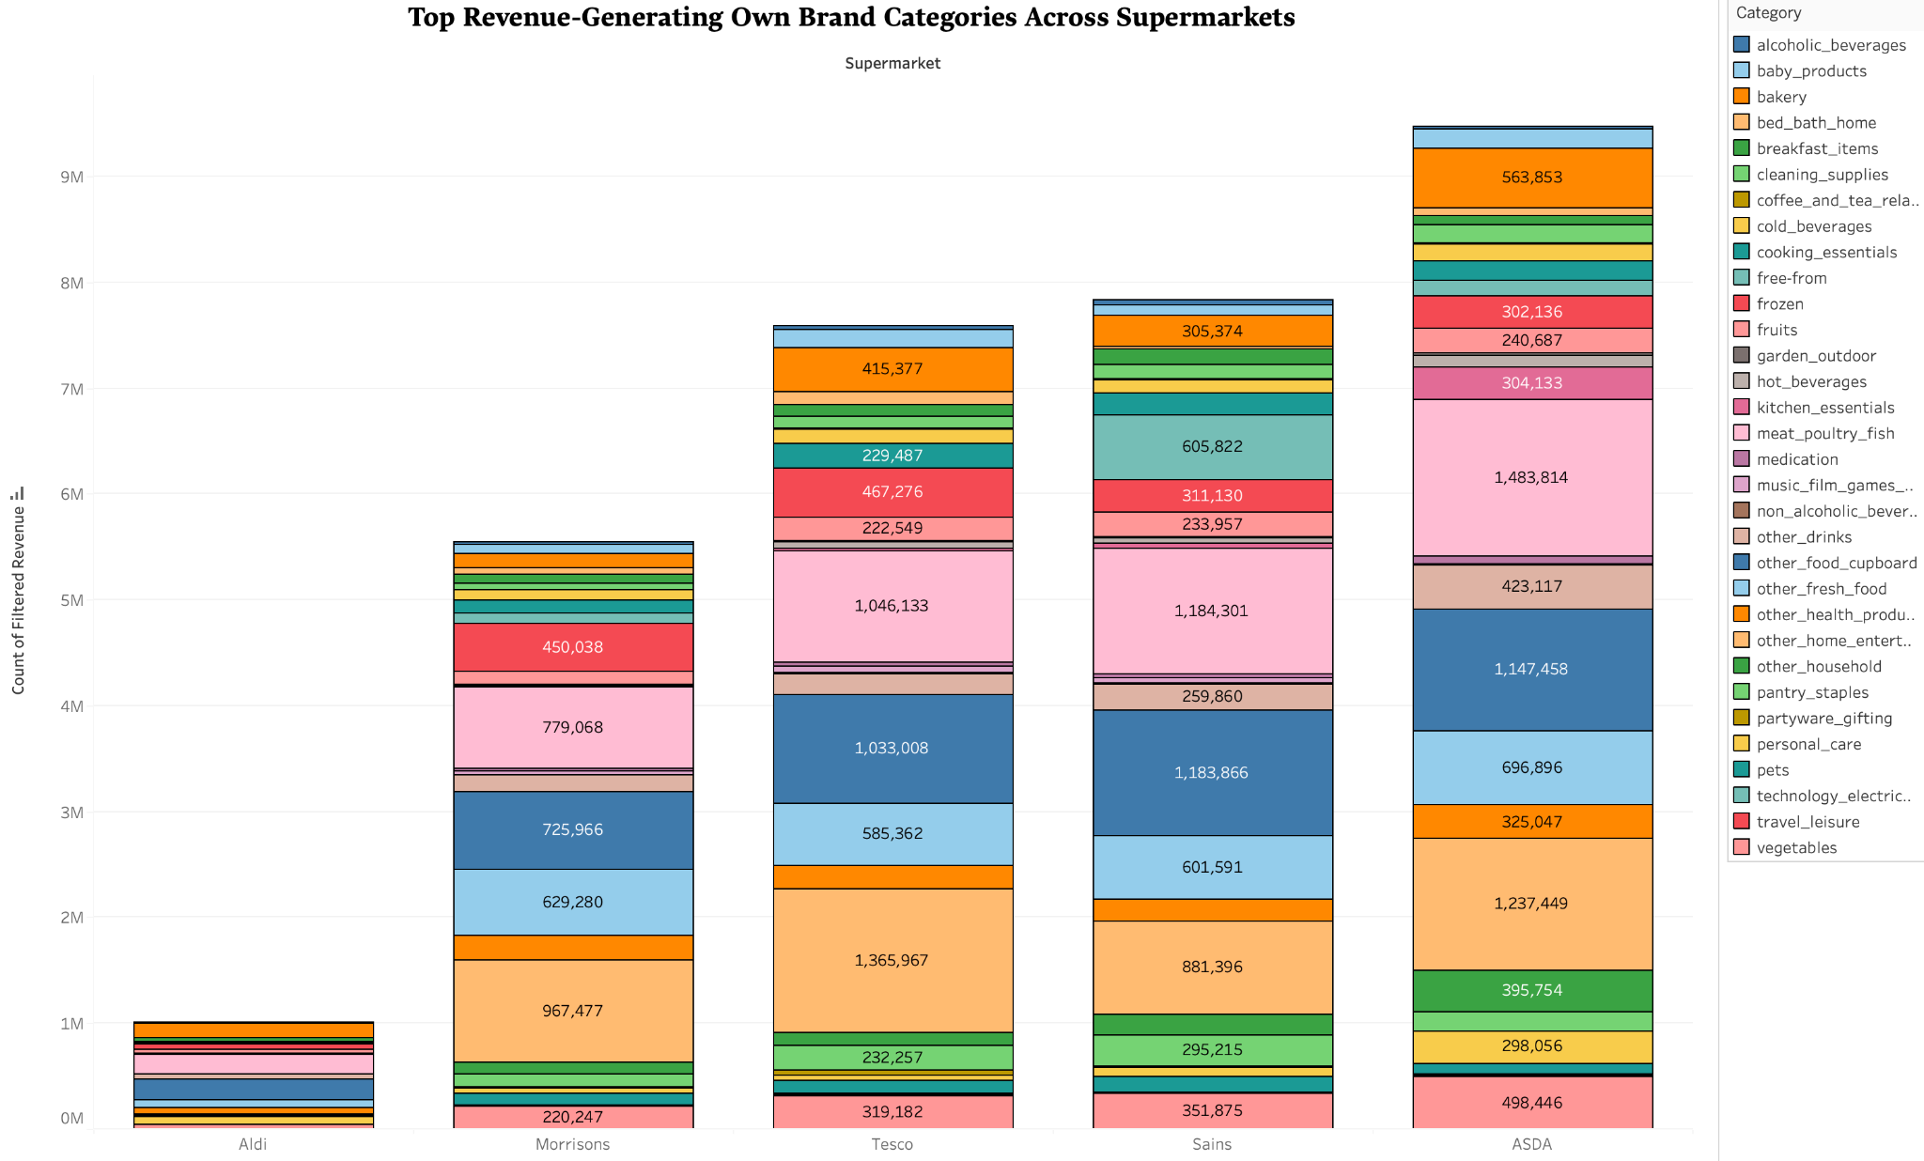
REVENUE GENERATED BY OWN BRAND PRODUCTS PER CATEGORY

Slide 14
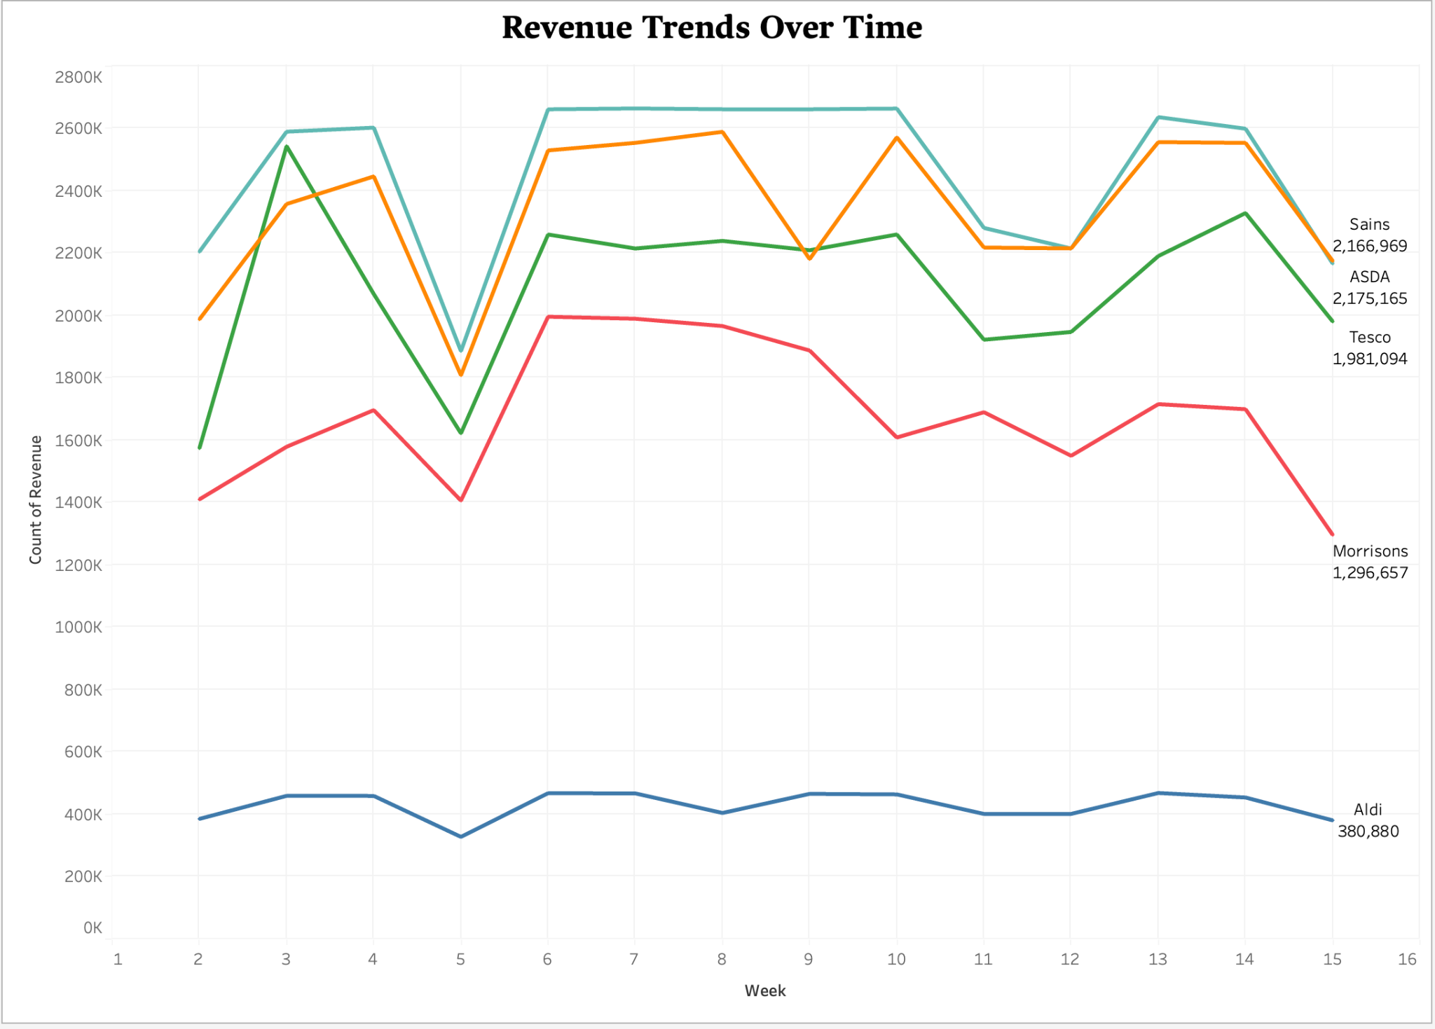
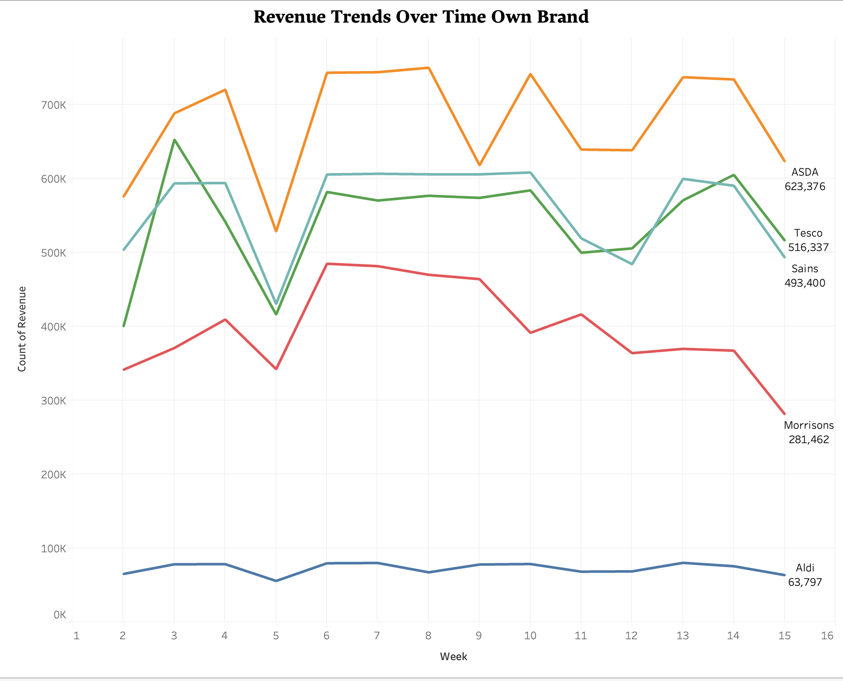
REVENUE TREND OVER TIME

Slide 15
FEATURE ENGINEERING

Slide 16
FEATURE ENGINEERING
Feature engineering is a crucial part in predictive modeling process, involving the creation, transformation and extracting data features.
Given the categorical nature of product categories in our dataset, appropriate encoding techniques were undertaken:
One-Hot Encoding
Label Encoding

Slide 17
FEATURE SELECTION RATIONAL & TECHNIQUES
The selection of relevant features was guided by both statistical analysis and domain knowledge:
Time-Related features
Lagged features
Price and volume interaction
We applied multiple feature engineering techniques like:
We used python to automate the encoding and generation of new features.
We conducted a second round of EDA to assess the impact of the new features.
We also performed recategorization of product categories.

Slide 18
MODELS

Slide 19
MACHINE LEARNING MODELS
We employed various machine learning algorithms such as -
Linear Regression
Random Forest
Extreme Gradient Boost (XGBoost)
We fine tuned these models to fit accordingly for our data, to get accurate predictions with respect to next-day revenue

Slide 20
DEEP LEARNING MODELS
We also employed deep learning models in order to get accurate next-day revenue prediction. The models used are -
Artificial Neural Network (ANN)
Long Short-Term Model (LSTM)

Slide 21
TIME SERIES MODEL
Lastly we implemented a time series model for our datasets as well and obtained results similar to our machine learning and deep learning models. The model used is -
Autoregressive Integrated Moving Average (ARIMA)

Slide 22
RESULTS

Slide 23
RESULTS
Model | R-square | MAE | RMSE
Linear Regression | Train: 0.88 Test: 0.85 | Train: 5.31 Test: 5.37 | Train: 14.98 Test: 15.78
Random Forest | Train: 0.93 Test: 0.90 | Train: 2.34 Test: 2.39 | Train: 10.98 Test: 11.08
XGBoost | Train: 0.94 Test: 0.91 | Train: 3.87 Test: 3.76 | Train: 13.68 Test: 13.55
ANN | Train: 0.92 Test: 0.90 | Train: 3.65 Test: 3.60 | Train: 11.93 Test: 11.68
LSTM | Train: 0.92 Test: 0.85 | Train: 3.65 Test: 5.17 | Train: 11.93 Test: 16.43
ARIMA | Train: 0.70 Test: 0.67 | Train: 6.30 Test: 6.40 | Train: 8.44 Test: 7.40

Slide 24
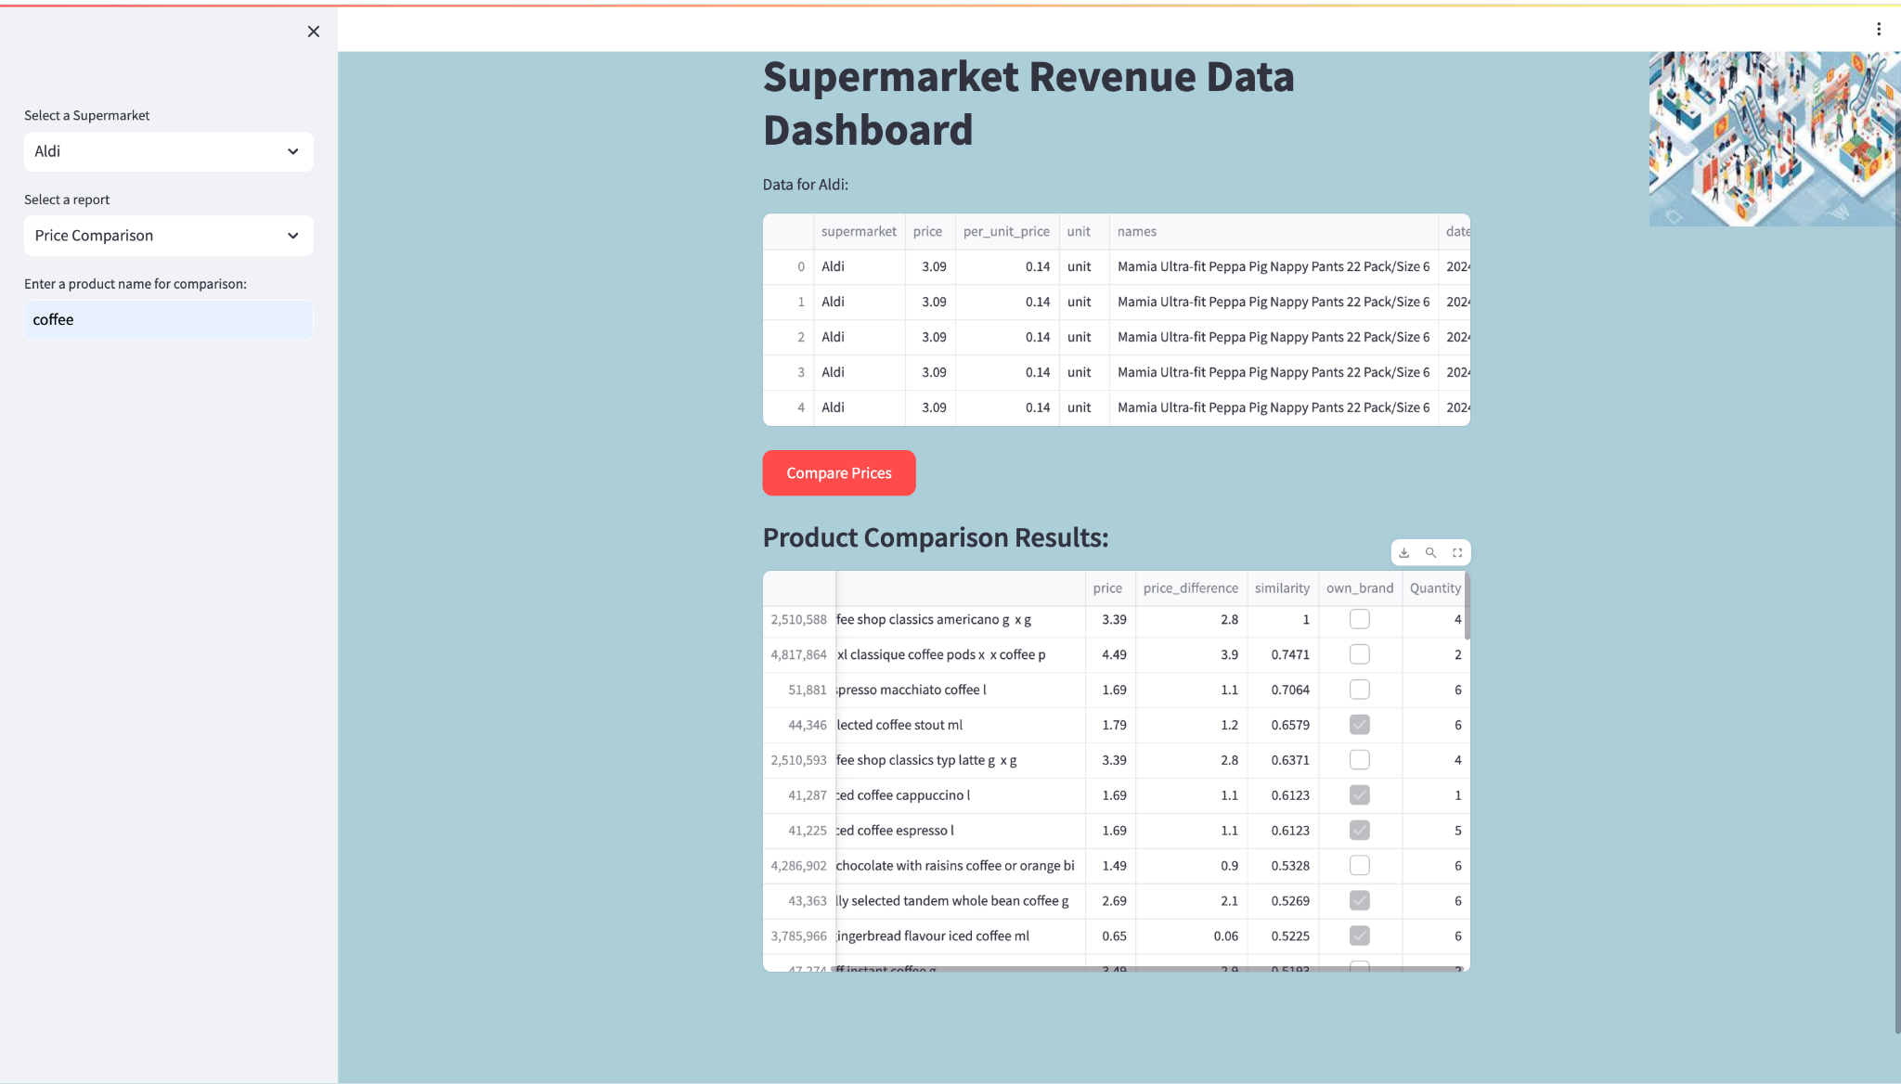
CUSTOMER ANALYTICS

Slide 25
REFERENCES
U.S. Bureau of Labor Statistics, Consumer Price Index for All Urban Consumers: All Items in U.S. City Average [CPIAUCSL], retrieved from FRED, Federal Reserve Bank of St. Louis; https://fred.stlouisfed.org/series/CPIAUCSL, October 10, 2023.
Liu, Y. (2022/04/18). Grocery sales forecasting. Paper presented at the 215-219. https://doi.org/10.2991/aebmr.k.220404.040 https://www.atlantis-press.com/proceedings/cike-22/125972906
Fredén, D., & Larsson, H. (2020). Forecasting daily supermarkets sales with machine learning

Slide 26
Q & A

Slide 27
THANK YOU

