Slide 1



sales_insight
View in Power BI
Last data refresh:
17-04-2023 16:48:00 UTC
Downloaded at:
17-04-2023 18:02:05 UTC

Slide 2
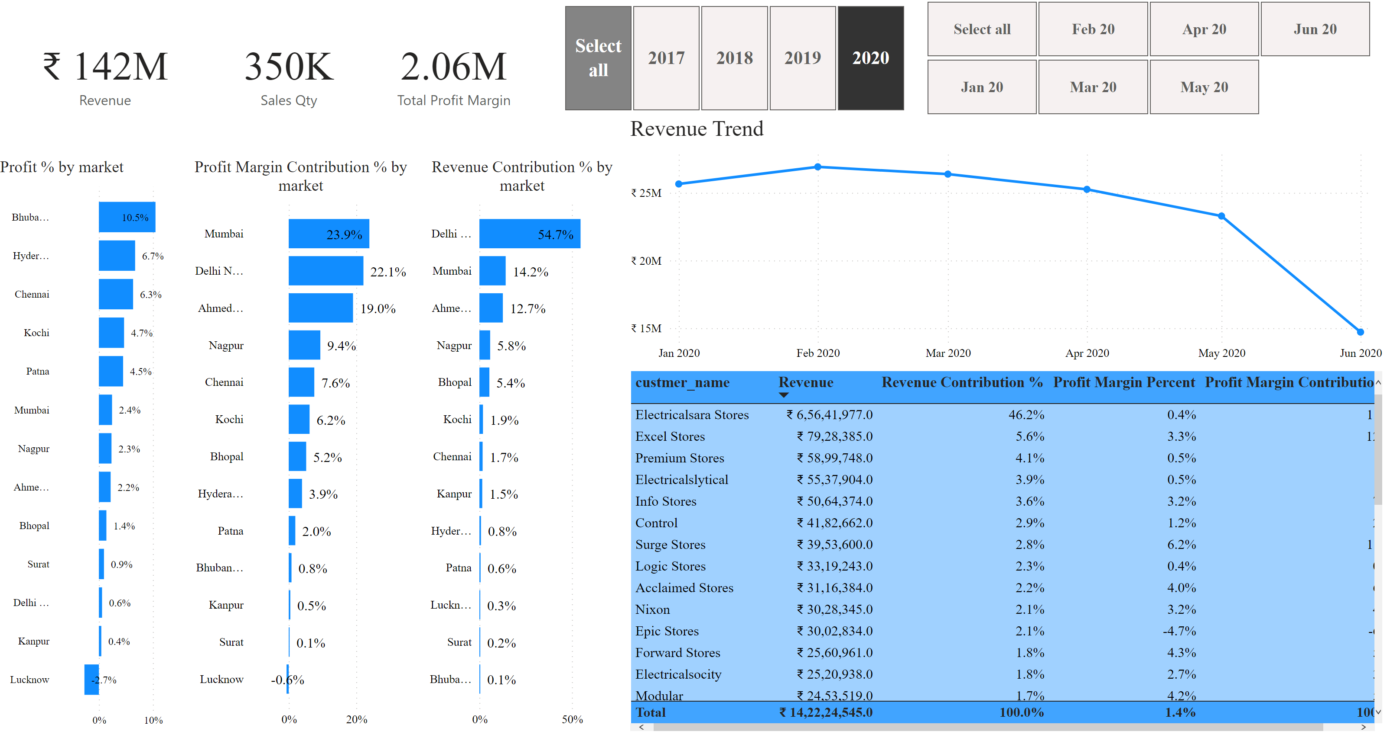
Page 1
Notes:
card
No alt text provided
card
No alt text provided
Profit % by market
No alt text provided
slicer
No alt text provided
slicer
No alt text provided
Revenue Trend
No alt text provided
card
No alt text provided
Profit Margin Contribution % by market
No alt text provided
Revenue Contribution % by market
No alt text provided
Top 5 customer by Revenue
No alt text provided

Slide 3
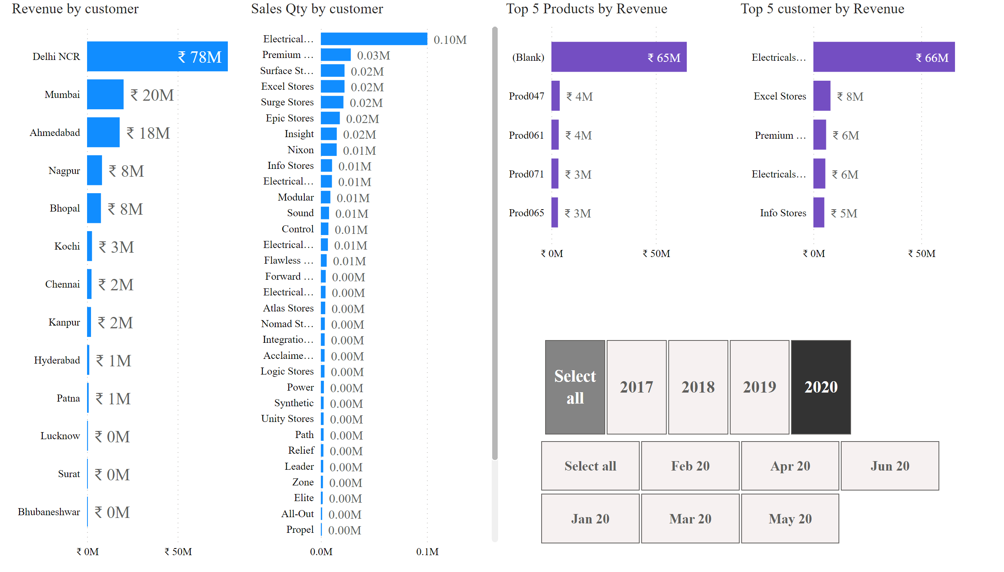
Page 2
Notes:
Revenue by customer
No alt text provided
Sales Qty by customer
No alt text provided
Top 5 Products by Revenue
No alt text provided
Top 5 customer by Revenue
No alt text provided
slicer
No alt text provided
slicer
No alt text provided

Slide 4
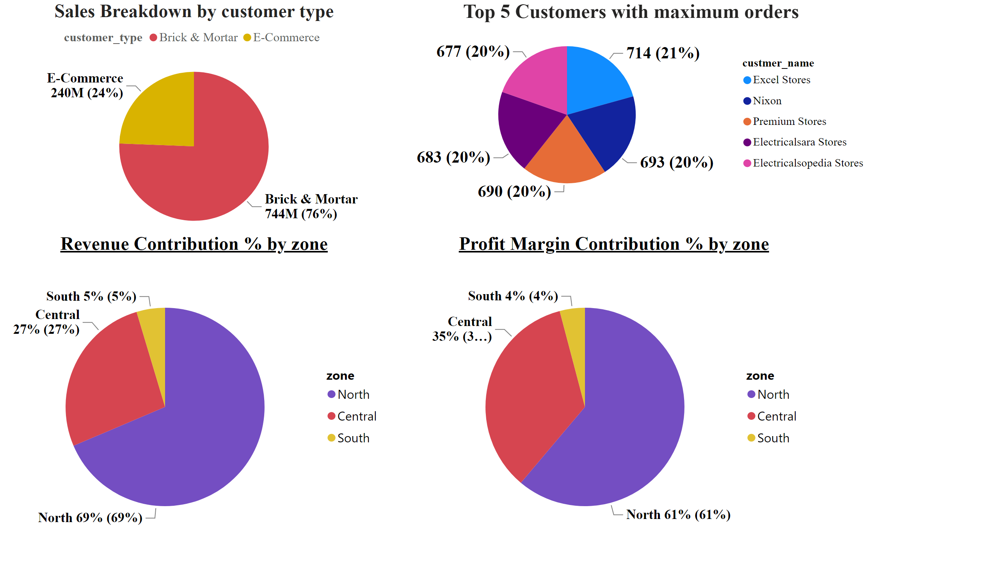
Page 3
Notes:
Sales Breakdown by customer type
No alt text provided
Top 5 Customers with maximum orders
No alt text provided
pieChart
No alt text provided
pieChart
No alt text provided

