Slide 1

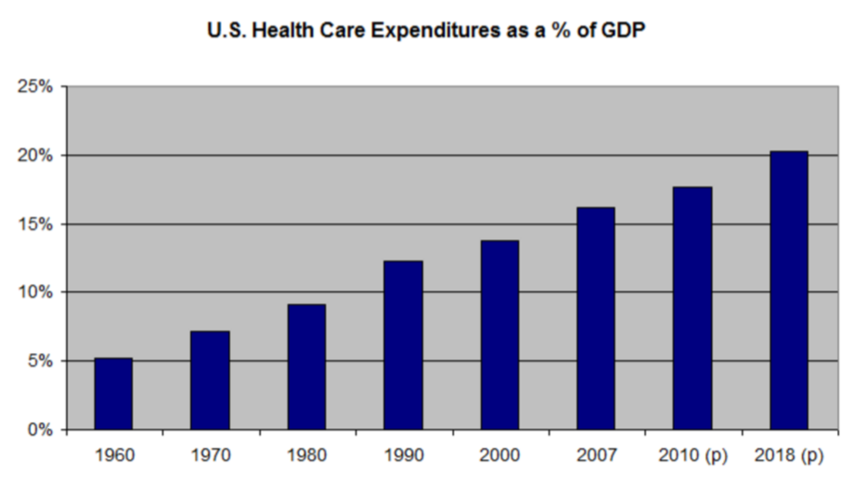
Is an ounce of prevention worth a pound of cure?
Is the reactive and episodic model of “sick care” effective in the US?
US Health Care Costs Per GDP in 2007 = 16%, 2010 = 18%, 2018 ~ 20%
Wellness Program
For 2015-2025, health spending is projected to grow at an average rate of 5.8 percent per year (4.9 percent on a per capita basis)
https://www.cms.gov

Slide 2
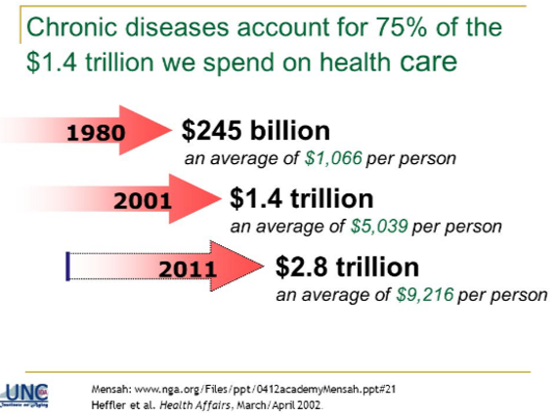
Wellness Program

Slide 3
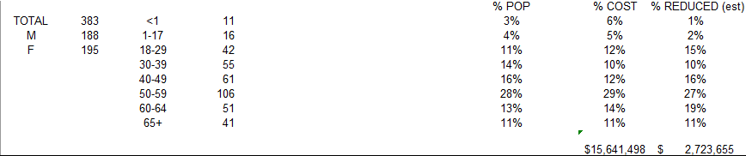
2014 PAE Hi Claims Costs Data >$25,000/claim
383 PAE employees with $15 Million Health Care Costs
Est. $2.7 Million Savings with Wellness Program Services
Wellness Program

Slide 4
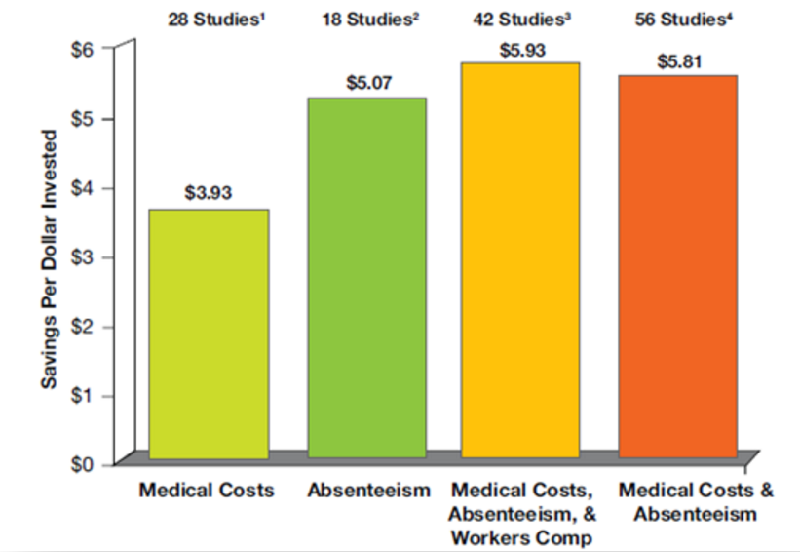
Wellness Program
Saving $$$ With Wellness Programs

Slide 5
Wellness Program
Harvard Business Review published in 2010 solid evidence for ROI for implementing corporate wellness programs.
Well, it turns out that a comprehensive, strategically designed investment in employees’ social, mental, and physical health pays off.
Johnson & Johnson leaders estimate that wellness programs have cumulatively saved the company $250 million on health care costs over the past decade; from 2002 to 2008, the return was $2.71 for every dollar spent.
https://hbr.org/2010/12/whats-the-hard-return-on-employee-wellness-programs

Slide 6
Wellness Program
RAND’s research into wellness programs
A recent RAND study conducted for the U.S. Department of Labor found that about half of U.S. employers with at least 50 workers and more than 90 percent of those with more than 50,000 workers offered a wellness program during 2012.
The current RAND study provides an assessment of over seven years of PepsiCo's Healthy Living wellness program. The program includes numerous components, including health risk assessments, on-site wellness events, lifestyle management, disease management, complex care management and a nurse advice phone line. The study evaluated the experiences of more than 67,000 workers who were eligible for the disease management or lifestyle management programs.
Researchers found that the disease management program reduced costs among participants by $136 per member per month, or $1,632 annually, driven by a 29 percent drop in hospital admissions. Among people who participated in both the disease management and lifestyle management programs, the savings were $160 per month with a 66 percent drop in hospital admissions.
http://www.rand.org/news/press/2014/01/06/index1.html

Slide 7
Wellness Program
ROI for Wellness Programming – Case Studies
Johnson & Johnson, which started its first wellness program in 1979, saves an estimated $9 to $10 million per year from reduced medical utilization and lower administrative expenses in its Healthy People program. J&J reports that “Our focus on health and wellness among our U.S. workforce has helped reduce per-capita health-plan costs by $400 per employee per year (based on 2007 data) and significantly improved overall employee health and productivity.” [4]
Citibank's comprehensive health management program demonstrates that for every dollar invested in programming activities, $4.56 to $4.73 is saved in reduced health care costs.
Union Pacific Railroad's medical self-care program achieved cost savings of $2.78 for every dollar invested by reducing inappropriate emergency room and outpatient visits.[5]
In a meta-analysis of the literature on costs and savings associated with workplace disease prevention and wellness programs, Harvard researchers led by Katherine Baicker recently reported that medical costs fall by about $3.27 for every dollar spent on wellness programs and that absenteeism costs fall by about $2.73 for every dollar spent. (New England Journal of Medicine, 2009).[6]

Slide 8
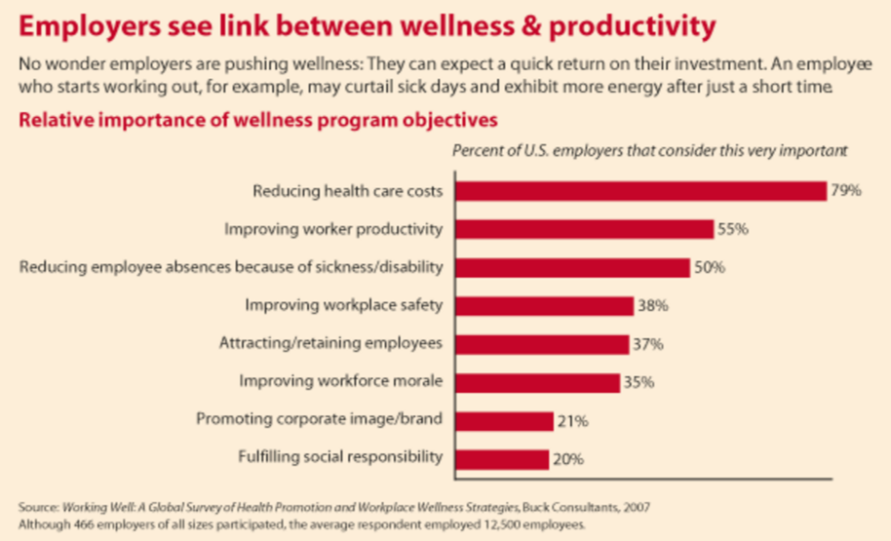
Wellness Program

Slide 9

PAE Programming Solution:
Expand from two PAE Wellness Program Test Sites to a Corporate-Wide PAE Wellness Program!
Wellness Program

Slide 10
PAE Wellness Program Expansion Goals
Wellness Program
Mission: Expanding the scope of the health and wellness services from a few PAE sites to a PAE corporate-wide web-based integrated service model with benefit plan incentives.
Existing Programming: Two locations (NASA JSC and Sheppard AFB) have established a programming and service model.
Expansion Goal: Provide online and site specific health and wellness services to all PAE employees in the continental USA then Globally

Slide 11
Roll-Out Plan
Wellness Program
Establish wellness program standard services that integrates into the PAE benefit plan options through two programming systems: 1. Chronic disease prevention and management with lifestyle management services and 2. Reduce risks for OSHA recordable injuries and improve injury management.
Benefit incentives based upon employee outcome measures for active participation and improvements in behavior changes demonstrating reduced risks. These measures are logged online and reported in aggregate format for each PAE site to PAE Corporate Headquarters Safety, Health and Environmental and Global Benefits Departments.
Integrate services through a corporate-wide safety meeting format by extending each PAE site safety meeting to include wellness programming services via web download curriculum. Services are educational and also involve employees in practical behaviors reducing health risks.

Slide 12
Roll-Out Time Line
Wellness Program
Year 1: Program impact year 2017 for expansion and integration of IT data systems into PAE benefit plan options and training of all USA PAE site management teams for roll out year
Year 2: Program rollout during PAE Open Enrollment for benefit year 2018 for all USA sites
Year 3: Expansion to all Global PAE sites
Year 4: Share PAE best practice sites with other PAE sites for optimal all around ROI benefits
Year 5: Refinement of management and operational systems for greater ROI impact

Slide 13
NASA Fitness, LLC
Wellness Program
"Dr. Kyle" Sprecher, D.C., M.A., Owner, NASA Fitness, LLC,
Doctor of Chiropractic 1986, Exercise Physiologist 1993
Currently manages two PAE Health and Wellness Contracts at NASA JSC (4 years) and Sheppard AFB (2 Years)
Past education committee chair for the Houston Area Health Care Coalition (HAHCC), representing preventive care services for large employers in Houston including Boeing, United Space Alliance and Lockheed Martin.
Past educational resources coordinator for the Texas Business Group on Health (TBGH) for six million Texans
Past educational resources coordinator, National Business Coalition on Health (NBCH) for 30 million Americans
Past co-founder of the Texas Alliance for Worksite Wellness. Responsible for coordinating government (Texas Department of Health), American Cancer Society, American Heart Association, March of Dimes and other National not-for-profit organizations to standardize wellness programs for large employers throughout the state of Texas and the USA.
Past coordinator for six southern states to implement the national healthy cities and healthy communities initiative. Working nationally, state, regionally, city and most recently locally to standardize preventive care programming involving government and other key stakeholders.

