Slide 1
Ch.2:
Supervised Learning

Slide 2
Learning a Class from Examples
Class C of a “family car”
  Prediction: Is car x a family car?
  Knowledge extraction: What do people expect from a family car?
Output:
  Positive (+) and negative (–) examples
Input representation:
x₁: price, x₂ : engine power
Lecture Notes for E Alpaydın 2004 Introduction to Machine Learning © The MIT Press (V1.1)

Slide 3
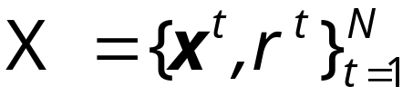
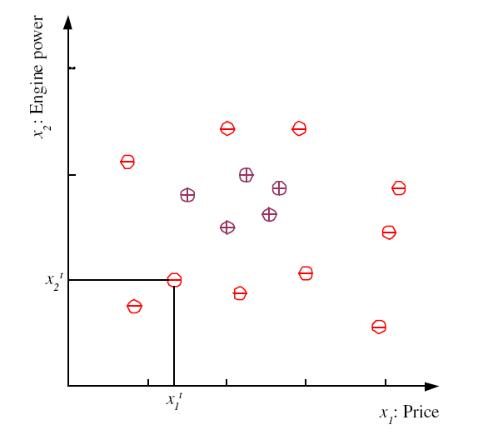
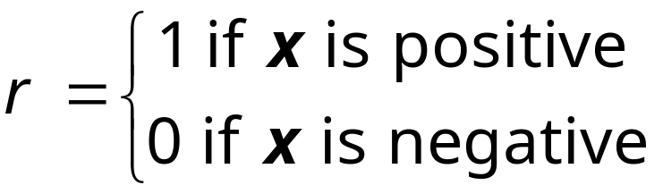
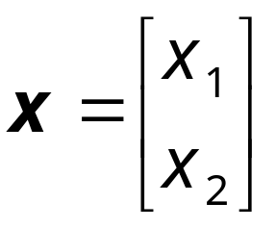
Training set X
Lecture Notes for E Alpaydın 2004 Introduction to Machine Learning © The MIT Press (V1.1)

Slide 4
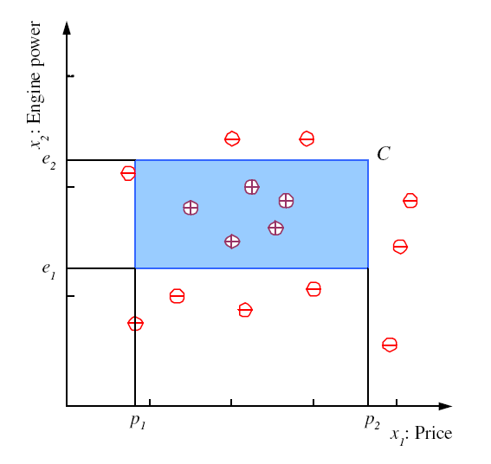
Class C
Lecture Notes for E Alpaydın 2004 Introduction to Machine Learning © The MIT Press (V1.1)

Slide 5
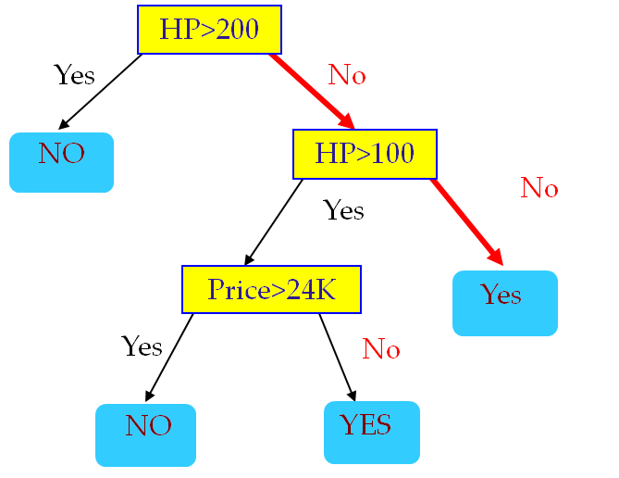
Family Car Decision Tree

Slide 6
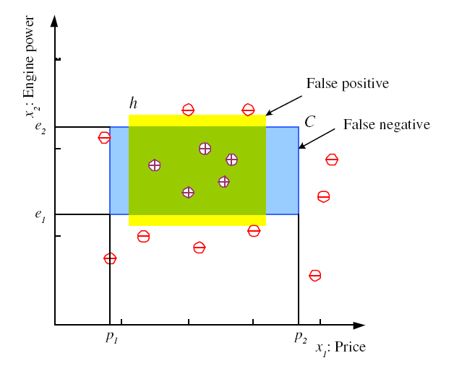
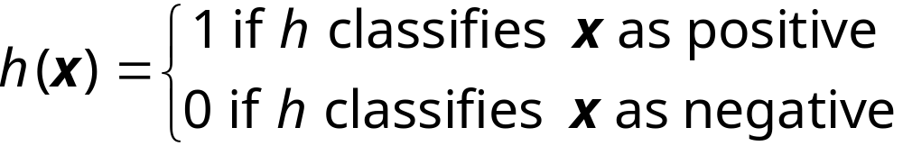
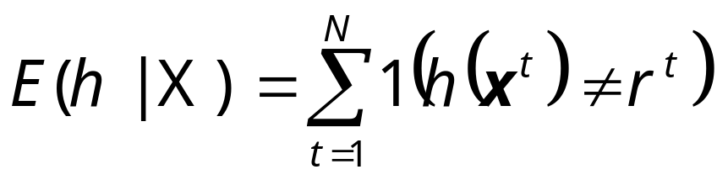
Hypothesis class H
Error of h on H
Lecture Notes for E Alpaydın 2004 Introduction to Machine Learning © The MIT Press (V1.1)

Slide 7
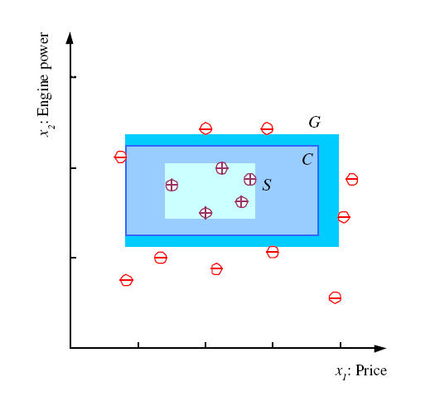
S, G, and the Version Space
most specific hypothesis, S
most general hypothesis, G
h ∈ H, between S and G is
consistent
and make up the
version space
(Mitchell, 1997)
Lecture Notes for E Alpaydın 2004 Introduction to Machine Learning © The MIT Press (V1.1)

Slide 8
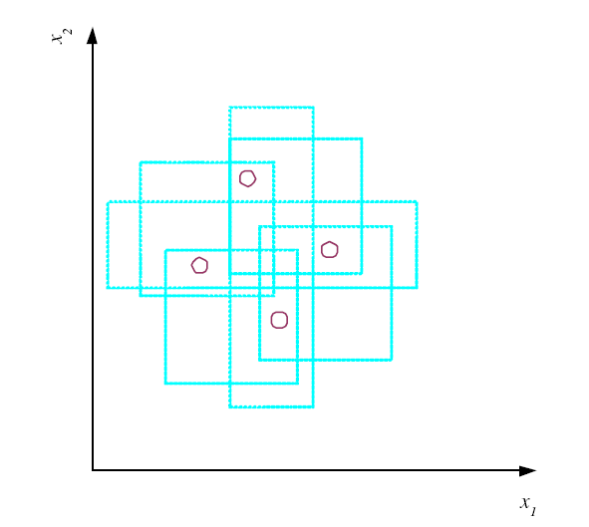
VC Dimension
Vapnik-Chervonenkis
N points can be labeled in 2^{N} ways as +/–
H shatters N if there
exists h ∈ H consistent
for any of these:
VC(H ) = N
Does not work for 5 points!
Only
2 +/2- depicted!
rectangles here
x
x
x
x
x
try it:
Homework
An axis-aligned rectangle shatters 4 points only !
Lecture Notes for E Alpaydın 2004 Introduction to Machine Learning © The MIT Press (V1.1)

Slide 9
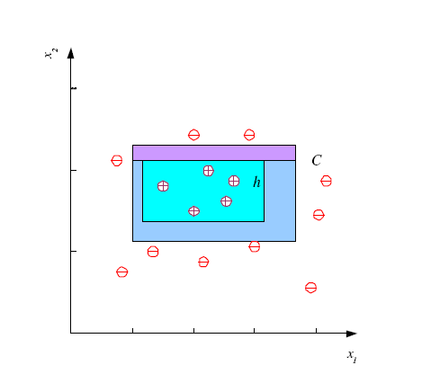
Probably Approximately Correct (PAC) Learning
Skipped!
How many training examples N should we have, such that with probability at least 1 ‒ δ, h has error at most ε ?
(Blumer et al., 1989)
Each strip is at most ε/4
Pr that we miss a strip 1‒ ε/4
Pr that N instances miss a strip (1 ‒ ε/4)^{N}
Pr that N instances miss 4 strips 4(1 ‒ ε/4)^{N}
4(1 ‒ ε/4)^{N} ≤ δ and (1 ‒ x)≤exp( ‒ x)
4exp(‒ εN/4) ≤ δ and N ≥ (4/ε)log(4/δ)
Lecture Notes for E Alpaydın 2004 Introduction to Machine Learning © The MIT Press (V1.1)

Slide 10
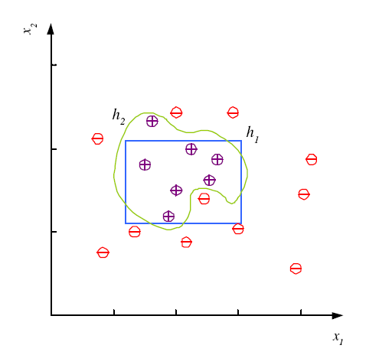
Noise and Model Complexity
Use the simpler one because
Simpler to use
(lower computational
complexity)
Easier to train (lower
space complexity)
Easier to explain
(more interpretable)
Generalizes better (lower
variance - Occam’s razor)
2 Other Classification Technique: Decision Trees and kNN
Lecture Notes for E Alpaydın 2004 Introduction to Machine Learning © The MIT Press (V1.1)

Slide 11
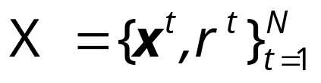
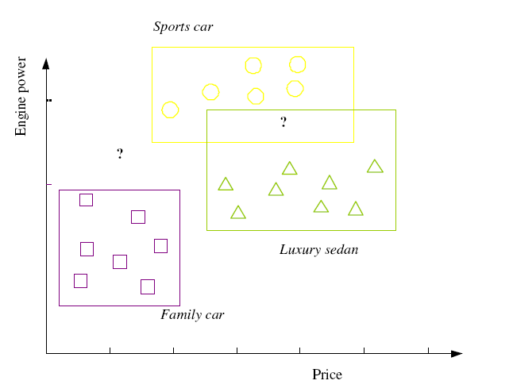
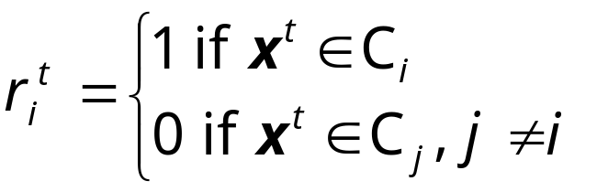

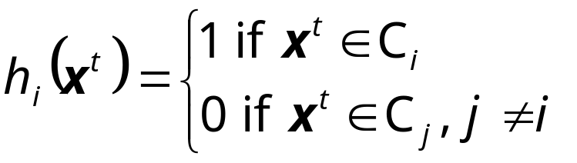
Multiple Classes, C_{i} i=1,...,K
Train hypotheses
h_{i}(x), i =1,...,K:
Lecture Notes for E Alpaydın 2004 Introduction to Machine Learning © The MIT Press (V1.1)

Slide 12
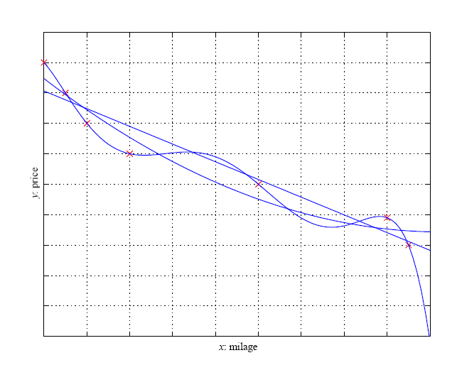
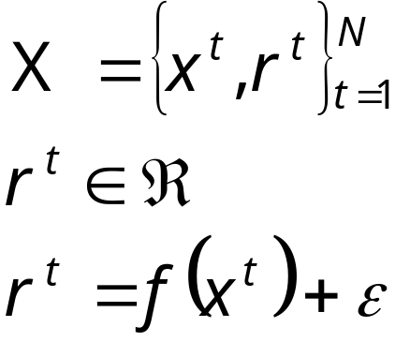
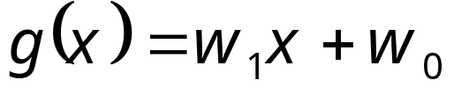
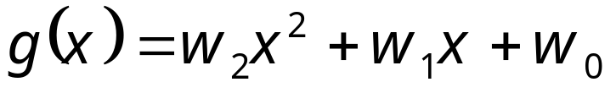
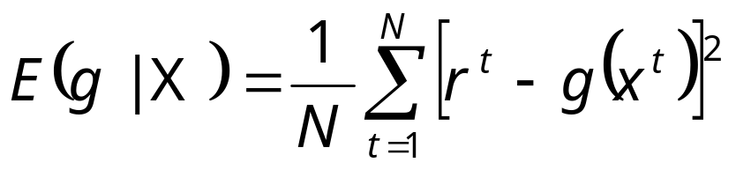
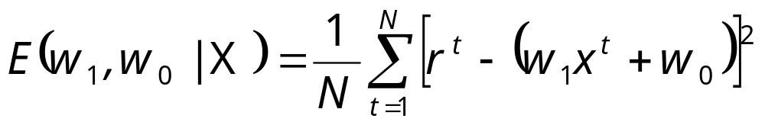
Regression
Lecture Notes for E Alpaydın 2004 Introduction to Machine Learning © The MIT Press (V1.1)

Slide 13
Finding Regression Coefficients
How to find w₁ and w₀?
Solve: dE/dw₁=0 and dE/dw₀=0
And solve the two obtained equations!
Ungraded Homework!
http://en.wikipedia.org/wiki/Simple_linear_regression
Lecture Notes for E Alpaydın 2004 Introduction to Machine Learning © The MIT Press (V1.1)

Slide 14
Model Selection & Generalization
Learning is an ill-posed problem; data is not sufficient to find a unique solution
The need for inductive bias, assumptions about H
Generalization: How well a model performs on new data
Overfitting: H more complex than C or f
Underfitting: H less complex than C or f
Lecture Notes for E Alpaydın 2004 Introduction to Machine Learning © The MIT Press (V1.1)

Slide 15

Underfitting and Overfitting
Underfitting
Overfitting
Complexity of a Decision
Tree := number of nodes
It uses
Complexity of the classification function
Underfitting: when model is too simple, both training and test errors are large
Overfitting: when model is too complex and test errors are large although training errors are small.

Slide 16
Cross-Validation
Error on new examples; actually the
testing error is used as an estimation
of the generalization error!
Two errors: training error, and testing error usually called generalization error. Typically, the training error is smaller than the generalization error.
To estimate generalization error, we need data unseen during training. We could split the data as
  Training set (50%)
  Validation set (25%)→optional, for selecting ML algorithm parameters (e.g. model complexity)
  Test (publication) set (25%)
Resampling when there is few data
Lecture Notes for E Alpaydın 2004 Introduction to Machine Learning © The MIT Press (V1.1)

Slide 17
Triple Trade-Off
overfitting
There is a trade-off between three factors (Dietterich, 2003):
  Complexity of H, c (H),
  Training set size, N,
  Generalization error, E on new data
As N↑, E↓
As c (H)↑, first E↓ and then E↑
Αs c (H)↑ the training error decreases for some time and then stays constant (frequently at 0)
Lecture Notes for E Alpaydın 2004 Introduction to Machine Learning © The MIT Press (V1.1)

Slide 18

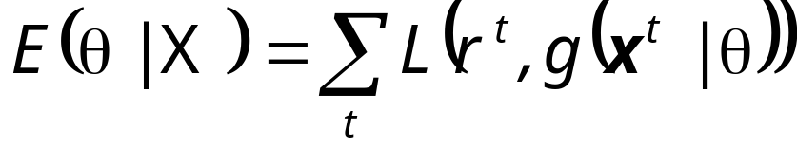
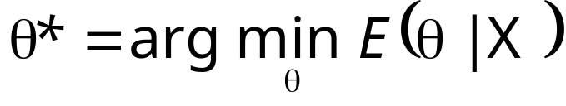
Dimensions of a Supervised Learner
Model :
Loss function:
Optimization procedure:

Remark: This procedure is typical for
Parametric approaches to supervised learning;
Non-parametric approaches work differently!
Lecture Notes for E Alpaydın 2004 Introduction to Machine Learning © The MIT Press (V1.1)

