Slide 1
Chapter 13
Shell Scripts: Writing Applications
This chapter builds on the commands and concepts of the previous chapter
It discusses additional shell programming commands and techniques.
It presents a simple application program.
It shows the process of developing programs using the shell language.
Amir Afzal
UNIX Unbounded, 5th Edition
Copyright ©2008 by Pearson Education, Inc

Slide 2
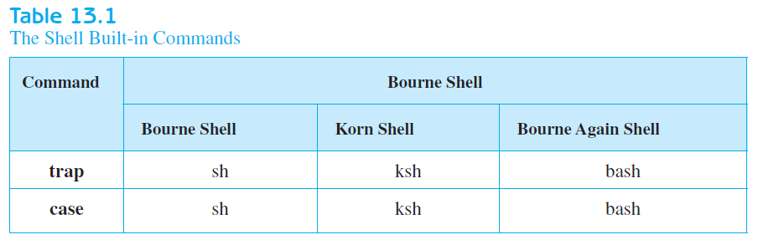
WRITING APPLICATIONS
Shell built-in commands that are covered in this chapter and their availability under different shells
Amir Afzal
UNIX Unbounded, 5th Edition
Copyright ©2008 by Pearson Education, Inc

Slide 3
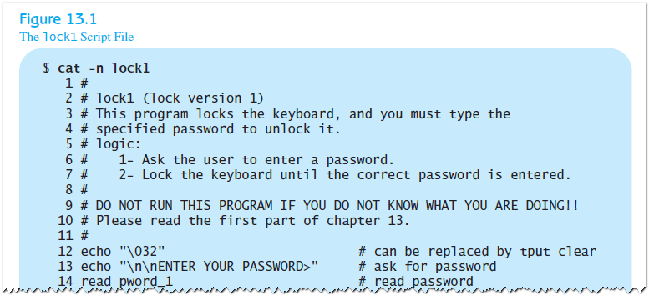
The lock1 Program
Scenario: you want to protect the access to your without logging off and then logging in again
Write a script file that, when invoked, shows a message on the screen and does not go away until you enter the correct password
Amir Afzal
UNIX Unbounded, 5th Edition
Copyright ©2008 by Pearson Education, Inc

Slide 4
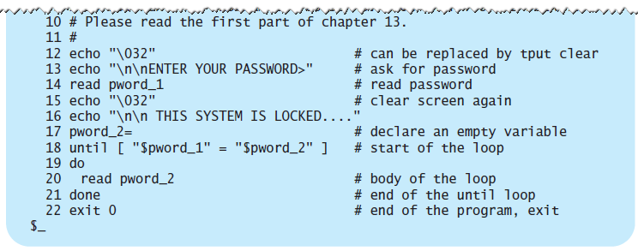
The lock1 Program
Scenario: you want to protect the access to your without logging off and then logging in again
Amir Afzal
UNIX Unbounded, 5th Edition
Copyright ©2008 by Pearson Education, Inc

Slide 5
The lock1 Program
Problems with the lock1 Program – not foolproof!
  While the keyboard is locked, if you press [Del] (the interrupt key), the lock1 script is terminated
  The password is displayed.
  The message is hard coded. It always shows.
To solve these problems, a few more commands must be explored.
Amir Afzal
UNIX Unbounded, 5th Edition
Copyright ©2008 by Pearson Education, Inc

Slide 6
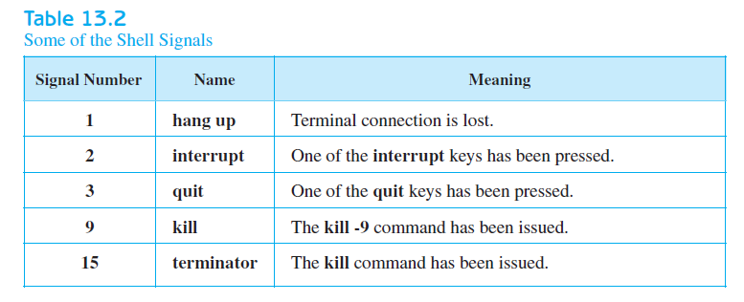
UNIX INTERNALS: THE SIGNALS
Several different events that make the kernel send a signal to your process
Amir Afzal
UNIX Unbounded, 5th Edition
Copyright ©2008 by Pearson Education, Inc

Slide 7

UNIX INTERNALS: THE SIGNALS
Trapping the Signals: The trap Command
  Commands that are specified to the trap command must be enclosed in single or double quotation marks
  You can specify more than one signal number to be trapped
  Signal numbers are the numbers associated with the signals that you want the trap command to catch
Amir Afzal
UNIX Unbounded, 5th Edition
Copyright ©2008 by Pearson Education, Inc

Slide 8
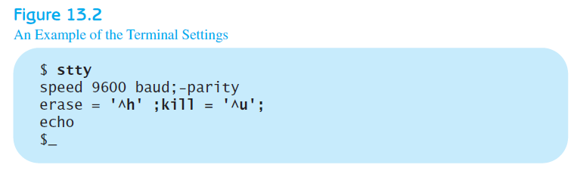
UNIX INTERNALS: THE SIGNALS
Resetting the Traps
  Issuing a trap command in your script changes the default actions of the signals received by your process
  Using the trap command, without the optional commands part, changes the specified signals to their default actions
Setting Terminal Options: The stty Command
  Use the command to set and display terminal characteristics
Amir Afzal
UNIX Unbounded, 5th Edition
Copyright ©2008 by Pearson Education, Inc

Slide 9
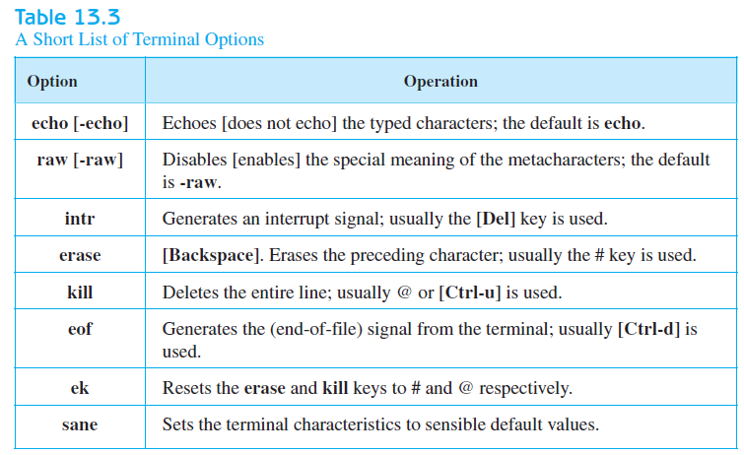
UNIX INTERNALS: THE SIGNALS
Setting Terminal Options
Amir Afzal
UNIX Unbounded, 5th Edition
Copyright ©2008 by Pearson Education, Inc

Slide 10
MORE ABOUT TERMINALS
The Terminals Database: The terminfo File
  A single text file that contains descriptions of many types of terminals
  A list of capabilities associated with each terminal in the database.
Setting Terminal Capabilities: The tput Command
  Lets you print out the values of any single capability
  Makes it possible to use the terminals’ capabilities in shell programming
Amir Afzal
UNIX Unbounded, 5th Edition
Copyright ©2008 by Pearson Education, Inc

Slide 11
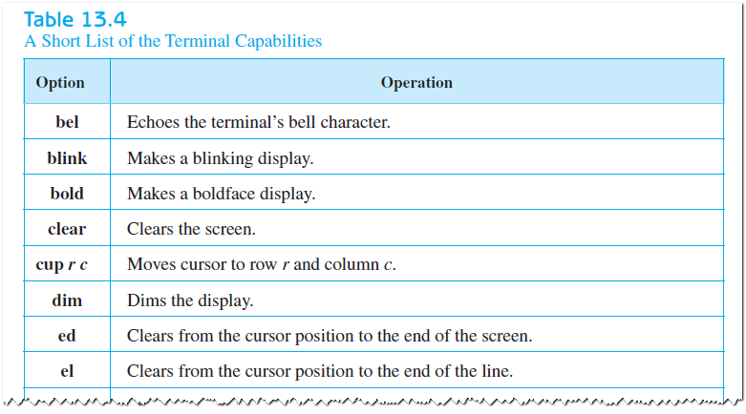
MORE ABOUT TERMINALS
Terminal Capabilities
Amir Afzal
UNIX Unbounded, 5th Edition
Copyright ©2008 by Pearson Education, Inc

Slide 12
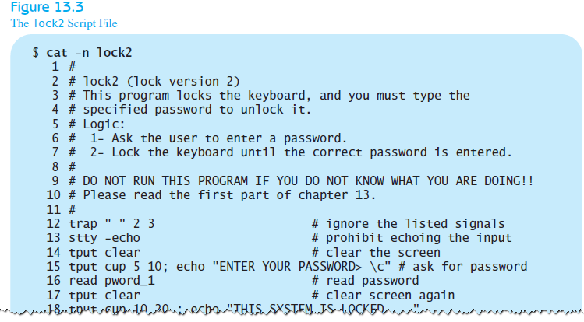
MORE ABOUT TERMINALS
Solving the lock1 Program Problems
Amir Afzal
UNIX Unbounded, 5th Edition
Copyright ©2008 by Pearson Education, Inc

Slide 13
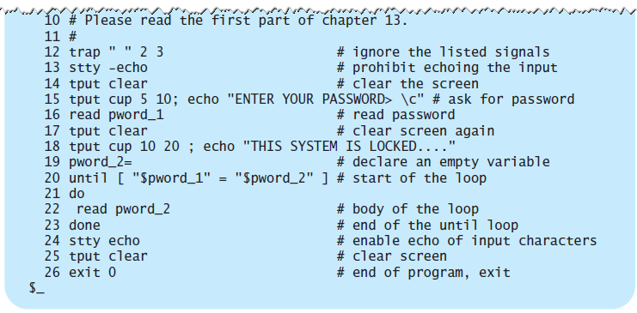
MORE ABOUT TERMINALS
Solving the lock1 Program Problems
Amir Afzal
UNIX Unbounded, 5th Edition
Copyright ©2008 by Pearson Education, Inc

Slide 14
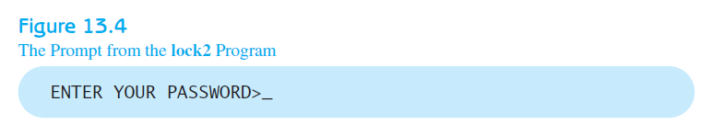
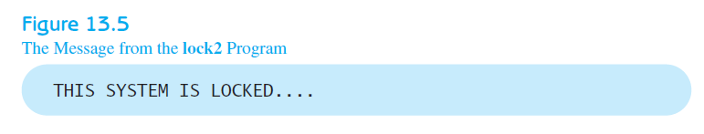
MORE ABOUT TERMINALS
Solving the lock1 Program Problems
Amir Afzal
UNIX Unbounded, 5th Edition
Copyright ©2008 by Pearson Education, Inc

Slide 15
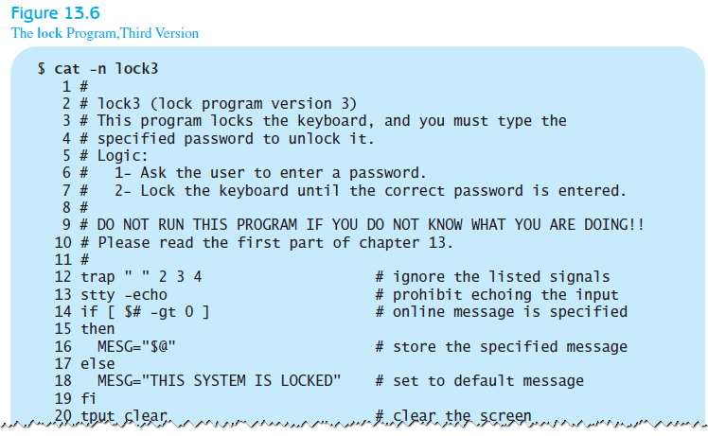
MORE ABOUT TERMINALS
Specifying the Display Message
Amir Afzal
UNIX Unbounded, 5th Edition
Copyright ©2008 by Pearson Education, Inc

Slide 16
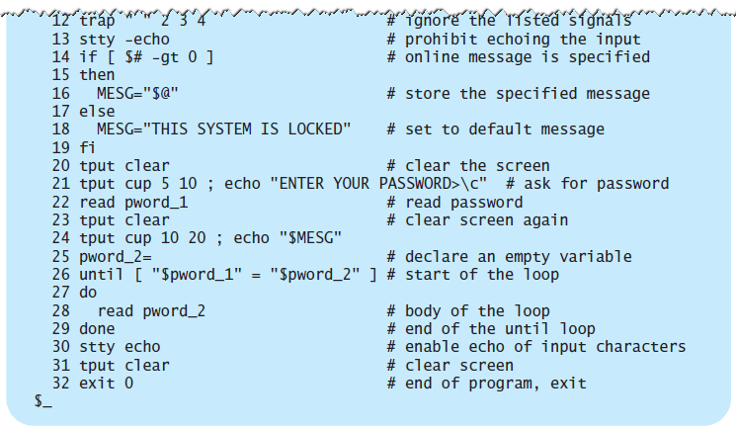
MORE ABOUT TERMINALS
Specifying the Display Message
Amir Afzal
UNIX Unbounded, 5th Edition
Copyright ©2008 by Pearson Education, Inc

Slide 17
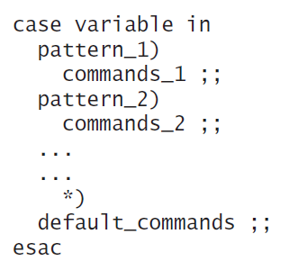
MORE COMMANDS
Multiway Branching: The case Construct
Amir Afzal
UNIX Unbounded, 5th Edition
Copyright ©2008 by Pearson Education, Inc

Slide 18
MORE COMMANDS
Multiway Branching: The case Construct
Consider use of a menu program
  Display the possible options.
  Prompt the user to select a function.
  Read the user input.
  Call other programs according to the user input.
  Display an error message if the input is wrong.
Amir Afzal
UNIX Unbounded, 5th Edition
Copyright ©2008 by Pearson Education, Inc

Slide 19
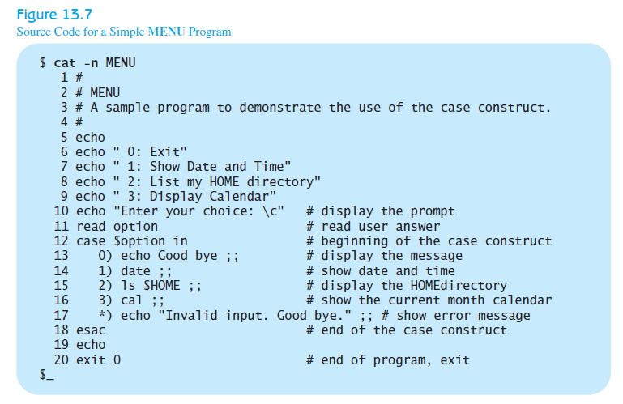
MORE COMMANDS
Multiway Branching: The case Construct
Amir Afzal
UNIX Unbounded, 5th Edition
Copyright ©2008 by Pearson Education, Inc

Slide 20
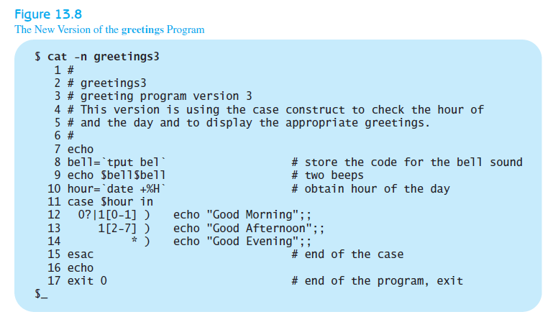
MORE COMMANDS
Revisiting the greetings Program
Amir Afzal
UNIX Unbounded, 5th Edition
Copyright ©2008 by Pearson Education, Inc

Slide 21
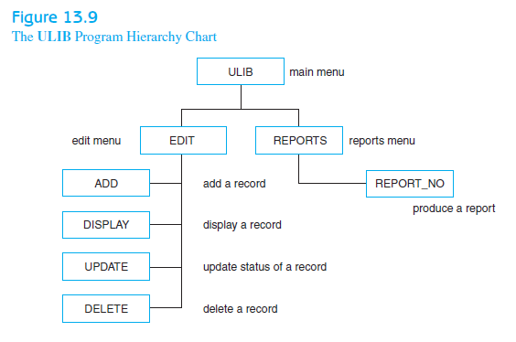
A MENU-DRIVEN APPLICATION
Scenario: write a menu-driven application that facilitates keeping track of your UNIX books
The Hierarchy Chart
Amir Afzal
UNIX Unbounded, 5th Edition
Copyright ©2008 by Pearson Education, Inc

Slide 22
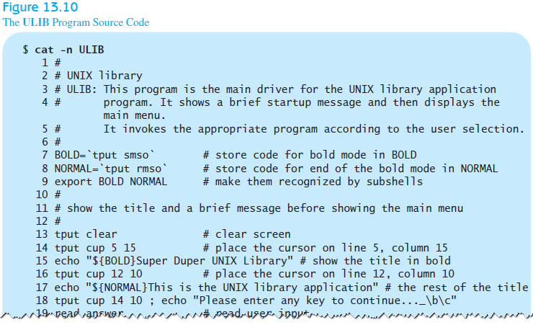
A MENU-DRIVEN APPLICATION
The ULIB Program
Amir Afzal
UNIX Unbounded, 5th Edition
Copyright ©2008 by Pearson Education, Inc

Slide 23
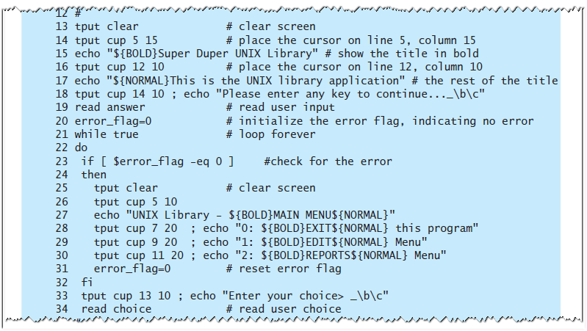
A MENU-DRIVEN APPLICATION
The ULIB Program
Amir Afzal
UNIX Unbounded, 5th Edition
Copyright ©2008 by Pearson Education, Inc

Slide 24
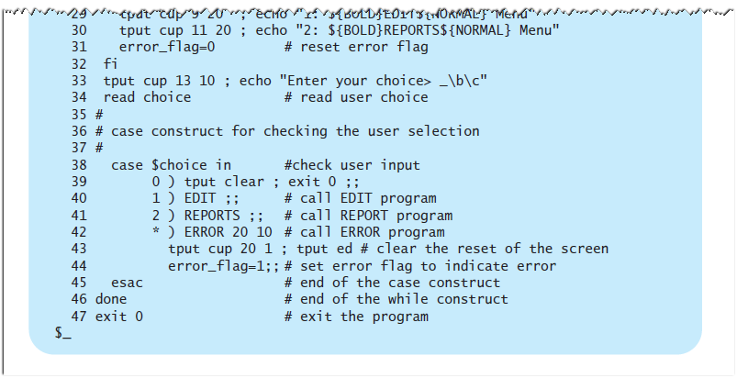
A MENU-DRIVEN APPLICATION
The ULIB Program
Amir Afzal
UNIX Unbounded, 5th Edition
Copyright ©2008 by Pearson Education, Inc

Slide 25
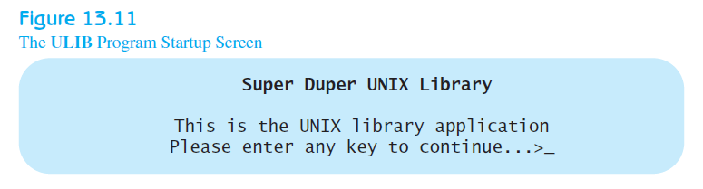
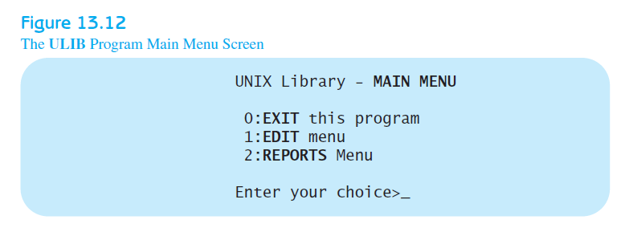
A MENU-DRIVEN APPLICATION
The ULIB Program
Amir Afzal
UNIX Unbounded, 5th Edition
Copyright ©2008 by Pearson Education, Inc

Slide 26
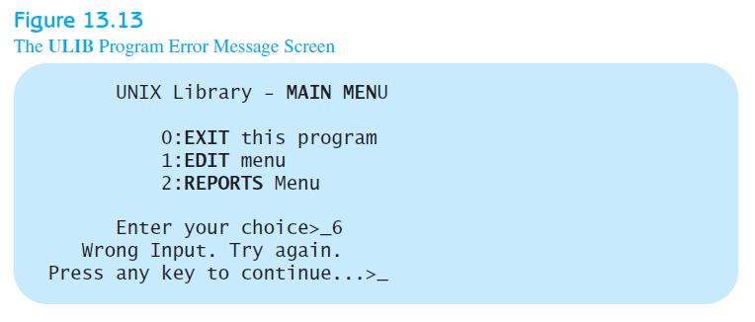
A MENU-DRIVEN APPLICATION
The ULIB Program
Amir Afzal
UNIX Unbounded, 5th Edition
Copyright ©2008 by Pearson Education, Inc

Slide 27
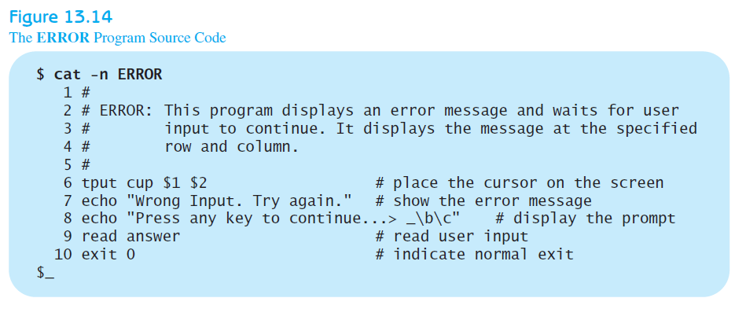
A MENU-DRIVEN APPLICATION
The ERROR Program
Amir Afzal
UNIX Unbounded, 5th Edition
Copyright ©2008 by Pearson Education, Inc

Slide 28
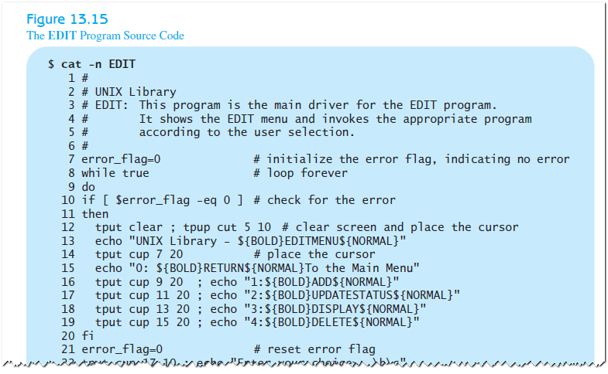
A MENU-DRIVEN APPLICATION
The EDIT Program
Amir Afzal
UNIX Unbounded, 5th Edition
Copyright ©2008 by Pearson Education, Inc

Slide 29
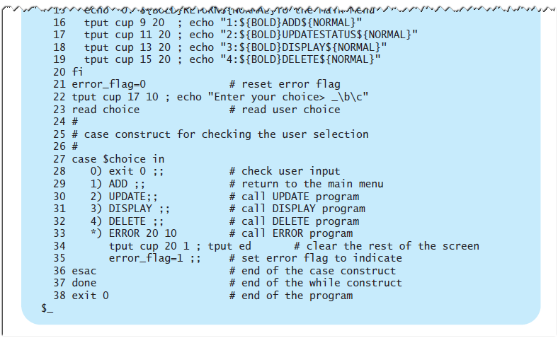
A MENU-DRIVEN APPLICATION
The EDIT Program
Amir Afzal
UNIX Unbounded, 5th Edition
Copyright ©2008 by Pearson Education, Inc

Slide 30
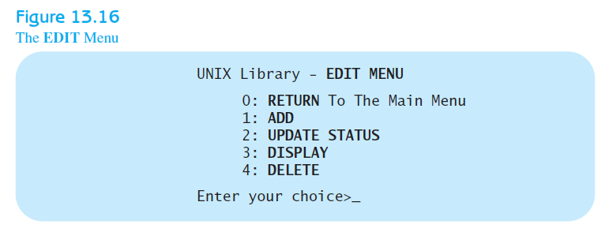
A MENU-DRIVEN APPLICATION
The EDIT Program
Amir Afzal
UNIX Unbounded, 5th Edition
Copyright ©2008 by Pearson Education, Inc

Slide 31
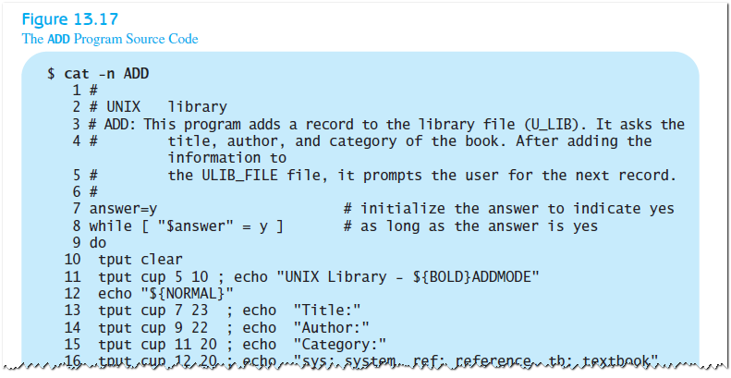
A MENU-DRIVEN APPLICATION
The ADD Program
Amir Afzal
UNIX Unbounded, 5th Edition
Copyright ©2008 by Pearson Education, Inc

Slide 32
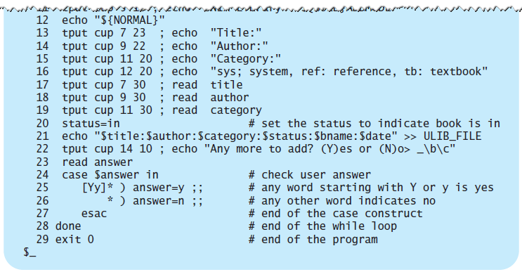
A MENU-DRIVEN APPLICATION
The ADD Program
Amir Afzal
UNIX Unbounded, 5th Edition
Copyright ©2008 by Pearson Education, Inc

Slide 33
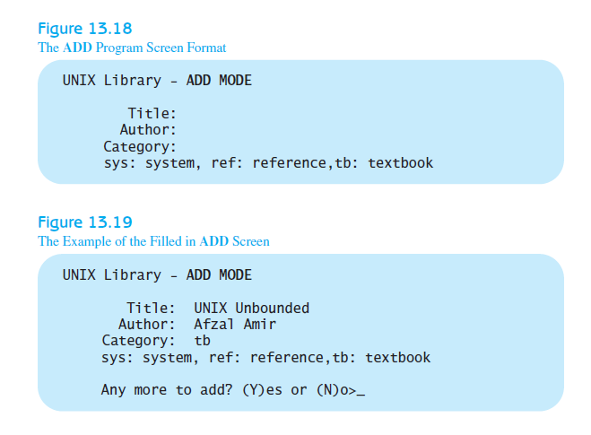
A MENU-DRIVEN APPLICATION
The ADD Program
Amir Afzal
UNIX Unbounded, 5th Edition
Copyright ©2008 by Pearson Education, Inc

Slide 34
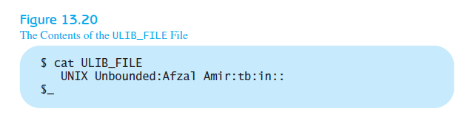
A MENU-DRIVEN APPLICATION
Delimiter Character
  Fields in each record are stored in sequential order
  Must designate a field delimiter
  [Tab], [Return], and [Spacebar] are not good choices
  Better options: ~, ^, or :
Amir Afzal
UNIX Unbounded, 5th Edition
Copyright ©2008 by Pearson Education, Inc

Slide 35
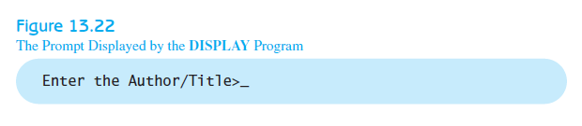
A MENU-DRIVEN APPLICATION
Record Retrieval
  To display a record, you must specify what record you want displayed
The DISPLAY Program
  displays a specified record from the ULIB_FILE file on the screen
  When it runs, displays query below
Amir Afzal
UNIX Unbounded, 5th Edition
Copyright ©2008 by Pearson Education, Inc

Slide 36
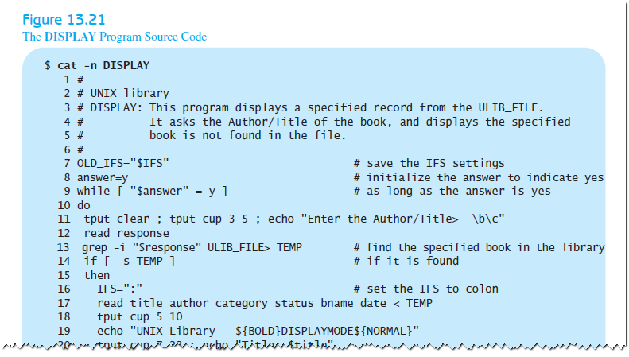
A MENU-DRIVEN APPLICATION
The DISPLAY Program
Amir Afzal
UNIX Unbounded, 5th Edition
Copyright ©2008 by Pearson Education, Inc

Slide 37
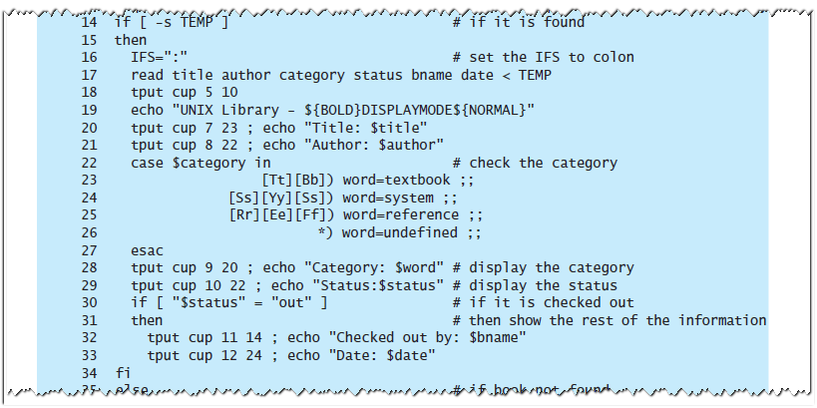
A MENU-DRIVEN APPLICATION
The DISPLAY Program
Amir Afzal
UNIX Unbounded, 5th Edition
Copyright ©2008 by Pearson Education, Inc

Slide 38
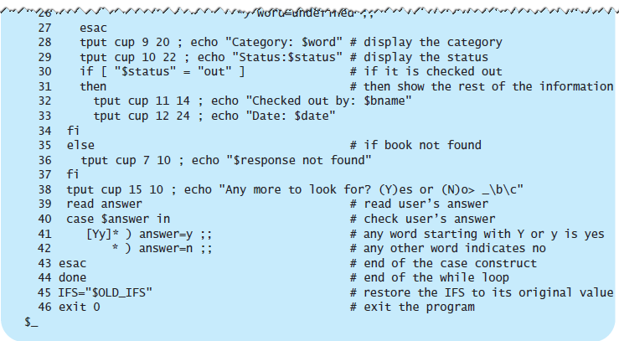
A MENU-DRIVEN APPLICATION
The DISPLAY Program
Amir Afzal
UNIX Unbounded, 5th Edition
Copyright ©2008 by Pearson Education, Inc

Slide 39
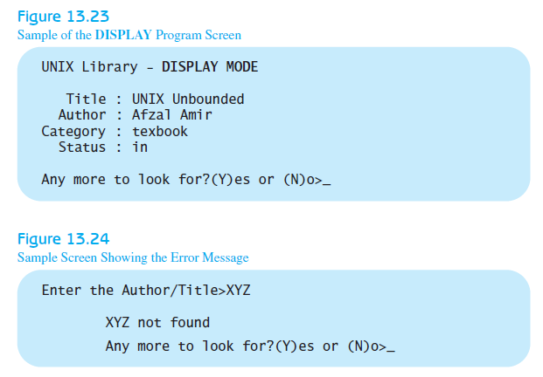
A MENU-DRIVEN APPLICATION
The DISPLAY Program
Amir Afzal
UNIX Unbounded, 5th Edition
Copyright ©2008 by Pearson Education, Inc

Slide 40
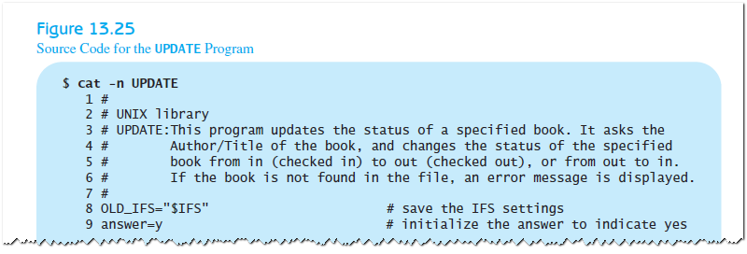
A MENU-DRIVEN APPLICATION
The UPDATE Program
Amir Afzal
UNIX Unbounded, 5th Edition
Copyright ©2008 by Pearson Education, Inc

Slide 41
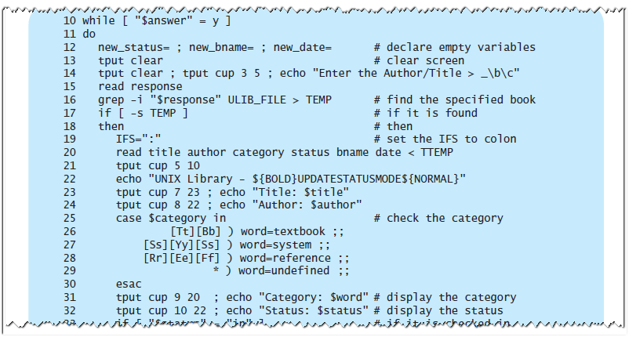
A MENU-DRIVEN APPLICATION
The UPDATE Program
Amir Afzal
UNIX Unbounded, 5th Edition
Copyright ©2008 by Pearson Education, Inc

Slide 42
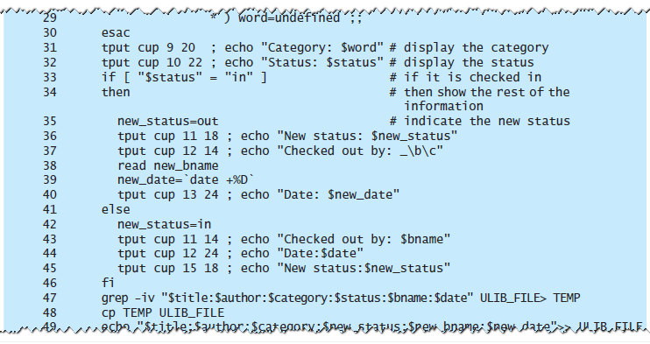
A MENU-DRIVEN APPLICATION
The UPDATE Program
Amir Afzal
UNIX Unbounded, 5th Edition
Copyright ©2008 by Pearson Education, Inc

Slide 43
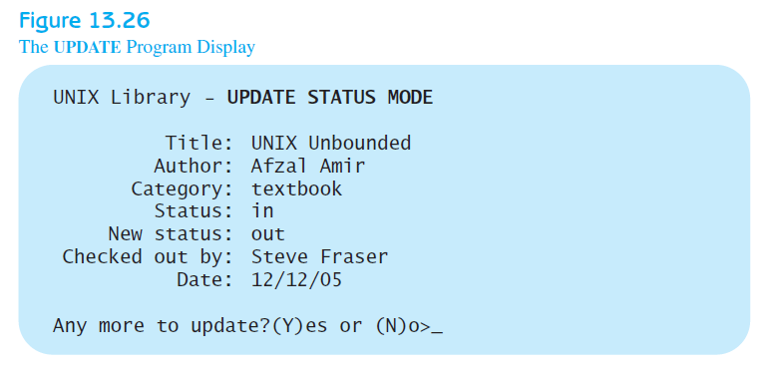
A MENU-DRIVEN APPLICATION
The UPDATE Program
Amir Afzal
UNIX Unbounded, 5th Edition
Copyright ©2008 by Pearson Education, Inc

Slide 44
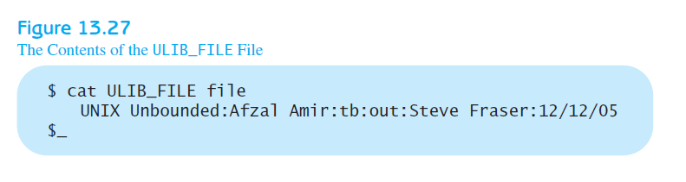
A MENU-DRIVEN APPLICATION
The UPDATE Program
Amir Afzal
UNIX Unbounded, 5th Edition
Copyright ©2008 by Pearson Education, Inc

Slide 45
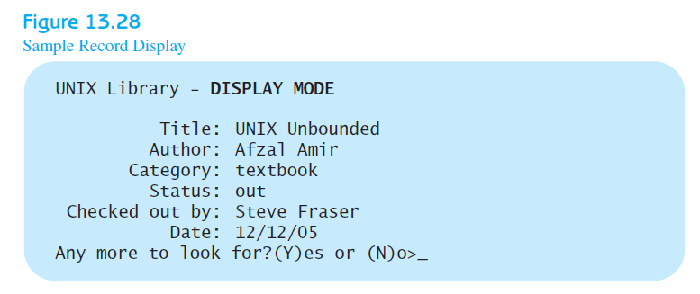
A MENU-DRIVEN APPLICATION
The UPDATE Program
Amir Afzal
UNIX Unbounded, 5th Edition
Copyright ©2008 by Pearson Education, Inc

Slide 46
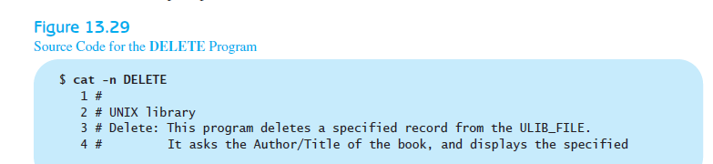
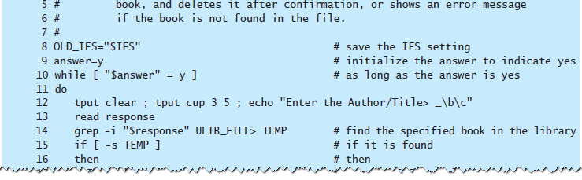
A MENU-DRIVEN APPLICATION
The DELETE Program
Amir Afzal
UNIX Unbounded, 5th Edition
Copyright ©2008 by Pearson Education, Inc

Slide 47
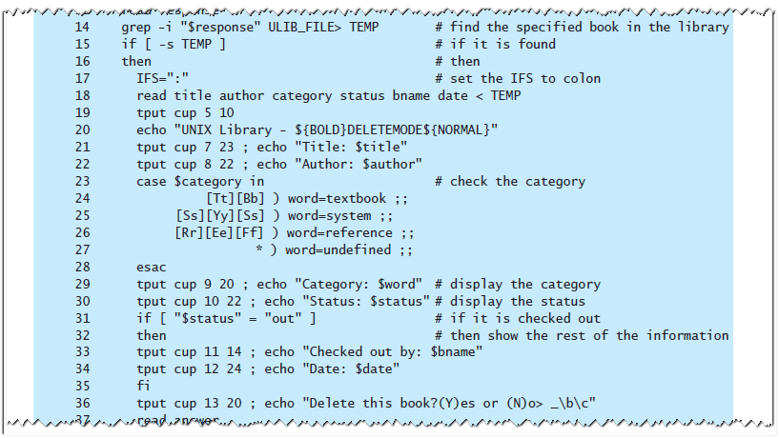
A MENU-DRIVEN APPLICATION
The DELETE Program
Amir Afzal
UNIX Unbounded, 5th Edition
Copyright ©2008 by Pearson Education, Inc

Slide 48
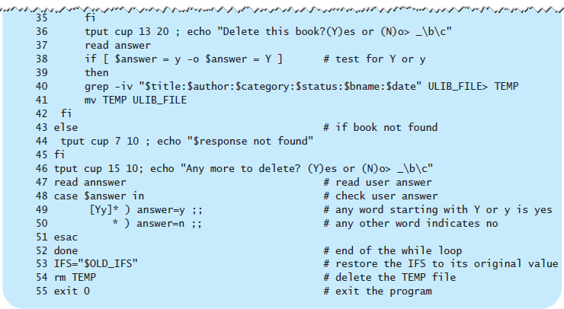
A MENU-DRIVEN APPLICATION
The DELETE Program
Amir Afzal
UNIX Unbounded, 5th Edition
Copyright ©2008 by Pearson Education, Inc

Slide 49
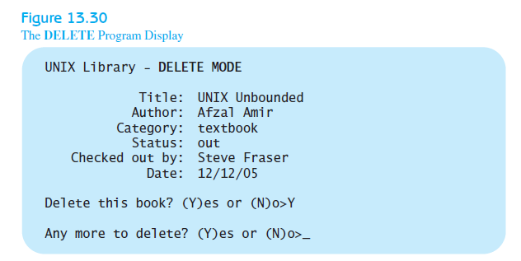
A MENU-DRIVEN APPLICATION
The DELETE Program
Amir Afzal
UNIX Unbounded, 5th Edition
Copyright ©2008 by Pearson Education, Inc

Slide 50
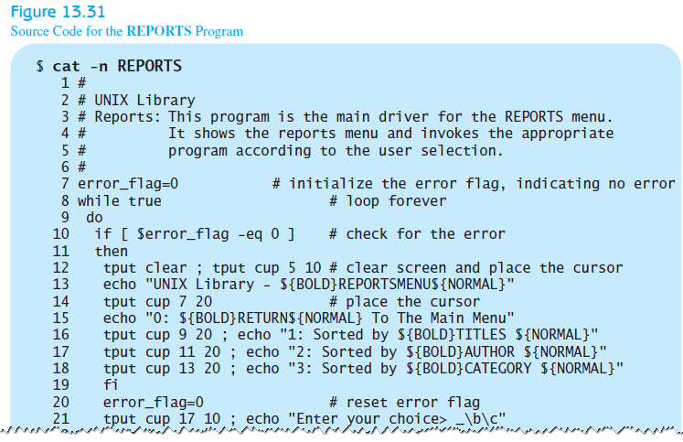
A MENU-DRIVEN APPLICATION
The REPORTS Program
Amir Afzal
UNIX Unbounded, 5th Edition
Copyright ©2008 by Pearson Education, Inc

Slide 51
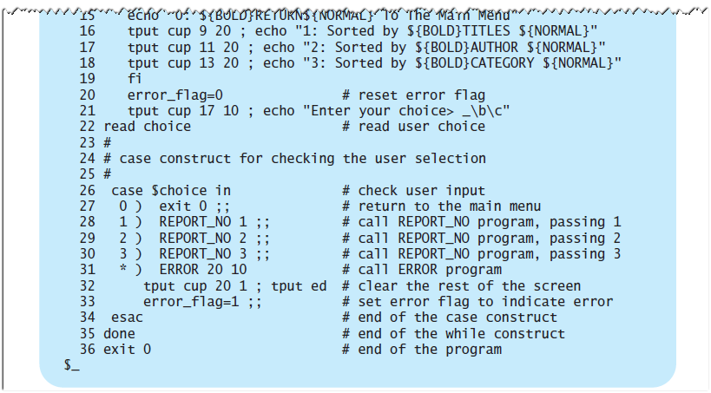
A MENU-DRIVEN APPLICATION
The REPORTS Program
Amir Afzal
UNIX Unbounded, 5th Edition
Copyright ©2008 by Pearson Education, Inc

Slide 52
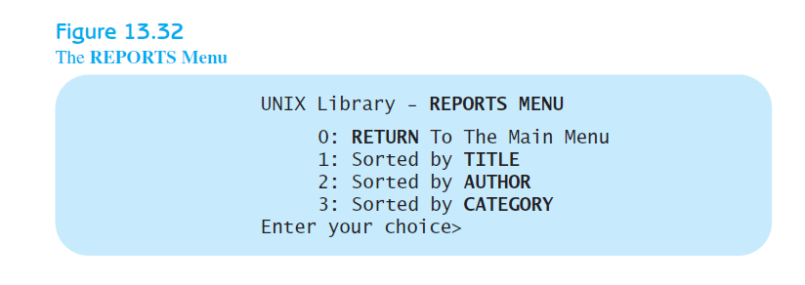
A MENU-DRIVEN APPLICATION
The REPORTS Program
Amir Afzal
UNIX Unbounded, 5th Edition
Copyright ©2008 by Pearson Education, Inc

Slide 53
A MENU-DRIVEN APPLICATION
The REPORT_NO Program
  activated whenever you select a report number from the REPORTS menu
Options:
  The -f option considers all lowercase letters to be uppercase letters.
  The -d option ignores all blanks or nonalphanumeric characters.
  The -t option indicates which character is to be used as the field separator.
  The number option (+1 and +2) sorts the file on the next field specified by the field number
Amir Afzal
UNIX Unbounded, 5th Edition
Copyright ©2008 by Pearson Education, Inc

Slide 54

A MENU-DRIVEN APPLICATION
The REPORT_NO Program
Amir Afzal
UNIX Unbounded, 5th Edition
Copyright ©2008 by Pearson Education, Inc

Slide 55

A MENU-DRIVEN APPLICATION
The REPORT_NO Program
Amir Afzal
UNIX Unbounded, 5th Edition
Copyright ©2008 by Pearson Education, Inc

Slide 56

A MENU-DRIVEN APPLICATION
The REPORT_NO Program
Amir Afzal
UNIX Unbounded, 5th Edition
Copyright ©2008 by Pearson Education, Inc

