Slide 1

Anaerobic: Setting up a program
NASA Fitness
April 4 2016
Week 2 / 4

Slide 2
Overview
NASA Fitness
Periodization
Resistance Training Program Design Variables
Needs analysis
Exercise selection
Training frequency
Exercise order
Training load and repetitions
Volume
Rest periods

Slide 3
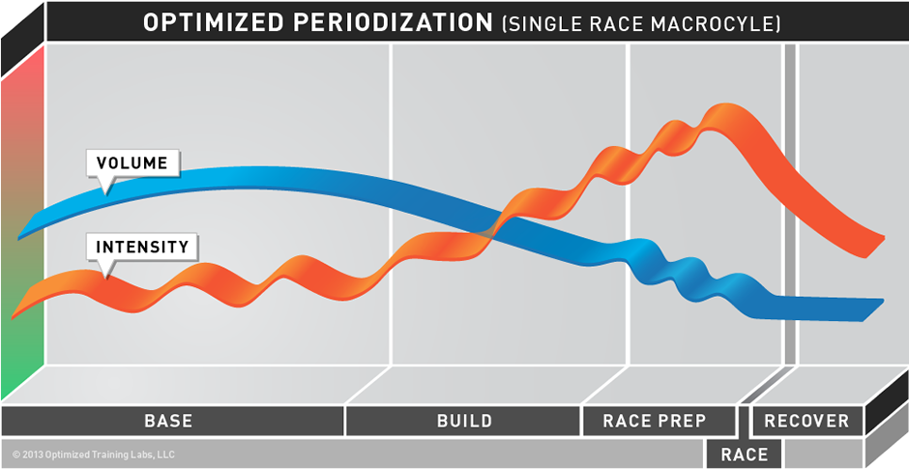
Definition of Periodization
NASA Fitness
Periodization is an organized approach to training that involves progressive cycling of various aspects of a training program during a specific period of time to bring about optimal gains in physical performance.
Essentials of Strength Training and Conditioning - 3rd Edition

Slide 4
Ideas Behind Periodization
NASA Fitness
Although training will produce positive outcomes, the desirable results can not continue indefinitely.
    General Adaptation Syndrome- the body’s adaptation and reaction to short and long term stressors.
In order to gain any particular aspect of strength or conditioning, you need to overload your system with increased external stimulus
Essentials of Strength Training and Conditioning - 3rd Edition

Slide 5
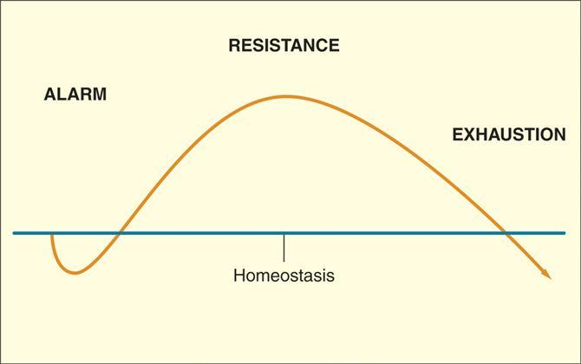
General Adaptation Syndrome (GAS)
NASA Fitness
Alarm- body is introduced to new or increased stress
  Soreness, temporary drop in performance
Resistance Phase- body adapts to stimulus and returns to regular functioning
  “super compensation”- relies on neurological adaptations to continue training while muscle tissue undergoes biochemical, structural and mechanical adjustments
Exhaustion- overtraining
  Fatigue, soreness; non-training stress may aid in leading to this stage
Essentials of Strength Training and Conditioning - 3rd Edition

Slide 6
Why is it programed this way?
NASA Fitness
Periodization is most widely used in resistance program design to avoid over-training and to systematically alternate high loads of training with decreased loading phases to improve components of muscular fitness (strength, strength-speed, strength-endurance) aiming to peak at the most advantageous time for an athlete
Essentials of Strength Training and Conditioning - 3rd Edition

Slide 7
Various Aspects of Training
NASA Fitness
Many training variables can be manipulated in an attempt to optimize the exercise program:
  # of sets per exercise
  # of repetitions per set
  Types, order and # of exercises per training session
  Rest periods between sets and exercises
  Resistance/Load
  Type and tempo of muscle action (e.g., eccentric, concentric, isometric)
  Frequency of training sessions
Essentials of Strength Training and Conditioning - 3rd Edition

Slide 8
Resistance Training
NASA Fitness
Resistance Training Program Design Variables (7 steps)
  Needs analysis
  Exercise selection
  Training frequency
  Exercise order
  Training load and repetitions
  Volume
  Rest periods
Essentials of Strength Training and Conditioning - 3rd Edition

Slide 9

Step 1: Needs Analysis
NASA Fitness
Needs analysis is a two-stage process that includes an evaluation of the requirements and characteristics of the sport and an assessment of the individual.
Essentials of Strength Training and Conditioning - 3rd Edition

Slide 10

Step 1: Needs Analysis
NASA Fitness
Assessment of the Individual
  Training Status
    Type of training program
    Length of recent regular participation in previous training program(s)
    Level of intensity involved in previous training program(s)
    Degree of exercise technique experience
Essentials of Strength Training and Conditioning - 3rd Edition

Slide 11
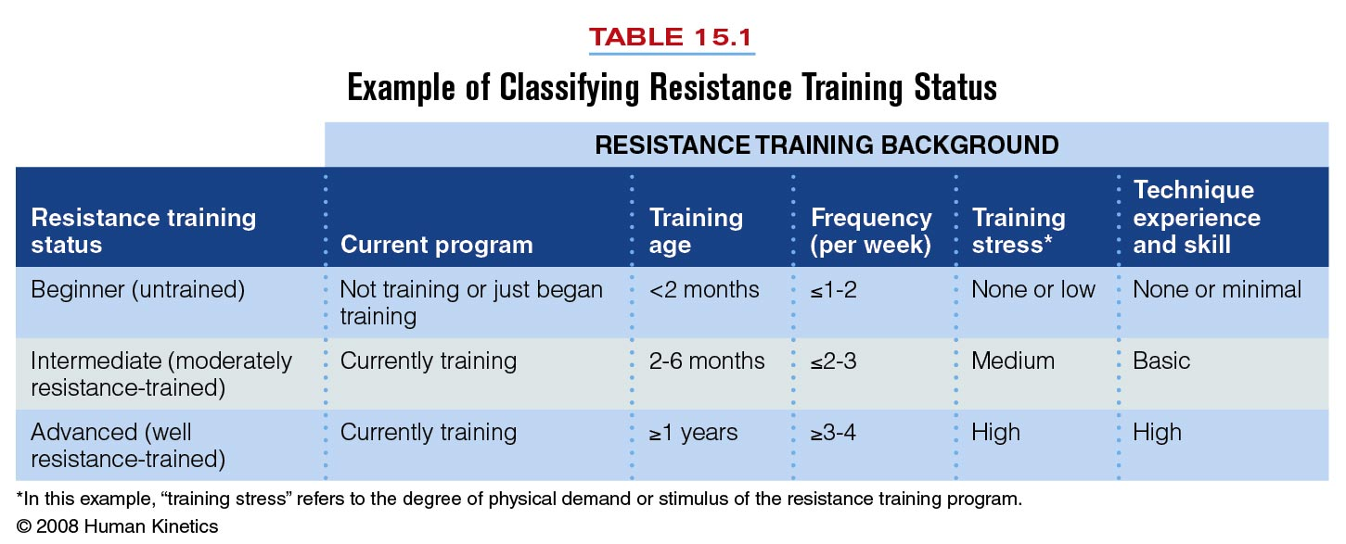
NASA Fitness
***TRAINING AGE IS THE AMOUNT OF TIME AN INDIVIDUAL HAS BEEN TRAINING. THUS, a 40 y.o. can have a training age of 2 months!***
Essentials of Strength Training and Conditioning - 3rd Edition

Slide 12
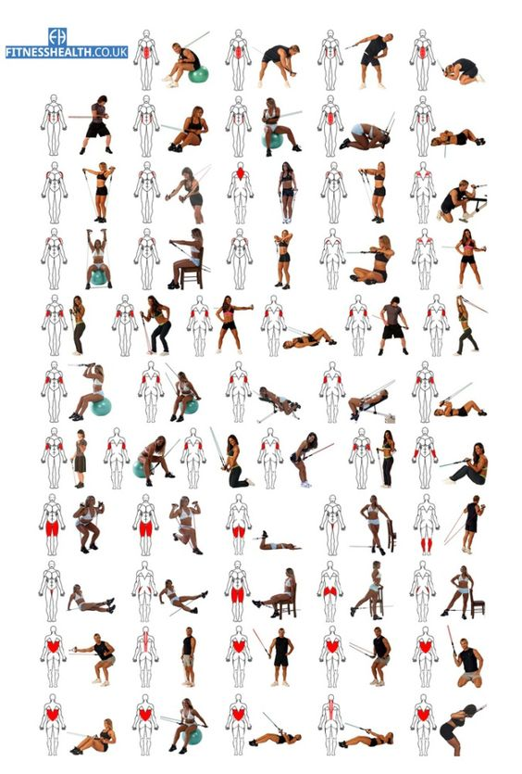
Step 2: Exercise Selection
NASA Fitness
Step 2 involves choosing exercises for a resistance training program.
Essentials of Strength Training and Conditioning - 3rd Edition

Slide 13
Step 2: Exercise Selection
NASA Fitness
Exercise Type
  Core and Assistance Exercises
    Core exercises recruit one or more large muscle areas, involve two or more primary joints, and receive priority when one is selecting exercises because of their direct application to the sport.
    Assistance exercises usually recruit smaller muscle areas, involve only one primary joint, and are considered less important to improving sport performance.
Essentials of Strength Training and Conditioning - 3rd Edition

Slide 14
Step 2: Exercise Selection
NASA Fitness
Exercise Type
  Structural and Power Exercises
    Structural exercises emphasize loading the spine directly
    or indirectly.
    Power exercises are structural exercises that are performed very quickly or explosively.
Essentials of Strength Training and Conditioning - 3rd Edition

Slide 15
Step 2: Exercise Selection
NASA Fitness
Movement Analysis of the Sport
  Muscle Balance
    agonist: The muscle or muscle group actively causing the movement.
    antagonist: The sometimes passive muscle or muscle group located on the opposite side of the limb.
Essentials of Strength Training and Conditioning - 3rd Edition

Slide 16

Step 3: Training Frequency
NASA Fitness
Training frequency is the number of training sessions completed in a given time period.
For a resistance training program, a common time period is one week.
Essentials of Strength Training and Conditioning - 3rd Edition

Slide 17
Step 3: Training Frequency
NASA Fitness
Training Status
  Training status affects the number of rest days needed between sessions.
  Three workouts per week are recommended for many individuals to allow sufficient recovery between sessions.
Essentials of Strength Training and Conditioning - 3rd Edition

Slide 18

Key Point!
NASA Fitness
The general guideline is to schedule training sessions so that there is at least one rest or recovery day—but not more than three—between sessions that stress the same muscle groups.
Essentials of Strength Training and Conditioning - 3rd Edition

Slide 19
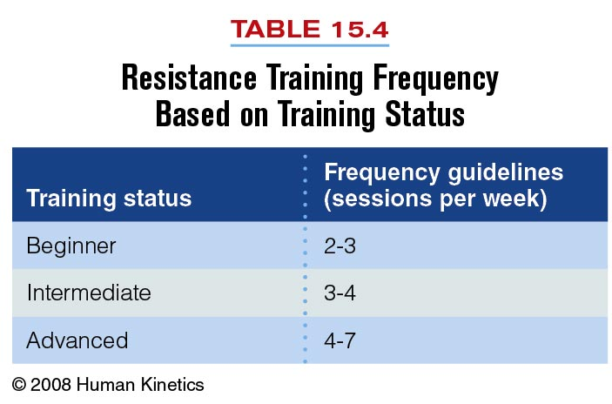
NASA Fitness
Essentials of Strength Training and Conditioning - 3rd Edition

Slide 20
Step 4: Exercise Order
NASA Fitness
Exercise order is the sequence of resistance exercises performed during one training session.
Upper and Lower Body Exercises (Alternated)
  One method of providing the opportunity for individuals to recover more fully between exercises is to alternate upper body exercises with lower body exercises.
  If the exercises are performed with minimal rest periods, this method is also referred to as circuit training.
Essentials of Strength Training and Conditioning - 3rd Edition

Slide 21
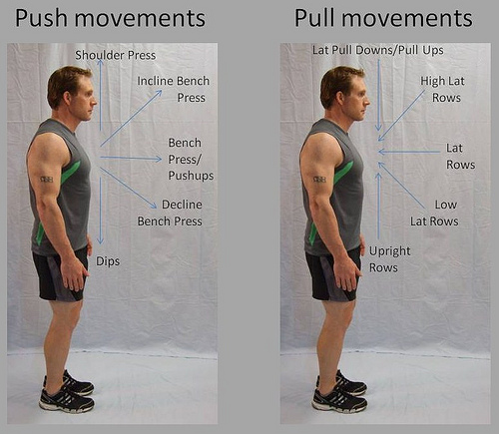
Step 4: Exercise Order
NASA Fitness
“Push” and “Pull” Exercises (Alternated)
  Another method of improving recovery and recruitment between exercises is to alternate pushing exercises (e.g., bench press, shoulder press, and triceps extension) with pulling exercises (e.g., lat pulldown, bent-over row, biceps curl).
Essentials of Strength Training and Conditioning - 3rd Edition

Slide 22

Step 5: Training Load and Repetitions (Reps)
NASA Fitness
Relationship Between Load and Repetitions
  The heavier the load, the lower the number of repetitions that can be performed.
  Load is commonly described as a percentage of a
  1-repetition maximum (1RM) or as a repetition maximum (RM).
Essentials of Strength Training and Conditioning - 3rd Edition

Slide 23
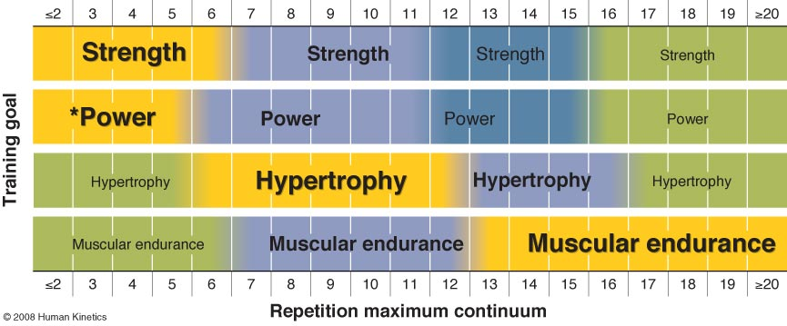
NASA Fitness
Essentials of Strength Training and Conditioning - 3rd Edition

Slide 24
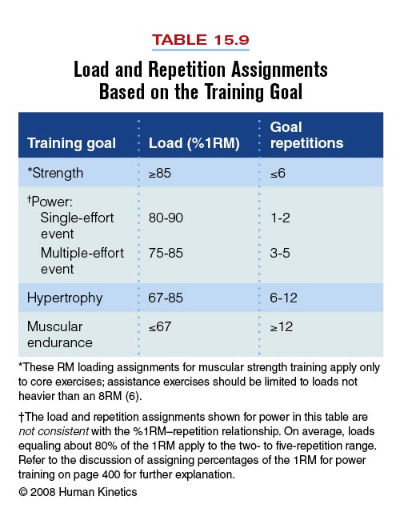
NASA Fitness
Essentials of Strength Training and Conditioning - 3rd Edition

Slide 25

Step 6: Volume
NASA Fitness
Training Status
  It is appropriate for an individual to perform only one or two sets as a beginner and to add sets as he or she becomes better trained.
Essentials of Strength Training and Conditioning - 3rd Edition

Slide 26
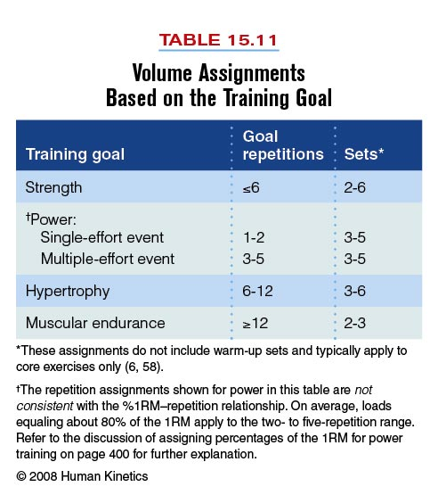
Step 6: Volume
NASA Fitness
Primary Resistance Training Goal
  Strength and Power
    Volume assignments for power training are typically lower than those for strength training in order to maximize the quality of exercise.
Essentials of Strength Training and Conditioning - 3rd Edition

Slide 27
Step 6: Volume
NASA Fitness
Primary Resistance Training Goal
  Hypertrophy
    Increases in muscular size are associated with higher training volumes and performing three or more exercises per muscle group.
  Muscular Endurance
    Programs for muscular endurance involve many repetitions (12 or more) per set, lighter loads, and fewer sets.
Essentials of Strength Training and Conditioning - 3rd Edition

Slide 28
Step 7: Rest Periods
NASA Fitness
The time dedicated to recovery between sets and exercises is called the rest period or interset rest.
The length of the rest period between sets and exercises is highly dependent on the goal of training, the relative load lifted, and the athlete’s training status.
Essentials of Strength Training and Conditioning - 3rd Edition

Slide 29
Step 7: Rest Periods
NASA Fitness
Strength and Power
  Maximal or near-maximal loads require longer rest periods.
  Guidelines range from 2 to 5 minutes.
Hypertrophy
  Short to moderate rest periods are required.
  Typical strategies range from 30 seconds to 1.5 minutes.
Muscular Endurance
  Very short rest periods of 30 seconds or less are required.
Essentials of Strength Training and Conditioning - 3rd Edition

Slide 30
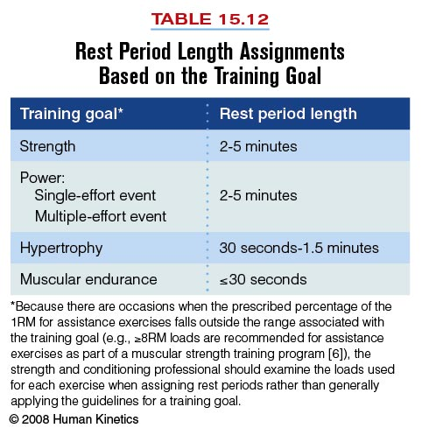
Step 7: Rest Periods
NASA Fitness
Essentials of Strength Training and Conditioning - 3rd Edition

Slide 31
Questionnaire
NASA Fitness
T Periodization involves progressive cycling of various aspects of a training program during a specific period of time.
T General Adaptation Syndrome is the body’s reaction and adaptation to stress.
F Training age is the same thing as the chronological age of a person.
T The general guideline is to schedule training sessions so that there is at least one rest or recovery day—but not more than three—between sessions that stress the same muscle groups.
F The heavier the load, the higher number of repetitions that can be performed.

Slide 32

Questions?
NASA Fitness

