Slide 1
CHAPTER 1:
Introduction

Slide 2
Why “Learn”?
Machine learning is programming computers to optimize a performance criterion using example data or past experience.
There is no need to “learn” to calculate payroll
Learning is used when:
  Human expertise does not exist (navigating on Mars),
  Humans are unable to explain their expertise (speech recognition)
  Solution changes in time (routing on a computer network)
  Solution needs to be adapted to particular cases (user biometrics)

Slide 3
What We Talk About When We Talk About“Learning”
Learning general models from a data of particular examples
Data is cheap and abundant (data warehouses, data marts); knowledge is expensive and scarce.
Example in retail: Customer transactions to consumer behavior:
  People who bought “Da Vinci Code” also bought “The Five People You Meet in Heaven” (www.amazon.com)
Build a model that is a good and useful approximation to the data.

Slide 4
Data Mining/KDD
Definition := “KDD is the non-trivial process of identifying valid, novel, potentially useful, and ultimately understandable patterns in data” (Fayyad)
Applications:
Retail: Market basket analysis, Customer relationship management (CRM)
Finance: Credit scoring, fraud detection
Manufacturing: Optimization, troubleshooting
Medicine: Medical diagnosis
Telecommunications: Quality of service optimization
Bioinformatics: Motifs, alignment
Web mining: Search engines
...

Slide 5
What is Machine Learning?
Machine Learning
  Study of algorithms that
  improve their performance
  at some task
  with experience
Optimize a performance criterion using example data or past experience.
Role of Statistics: Inference from a sample
Role of Computer science: Efficient algorithms to
  Solve the optimization problem
  Representing and evaluating the model for inference

Slide 6
Growth of Machine Learning
Machine learning is preferred approach to
  Speech recognition, Natural language processing
  Computer vision
  Medical outcomes analysis
  Robot control
  Computational biology
This trend is accelerating
  Improved machine learning algorithms
  Improved data capture, networking, faster computers
  Software too complex to write by hand
  New sensors / IO devices
  Demand for self-customization to user, environment
  It turns out to be difficult to extract knowledge from human experts → failure of expert systems in the 1980’s.

Slide 7
Applications
Association Analysis
Supervised Learning
  Classification
  Regression/Prediction
Unsupervised Learning
Reinforcement Learning

Slide 8
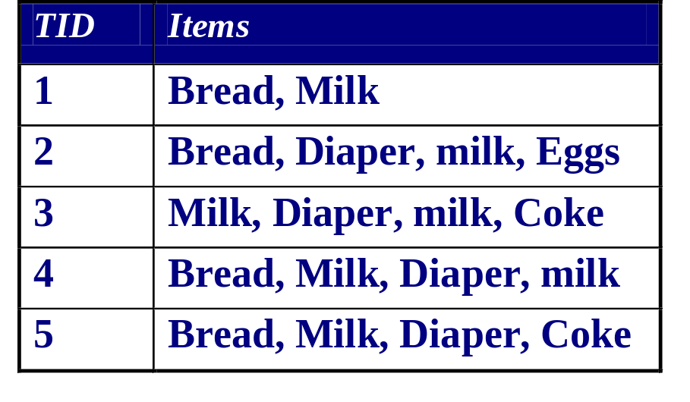
Learning Associations
Basket analysis:
P (Y | X ) probability that somebody who buys X also buys Y where X and Y are products/services.
Example: P ( chips | coke) = 0.7
Example of Market-Basket transactions

Slide 9
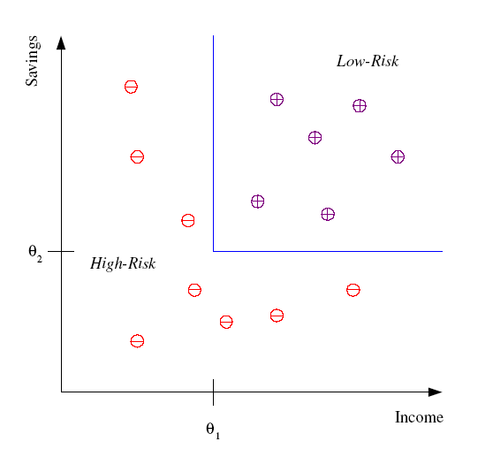
Classification
Example:
Credit scoring
Differentiating between low-risk and high-risk customers from their income and savings
Discriminant: IF income > θ₁ AND savings > θ₂
THEN low-risk ELSE high-risk
Model

Slide 10
Classification: Applications
Pattern recognition
Aka:
Face recognition: Pose, lighting, occlusion (glasses, beard), make-up, hair style
Character recognition: Different handwriting styles.
Speech recognition: Temporal dependency.
  Use of a dictionary or the syntax of the language.
  Sensor fusion: Combine multiple modalities; eg, visual (lip image) and acoustic for speech
Medical diagnosis: From symptoms to illnesses
Web Advertizing: Predict if a user clicks on an ad on the Internet.

Slide 11








Face Recognition
Training examples of a person
Test images
AT&T Laboratories, Cambridge UK
http://www.uk.research.att.com/facedatabase.html

Slide 12
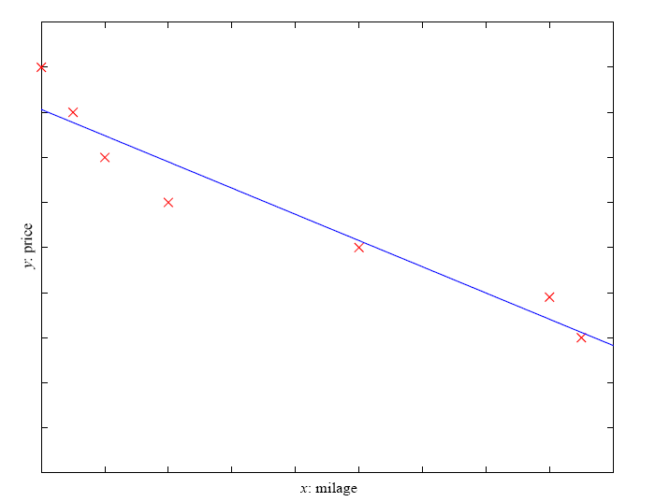
Prediction: Regression
Example: Price of a used car
x : car attributes
y : price
y = g (x | θ )
g ( ) model,
θ parameters
y = wx+w₀
Y: Price
X : mileage

Slide 13
Regression Applications
Navigating a car: Angle of the steering wheel (CMU NavLab)
Kinematics of a robot arm
(x,y)
α₁= g₁(x,y)
α₂= g₂(x,y)
α₂
α₁

Slide 14
Supervised Learning: Uses
Example: decision trees tools that create rules
Prediction of future cases: Use the rule to predict the output for future inputs
Knowledge extraction: The rule is easy to understand
Compression: The rule is simpler than the data it explains
Outlier detection: Exceptions that are not covered by the rule, e.g., fraud

Slide 15
Unsupervised Learning
Learning “what normally happens”
No output
Clustering: Grouping similar instances
Other applications: Summarization, Association Analysis
Example applications
  Customer segmentation in CRM
  Image compression: Color quantization
  Bioinformatics: Learning motifs

Slide 16
Reinforcement Learning
Topics:
  Policies: what actions should an agent take in a particular situation
  Utility estimation: how good is a state (→used by policy)
No supervised output but delayed reward
Credit assignment problem (what was responsible for the outcome)
Applications:
  Game playing
  Robot in a maze
  Multiple agents, partial observability, ...

Slide 17
Resources: Datasets
UCI Repository: http://www.ics.uci.edu/~mlearn/MLRepository.html
UCI KDD Archive: http://kdd.ics.uci.edu/summary.data.application.html
Statlib: http://lib.stat.cmu.edu/
Delve: http://www.cs.utoronto.ca/~delve/

Slide 18
Resources: Journals
Journal of Machine Learning Research www.jmlr.org
Machine Learning
IEEE Transactions on Neural Networks
IEEE Transactions on Pattern Analysis and Machine Intelligence
Annals of Statistics
Journal of the American Statistical Association
...

Slide 19
Resources: Conferences
International Conference on Machine Learning (ICML)
European Conference on Machine Learning (ECML)
Neural Information Processing Systems (NIPS)
Computational Learning
International Joint Conference on Artificial Intelligence (IJCAI)
ACM SIGKDD Conference on Knowledge Discovery and Data Mining (KDD)
IEEE Int. Conf. on Data Mining (ICDM)

Slide 20
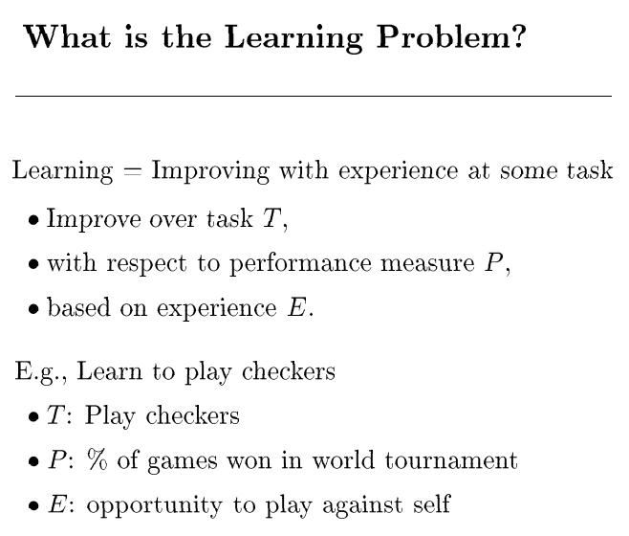

From book: Machine Learning, Tom Mitchel

