Slide 1

Anaerobic Training
NASA Fitness
March 28, 2016
Week 1 / 4

Slide 2
Overview
NASA Fitness
What is anaerobic?
Resistance Training
Basic Principles
Health Benefits
Starting Up

Slide 3
Anaerobic
NASA Fitness
Merriam-Webster definition
  living, active, occurring, or existing in the absence of free oxygen
But… as humans, we are never without oxygen.
  Of course, there are exceptions (e.g. underwater)…
So what does anaerobic actually mean in the physiological sense?

Slide 4
Anaerobic Exercise- Physiology
NASA Fitness
Definition from the Dictionary of Sport and Exercise Science and Medicine by Churchill Livingstone
  Exercise at an intensity exceeding aerobic capacity, which therefore draws a significant fraction of its energy from ANAEROBIC sources.
  Sprints of any form, jumps and forceful throws (shotput, javelin) are examples.
  In sustained anaerobic exercise, metabolic products accumulate rapidly and cause termination of exercise after 10-120s depending on intensity.
  Also know as supramaximal exercise

Slide 5
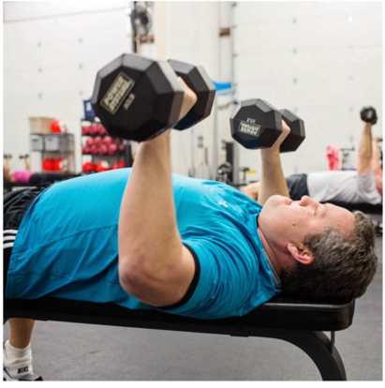
Resistance Training
NASA Fitness
The most common form of anaerobic exercise individuals participate in is resistance training/weightlifting, which is focused on in this lecture.
Another form is HIIT – high intensity interval training– which is exercise performed for short durations at high intensity.

Slide 6
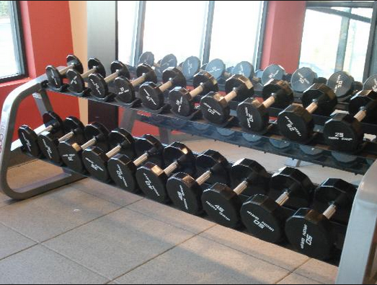
Types of Resistance Training
NASA Fitness
Free weights – a weight used in weightlifting that is not attached to an apparatus
Classic strength training tools such as dumbbells or barbells

Slide 7
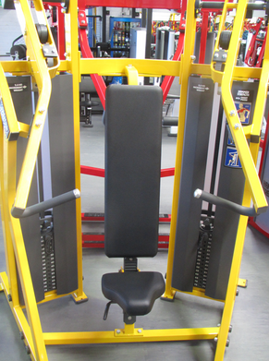
Resistance Training
NASA Fitness
Weight machines – is an exercise machine used for weight training that uses gravity as the primary source of resistance and a combination of simple machines to convey that resistance to the person using the machine.

Slide 8
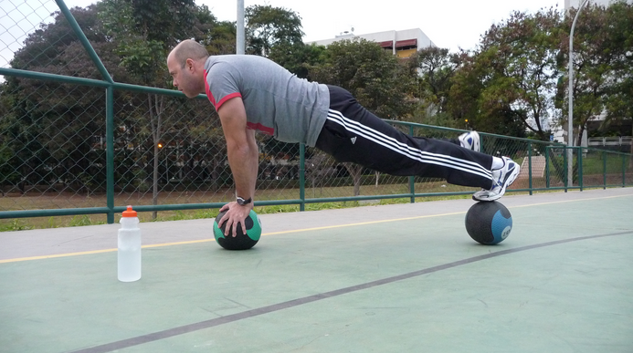
Resistance Training
NASA Fitness
Medicine balls – a large, heavy solid weighted ball thrown and caught for exercise

Slide 9
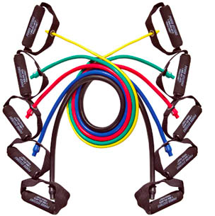
Resistance Training
NASA Fitness
Resistance bands – similar to giant rubber bands – these provide resistance when stretched. They are portable and can be adapted to most workouts. The bands provide continuous resistance throughout a movement

Slide 10
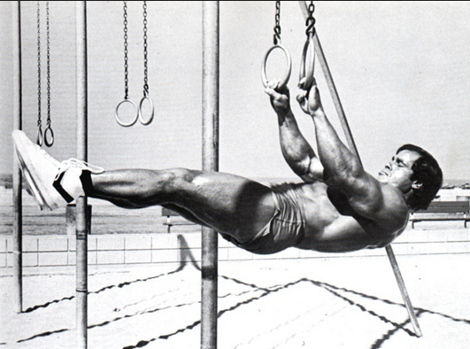
Resistance Training
NASA Fitness
Your own body weight – can be used for squats, push-ups and chin-ups. Using your own body weight is convenient, especially when travelling or at work.

Slide 11
Resistance Training Health Benefits
NASA Fitness
Improved muscle strength and tone – to protect your joints from injury. It also helps you maintain flexibility and balance and helps you remain independent as you age
Weight management and increased muscle-to-fat ratio – as you gain muscle, your body burns more calories when at rest (increases resting metabolic rate)

Slide 12
Resistance Training Health Benefits
NASA Fitness
Greater stamina – as you grow stronger, you won’t get tired as easily
Prevention or control of chronic conditions such as diabetes, heart disease, arthritis, back pain, depression and obesity
Pain management

Slide 13
Resistance Training Health Benefits
NASA Fitness
Improved mobility and balance
Improved posture
Decreased risk of injury
Increased bone density and strength and reduced risk of osteopenia and osteoporosis
Improved sense of wellbeing – resistance training may boost self-confidence, improve body image and mood
Enhanced performance of everyday tasks.

Slide 14
Resistance Training-Basic Principles
NASA Fitness
Exercise – a particular movement, for example a calf-raise, is designed to strengthen a particular muscle or group of muscles.
Repetitions or ‘reps’ – refer to the number of times you continuously repeat each exercise in a set.
Set – is a group of repetitions performed without resting, for example, two sets of squats by 15 reps would mean you do 15 squats then rest muscles before doing another 15 squats.

Slide 15
Resistance Training-Basic Principles
NASA Fitness
Rest – you need to rest between sets. Rest periods vary depending on the intensity of exercise being undertaken.
Variety – switching around your workout routine, such as regularly introducing new exercises, challenges your muscles and forces them to adapt and strengthen.
Recovery – muscle needs time to repair and adapt after a workout. A good rule of thumb is to rest the muscle group for at up to 48 hours before working the same muscle group again.

Slide 16
Resistance Training-Starting Up General Recommendations
NASA Fitness
It is important to pay attention to safety and good form to reduce the risk of injury. A registered exercise professional can help you develop a safe, effective program.
To start, a typical beginner’s strength training program involves:
  eight to 10 exercises that work the major muscle groups of the body and are performed two to three times every week
  beginning with one set of each exercise, comprising as few as eight repetitions (reps), no more than twice a week.

Slide 17
Resistance Training-Starting Up
NASA Fitness
Your aim is to gradually increase to two to three sets for each exercise – comprising eight to 12 reps, every second or third day. Once you can comfortably do 12 reps of an exercise, you should look at progressing further.

Slide 18
Questionnaire
NASA Fitness
T Anaerobic means “without oxygen”.
F Long endurance events such a half marathon is a form of anaerobic training/exercise.
T Resistance training may increase bone density and reduce the risk of osteopenia or osteoporosis.
F When doing resistance exercise training, it is recommended that an individual does not rest to maximize performance outcomes.
F Only a well-seasoned “gym-goer” should participate in resistance training.

Slide 19

Questions?
NASA Fitness

