Slide 1

Topic labelling using Recurrent Neural Networks
pragya(1AM17CS135)
PURV H JEJA(1AM17CS143)
VAIBHAV RATHORE(1AM17CS205)
Under the guidance of:
Mrs. Sri vidhya vr.

Slide 2
Topic LABELING?

Slide 3
What happens When we search something on Google?

Slide 4


Slide 5
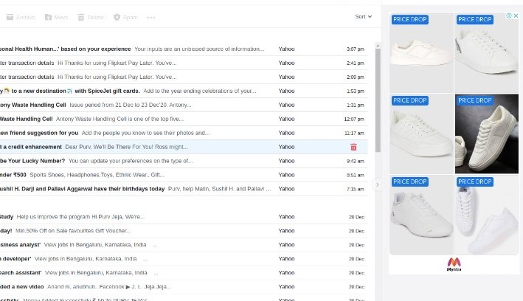

Slide 6


Slide 7
OUR PROJECT
Topic analysis is a Natural language processing (NLP) technique that allows us to automatically extract meaning from texts by identifying recurrent themes or topics.
Topic analysis models are able to detect topics in a text with advanced machine learning algorithms that count words and find and group similar word patterns.
It uses Natural language processing (NLP) to break down human language so that you can find patterns and unlock semantic structures within texts to extract insights and help make data-driven decisions.
The main aim of our project is to extract the keywords from the documents which are being repeated using RNN (Recurrent Neural Network).

Slide 8
WORKING
The way these machine learning algorithms work is by assuming that each document is composed of a mixture of topics, and then trying to find out how strong a presence each topic has in a given document. This is done by grouping together the documents based on the words they contain, and noticing correlations between them.
The way this works is by directly programming a set of hand-made rules based on the content of the documents that a human expert actually read. The idea is that the rules represent the codified knowledge of the expert, and are able to discern between documents of different topics by looking directly at semantically relevant elements of a text, and at the metadata that a document may have. Each one of these rules consists of a pattern and a prediction (in this case, a predicted topic).

Slide 9
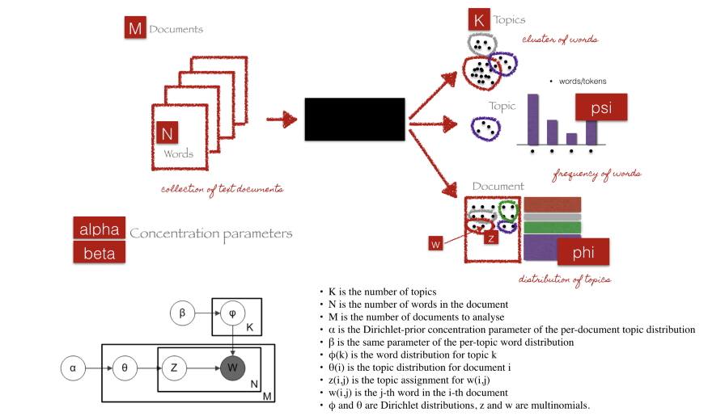
LDA : HOW IT WORKS?

Slide 10
EXISTING SYSTEM
Topic analysis (also called topic detection, topic modeling, or topic extraction) is a machine learning technique that organizes and understands large collections of text data, by assigning “tags” or categories according to each individual text’s topic or theme.
When it comes to analyzing huge amounts of text data, it’s just too big a task to do manually. It’s also tedious, time-consuming, and expensive. Manually sorting through large amounts of data is more likely to lead to mistakes and inconsistencies. Plus, it doesn’t scale well.

Slide 11
FUTURE IMPLEMENTATION
Businesses generate and collect massive amounts of data every day. Analyzing and processing this data using automated topic analysis methods will help businesses make better decisions, optimize internal processes, identify trends, and provide all sorts of other advantages to make them more efficient and productive.
Automated topic analysis is based on Natural language processing (NLP) – a combination of statistics, computational linguistics, and computer science – so you can expect high-quality results with unsurpassed accuracy.
Topic analysis helps businesses become more efficient by saving time on repetitive manual tasks and gathers insights from the text data they manage on a daily basis.

Slide 12
Literature survey
Authors | Title | Technology Used | Output
Landauer, Foltz (1998) | An Introduction to Latent Semantic Analysis | Singular‐value decomposition | A new method for automatic indexing and retrieval.
Blei, Ng and Jordan, (2003) | Latent Dirichlet Allocation | Latent Dirichlet Allocation | Short representations of the discrete data.

Slide 13


