Slide 1
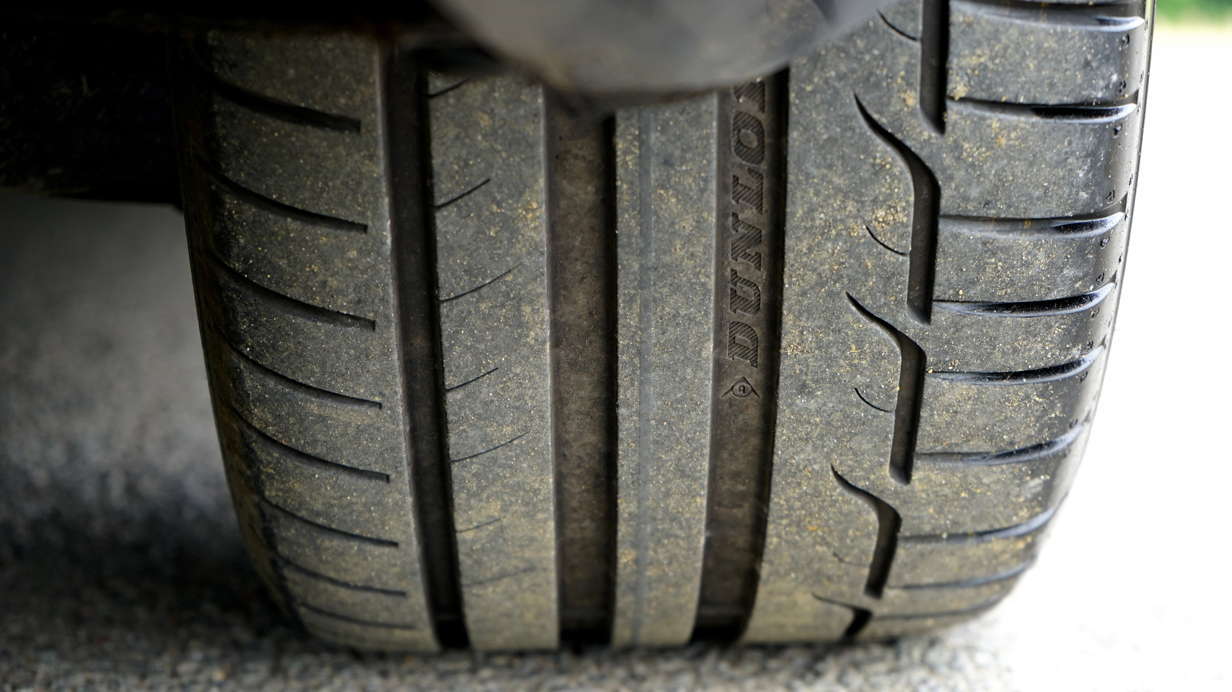
TIRES ON HIGHWAY
Developing an AI-Driven Model to
Assess Tire Condition through Toll
Plaza Images.

Slide 2
AGENDA
INTRODUCTION
PLAN FOR PROJECT
TECH ARCHITECTURE
WEB INTERFACES

Slide 3
Project Management Infographics
Laying The Foundation
AI/ML Model
Designing the architecture,selecting technology stack,and creating a roadmap for development.
Analyzes images to provide feedback on tire condiction.
PLAN FOR PROJECT
Project Execution
Deployment.
Web Apps
The setup of the TiresOnHighway web apps.
Project Monitoring and controlling and completing
Ensure project runs smoothly without any issues

Slide 4
Technology Stacks
Frontend
Backend
Database
ML Model
MongoDB
Express.js
Node.js
Flask
CNN(convolutional neural network)
React
Bootstrap
HTML
CSS JS

Slide 5
Interfaces Involved
USER INTERFACE
WEB APP
Report of the tire and details of vechile
TOLL PLAZA INTERFACE
Uploading Photos
TIRE DEALER INTERFACE
List of records generated by model

Slide 6
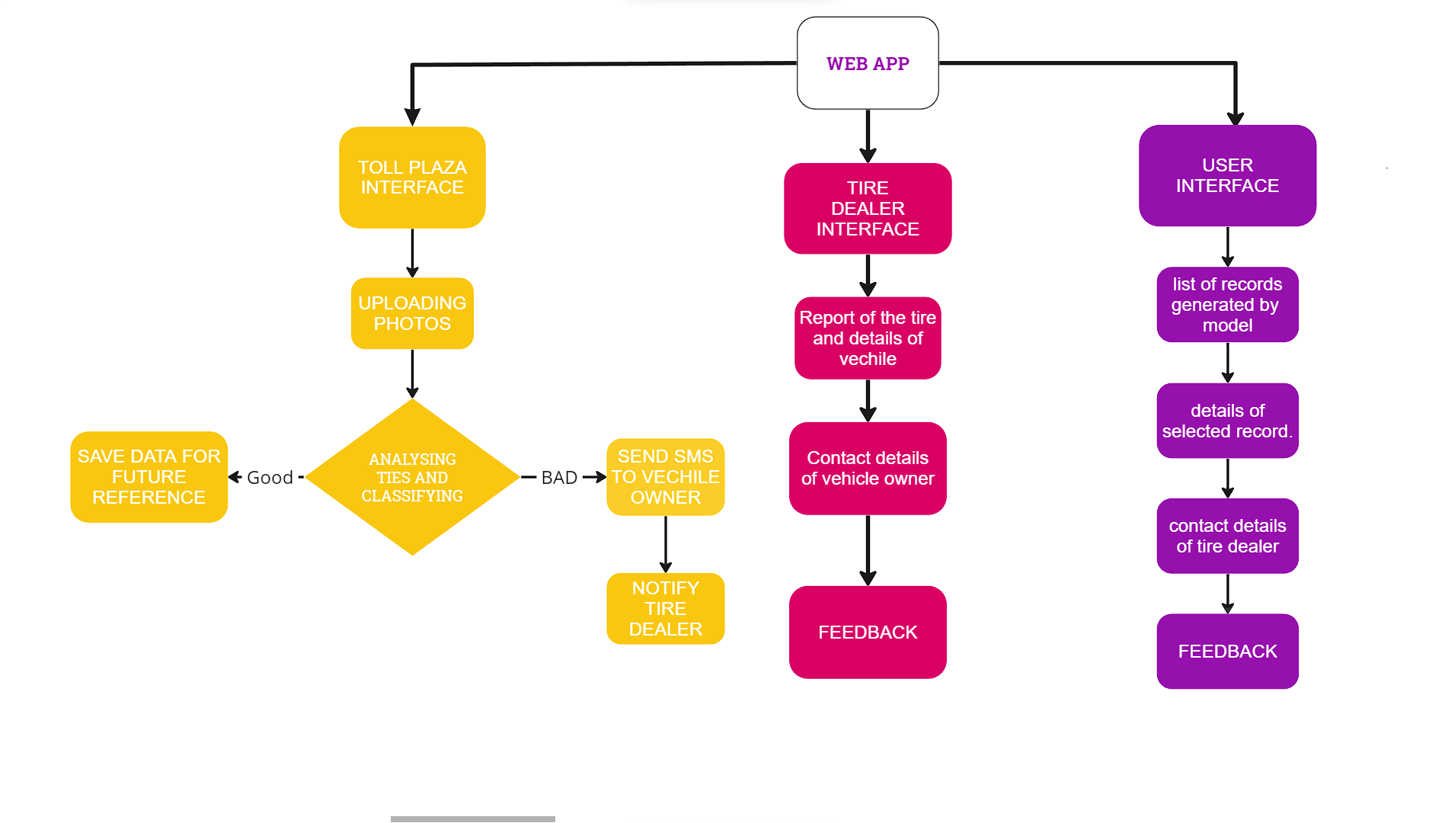
WEB APP INTERFACE FLOWCHART

Slide 7
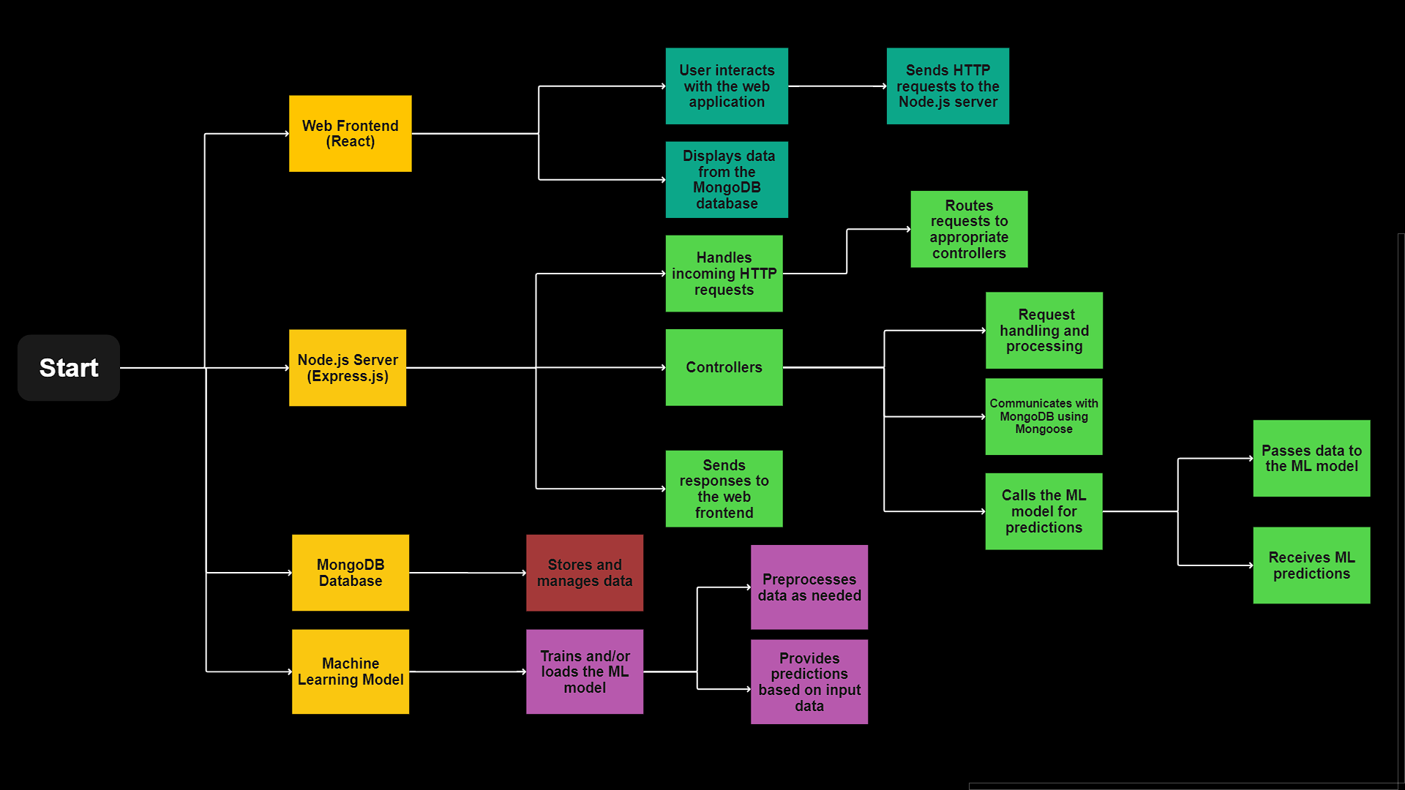
TECH ARCHITECTURE

Slide 8
INTERFACES

Slide 9
Project Management Infographics
Step 01
Step 02
Step 03
Step 04
Mercury is the closest planet to the Sun
Despite being red, Mars is a cold place
Jupiter is a gas giant and the biggest planet
Neptune is the farthest planet from the Sun

Slide 10
Project management infographics
Saturn
Jupiter
Venus
Mercury
Mars
Saturn is a gas giant made of hydrogen and helium
Jupiter is a gas giant and the biggest planet
Venus is the second planet from the Sun
Mercury is the smallest planet in the Solar System
Despite being red, Mars is actually a cold place

Slide 11
Project management infographics
Saturn
Mars
Saturn is a gas giant composed mostly of hydrogen and helium
Despite being red, Mars is a cold place full of iron oxide dust
Jupiter
Venus
Mercury
Jupiter is a gas giant and the biggest planet in the Solar System
Venus has a beautiful name, but it is terribly hot there
Mercury is the smallest planet in the Solar System

Slide 12
Project Management Infographics
Saturn
Mercury
Saturn is a gas giant made of hydrogen and helium
Mercury is the smallest planet in the Solar System
Jupiter
Neptune
Jupiter is a gas giant and the biggest planet
Neptune is the farthest planet from the Sun

Slide 13
Project Management Infographics
Mercury
Neptune
Mercury is the closest planet to the Sun and the smallest one
Neptune is the farthest planet from the Sun and the fourth-largest
Mercury
Saturn
Earth
Despite being red, Mars is a cold place full of iron oxide dust
Earth is the third planet from the Sun and the only one that harbors life

Slide 14
Project Management Infographics
Jan
Feb
Mercury
Neptune
Mercury is the closest planet to the Sun and the smallest one
Neptune is the farthest planet from the Sun and the fourth-largest one
Mars
Earth
Despite being red, Mars is a cold place full of iron oxide dust
Earth is the third planet from the Sun and the only one that harbors life
Mar
Apr

Slide 15
Project Management Infographics
Neptune is the farthest planet from the Sun and a gas giant
Neptune
Mercury
Mercury is the closest planet to the Sun and the smallest one
Earth is the third planet from the Sun and the one that harbors life
Earth
Mars
Despite being red, Mars is a cold place full of iron oxide dust
Jupiter is a gas giant and the biggest planet in the Solar System
Jupiter

Slide 16
Project Management Infographics
01
02
03
04
Mercury is the closest planet to the Sun
Despite being red, Mars is a cold place
Jupiter is a gas giant and the biggest planet
Neptune is the farthest planet from the Sun

Slide 17
Project Management Infographics
Neptune
Mercury
Item 2
Neptune is the farthest planet from the Sun and a gas giant
Mercury is the closest planet to the Sun and the smallest
Item 1
2023
Item 3
Earth
Mars
Earth is the third planet from the Sun
Item 4
Despite being red, Mars is actually a cold place

Slide 18
Project Management Infographics
Why 1
Mercury is the closest to the Sun and the smallest
Why 2
Venus is the second planet from the Sun
Why 3
Despite being red, Mars is a cold place
Why 4
Jupiter is the biggest planet in the Solar System
Why 5
Saturn is composed of hydrogen and helium

Slide 19
Project Management Infographics
Neptune
Neptune is the farthest planet from the Sun and a gas giant
Mars
Despite being red, Mars is a very cold place full of iron oxide dust
Earth
Earth is the third planet from the Sun and the only one that harbors life
Jupiter
Jupiter is a gas giant and the biggest planet in the Solar System

Slide 20
Project Management Infographics
Neptune
Mercury
Neptune is the farthest planet from the Sun and a gas giant
Mercury is the closest planet to the Sun
Earth
Mars
Earth is the third planet from the Sun
Despite being red, Mars is actually a cold place
Jupiter
Jupiter is a gas giant and the biggest planet of them all

Slide 21
Project Management Infographics
Neptune
Neptune is the farthest planet from the Sun
Mars
Despite being red, Mars is a very cold place
Saturn
Saturn is composed of hydrogen and helium
Mercury
Mercury is the closest planet to the Sun

Slide 22
Project management infographics
Saturn
Mercury
Saturn is a gas giant made of hydrogen and helium
Mercury is the smallest planet in the Solar System
Jupiter
Neptune
Jupiter is a gas giant and the biggest planet
Neptune is the farthest planet from the Sun
Venus
Mars
Venus is the second planet from the Sun
Despite being red, Mars is actually a cold place

Slide 23
Planet Jupiter is a gas giant and also the biggest one in the Solar System
Task 1
Project Management Infographics
Mercury is the closest to the Sun and the smallest one in the Solar System
Task 2
Venus has a beautiful name and is the second planet from the Sun. It’s terribly hot—even hotter than Mercury—and its atmosphere is extremely poisonous. It’s the second-brightest natural object in the night sky after the Moon
Despite being red, Mars is a very cold place full of iron oxide dust
Task 3
Earth is the third planet from the Sun and the only one that harbors life

Slide 24
Project Management Infographics
Option 1
Option 2
Option 3
Option 4
Mars
Jupiter
Saturn
Neptune
Despite being red, Mars is actually a cold place
Jupiter is a gas giant and the biggest planet
Saturn is a gas giant and has several rings
Neptune is the farthest planet from the Sun

Slide 25
Project Management Infographics
Day 1
Neptune
Mercury
Neptune is the farthest planet from the Sun and a gas giant
Mercury is the closest planet to the Sun
Day 4
Day 2
Earth
Mars
Day 3
Earth is the third planet from the Sun
Despite being red, Mars is actually a cold place

Slide 26
Project Management Infographics
Mercury
Mercury is the smallest planet in the Solar System
Mars
Despite being red, Mars is actually a cold place
Jupiter
Jupiter is a gas giant and the biggest planet of them all
Neptune
Neptune is the farthest planet from the Sun and a gas giant
Earth
Earth is the third planet from the Sun and the one with life

Slide 27
Project Management Infographics
Despite being red, Mars is actually a cold place
Mercury is the smallest planet in the Solar System
Mars
Mercury
Saturn is composed mostly of hydrogen and helium
2023
Venus is the second planet from the Sun
Saturn
Venus
Planet Jupiter is a gas giant and the biggest one
Neptune is the farthest planet from the Sun
Jupiter
Neptune

Slide 28
Project Management Infographics
Saturn
Mercury
Saturn is composed of hydrogen and helium
Option 1
Mercury is the smallest planet in the Solar System
Option 4
Option 2
Jupiter
Neptune
Jupiter is a gas giant and the biggest planet
Option 3
Neptune is the farthest planet from the Sun

Slide 29
Project Management Infographics
Venus
Neptune
Saturn
Jupiter
Mars
Despite being red, Mars is actually a cold place
Jupiter is a gas giant and also the biggest planet
Saturn is a giant made of hydrogen and helium
Neptune is the farthest planet from the Sun
Venus is the second planet from the Sun

Slide 30
Project Management Infographics
Mercury
Mercury is the smallest planet of them all
Neptune
Neptune is the farthest planet from the Sun
Saturn
Saturn is composed of hydrogen and helium
Jupiter
Jupiter is a gas giant and the biggest planet
Mars
Despite being red, Mars is a very cold place
Venus
Venus is the second planet from the Sun

Slide 31
Project Management Infographics
Planet Saturn is a gas giant composed mostly of hydrogen and helium
01
Saturn
Mercury is the smallest planet in the Solar System and the closest to the Sun
02
Mercury
Despite being red, Mars is a very cold place full of iron oxide dust
03
Mars
Venus has a beautiful name and is the second planet from the Sun
04
Venus

Slide 32
Instructions for use
In order to use this template, you must credit Slidesgo and Freepik in your final presentation and include links to both websites.
You are allowed to:
- Modify this template.
- Use it for both personal and commercial projects.
You are not allowed to:
- Sublicense, sell or rent any of Slidesgo Content (or a modified version of Slidesgo Content).
- Distribute Slidesgo Content unless it has been expressly authorized by Slidesgo.
- Include Slidesgo Content in an online or offline database or file.
- Offer Slidesgo templates (or modified versions of Slidesgo templates) for download.
- Acquire the copyright of Slidesgo Content.
For more information about editing slides, please read our FAQs or visit Slidesgo School:
https://slidesgo.com/faqs and https://slidesgo.com/slidesgo-school

Slide 33
Infographics
You can add and edit some infographics to your presentation to show your data in a visual way.
Choose your favourite infographic and insert it in your presentation using Ctrl C + Ctrl V or Cmd C + Cmd V in Mac.
Select one of the parts and ungroup it by right-clicking and choosing “Ungroup”.
Change the color by clicking on the paint bucket.
Then resize the element by clicking and dragging one of the square-shaped points of its bounding box (the cursor should look like a double-headed arrow). Remember to hold Shift while dragging to keep the proportions.
Group the elements again by selecting them, right-clicking and choosing “Group”.
Repeat the steps above with the other parts and when you’re done editing, copy the end result and paste it into your presentation.
Remember to choose the “Keep source formatting” option so that it keeps the design. For more info, please visit Slidesgo School.

