Slide 1












..
tlllllllll
uerly
c₋
-
-<..
A Web3 Query Mangement system
v V V v
\I

Slide 2
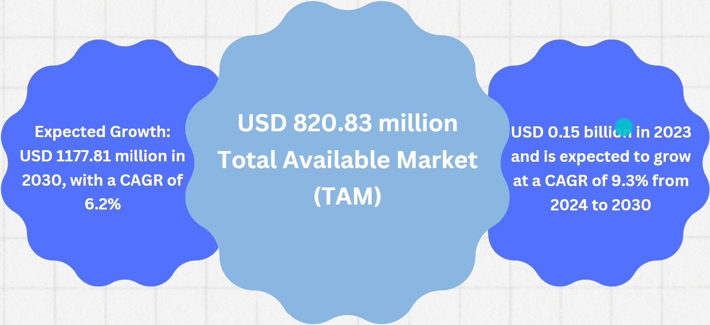
SIZE OF MARKET

Slide 3


Market go-to-plan
PRE-LAUNCH
/ 1 ' -
Offer f lex ible subsc ription o ptions in popular tokens.
Online campaigns
PUBLIC LAUNCH
I
•
GROWTH PERIOD
:ffe

Slide 4



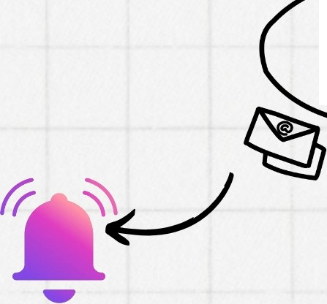
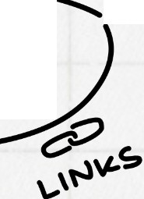





MASCOTS & IRL EVENTS
( Giving a face to the brand to connect with people andlaunch events wearing such costumes to bring
COMMUNITY
Collaborations
hype towards brand)
It
Partnership
_;1'
'-- @
ei.>T SE
Partner with Crypto based
wallets & applications
MAR\cETING
strate9
•
₋-
B
. . ..· .
·., MEDIA ,]····
ONLINE CAMPAIGNS ?OCIA._L' \ \
f
COMMUNITY CHALLENGES
CHATS & NOTIFICATION
s
j., -'".. • /
".·•"

Slide 5
Product Interface

Slide 6
















uu
I
...
•
v v v v
1\ 1\ /\ 1\

