Slide 1












..
tllllll
uerly
c₋
-
-<,
A Web3 Query Mangement system
v V V v
\I

Slide 2

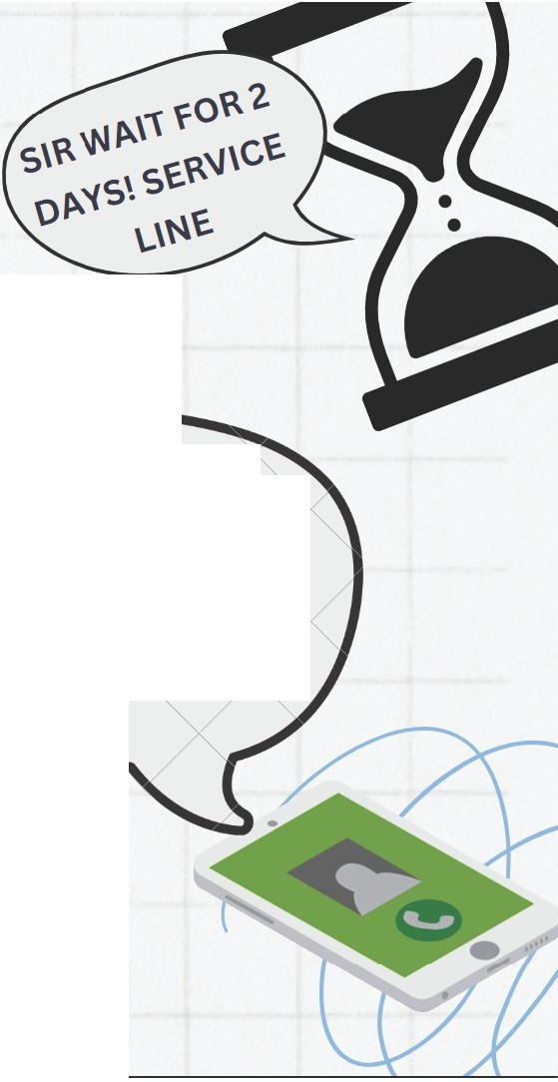


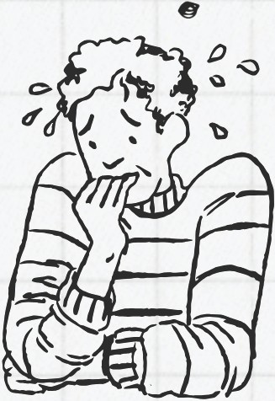



?
My problem is not listed in chat - service!!
MESSAGE ovER
987XXXXXX AND GET
•
U R QU·ER)'(SOLVED
/

Slide 3

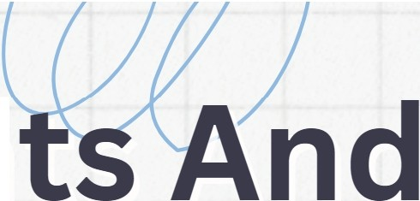


- ain Poin
Gaps
Web2 chatbots rely on pre-set questions that hinder their
ability to resolve complex queries,
leads to unresolved
•issues.
Centralized Web2 systems' demand for excessive personal data compromises user privacy,and
raises security concerns.
T raditional ticketing systems f rustrate custo mers w it h
Long wait times
ineffective solutions, reducing trust in
companies' service
z• 2· 11

Slide 4






Adaptabil ity
Persistance
How Querly Solves The Problem?
Our Al-driven Web3 chatbot dynamically adapts to each user's unique needs.
This approach enables swift and accurate solutions to user queries.
PUSH Protocol­ powered live chat system relmaglnes assets, offerln& direct and efficient communication.
Opportunities
Privacy
Our SDK offers seamless Integration for diverse protocols and projects across Web3.
It enables easy enhancement of user support and enaaaement for var ous platforms.
Our decentralized platform minimizes personal data requirements,safeguarding user privacy.
On-chain storage ensures a secure, transparent support experience.

Slide 5


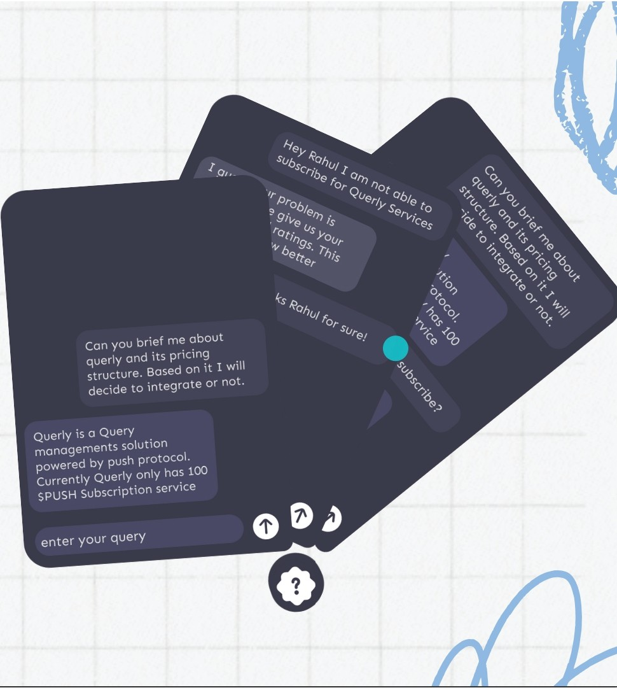
u
u
\
-ow it works?
One-click integration for seamless setup and immediately get accessed to quer ly
c hatbot.
Quick live chat support w ith real human agents for complex q ueries that requir e personalized assistance.
Organization-specific f orums fo r efficient
q uery management, know ledge s haring, and community -driven problem-solving.
v v v

Slide 6




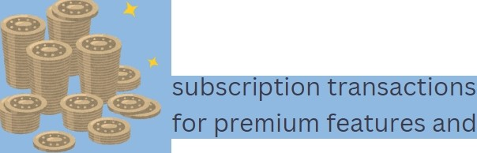




u v van ed chatbot powered by
Fu Uy on-chain architecture ensuring transparency, immutability, and decentralized operation of all chatbot interactions and
• 1-•
state-of-the-art Llama3 language model, Delivering intelligent Nuanced responses for
superior user experience in the
')
,
(
user data management.
Web3 space.
Technology
...------..,J
Integrated cryptocurrency payment gateway
enabling seamless
Seamless integration of Push protocol for both bot chat and live chat functionalities, enabling real-time, decentralized messaging and notificat ions across Web3 platforms
exclusive content access.
v

Slide 7







() VU \
Project Progress
+
+
+
+
+
01
Chat bot system and training
02
Smart contract development and testing
03
Bot server and backend system
04
Frontend UI
05
Integration of Push ecosystem
06
Final Checks &
Deploy
v

Slide 8
Product Interface

Slide 9
















uu
I
...
•
v v v v
f\ 1\ 1\ /\

