Slide 1
Solutions Architect Hiring Assignment
July 2nd 2019
Hae-Yeon, Hwang

Slide 2
Executive Summary
My Goal
Proposal AWS cloud architecture for early stage start-up company who trying to launch a web application on AWS
Consideration
Proof of concept (PoC) stage, but run on AWS cloud
Face a too many problem (failed in loading page at LAMP environment)
Guide a proper architecture to customer who need a clearly solution.

Slide 3
Assignment
Task #1
Trouble shoot the issue by modifying the misconfiguration generated by given CloudFormation template and load demo.html page thru ELB hostname
Task #2
Propose changes to the current implementation that would improve the reliability, security, cost, operation and performance before the project goes into production.

Slide 4







Task #1 :: Target Architecture
AWS Cloud
ap-northeast-2a
ap-northeast-2c
Internet
Gateway
VPC
10.0.0.0/16
Public subnet
Public subnet
EC2
Application
Load Balancer
EC2
10.0.0.0/24
10.0.1.0/24
Private subnet
Private subnet
10.0.2.0/24
10.0.3.0/24

Slide 5
Task #1 :: Trouble Shooting (step-by-step)
Build VPC
VPC (My VPC, 10.0.0.0/16)
Subnet (Public 1/10.0.1.0/24, Public 2/10.0.2.0/24; auto-assign IP setting)
Internet Gateway (My IG; attach to VPC)
Route Table (add route 0.0.0.0/0; subnet associations)
Security Group (VPC; Inbound Rules: HTTP/Anywhere)
Launch a EC2 and ELB/ALB
Launch EC2 (Amazon Linux AMI; VPC; Existing Security Group) Instance on Public1 and 2
LB (ApplicationLB/ELB/select AZ)
Config Routing (myTarget/healthy threshold:3/add register instance)

Slide 6
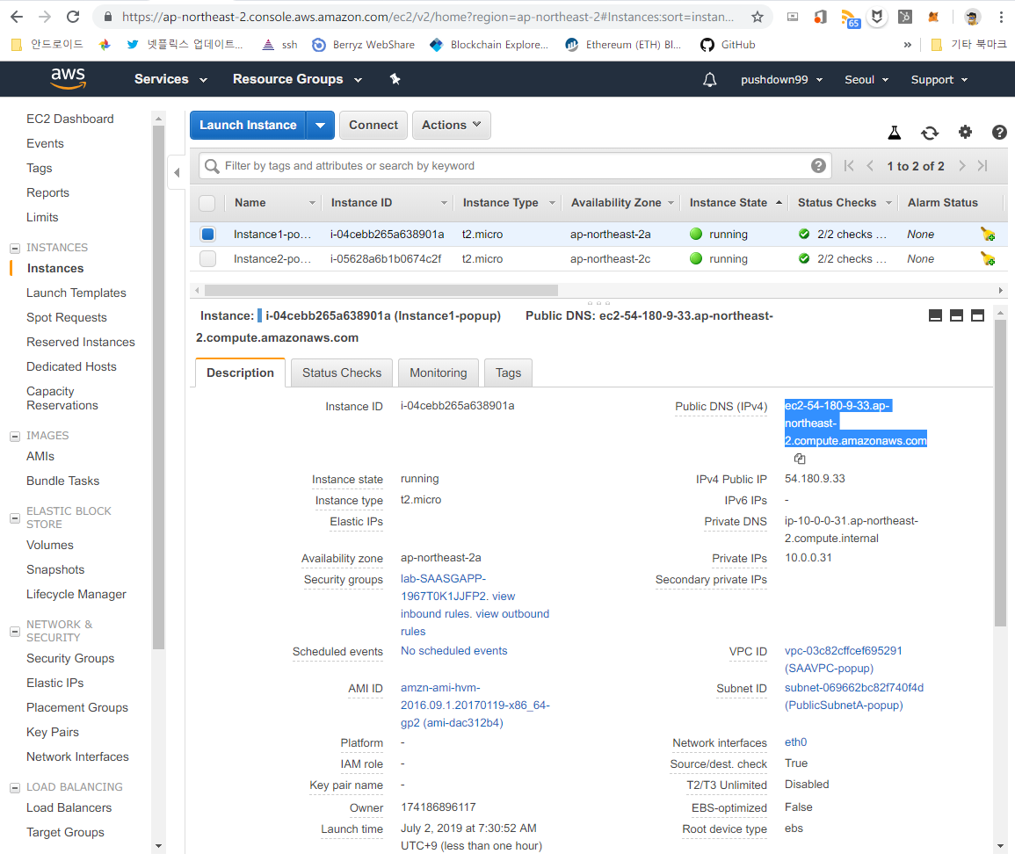
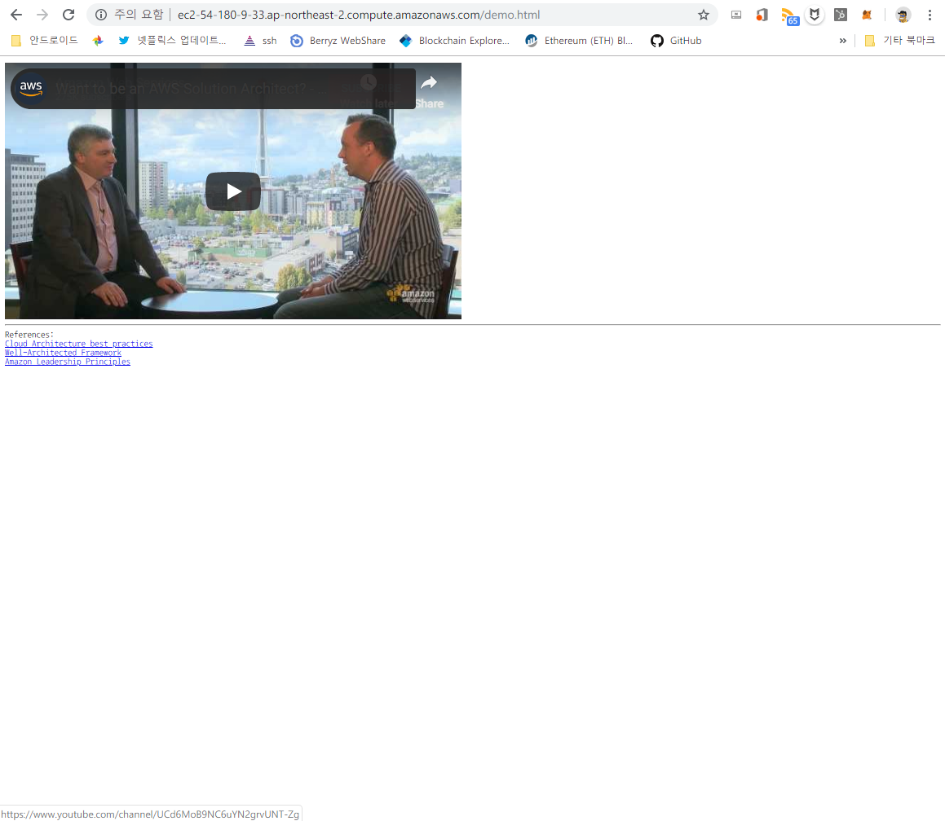
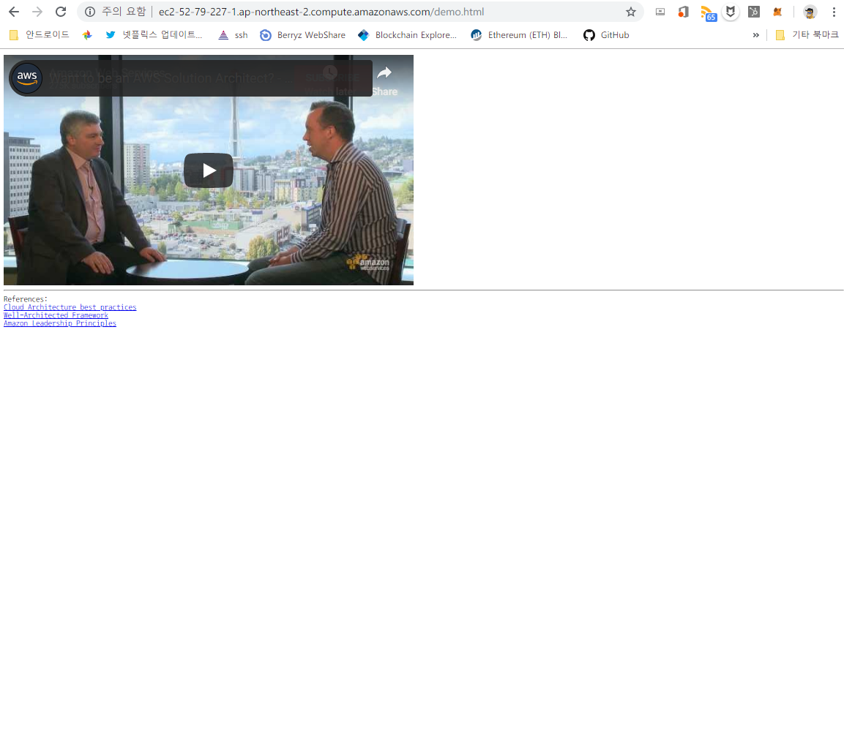
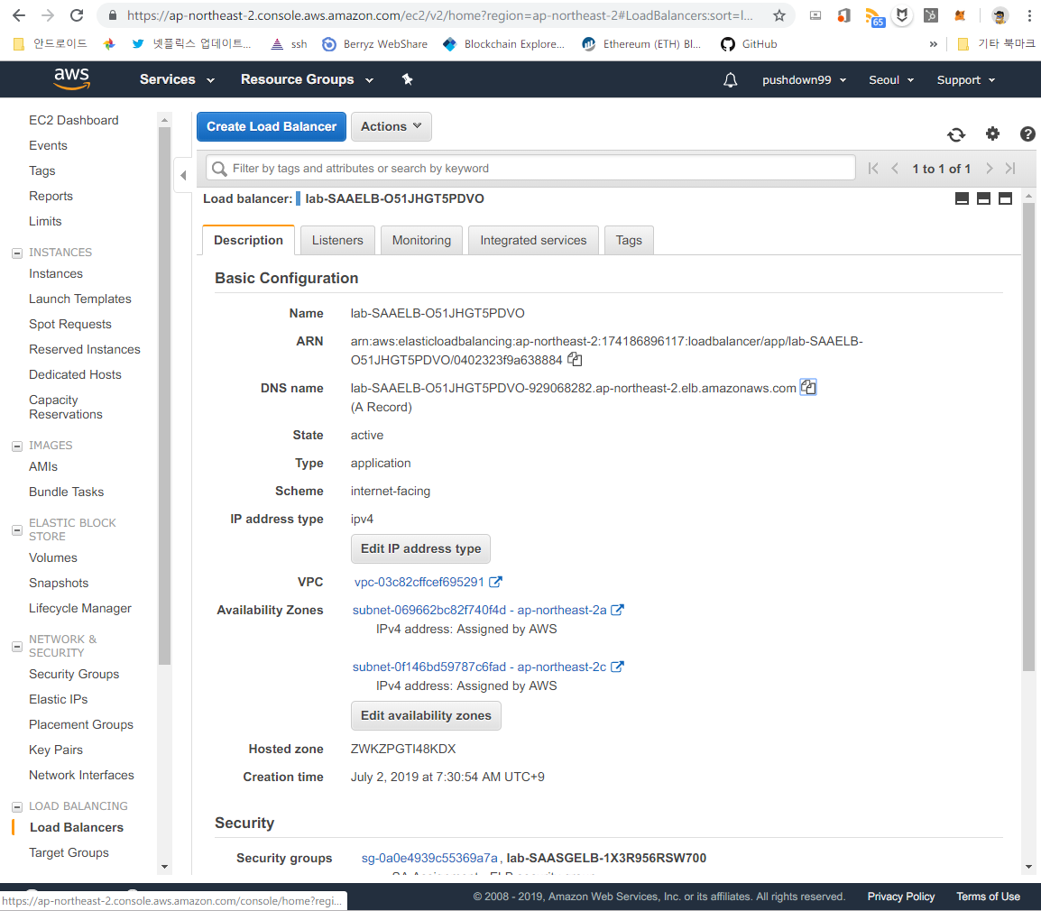
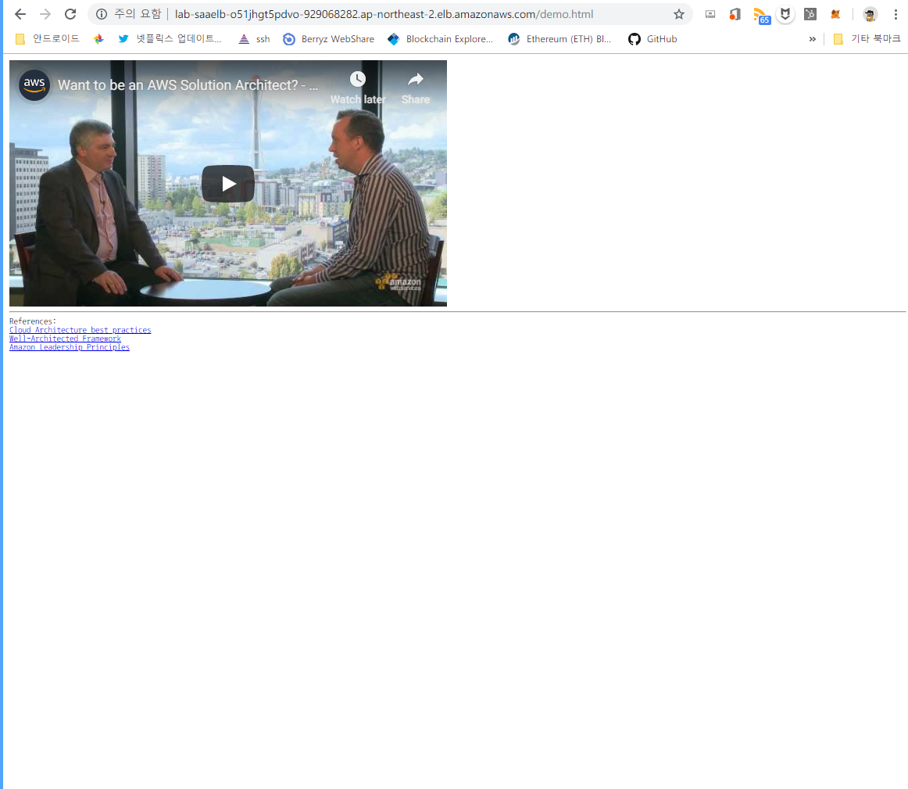
Task #1 :: Demonstration
AWS Console |  | Page (demo.html) Access
EC2
Instance#1
Public DNS
Instance#2
Public DNS
ELB
ELB (application)
DNS

Slide 7
Task #2 :: Requirements, 1/2
HA/Reliable/Robust
A Highly available architecture that resists to the failure of single component
Disaster Recovery should be considered in case of multiple components failure
A self-healing infrastructure that recovers from failed service instances
High Performance
Configure their database and data access layer for high performance and throughput
Browser very low latency even though a large portion of their user base will be from far away
Effective distribution of load regardless whether it’s http/1.1 or http/2.0 request

Slide 8
Task #2 :: Requirements, 2/2
Security
Security of data at rest and in transit
Securing access to the environment as the delivery team expands
DevOps, Operation/Maintenance
An archival strategy for inactive objects greater than 6 months
Ability to easily manage and replicate multiple environments based on their blueprint architecture.
Application lifecycle management should be considered as a DevOps strategy
Cost-effectiveness should also be considered across all components of the architecture
Access logs generated need to be collected and aggregated for visualization
Scaling to meet the demand, but with uncertainty around when and how much this demand ..

Slide 9
〇 Building VPC Procedure
VPC (My VPC, 10.0.0.0/16)
Subnet (Public 1/10.0.1.0/24, Public 2/10.0.2.0/24; auto-assign IP setting)
Internet Gateway (My IG; attach to VPC)
Route Table (add route 0.0.0.0/0; subnet associations)
Security Group (VPC; Inbound Rules: HTTP/Anywhere)
Launch EC2 (Amazon Linux AMI; VPC; Existing Security Group)
Private Subnet (Private 1/My VPC/10.0.3.0/24, Private 2/My VPC/10.0.4.0/24)
Security group (Database/My VPC; add rules: MySQL/Aurora)
Database Subnet Group (My Subnet Group/My VPC/ add subnet)
Amazon RDS (MySQL/Dev.Test/Instance: db.t2.micro/myDB/admin/lab-password)

Slide 10
〇 Application ELB
LB (ApplicationLB/ELB/select AZ)
Config Routing (myTarget/healthy threshold:3/add register instance)
CloudWatch(Metrics/ApplicationELB)

Slide 11
〇 AWS Identity and Access Management (IAM)
User and Groups
user-1/user-2/user-3
EC2-Admin/EC2-Support/S3-Support
Add Users to Group
Sign-in and Test Users

Slide 12
> Requirements :: 2/2
A self-healing infrastructure that recovers from failed service instances
Security of data at rest and in transit
Securing access to the environment as the delivery team expands
An archival strategy for inactive objects greater than 6 months
Ability to easily manage and replicate multiple environments based on their blueprint architecture.
Application lifecycle management should be considered as a DevOps strategy
Cost-effectiveness should also be considered across all components of the architecture
Access logs generated need to be collected and aggregated for visualization

Slide 13
〇 Building VPC Procedure
VPC (My VPC, 10.0.0.0/16)
Subnet (Public 1/10.0.1.0/24, Public 2/10.0.2.0/24; auto-assign IP setting)
Internet Gateway (My IG; attach to VPC)
Route Table (add route 0.0.0.0/0; subnet associations)
Security Group (VPC; Inbound Rules: HTTP/Anywhere)
Launch EC2 (Amazon Linux AMI; VPC; Existing Security Group)
Private Subnet (Private 1/My VPC/10.0.3.0/24, Private 2/My VPC/10.0.4.0/24)
Security group (Database/My VPC; add rules: MySQL/Aurora)
Database Subnet Group (My Subnet Group/My VPC/ add subnet)
Amazon RDS (MySQL/Dev.Test/Instance: db.t2.micro/myDB/admin/lab-password)

Slide 14






〇 Building Your First Amazon Virtual Private Cloud (VPC)
AWS Cloud
ap-northeast-2a
ap-northeast-2c
Internet
Gateway
VPC
10.0.0.0/16
Public subnet
Public subnet
Application
Load Balancer
EC2
Auto Scaling
Group
EC2
10.0.0.0/24
10.0.1.0/24
Private subnet
Private subnet
RDS
RDS
10.0.2.0/24
10.0.3.0/24
S3 bucket
IAM
CloudWatch
CloudFormation

