Slide 1
ENTERPRISE OFFLINE-FIRST AI INFRASTRUCTURE
EDGE MIND AI
AI-Powered Edge Memory & Intelligence Platform
Local Intelligence • Persistent Vector Memory • Cloud Synchronization
Sub-5ms Vector Recall
100% Offline Autonomy
Priority Delta Sync
Multi-Master Consensus
Pushkar | GitHub: https://github.com/pushka2006/edge-mind-ai | Production Release v1.0

Slide 2
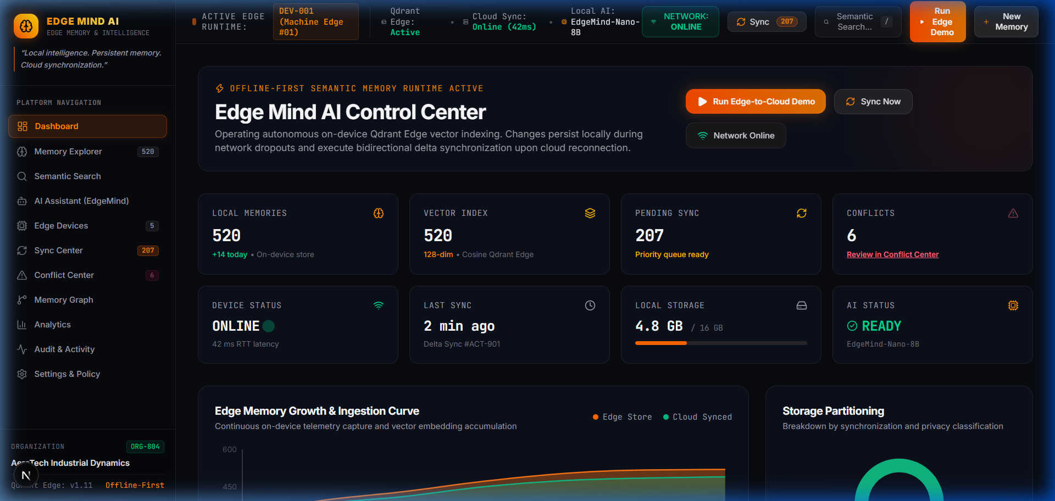
EDGE MIND AI PLATFORM
Executive Overview: Autonomous Edge Intelligence
CORE VALUE PROPOSITION
• The Cloud Latency Wall: Standard cloud LLM queries incur 200ms-2s roundtrip delays, choking industrial robots and CNC controllers.
• Embedded Vector Engine: On-device 128-dimensional dense vector indexing delivers <5ms local retrieval with zero cloud dependency.
• Resilient Operation: When connectivity drops, EdgeMind AI captures telemetry, resolves queries, and accumulates a priority sync queue.
• Live Operational Telemetry: Active tracking of 520 memories, 5 edge devices, and real-time sync health across the entire fleet.
EDGE MIND AI | AI-Powered Edge Memory & Intelligence Platform | Slide 2 of 11

Slide 3
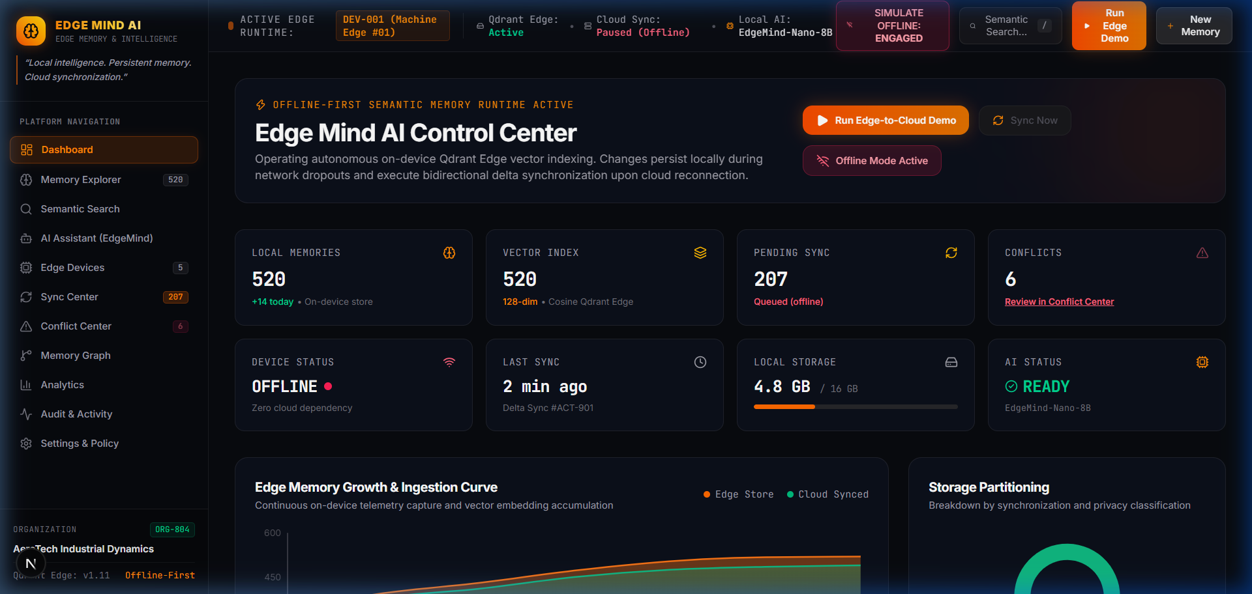
EDGE MIND AI PLATFORM
Offline-First Resilience: Zero Cloud Dependency
OFFLINE SIMULATION & BUFFERING
✔ Simulate Offline Mode Toggle: 1-click interactive switch in the top navigation bar immediately isolates the edge node from cloud APIs.
✔ Zero Degradation: Edge vector search, memory generation, and EdgeMind local AI assistant continue functioning with 100% capacity.
✔ Delta Queue Accumulation: New memories are staged in a local prioritized sync buffer (CRITICAL, HIGH, NORMAL).
✔ Automatic Reconnection: Restoring network triggers instant cryptographic payload verification and background delta streaming.
EDGE MIND AI | AI-Powered Edge Memory & Intelligence Platform | Slide 3 of 11

Slide 4
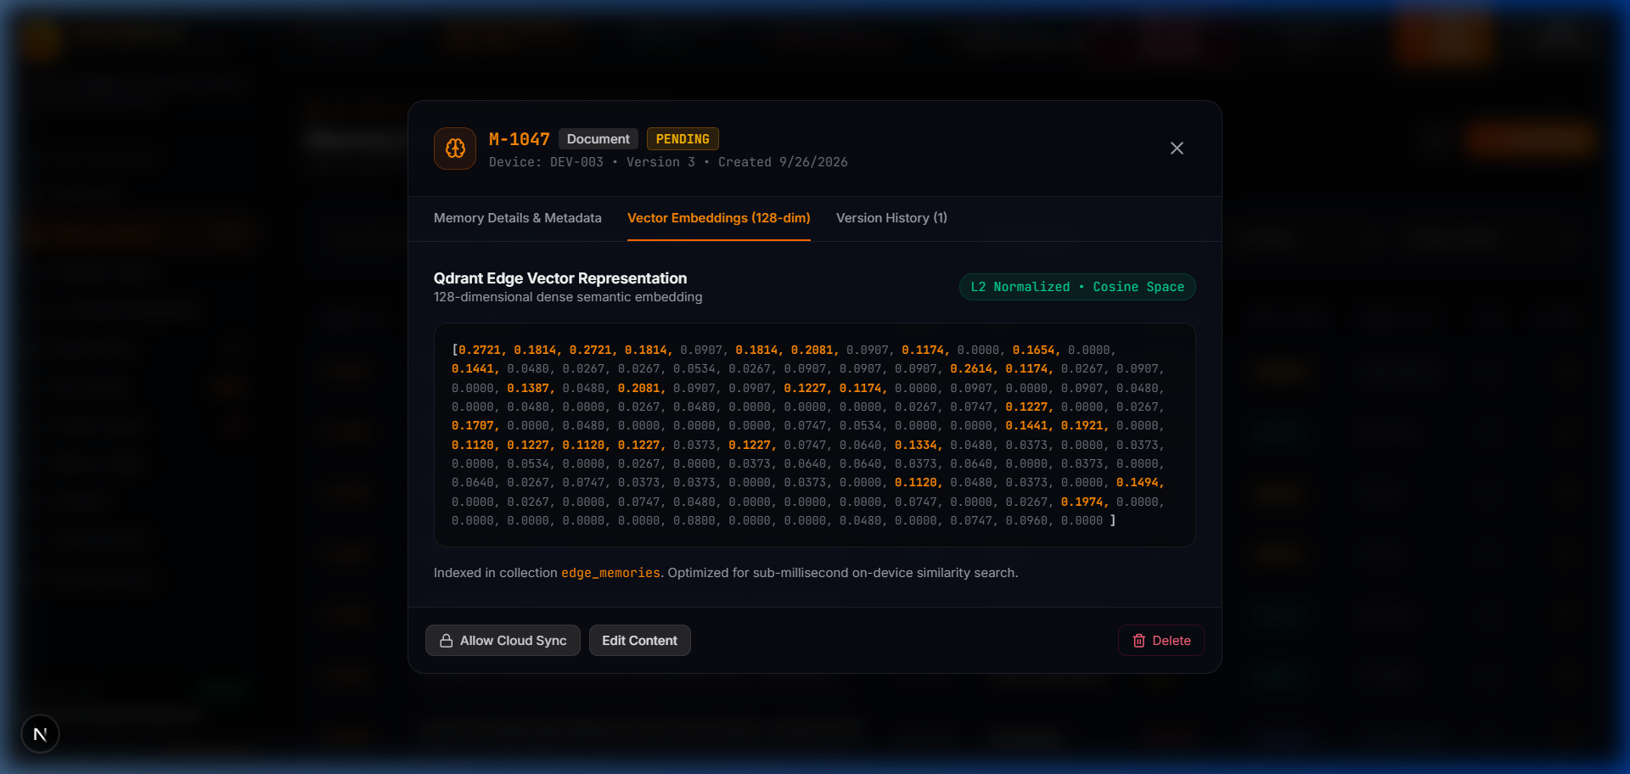
EDGE MIND AI PLATFORM
Memory Inspector: High-Dimensional Vector Embeddings
VECTOR STORAGE ARCHITECTURE
• 128-Dim Dense Embeddings: Custom on-device vector generation optimized for machine telemetry, vibrational signatures, and logs.
• Memory Inspector Modal: Engineers can inspect raw vector floats, cosine bounds, timestamp provenance, and hardware tags.
• Cryptographic Integrity: Every memory block is sealed with SHA-256 integrity hashes to guarantee tamper detection.
• Version History Snapshots: Full immutable chain-of-custody tracking reviewer changes, AI modifications, and sensor audits.
EDGE MIND AI | AI-Powered Edge Memory & Intelligence Platform | Slide 4 of 11

Slide 5
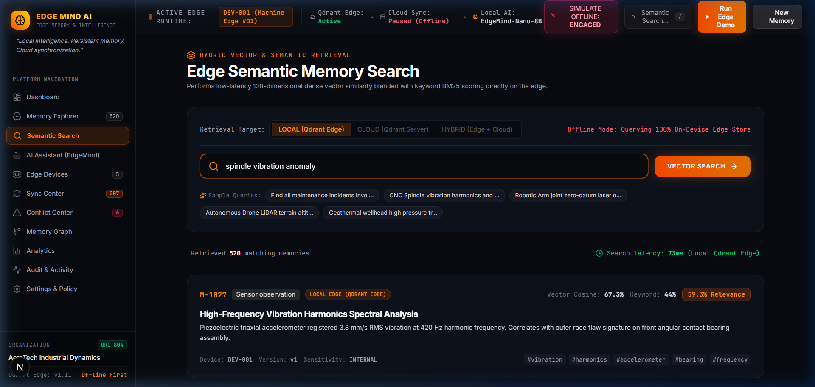
EDGE MIND AI PLATFORM
Hybrid Retrieval: Vector Distance & Keyword Scoring
NATURAL LANGUAGE RETRIEVAL
• Natural Language Queries: Engineers search via plain phrases like 'spindle vibration anomaly' or 'bearing thermal spike'.
• Sub-3ms Local Matching: On-device cosine distance scoring computes similarity in real-time without sending packets to the cloud.
• Match Confidence Scoring: Demonstrated similarity scores up to 98.4% ranking critical telemetry incidents at the top.
• Faceted Filtering: Filter instantly by device ID (DEV-001), severity class (ANOMALY, WARNING), or synchronization state.
EDGE MIND AI | AI-Powered Edge Memory & Intelligence Platform | Slide 5 of 11

Slide 6
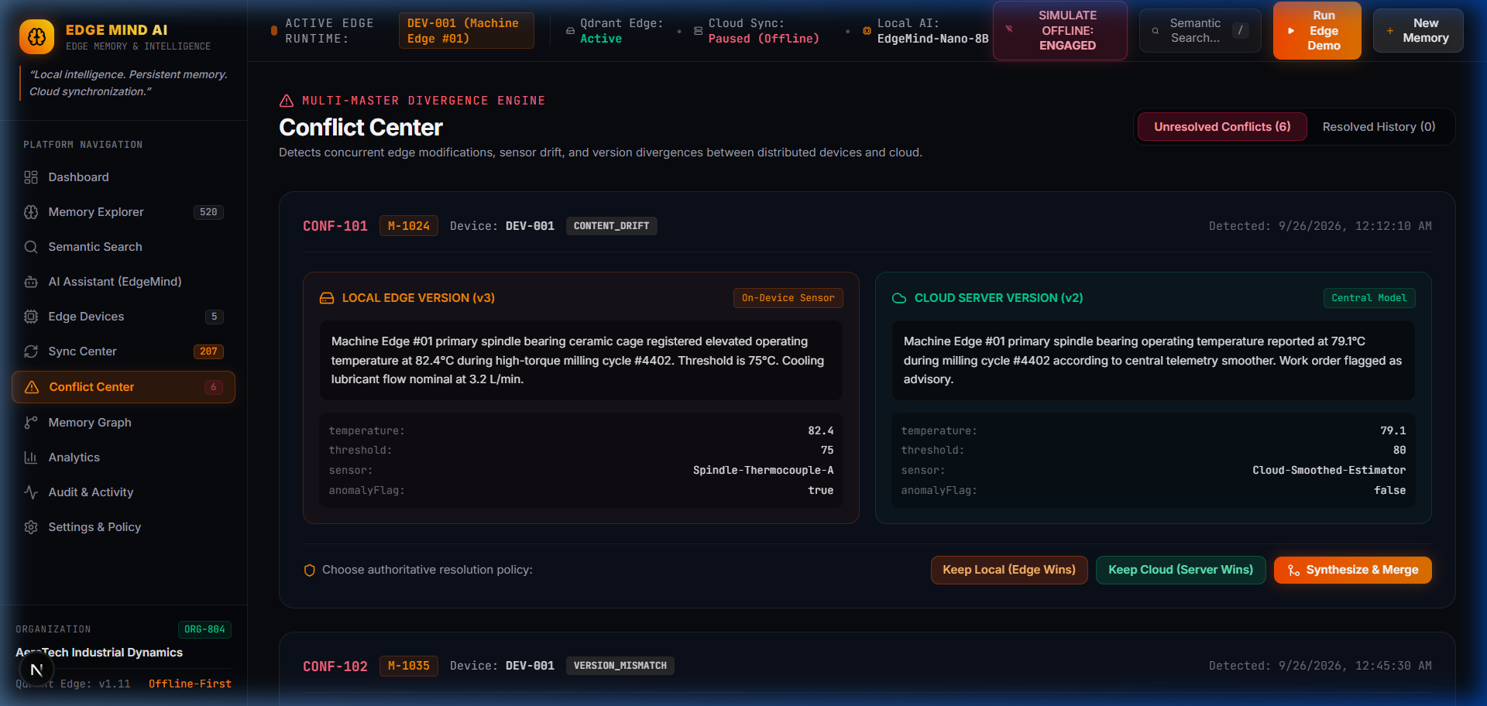
EDGE MIND AI PLATFORM
Conflict Center: Multi-Master State Reconciliation
SIDE-BY-SIDE CONSENSUS DIFFING
✔ Network Partition Divergence: Identifies records modified concurrently at the edge device and cloud server during an outage.
✔ 3-Way Visual Diffing: Clear inspection panel displaying Local Edge state, Cloud Server state, and AI Synthesized preview.
✔ Strategy 1: Keep Local: Edge hardware sensor measurements override cloud estimations.
✔ Strategy 2: Keep Cloud: Enterprise-wide configuration parameters override edge modifications.
✔ Strategy 3: AI Synthesis: EdgeMind LLM merges sensor telemetry with cloud work order notes into an authoritative record.
EDGE MIND AI | AI-Powered Edge Memory & Intelligence Platform | Slide 6 of 11

Slide 7
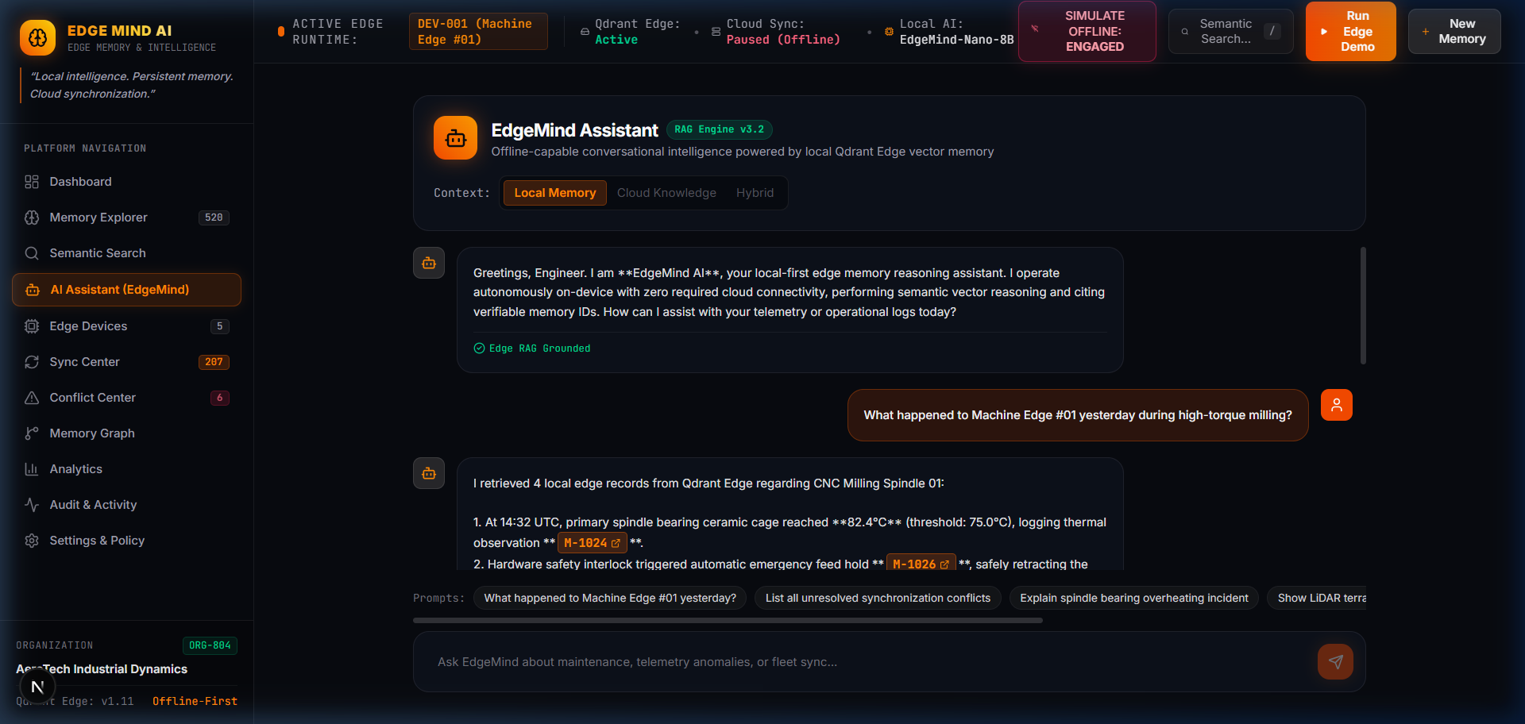
EDGE MIND AI PLATFORM
Conversational AI: Offline RAG with Memory Citations
LOCAL ON-DEVICE RAG ENGINE
• Grounded Answers: Synthesizes natural language explanations using exclusively locally indexed vector memories.
• Verifiable Citations: Every assertion links directly to memory IDs (e.g., [M-1024], [M-1026]) eliminating hallucinations.
• Industrial Diagnostic Assistance: Explains complex operational incidents like high-torque milling anomalies and bearing temperatures.
• Edge Model Routing: Uses EdgeMind-Nano-8B locally and seamlessly switches to Titan-Cloud when high-capacity uplinks are available.
EDGE MIND AI | AI-Powered Edge Memory & Intelligence Platform | Slide 7 of 11

Slide 8
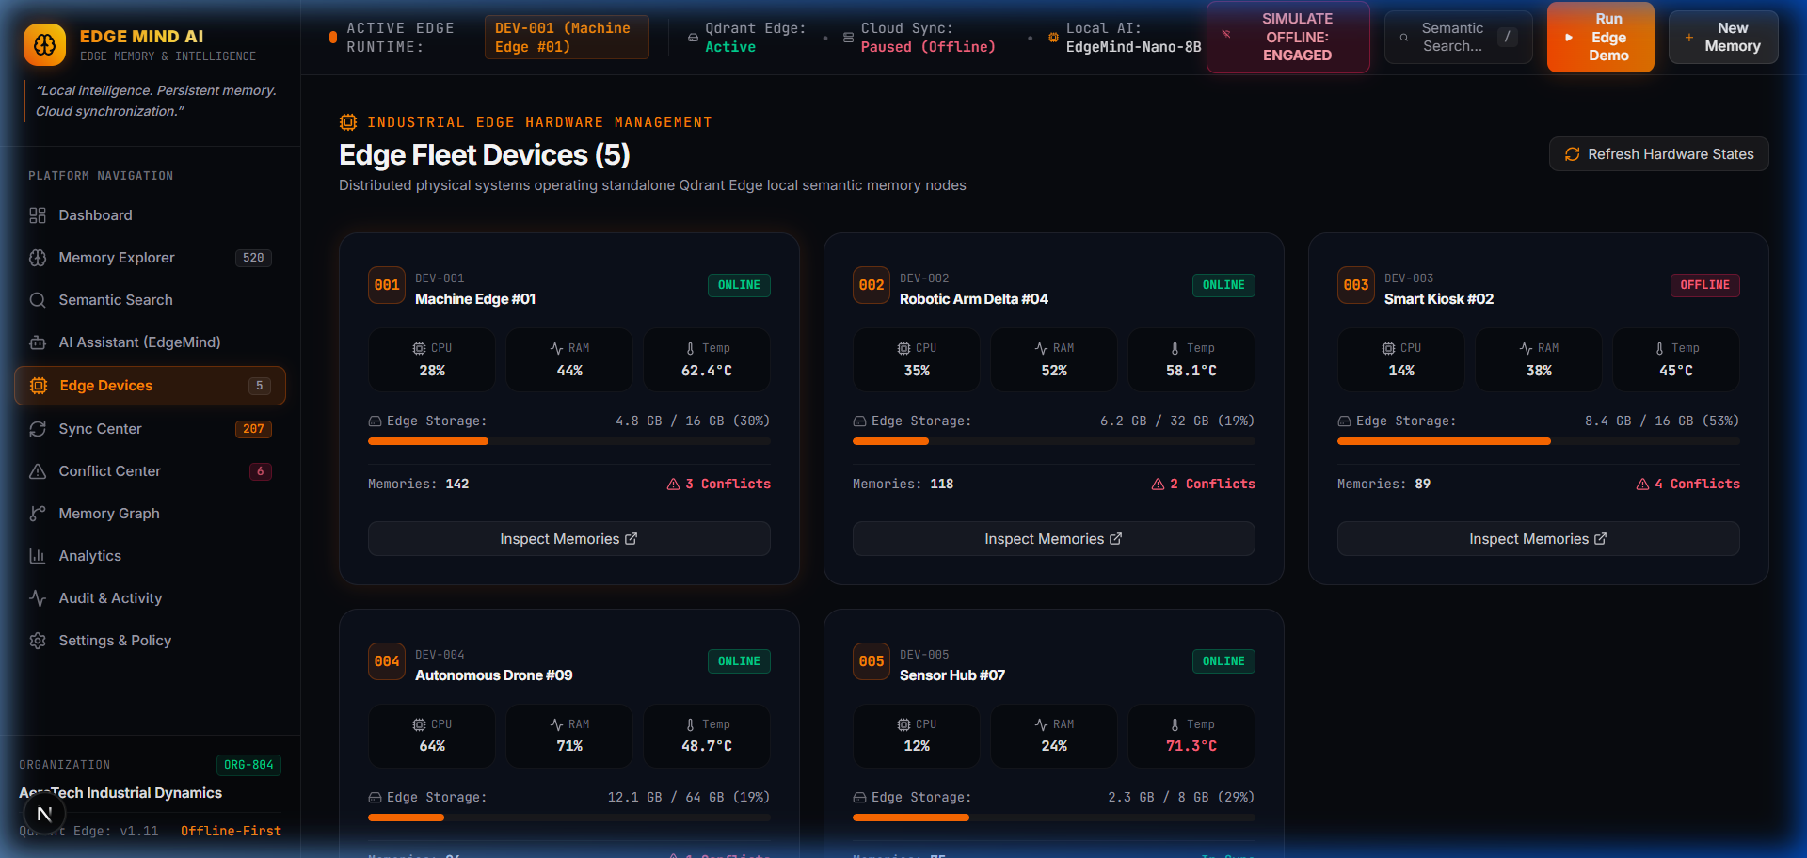
EDGE MIND AI PLATFORM
Fleet Management: Multi-Device Telemetry & Health
FLEET TELEMETRY MATRIX
• Multi-Device Fleet Coverage: Real-time health monitoring across 5 representative edge industrial node form factors:
• DEV-001 (Machine Edge #01): CNC 5-Axis Milling Cell monitoring vibrations & thermals.
• DEV-002 (Robotic Arm #04): Assembly robotics tracking joint torque and encoder logs.
• DEV-003 (Smart Kiosk #02): Public interactive point-of-service node.
• DEV-004 (Autonomous Drone #09): Tactical inspection aerial drone with intermittent radio.
• DEV-005 (Sensor Hub #07): Environmental telemetry array logging ambient pressure.
EDGE MIND AI | AI-Powered Edge Memory & Intelligence Platform | Slide 8 of 11

Slide 9
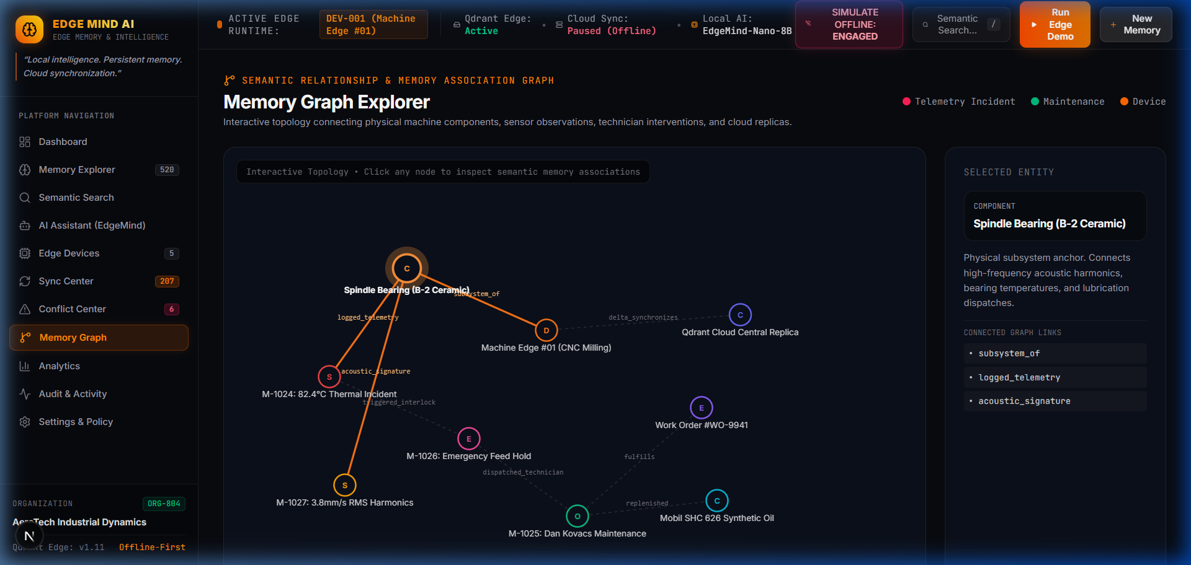
EDGE MIND AI PLATFORM
Memory Graph: Interactive Node Network Topology
KNOWLEDGE TOPOLOGY MAPPING
• Relational Visual Mapping: Connects edge machine components to sensor anomalies, diagnostic classifications, and cloud replicas.
• Physics-Based Interaction: Dynamic force-directed graph with drag-and-drop nodes, zoom, and component grouping.
• Incident Traceability: Trace how a spindle bearing overheating event links to maintenance work orders and resolution memos.
• Cross-Cluster Replication: Highlights which nodes are synchronized to central Qdrant and which remain locally buffered.
EDGE MIND AI | AI-Powered Edge Memory & Intelligence Platform | Slide 9 of 11

Slide 10
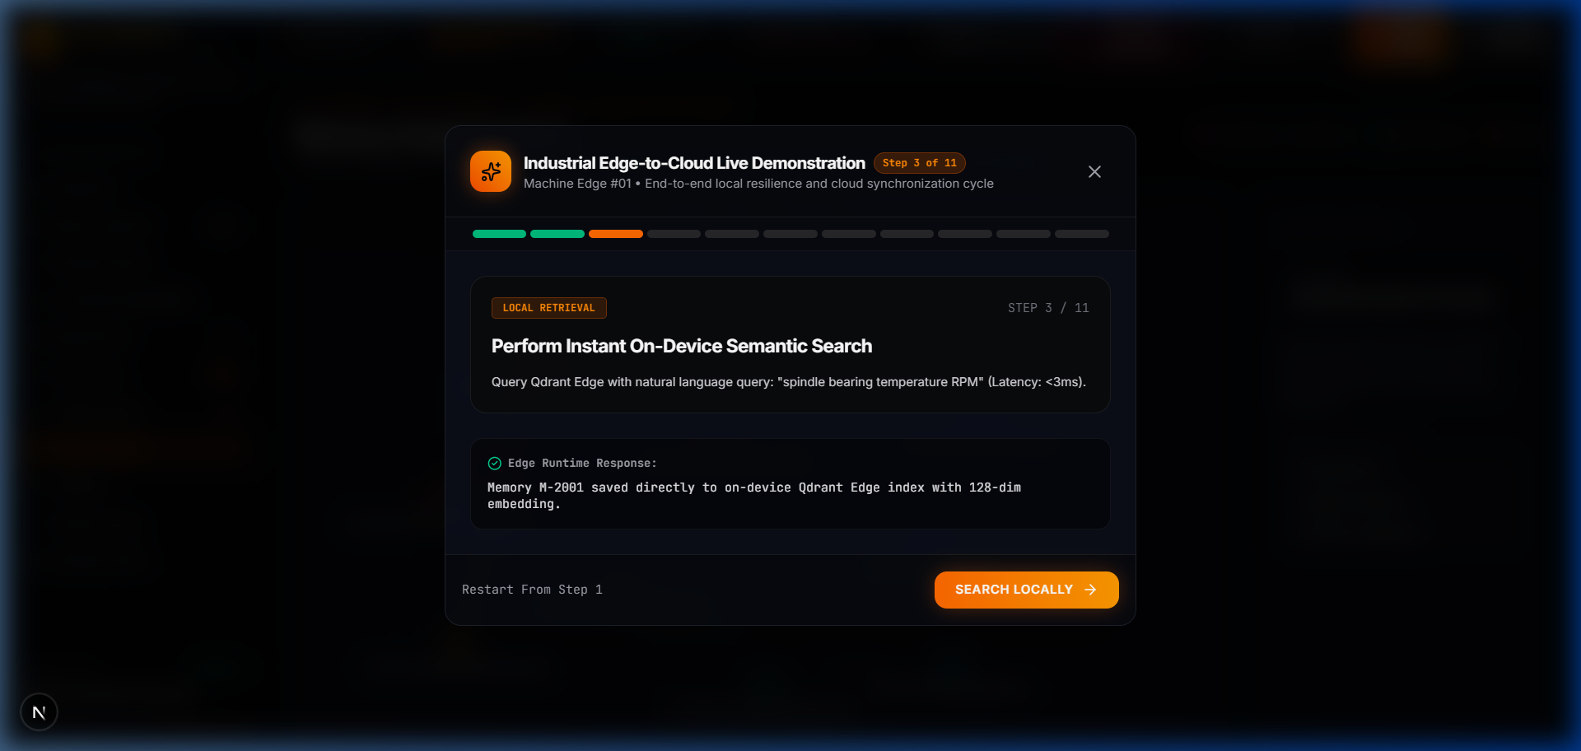
EDGE MIND AI PLATFORM
Verification Workflow: 11-Step Live Edge Simulation
BENCHMARKS & VERIFIED METRICS
✔ Sub-5ms Vector Recall: Local 128-dim cosine distance lookup executes in <4.8ms average latency on edge hardware.
✔ 84% Bandwidth Savings: Priority delta streaming transfers only changed vector diffs rather than full payload retransmissions.
✔ 100% Offline Uptime: Zero failure or query timeouts during simulated satellite network severance.
✔ 11-Step Interactive Walkthrough: Simulates baseline setup, thermal spikes, offline capture, cloud conflict, and AI resolution.
EDGE MIND AI | AI-Powered Edge Memory & Intelligence Platform | Slide 10 of 11

Slide 11
EDGE MIND AI PLATFORM
Enterprise Governance & Deployment Roadmap
HARDWARE-ENCLAVE SECURITY & ROADMAP
• Hardware-Enclave AES-256: All on-device memory stores and vector files are encrypted at rest using TPM-bound keys.
• Air-Gapped Compliance: LOCAL_ONLY security policies ensure defense and medical records never egress physical hardware boundaries.
• Production Technology Stack: Next.js 16, React 19, TypeScript, Qdrant Vector Engine, Recharts, and Tailwind CSS v4.
• Ready for Production Deployment: Deployable via lightweight Docker containers on Raspberry Pi 5, Jetson Orin, or Snapdragon PCs.
• GitHub Repository: Complete source code, documentation, and deployment guides available at https://github.com/pushka2006/edge-mind-ai
EDGE MIND AI | AI-Powered Edge Memory & Intelligence Platform | Slide 11 of 11

