Slide 1


Programming to
School of Computer Engineering,
KIIT University
26.6.07

Slide 2
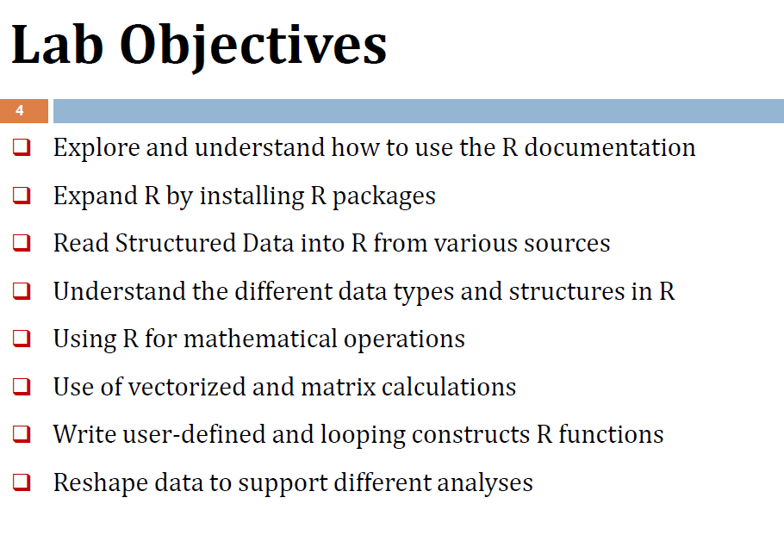

Slide 3

Internal | Before Mid Sem | After Mid Sem
1 | Program Execution (10) | Program Execution (10)
2 | Record (5) | Record (5)
3 | Quiz (20)
4 | Viva (10)

Slide 4
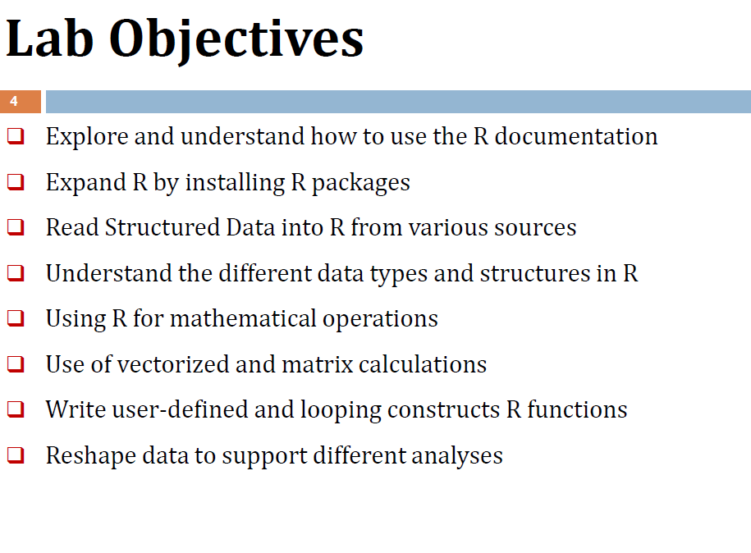

Slide 5
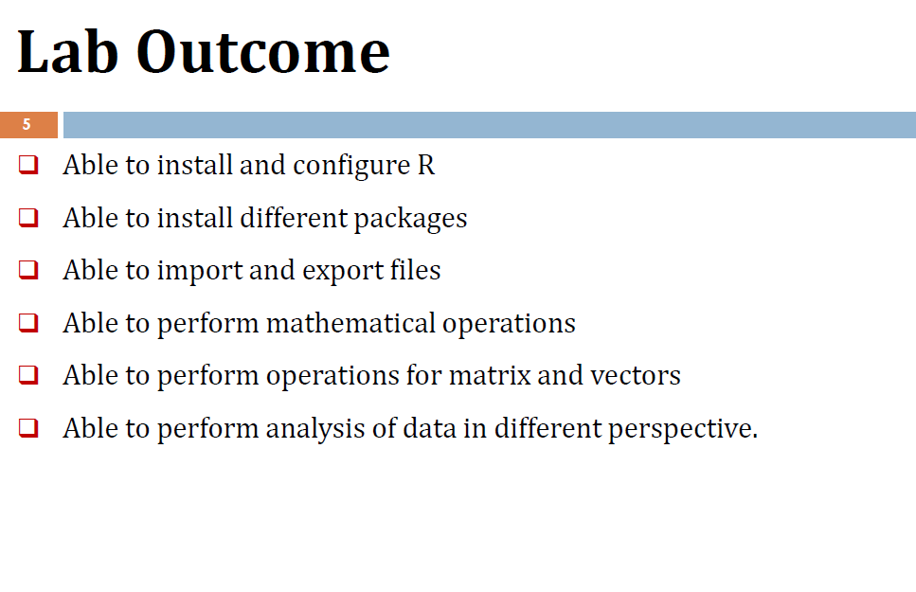

Slide 6
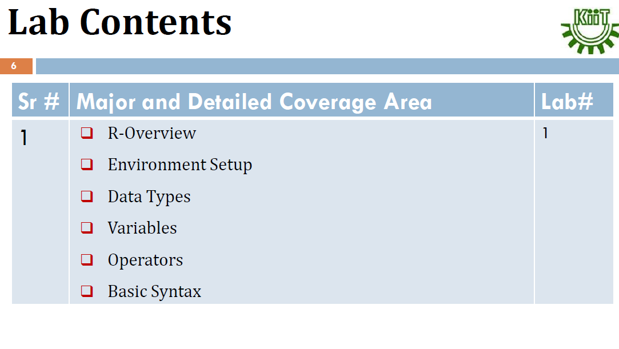

Slide 7
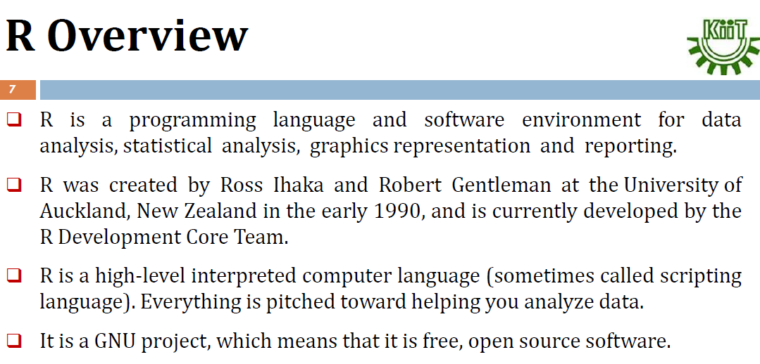

Slide 8
What R is and what it is not
R is
a programming language
a statistical package
an interpreter
Open Source
R is not
a database
a collection of “black boxes”
a spreadsheet software package
commercially supported

Slide 9
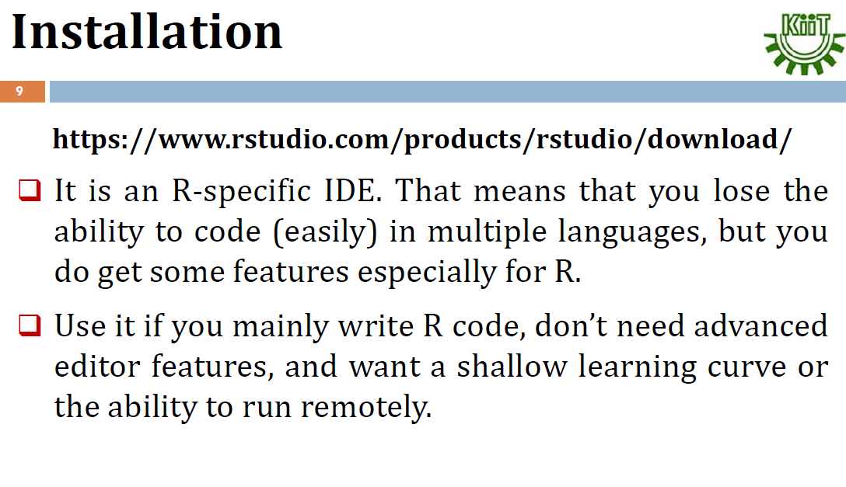

Slide 10

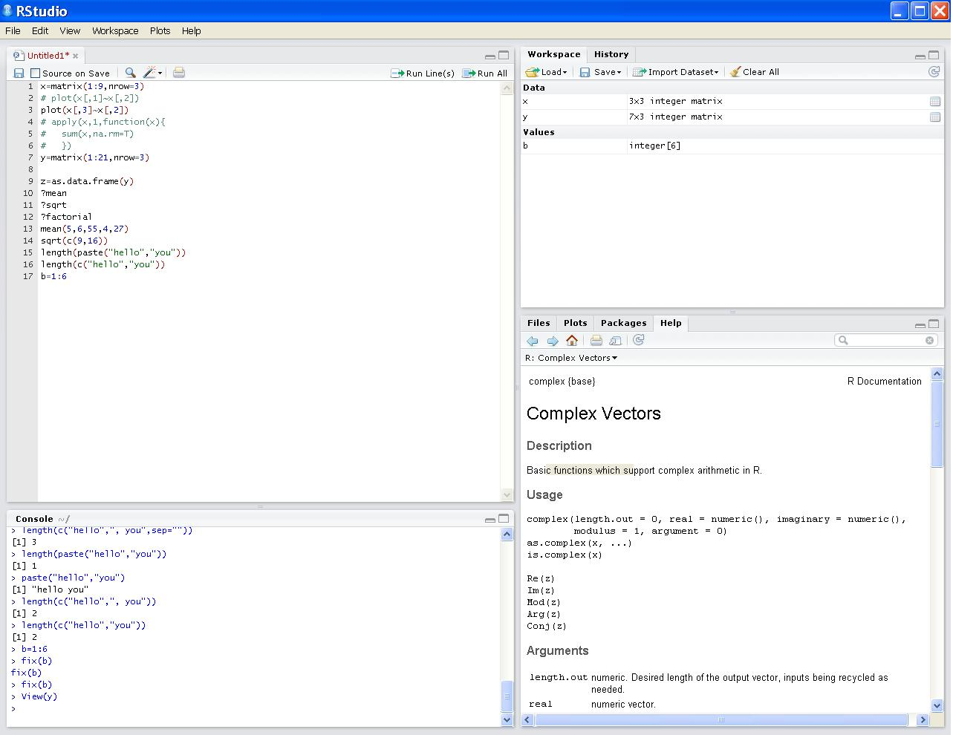
Using RStudio
Script editor
View variables in workspace and history file
View help, plots & files; manage packages
R console

Slide 11
Naming Convention
must start with a letter (A-Z or a-z)
can contain letters, digits (0-9), and/or periods “.”
case-sensitive
mydata different from MyData
do not use use underscore “_”
To quit R, use >q()

Slide 12
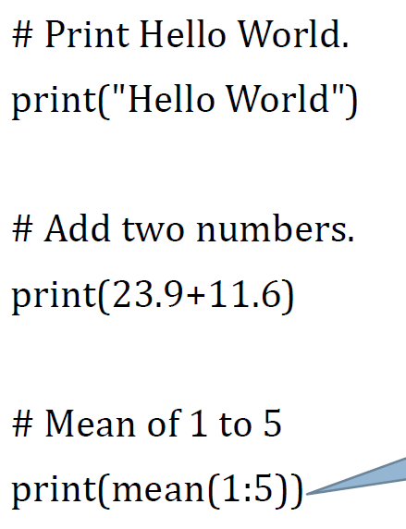
Examples

Slide 13
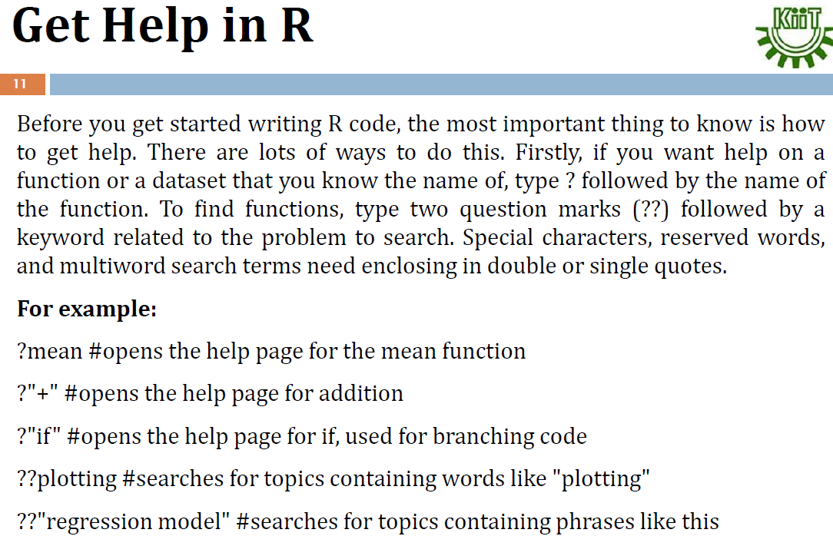

Slide 14
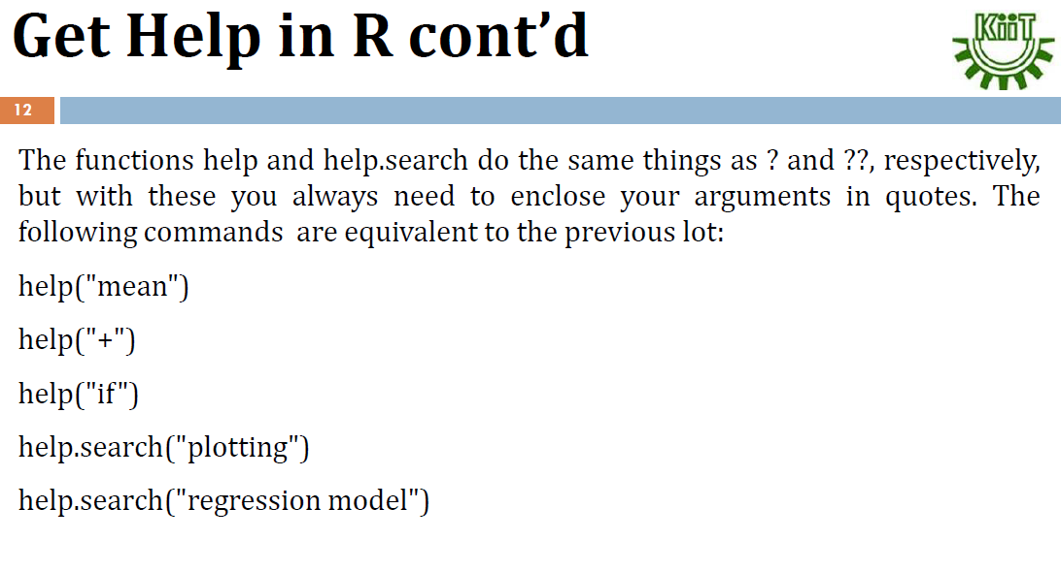

Slide 15
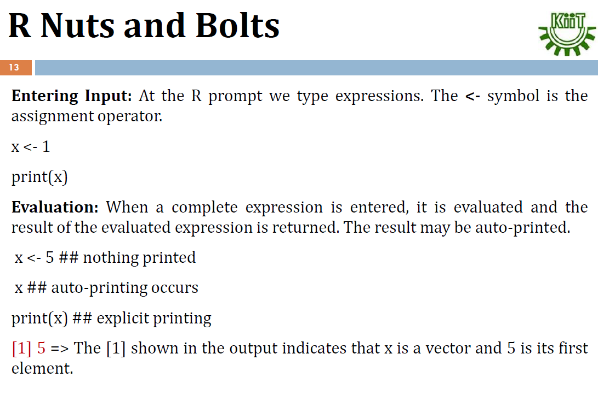

Slide 16
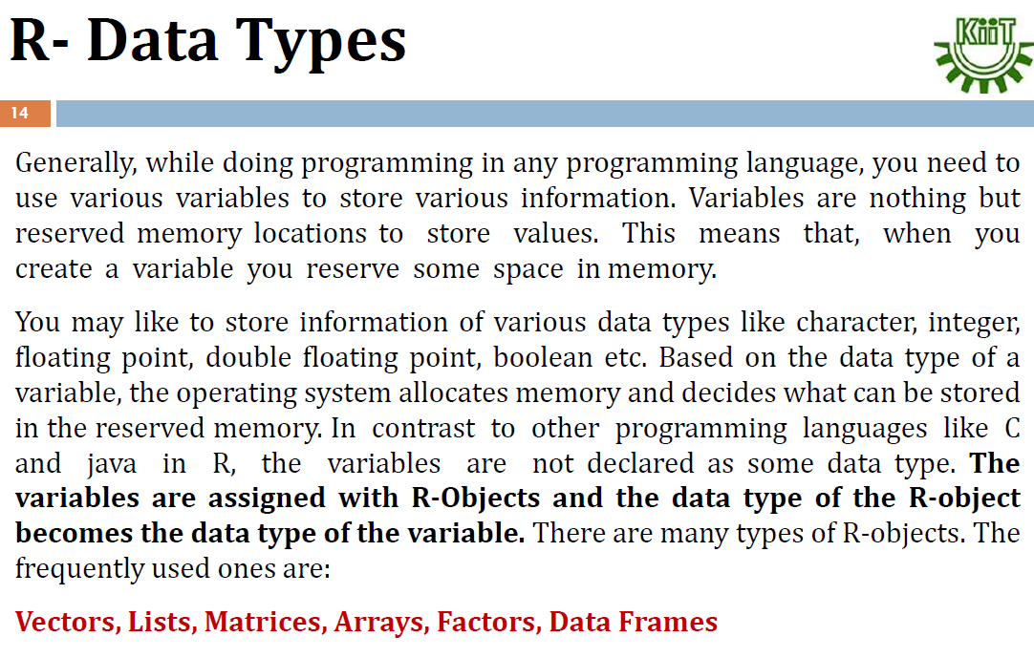

Slide 17
A[10]= A[0]=1st elemnt and A[9] last element
V[10]= V[1] 1st elemet and V[10] last element
V[10]= {1,2,3,4,5,5}

Slide 18
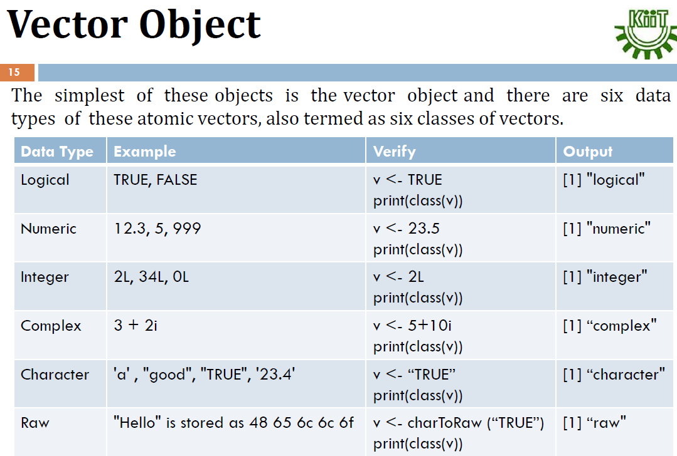

Slide 19
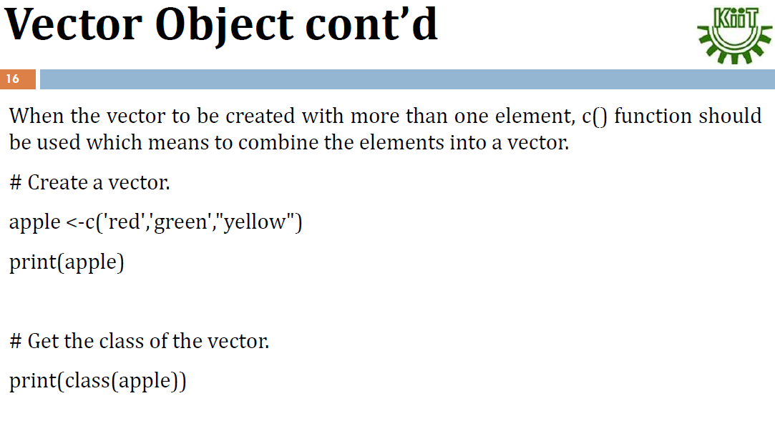

Slide 20
Variables - Numeric Vectors
A vector is a list of values. A numeric vector is composed of numbers
It may be created:
Using the c() function (concatenate) : x = c(3,7,9,11) > x [1] 3 7 9 11
Using the rep(what,how_many_times) function (replicate): x = rep(10,3)
Using the “:” operator, signifiying a series of integers x= c(4:15)
X={4,5,6,7,8,9.10…..15}
Notes:
Run with class

Slide 21
Variables - Character Vectors
Character strings are always double quoted
Vectors made of character strings: > x=c("I","want","to","go","home") > x [1] "I" "want" "to" "go" "home"
Using rep(): > rep("bye",2) [1] "bye" "bye"
Notice the difference using paste()
(1 element): > paste("I","want","to","go","home") [1] "I want to go home"

Slide 22
Variables - Boolean Vectors
Logical; either FALSE or TRUE
> 5>3 [1] TRUE
> x=1:5 > x [1] 1 2 3 4 5 > x<3 [1] TRUE TRUE FALSE FALSE FALSE

Slide 23
Manipulation of Vectors
Our vector: x=c(100,101,102,103)
[] are used to access elements in x
Extract 2nd element in x > x[2] [1] 101
Extract 3rd and 4th elements in x > x[3:4] # or x[c(,4)] [1] 102 103

Slide 24
Manipulation of Vectors – Cont.
> x [1] 100 101 102 103
Add 1 to all elements in x: > x+1 [1] 101 102 103 104
Multiply all elements in x by 2: > x*2 [1] 200 202 204 206

Slide 25
Manipulation of Vectors – Cont.
> x <- c(5.2, 1.7, 6.3)
> log(x)
[1] 1.6486586 0.5306283 1.8405496
> y <- 1:10 {1,2,3,4,5,6,7,8,9,10}
> z <- seq(1, 1.4, by 0.1) {1,1.1,1.2,1.3,1.4}
> y + z
[1] 2.0 3.1 4.2 5.3 6.4 8 9.1 10.2 11.4
> length(y)
[1] 5
> mean(y + z)
[1] 4.2

Slide 26
Manipulation of Vectors – Cont.
Mydata <- c(2,3.5,-0.2)
Vector c=“concatenate”)
Colors <- c("Red","Green","Red")
Character vector
x1 <- 25:30
> x1
[1] 25 26 27 28 29 30 Number sequences
> Colors[2]
[1] "Green" One element
> x1[3:5]
[1] 27 28 29 Various elements

Slide 27
Manipulation of Vectors – Cont.
> Mydata
[1] 2 3.5 -0.2
> Mydata > 0
[1] TRUE TRUE FALSE
> Mydata[Mydata>0]
[1] 2 3.5
> Mydata[-c(1,3)]
[1] 3.5
Test on the elements
Extract the positive elements
Remove elements

Slide 28
More Operators
Comparison operators:
Equal ==
Not equal !=
Less / greater than < / >
Less / greater than or equal <= / >=
Boolean (either FALSE or TRUE)
And &
Or |
Not !

Slide 29
Manipulation of Vectors – Cont.
Our vector: x=100:150
Elements of x higher than 145 > x[x>145] [1] 146 147 148 149 150
Elements of x higher than 135 and lower than 140 > x[ x>135 & x<140 ] [1] 136 137 138 139

Slide 30
Manipulation of Vectors – Cont.
Our vector: > x=c("I","want","to","go","home")
Elements of x that do not equal “want”: > x[x != "want"] [1] "I" "to" "go" "home"
Elements of x that equal “want” and “home”: > x[x %in% c("want","home")] [1] "want" "home"
Note: use “==” for 1 element and “%in%” for several elements

