Slide 1
Applying ACO and other algo on task scheduling in cloudSim and compare them
Pushkar Singh

Slide 2
AGENDA
Introduction​
Primary goals
About ACO
Comparison
​Summary​

Slide 3
Introduction
CloudSim is an open-source framework developed by Clouds Lab Organization which is used to simulate the cloud computing infrastructure and services. The framework is entirely written in Java. It is used for modelling and simulating a Cloud environment as a means for evaluating the hypothesis prior to the development of the software.

Slide 4
Basic terms in cloudsim
Datacenter :- Resource which is used to complete the tasks given in the VMs.
Host :- Datacenter consists of hosts which further contains Virtual Machines.
VM :- A Virtual Machine is an instance created from the datacenter.
Broker :- Broker provides the cloudlets to the Virtual Machines.
Cloudlets :- These are basically the tasks which are mapped to the VMs to be executed.

Slide 5
PRIMARY GOALS
To implement Ant Colony Optimization Algorithm on mapping cloudlets over VMs.
To implement SJF and Round Robin approach on mapping cloudlets over VMs.
To compare the results of all the algorithms and create a summary.

Slide 6



Task scheduling algorithms
SJF
FCFS
ACO
The SJF, is a scheduling algorithm which allocates cloudlets to VMs on the basis of lowest completion time.
The FCFS, is a scheduling algorithm which allocates the cloudlets to VMs on the basis of first come first serve basis.
In this, cloudlets are mapped over VMs on the basis of the Ant Colony Optimization Algorithm.

Slide 7
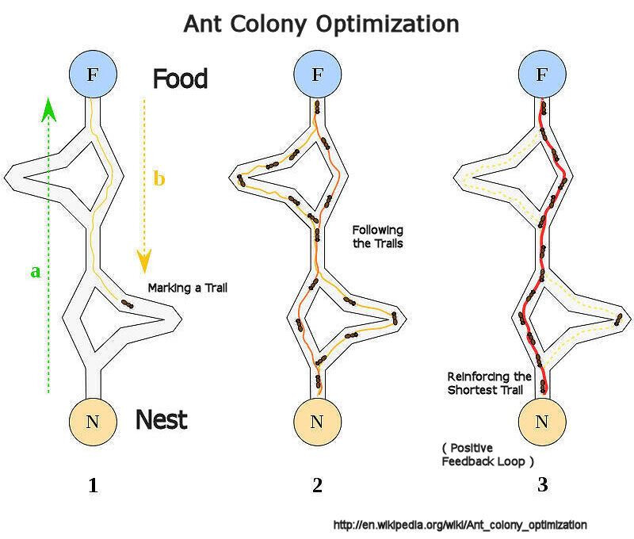
Ant Colony Optimization algorithm
This is the algorithm which is inspired from the foraging behaviour of ant colonies. Pheromones are organic chemicals secreted by ants that trigger a social response in members of same species. These are chemicals capable of acting like hormones outside the body of the secreting individual, to impact the behaviour of the receiving individuals. Ants live in community nests and the underlying principle of ACO is to observe the movement of the ants from their nests in order to search for food in the shortest possible path.
Initially, ants start to move randomly in search of food around their nests. This randomized search opens up multiple routes from the nest to the food source. Now, ants carry a portion of the food back by depositing necessary pheromone concentration on its return path. Depending on these pheromone trials, the probability of selection of a specific path by the following ants would be a guiding factor to the food source. Evidently, this probability is based on the concentration as well as the rate of evaporation of pheromone. It can also be observed that since the evaporation rate of pheromone is also a deciding factor.

Slide 8
Comparison

Slide 9
SUMMARY
Hence we can say from the above results that the Ant Colony Optimization Algorithm works better than SJF and Round Robin approach for mapping Cloudlets over VMs.
In reality Round Robin is better than SJF most of the times, but in CloudSim, it is underperforming because of the fact that the Cloudlet may choose a used VM again, hence increasing the overall makespan higher.

Slide 10
THANK YOU
Pushkar Singh

