Slide 1
“BANK MARKETING PREDICTION”
FINAL REPORT
PUSHKAR BHARAMBE | ANLY 500-91-O-2018

Slide 2
INTRODUCTION
Problem with bank marketing efforts
Data set information
My approach
Insights & Inference
Conclusion & Future work

Slide 3
PROJECT OVERVIEW
Biggest challenge faced by banks post financial crisis – how to grow customer base effectively?
Biggest driver is ‘Direct Marketing’ :
Pros – direct interaction with customers
Cons – expensive, time consuming, needs to highly targeted, large cycle
My solution is to use analytics to help ease this problem – early intervention, appropriate spending, targeted efforts, broad view of customer patterns – what ticks them/ what does not.

Slide 4
THE PROCESS
Procured data from UCI Machine Learning Repository
Selected tool - Alteryx
Loaded and explored data
Split data for training and testing
Built models – Logistic Regression, Decision Tree, Random Forest, Boosted methods
Compared & selected one model

Slide 5
BACKGROUND
Analytics can
help draw insights from large amounts of data
Flexibility of slicing and dicing data in multiple ways
suggest what to expect from campaigns before spending on them
If a relationship is found between success of campaign and input variables then
  the company can make targeted efforts
  spend wisely by allocating resources in an efficient way
  the company can cross sell their products to more customers hence increasing their top line
  Optimizing efforts can reflect in bottom line improvement as well

Slide 6
THE DATA
(REMEMBER THAT FOR ANALYTICS “DATA IS THE KING” SO…)
DATA SET INFORMATIONBACKGROUND
What data is required?
Customer info like age, education, bank balance, defaults etc.
Where/how did you get it?
UCI Machine Learning Repository. Data is in csv format
Why is this data important?
For success marketing efforts one needs to analyze the correct information on customers. The most important part is historical data on how different parameters resulting in customer decision, meaning the target variable – ‘yes’ or ‘no’
I used 16 input variables and one target variable.

Slide 7
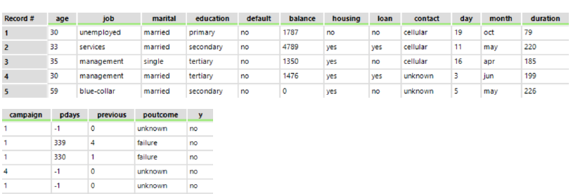
THE DATA
(REMEMBER THAT FOR ANALYTICS “DATA IS THE KING” SO…)
DATA SET INFORMATIONBACKGROUND
A look at the top five rows of data

Slide 8
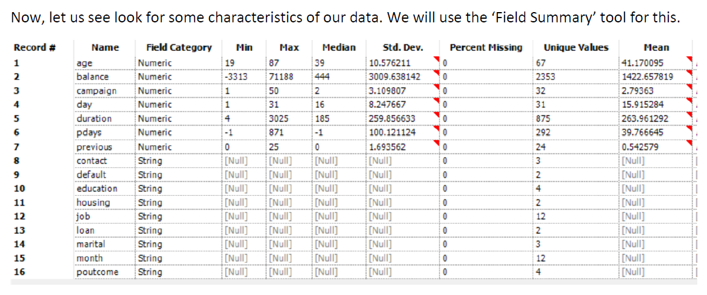
SUMMARY STATISTICS OR DATA VISUALIZATION
(PROVIDE ANY DATA VISUALIZATION YOU USED TO MAKE SENSE OF YOUR DATA)
Summary Statistics

Slide 9
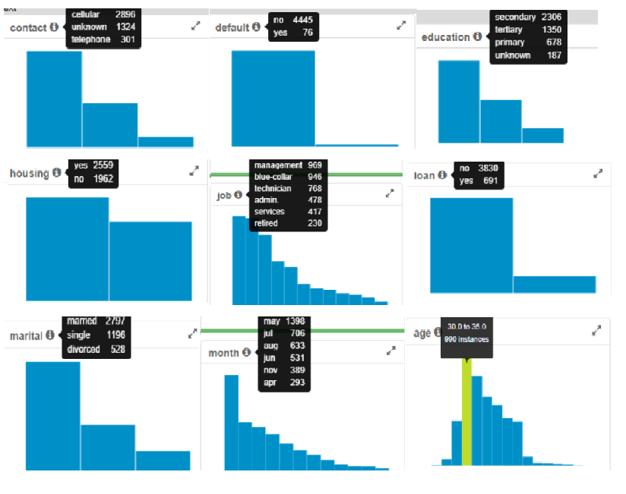
SUMMARY STATISTICS OR DATA VISUALIZATION
(PROVIDE ANY DATA VISUALIZATION YOU USED TO MAKE SENSE OF YOUR DATA)
Histograms

Slide 10
DATA ANALYSIS
(PROVIDE ANY DATA ANALYSIS YOU HAVE COMPLETED HERE)
Splitting Test / Train data
Training data – 70%
Test data – 30%

Slide 11
DATA ANALYSIS
(PROVIDE ANY DATA ANALYSIS YOU HAVE COMPLETED HERE)
Model Building
Logistic Regression
Decision Trees
Random Forest
Boosted

Slide 12
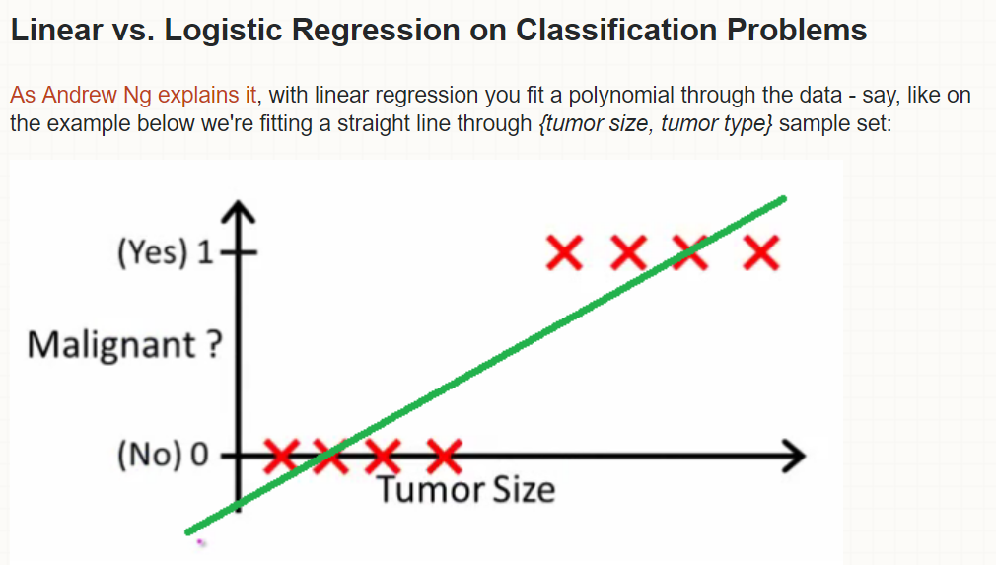
DATA ANALYSIS
(PROVIDE ANY DATA ANALYSIS YOU HAVE COMPLETED HERE)
Model Building Challenge

Slide 13
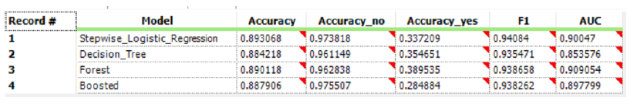
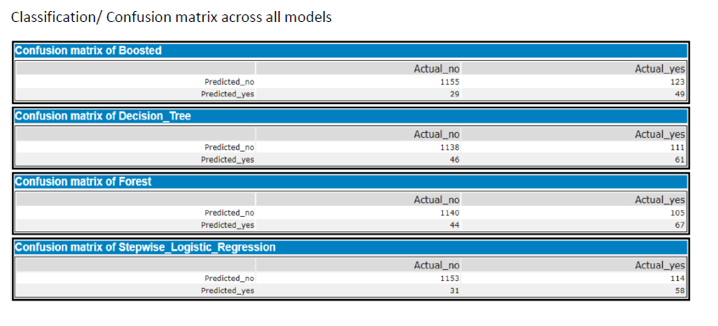
DATA ANALYSIS
(PROVIDE ANY DATA ANALYSIS YOU HAVE COMPLETED HERE)
Model Comparison

Slide 14
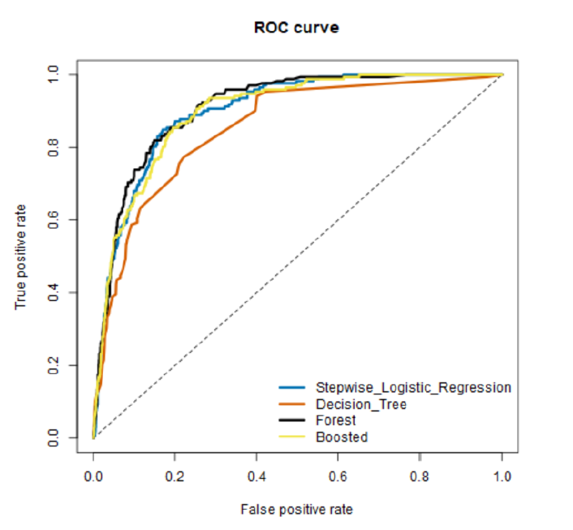
DATA ANALYSIS
(PROVIDE ANY DATA ANALYSIS YOU HAVE COMPLETED HERE)
Model Comparison

Slide 15
DATA ANALYSIS
(PROVIDE ANY DATA ANALYSIS YOU HAVE COMPLETED HERE)
Chose Forest Model because of high accuracy, highest yes_accuracy and better ROC curve.
Model Comparison

Slide 16
DATA ANALYSIS
(PROVIDE ANY DATA ANALYSIS YOU HAVE COMPLETED HERE)
Conclusion
The Random Forest binary classification model with 38.95% yes accuracy and 89.01% accuracy overall will help the bank to optimize targeting efforts for its marketing campaigns. This will help the bank to predict the success of subscribing a long-term deposit even before the telemarketing call is executed.

Slide 17
DATA ANALYSIS
(PROVIDE ANY DATA ANALYSIS YOU HAVE COMPLETED HERE)
Work on improving yes_accuracy and over all accuracy – fine tune models
Use Neural Networks as a model
Future efforts

Slide 18
LESSONS LEARNED
Improved understanding of how to use Alteryx
Its important to look at data from multiple points – histograms, correlation plots
Learnt multiple linear regression is bad for binary outcomes. Visual exploration of data is key to better understanding of data
Learnt a lot about machine learning models and how to implement them – logistic, decision trees, random forest and boosted models
All data science is an iterative process

