Slide 1

Healthcare Analytics for Doctor Visits
Pushkar Gaur
AICTE ID: STU6a5f4088577f51784627336

Slide 2

PROBLEM STATEMENT
The question: Why do some people visit a doctor far more often than others?
The challenge: About 80% of people have no visit at all, while a small group has many, so demand is hard to predict.
The goal: Find which factors (age, gender, income, illness, chronic conditions, healthcare support) drive doctor visits and predict who is likely to need more care.

Slide 3
Project Description
Data: 5,190 patient records with 12 features covering age, gender, income, illness, health status, chronic conditions and healthcare cover.
Method: data cleaning, exploratory analysis, Mann-Whitney U tests, Poisson regression and Random Forest models.
Predictions: number of doctor visits, and whether a person visits a doctor at all.
Risk score: a simple 3-level patient risk segmentation (low, medium, high).

Slide 4

WHO ARE THE END USERS?
Hospital and clinic managers: plan doctor capacity and appointment demand
Health insurers: identify members likely to need more care
Policy makers: understand how free-cover schemes and insurance relate to visits
Care and outreach teams: target older patients and those with many illnesses
Students and analysts: a practical healthcare analytics case study

Slide 5

Technology Used
  Python: pandas and NumPy for cleaning and analysis
Matplotlib and Seaborn: charts and visualisation
SciPy: Mann-Whitney U statistical tests
statsmodels: Poisson regression
scikit-learn: Random Forest and Logistic Regression
Jupyter Notebook and GitHub: development and hosting

Slide 6
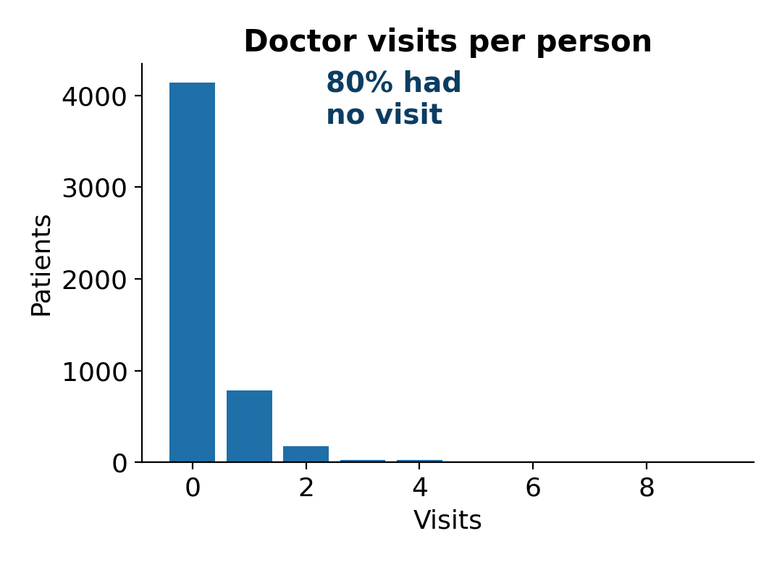
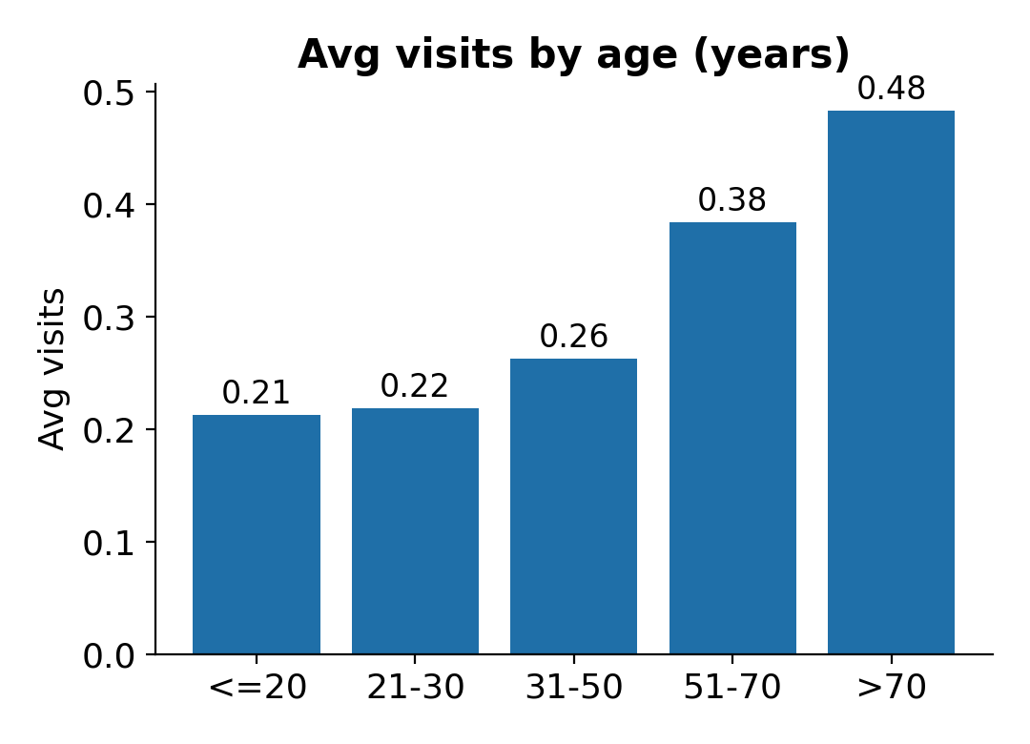
RESULTS: KEY FINDINGS
79.8% of people had no doctor visit (average 0.30 visits)
Women visit more than men (0.36 vs 0.24)
Visits rise with age, from 0.21 (20 or under) to 0.48 (over 70)
Private insurance has no real effect (p = 0.76); free low-income cover is linked to fewer visits

Slide 7
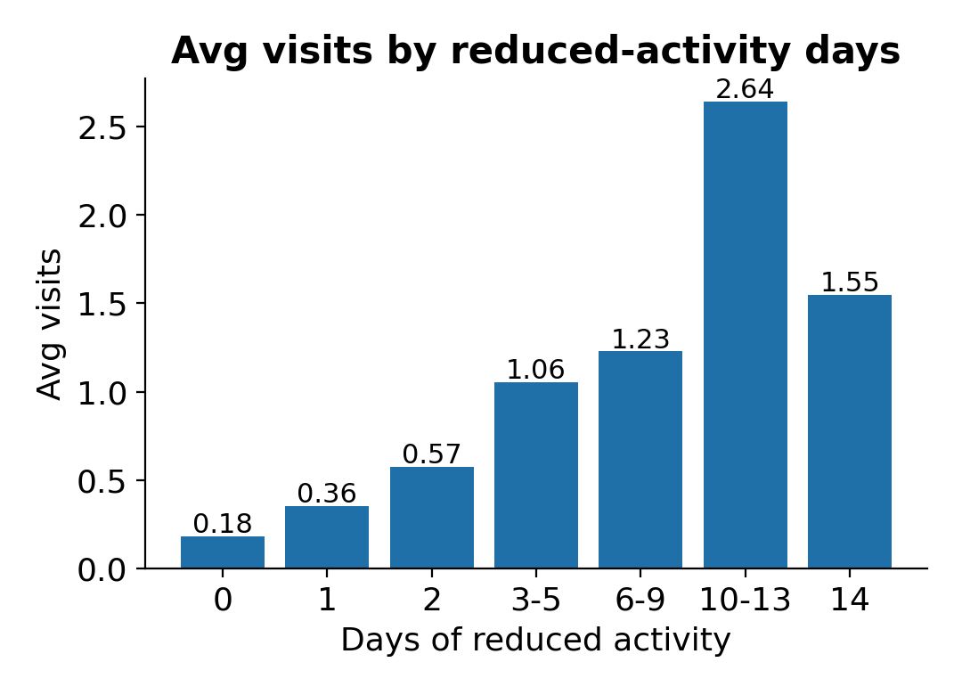
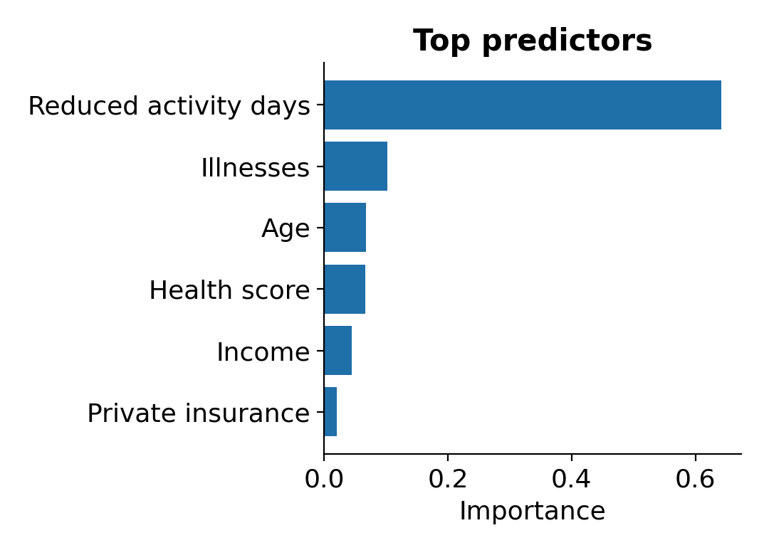
RESULTS: MODELS AND RISK
Days of reduced activity and number of illnesses are the strongest drivers
Random Forest error 0.41 vs 0.52 for the baseline; ROC-AUC 0.74 for visit or no visit
Each extra illness raises expected visits by about 20%
High-risk patients average 0.69 visits, about 7x the low-risk group (0.10)

Slide 8

GITHUB REPOSITORY
Complete project code and analysis notebook
Dataset used in the project
Charts, model results and written findings
Scan to open
https://github.com/pushkargaur09/healthcare-analytics-doctor-visits.git

Slide 9
Thank you
Pushkar Gaur

