Slide 1

TELECOMMUNICATIONS CHURN
A Data-Driven Approach to Customer Retention
Presented by:
PUSHKAR MISHRA
on Thursday, 17th August 2023.
Consulted, Advised & Supervised by:
DAVID PARENT

Slide 2
AGENDA FOR TODAY
Introduction.
Presentation.
Conclusion.
Questions.

Slide 3
Executive Summary
Customer “CHURN” is key for highly reduced Earnings Before Interest, Taxes, Depreciation, and Amortization (EBITDA).
Telecommunications industry is a highly competitive industry with 3 different “TIERS” of service providers in Canada, and many carriers operate within each tier.
Churn can result from factors like poor service quality, better offers from competitors, or customer service issues.
Providing Cellular service is a very unique line of business as it is dependent on various aspects, not just a handset or a static service. Hence, understanding why customers leave helps in improving services.

Slide 4
Objective & Background
ROGERS: BELL: TELUS:
Year | Blended Churn Percentage
FY2015 | 1.34%
FY2016 | 1.23%
FY2017 | 1.48%
FY2018 | 1.23%
FY2019 | 1.23%
FY2020 | 0.97%
Year | Blended Churn Percentage
FY2015 | 1.4%
FY2016 | 1.4%
FY2017 | 1.4%
FY2018 | 1.3%
FY2019 | 1.3%
FY2020 | 1.2%
Year | Blended Churn Percentage
FY2015 | 0.94%
FY2016 | 0.93%
FY2017 | 0.99%
FY2018 | 0.90%
FY2019 | 0.89%
FY2020 | 0.86%

Slide 5
A Story to Share
Putting
“TELECOMMUNICATION CHURN”
in perspective:

Slide 6
Project Overview
3 Core Components were addressed:
Understand business inter-dependencies within a telecommunication company related to “CHURN”.
Data modeling to find the Best Possible model and extracting the Best Variables predicting “CHURN”, &,
Create an interactive source for management to see the variables in action determining the prediction of “CHURN”.

Slide 7
Data Assumptions
The source data is made available by IBM.
The dataset is a hypothetical dataset as stated by IBM.
The dataset was obtained in 5 separate Excel formatted files and everything was done in Google Colab Environment with dependencies for different statistical modeling packages being satisfied in Google Colab.
There were some issues noticed while running the same codes in a different environment, viz. Jupyter Notebook.
The datasets used are “Static” dataset and not a dynamic dataset.

Slide 8
Modeling Approach and Flow
The approach deployed for this data science project to predict “CHURN” was as follows:
Obtaining Datasets
-> Data Exploration
-> Data Preparation and Feature Engineering
-> Model Exploration
-> Model Recommendation

Slide 9
Data Visualization
The Merged Dataset Source Report
file:///C:/Users/Pushkar/Desktop/Education_2022/Centennial/Class_Materials/Semester3_May8-Aug20_2023/BA723_CapstoneProject_David/Assignments/Capstone_Python_Files/New_Report.html
The Initial Split Dataset Comparison Report
file:///C:/Users/Pushkar/Desktop/Education_2022/Centennial/Class_Materials/Semester3_May8-Aug20_2023/BA723_CapstoneProject_David/Assignments/Capstone_Python_Files/New_Comparison.html

Slide 10
Key Findings
Model | Accuracy | Precision | Recall | F1 | ROC_AUC
DeTrClassifier Pre SMOTE | 0.750887 | N / A | N / A | N / A | N / A
DeTrCalssifier Pre SMOTE Encoded | 0.750887 | N / A | N / A | N / A | N / A
RaFoClassifier Pre SMOTE Encoded | 0.82115 | 0.705696 | 0.58377 | 0.638968 | 0.746607
LogRegression Pre SMOTE Encoded | 0.823989 | 0.689266 | 0.638743 | 0.663043 | 0.765818
DeTrClassifier depth5 Pre SMOTE | 0.796309 | 0.641791 | 0.562827 | 0.599721 | 0.722991
LogRegression Pre SMOTE) | 0.823989 | 0.689266 | 0.638743 | 0.663043 | 0.765818
LogRegression after SMOTE | 0.795652 | 0.779186 | 0.827885 | 0.802797 | 0.795496
Decision tree after SMOTE | 0.828986 | 0.82729 | 0.833654 | 0.83046 | 0.828963
RanForClassifier after SMOTE | 0.879227 | 0.881274 | 0.877885 | 0.879576 | 0.879234
XGBClassifier after SMOTE | 0.868116 | 0.872692 | 0.863462 | 0.868052 | 0.868139
SVC after SMOTE | 0.841546 | 0.820144 | 0.876923 | 0.847584 | 0.841374
KNN after SMOTE | 0.822705 | 0.767701 | 0.927885 | 0.840226 | 0.822195
Naive Bayes after SMOTE | 0.784058 | 0.790972 | 0.775 | 0.782904 | 0.784102
ADA Boost after SMOTE | 0.837198 | 0.823963 | 0.859615 | 0.841412 | 0.837089

Slide 11
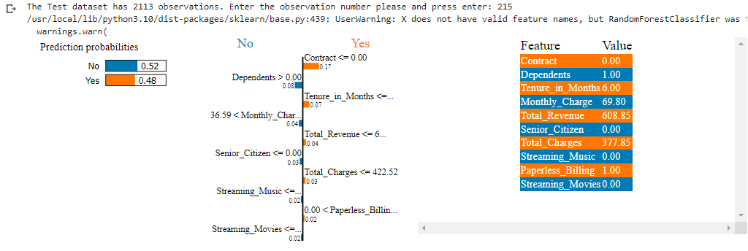
Key Findings…..Continued
Snip of the Interactive Tool to Display the “Individual Prediction” of a Test Data Observation Defining the Variables that is Impacting the “Decision Making” for the Selected “Random Forest Model”.
LET US SEE IT IN ACTION…….

Slide 12
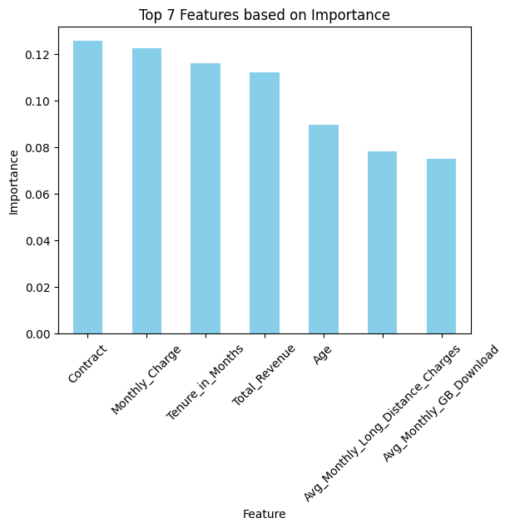
Recommendations
Index | Feature | Importance
22 | Contract | 0.112612
25 | Monthly_Charge | 0.09133
29 | Total_Revenue | 0.085778
6 | Tenure_in_Months | 0.083644
26 | Total_Charges | 0.083434
1 | Age | 0.071342
28 | Total_Long_Distance_Charges | 0.065047
13 | Avg_Monthly_GB_Download | 0.059779
9 | Avg_Monthly_Long_Distance_Charges | 0.058041
12 | Internet_Type | 0.032471
4 | Dependents | 0.025519
24 | Payment_Method | 0.021943
7 | Offer | 0.021041
2 | Senior_Citizen | 0.018739
23 | Paperless_Billing | 0.015722
17 | Premium_Tech_Support | 0.014815
14 | Online_Security | 0.0146
11 | Internet_Service | 0.01297
0 | Gender | 0.01212
20 | Streaming_Music | 0.010975
27 | Total_Extra_Data_Charges | 0.010934
10 | Multiple_Lines | 0.010857
15 | Online_Backup | 0.010046
5 | Referred_a_Friend | 0.010016
3 | Married | 0.009529
18 | Streaming_TV | 0.009407
19 | Streaming_Movies | 0.008633
16 | Device_Protection_Plan | 0.008245
21 | Unlimited_Data | 0.008242
8 | Phone_Service | 0.002169

Slide 13
Actions for Stakeholders
Since Contract is the very first variable that shows in the feature importance table, and quite intuitively so due to the penalty, efforts should be made to get more and more customers on a contract.
Monthly charges appear as the following most crucial variable in the list, and once again is quite intuitive as a higher monthly charge, will get the customers away from the carrier, hence efforts should be made to realign plans for them.
Tenured customers should be given utmost priority in being retained due to their overall value for revenue generation, earned through the long period of their loyalty with the carrier.
As a unique service provider, the telecommunication industry has the advantage of retaining its customers by targeting some other service that they offer, e.g., a lower internet bill can compensate for a higher cellular bill.
Age is another important aspect to be addressed as the younger generation’s needs are different than a mid-aged person, and they both differ from senior citizens. So plans need to be tailored for their specific needs, not tying them with generic offers.

Slide 14
CONCLUSION
This being a very high-level data research and analytic project, more analysis is needed to be done to identify some more variables and by removing the obvious ones, e.g., Contracts, High Bills, etc.
Subject to data availability, if the data could be obtained using internal resources, then real-life scenarios could be assessed more deeply to find a better answer for many questions still unanswered from this analysis.
Combination of variables should also be analyzed to get a better insight into customer behavior, and if possible run some surveys prompting the customers to provide their inputs on their perspectives for their vision of a telecommunications carrier as the Internet is an inseparable part of their lives.

Slide 15
Thank You for coming, for your patience, and for listening so attentively.
QUESTIONS?

