Slide 1

Sales Forecast – Maruti Suzuki
Assignment
Submitted by:
Pushkar Mittal
mittal.pushkar@gmail.com

Slide 2

Introduction
Why MS?
As the Passenger Vehicle Market sales are declining in India, we analyse sales of Maruti Suzuki in the recent past because
MS maintains about 50% market share for passenger Vehicle sold in India
More than 1,00,000 Vehicles sold monthly
Wide network of workshops and showrooms in India
More than 50 years of dominance in India

Slide 3

Methodology and Formulation
Formulate
Collect Data
Forecast
$$Future Sales=f(Historic Sales,Market Share,$$
$Number of upcoming models$,
$GDP, Fuel Prices,…..)$
Evaluate
No
Yes
Apply

Slide 4

Data Collection
Data is collected from several sources
Maruti Suzuki media releases – Sales data monthly
GDP of India, Finance Ministry
Crude oil prices from WTO
India Today report for Market share of leading PV companies.
CarDekho.com for Upcoming PV in India

Slide 5
Used Features
Some of the major features that were collected for the analysis are
Feature | Why it might be important ?
Monthly Sales Maruti Suzuki PV in different segments | These numbers inform about historic sales, trends and a rough estimate for the sale forecast
Crude oil prices ($/Barrel) | Cost of fuel could be an important factor in driving vehicle sales.
Market Share by brand (Annually) | Market share of leading companies can aid in forecast
Dollar to INR (monthly) | Dollar to INR conversion could be an important factor in determining cost of vehicles and oil in India since some of them is imported

Slide 6
Existing sales

Slide 7
Existing sales

Slide 8
Existing sales

Slide 9
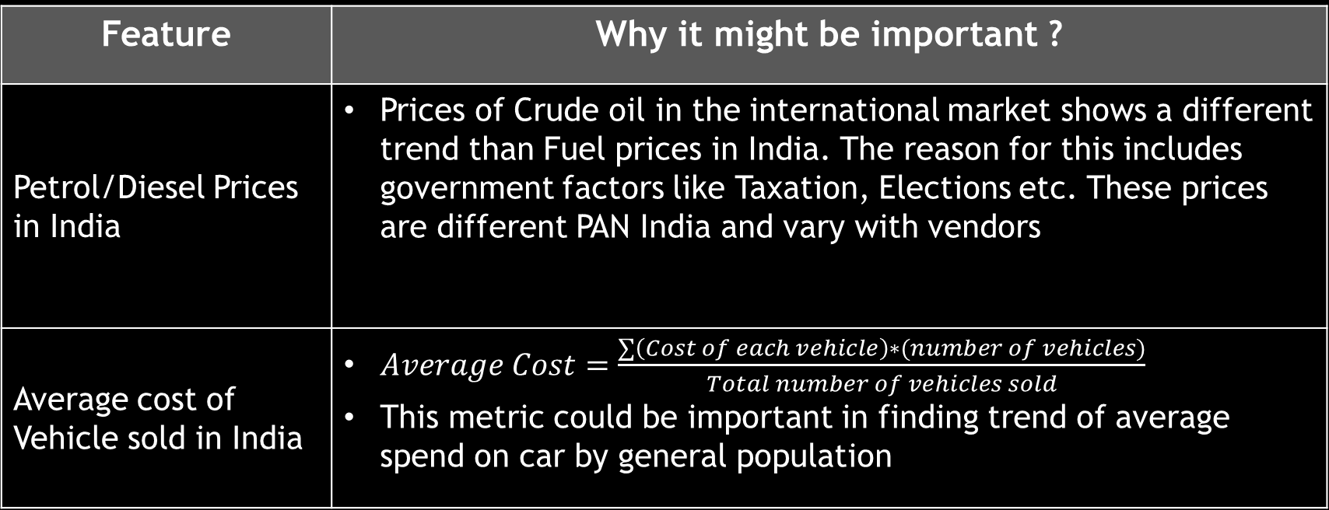
Limitations
The following features were not collected due to time limitations
Feature | Why it might be important ?
Petrol/Diesel Prices in India | Prices of Crude oil in the international market shows a different trend than Fuel prices in India. The reason for this includes government factors like Taxation, Elections etc. These prices are different PAN India and vary with vendors
Average cost of Vehicle sold in India | $Average Cost=\frac{∑\left(Cost of each vehicle\right)∗(number of vehicles)}{Total number of vehicles sold}$ This metric could be important in finding trend of average spend on car by general population

Slide 10
Limitations (Cont..)
The following features were not collected due to time limitations
Feature | Why it might be important ?
Advertisement Budget | Advertisement and marketing could be important in driving the sales of vehicles
Offers and promotions | Sales among competitors could be dependent on the Offers and promotions offered by the companies during festivals like Diwali and Dussehra

Slide 11
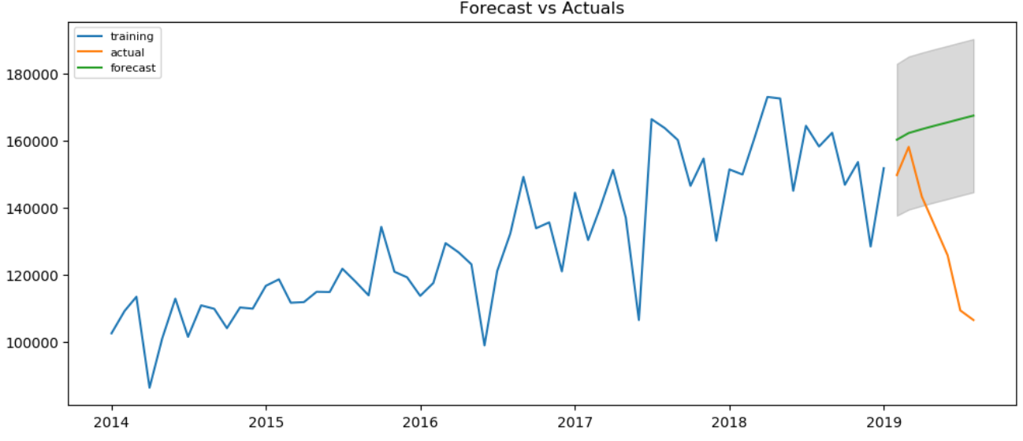
Quantitative Forecast of Sales vs Actual – Method 1

Slide 12
Quantitative Forecast of Sales vs Actual – Method 2

Slide 13
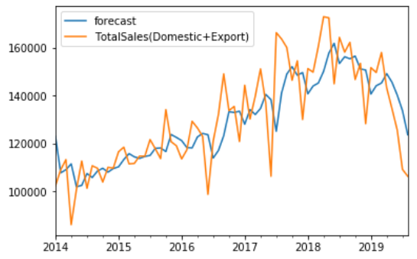
Quantitative Forecast-Adjusted
Limitation: Prediction of only 3 months in advance.
Algorithm Feeds new data iteratively to retune forecast after every month
The algorithm improvises the forecast to eventually provide better estimates as more data is made available.

Slide 14
Possible reasons for unexpected decline in sales
On one hand, sales of vehicles to private consumers is declining due to emergence of Taxi services like OLA and Uber. On the other hand, cab market is facing saturation where sales of vehicles to cab owners is declining due to slower increase in demands for cabs
Sales of Maruti Suzuki could have declined due to the recent announcement by the company to discontinue production of diesel vehicles from 2020. Customers may fear difficult support and service if they will buy vehicles which run on diesel.

Slide 15
Possible reasons for unexpected decline in sales (Cont.)
Non Banking Financial Corporations (NBFC)’s which are major lenders in tier 2 and small cities have observed liquidity squeeze due to economic slowdown which has made it difficult to own cars In these markets.
Other reasons like consumers postponing their purchase as they wait for decline in GST rates, festive offers etc.

Slide 16
Impact on Sales due to emergence of Electric Vehicles by competitors: Case
Major competitors like Hyundai, M&M, Tata, Honda have scheduled launch of electric powered vehicles ranging from Mini and Compact Segment (which makes up 66% percent of total sales of Maruti Suzuki). Based on the trend of increasing acceptance of electric vehicles, government policies and the fact that luxury car brands like Audi and BMW are also launching their version of electric, It can be predicted that overall sales of Maruti Suzuki will decline further.

Slide 17
Impact on Sales due to emergence of Electric Vehicles by competitors: Impact
Competitors like M&M, Hyundai and Tata are expected to gain market share in Mini and Compact Segment, while Maruti Suzuki Losing about 13.2%* of total market share in the year 2020 to them due to loss in sales in Electric segments. Further upto 2.4% decline in market share is expected due to emergence of newer competitors and Indian customers behavior in increased demand for luxury car companies like Audi and BMW.
Maruti Suzuki is expected to sell another 6,50,000 lakh vehicles in Sept-Dec 2019 and about 17,00,000 (19.1% less than expected) vehicles In the year 2020 if the market follows current trends.
*Assuming 20% of consumers in these segments of Maruti Suzuki will shift to Electric alternative in 2020 based on sales in other countries that recently switched to Electric powered engines.

Slide 18
References
https://www.marutisuzuki.com/corporate/media/press-releases
https://data.gov.in/sector/petroleum-and-natural-gas?page=2
http://www.infomine.com/investment/metal-prices/crude-oil/5-year/
http://delhitrafficpolice.nic.in/public-interface/authorized-parking-area/
https://tradingeconomics.com/india/gdp-growth-annual
https://economictimes.indiatimes.com/small-biz/startups/newsbuzz/hail-no-more-ola-ubers-ride-growth-slows-to-a-crawl/articleshow/69641990.cms?from=mdr
https://indianexpress.com/article/explained/explained-why-july-sales-of-maruti-suzuki-cars-are-dropping-5869282/
https://www.cardekho.com/india-car-news/launching-in-2019-5-carsconcepts-that-debuted-at-2018-auto-expo-22954.htm
https://www.cardekho.com/india-car-news/confirmed-maruti-suzuki-to-discontinue-all-diesel-cars-by-april-2020-23596.htm

