Slide 1


UIDAI Hackathon
Team Reference ID : TBkSiZTf2t
Team Member Details
S. No | Name | E Mail ID
1 | Ashish Jingar | jingarashish.57@gmail.com
2 | Param Mehta | param.mehta@spit.ac.in
3 | Parth Lende | parth.lende@spit.ac.in
4 | Pushkar Sutar | pushkar.sutar@spit.ac.in
5 | Sruthi Shivaramakrishnan | sruthi.shivaramakrishnan@gmail.com

Slide 2
PS1-Mobile Operator App
Walkthrough-
Core Java Based Android Application .
Aimed as a solution for problem statement 1.
Uses Firebase Realtime Database for storage of Device UID assigned.
Uses Firebase Cloud Messages to Receive Notifications Across the Devices.
Compatible with >92% Android Devices since minSDK support is API 21.
Uses OTP, Ekyc and Auth API

Slide 3
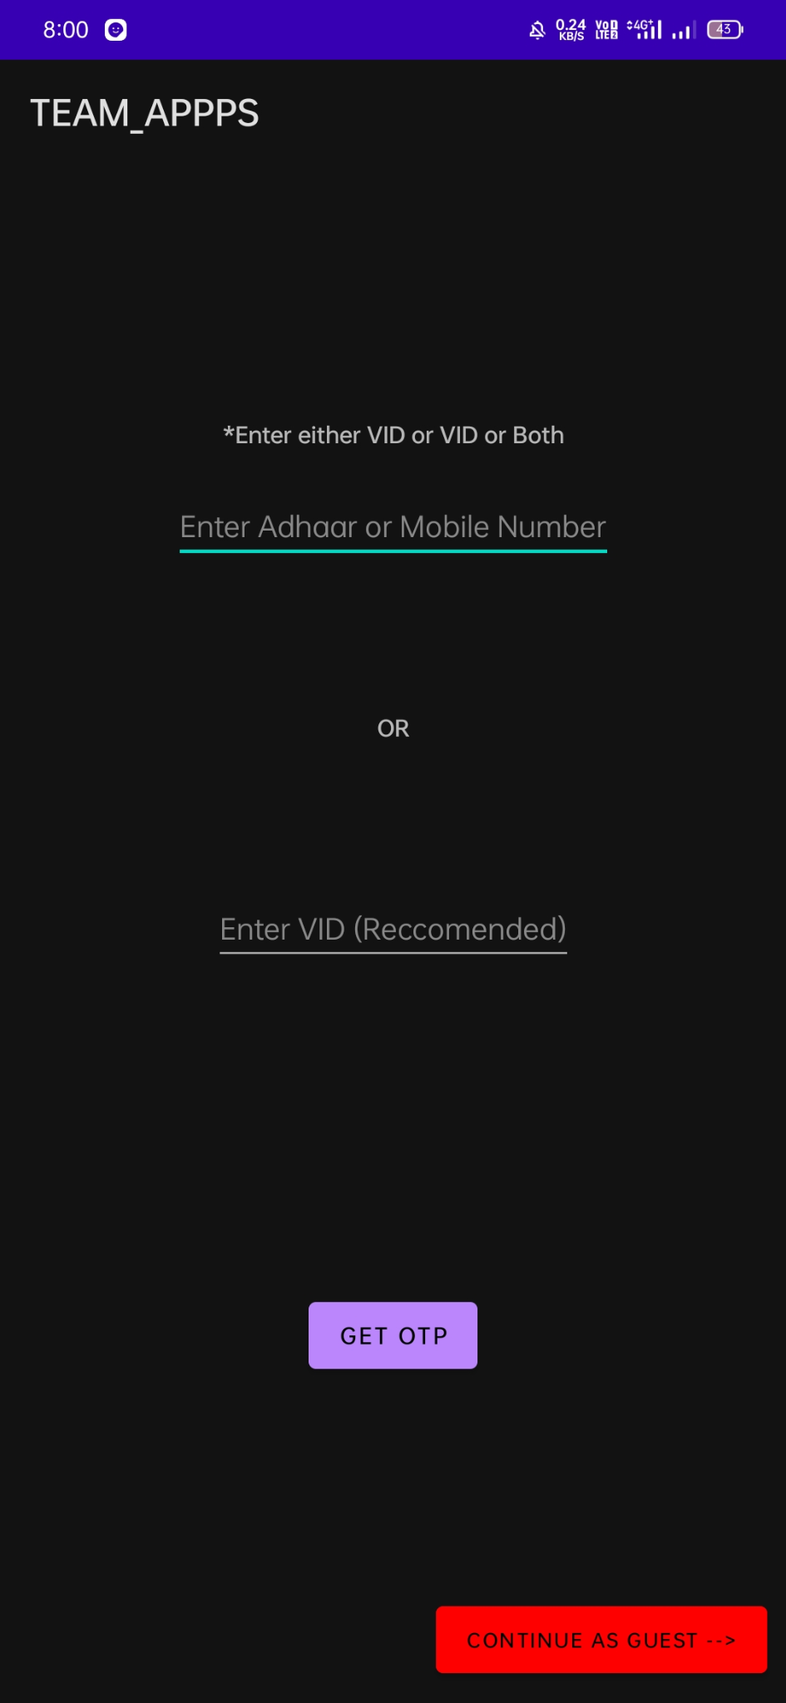
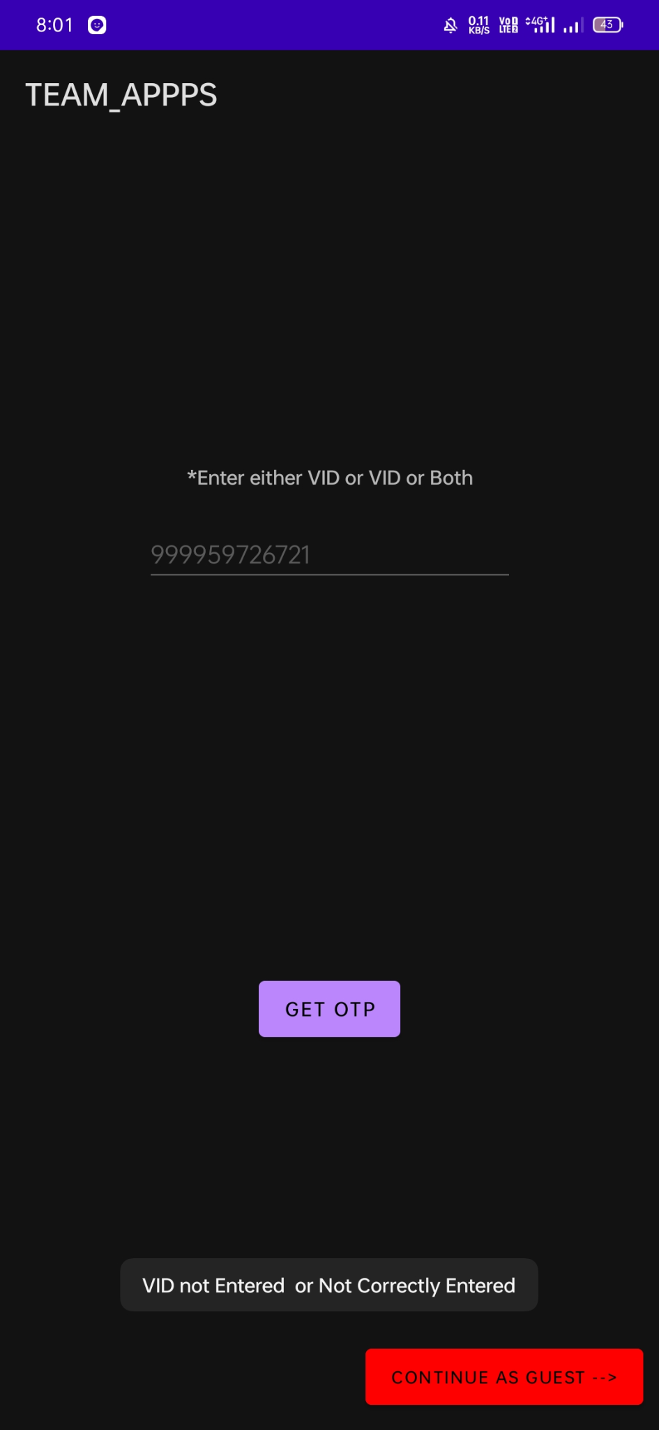
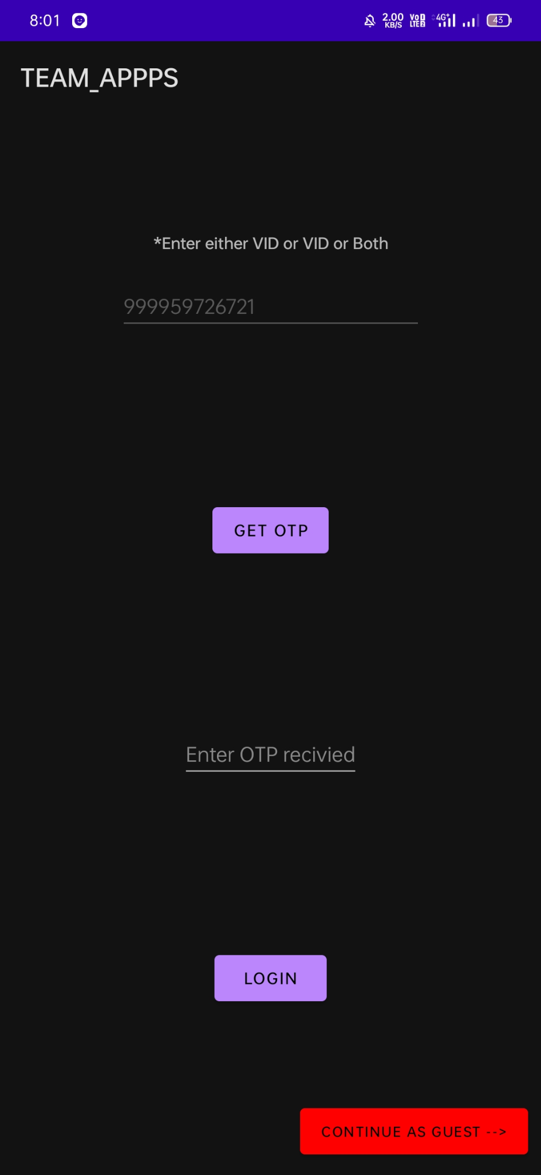
Launch Screen
OnCreate
On OTP Requested
On OTP Recieved

Slide 4
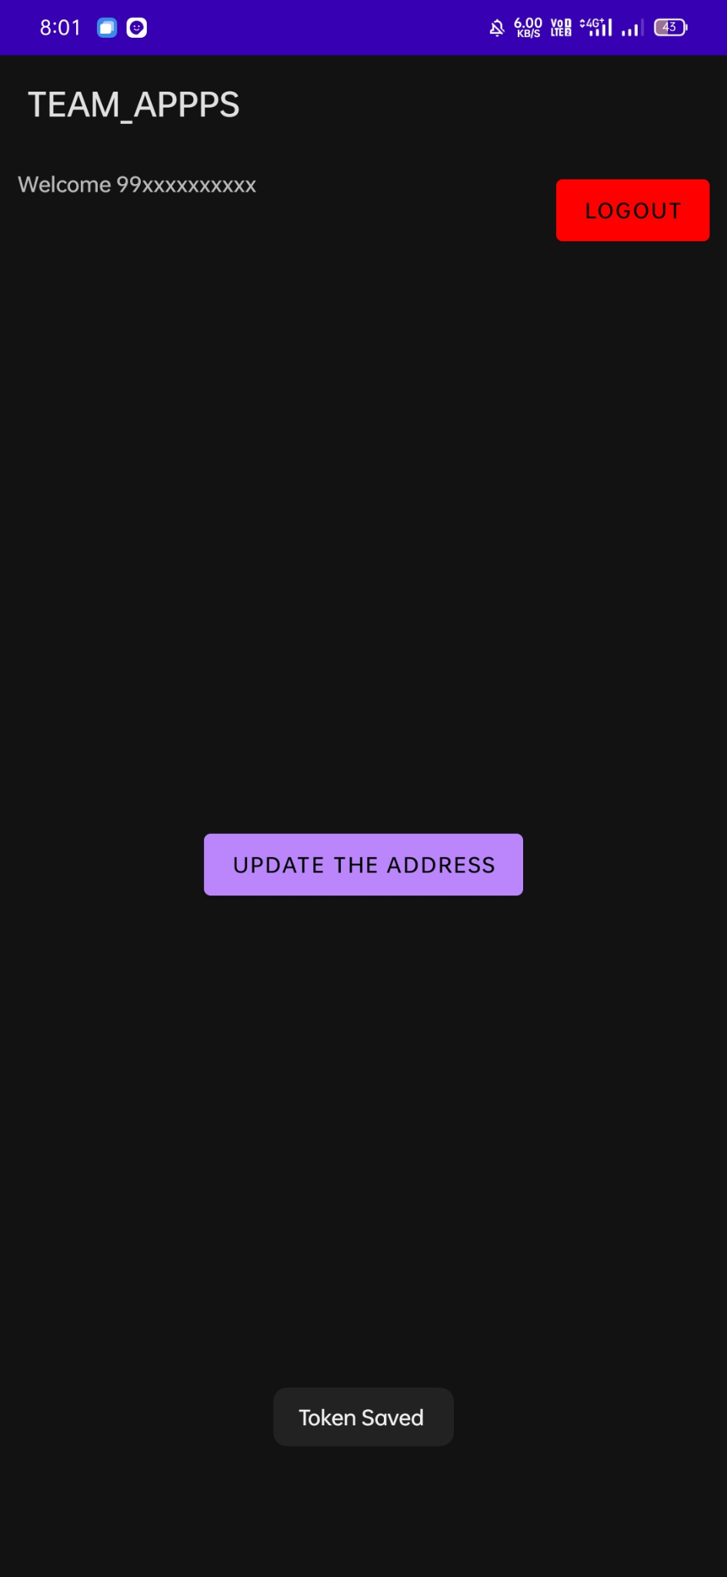
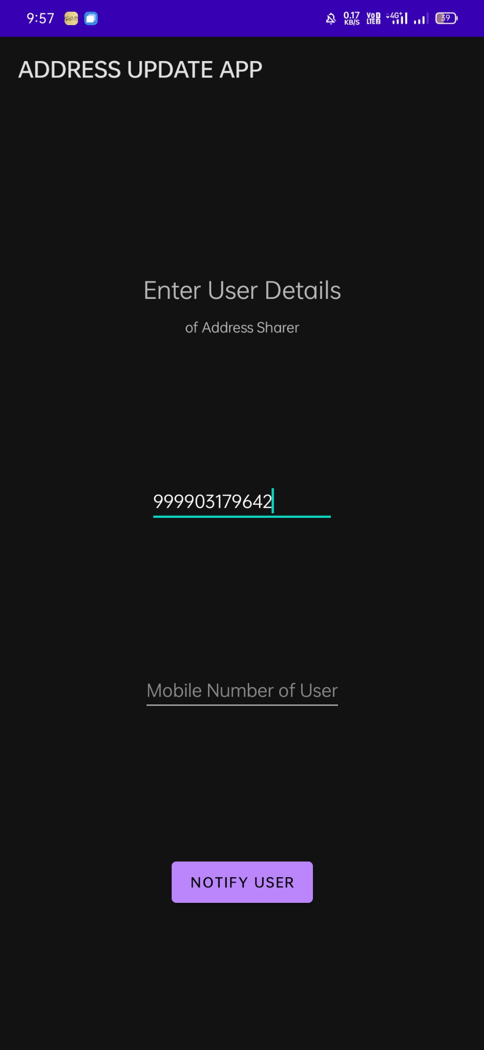
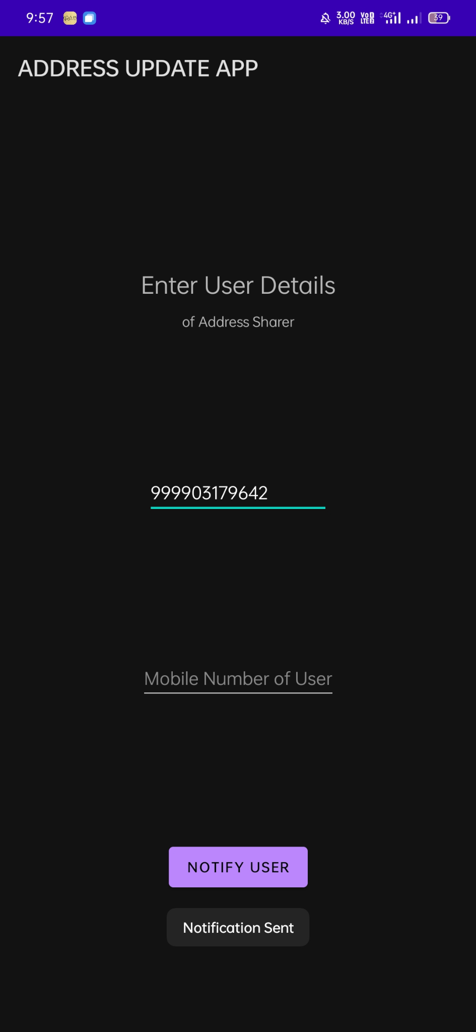
Dashboard Screen
User Details
After Notification to Landlord is Sent

Slide 5
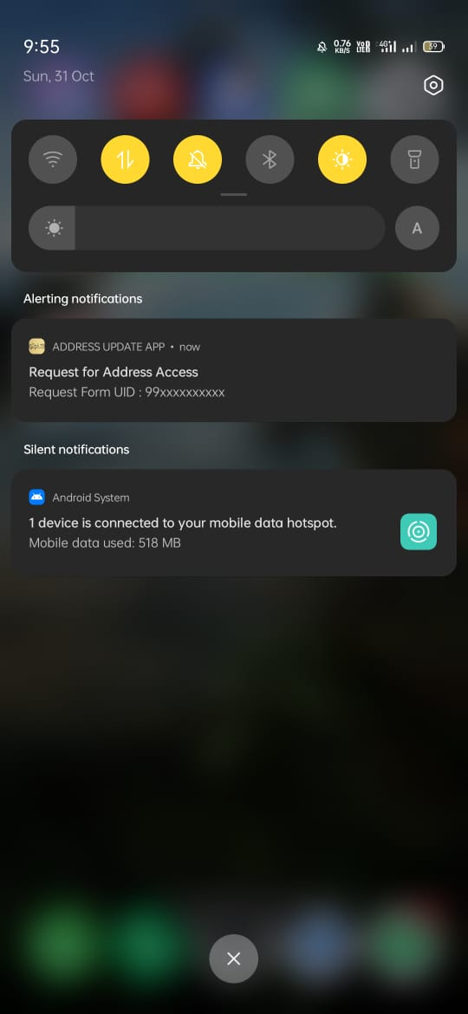
Landlord Receiving the Notification

Slide 6
PS2-Mobile Operator App
Walkthrough-
Android application built on android studio using Java.
Aimed as a solution for problem statement 2.
Uses Firebase ML Vision for text OCR.
Uses Google Maps API for address validation.
Minor changes to address can be made.
Changes made to the address are again validated.
Final address can be submitted and stored to a database.

Slide 7
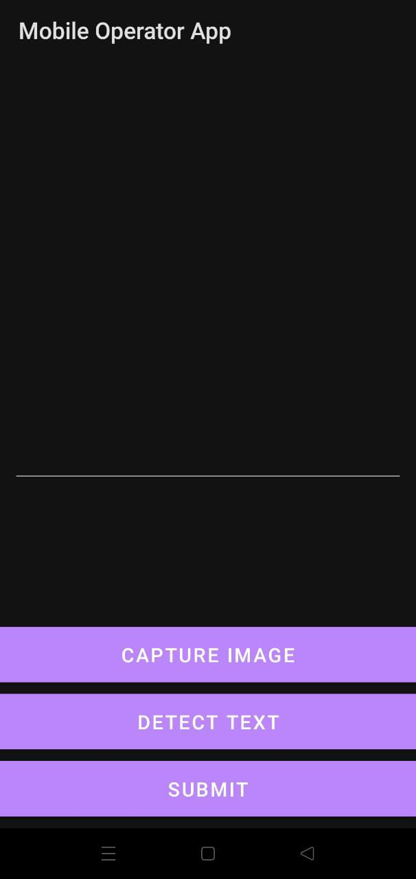
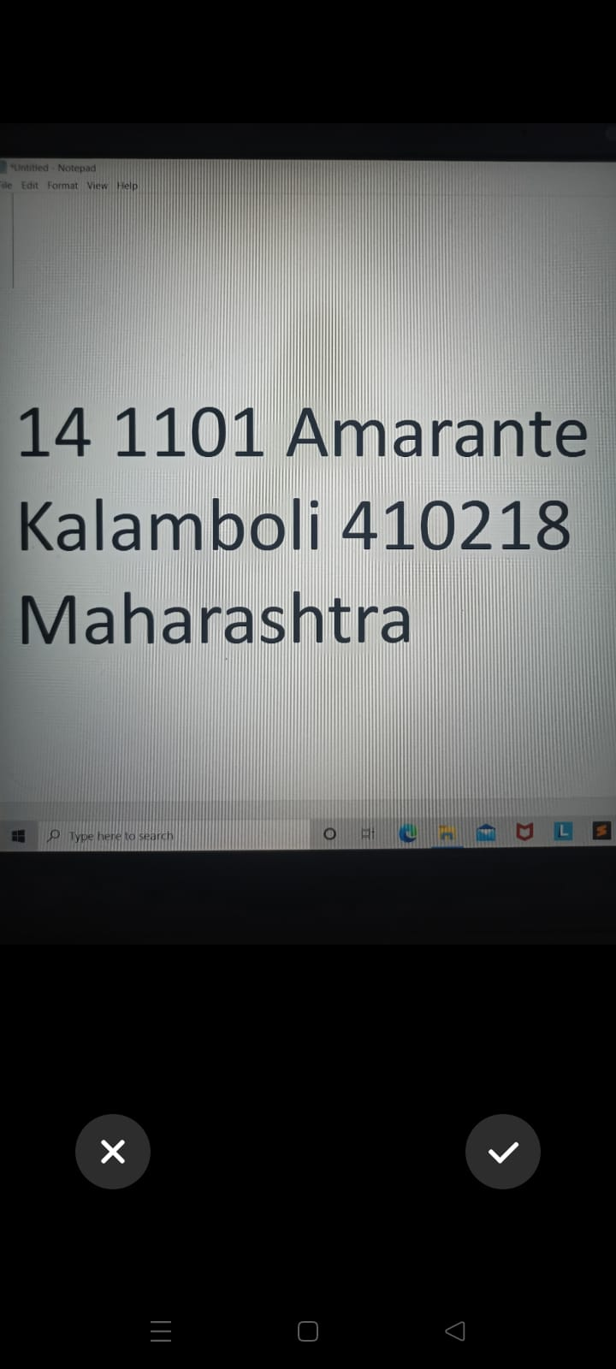
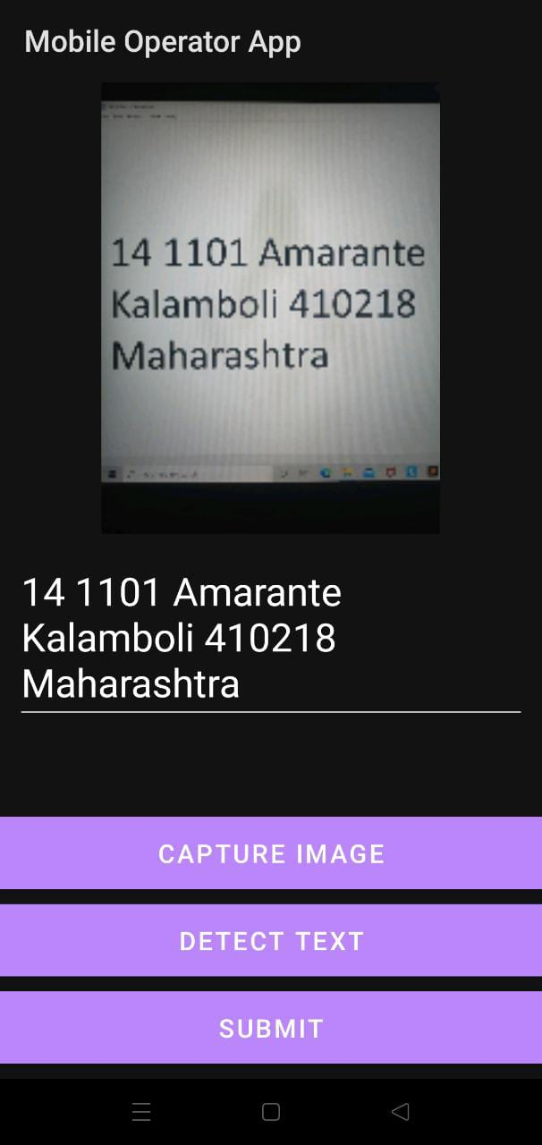
1) Main Screen
2) Sample Address captured with camera
3) Address text detected from image

Slide 8
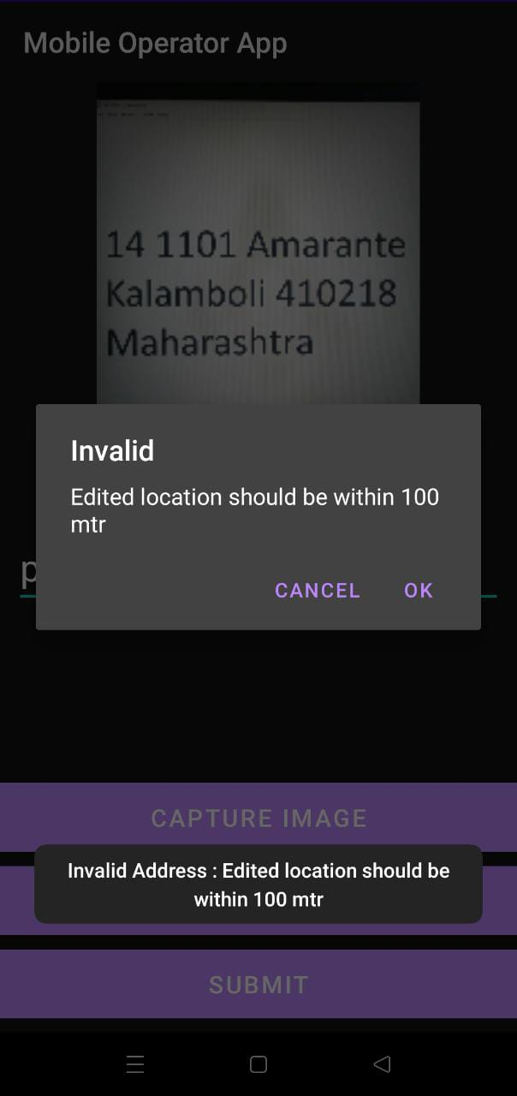
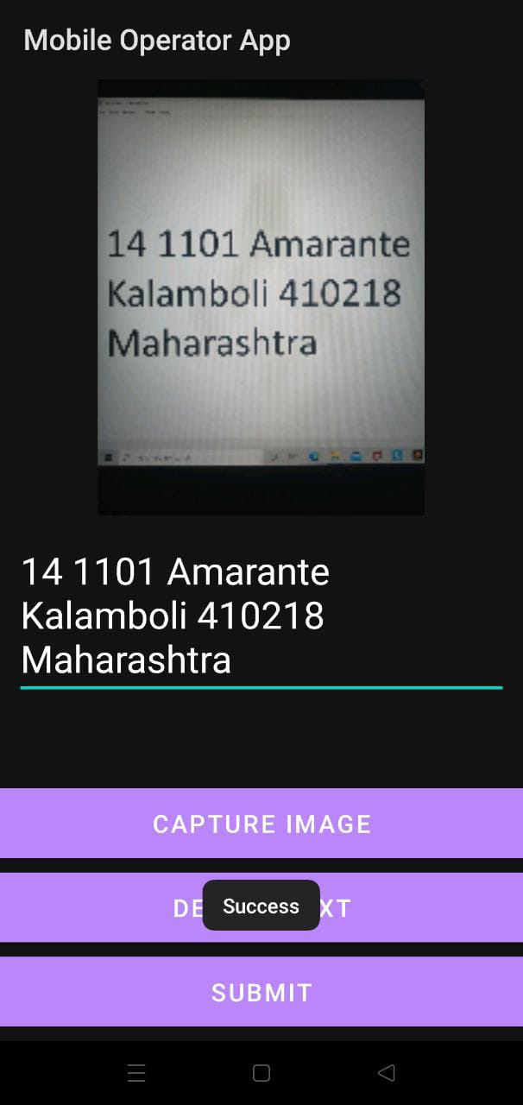
4)Invalid if major changes made to address
5) Saves if valid changes made

Slide 9
PS3 - Address Formatting API
REST API for proper formatting of address.
Creates a web based server.
Tesseract-OCR API to convert the image address to a corresponding text address.
Supports 100 different languages.
Formatted address can be viewed on localhost.

