Slide 1
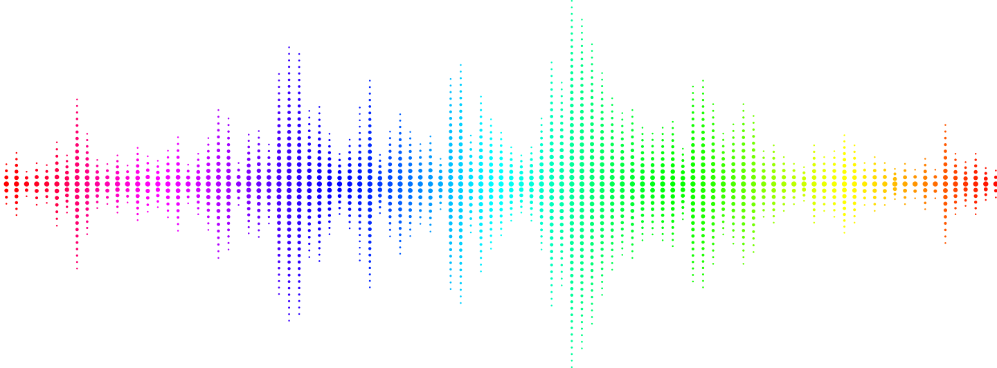

Sardar Patel Institute of Technology
Bachelor of Technology, Department of Electronics Engineering.
Speech Emotion Recognition Using Multilayer Feedforward Neural Network
Guided by :
Prof. Najib Ghatte and Prof. Sukanya Kulkarni
UID | NAME
2019110059 | Sruthi Shivaramakrishnan
2019110060 | Pushkar Sutar
2019110062 | Darshan Tater

Slide 2
Introduction:
Speech emotion recogniser detects emotions using human speech.
It can detect 7 to 8 emotions.
Commonly used emotion recognisers detect emotions through facial expressions which can be inaccurate.
This particular SER uses MLP classifier which is widely used for speech recognition, image recognition, etc.

Slide 3
Problems and Theories:
Emotions are important part of understanding human interactions.
The ability too understand people through spoken language is a skill that many humans beings take for granted.
On the contrary, the same task is not as easy for machines
Speech Emotion Recognition, abbreviated as SER, is the act of attempting to recognize human emotion and affective states from speech.

Slide 4
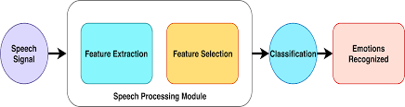
Problems and Theories:
Capitalizing on the fact that voice often reflects underlying emotion through tone and pitch, analyzing the tones and frequency of their speech, emotion can be determined through speech upto a certain limit of precision.

Slide 5
Problems and Theories:
SER have been used in places where customer interaction is important.
This process is used in call centres companies.
The employees of these call centres recognize customers’ emotions from speech, so that they can improve their service and convert more people.
It also kind of measures feeling of excitement.
Voice data were collected from the personnel of military medical corps participating in a special stressful mission.
The techniques of emotion recognition may be used for screening of mental status in military situation.

Slide 6
Description of Proposed Work :
Classes of emotion recognition - acoustic, visual and lexical. We focus on acoustic features.
Discrete classification of emotions using neural networks.
Use of RAVDESS dataset for classification.
Features for extraction - MFCC, contrast and MEL.
Training the model on MLP classifier for feature extraction.
Using three- layer classification neural network.

Slide 7
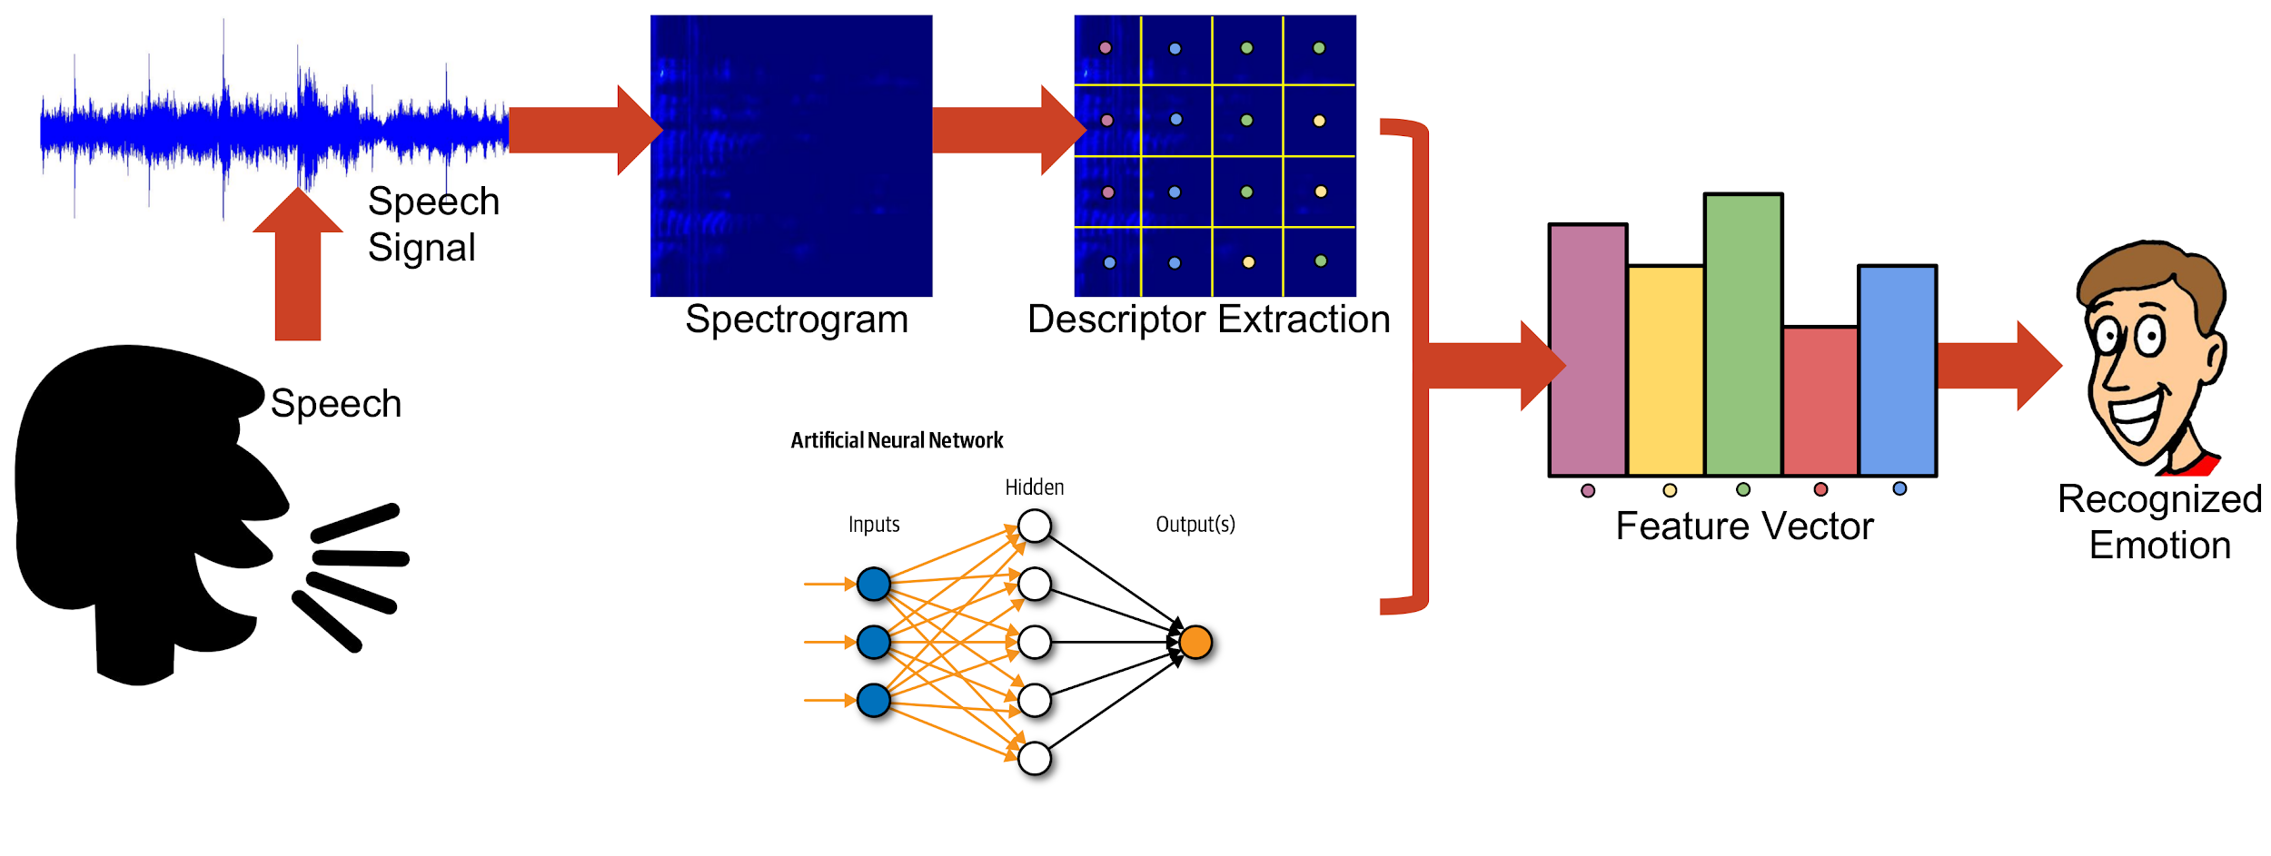
Description of Proposed Work :

Slide 8
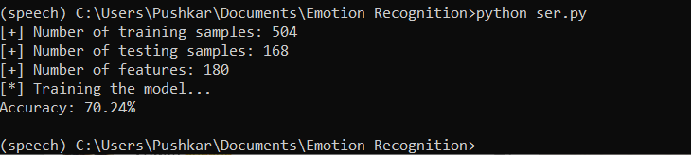
Results and Discussions :
Result based on accuracy metric for neural networks.
Accuracy of 70.24% on the training RAVDESS dataset.
MLP classifier model used gives better accuracy than other models like SVM and XGB. The accuracy is lower compared to CNN model.
Accuracy can be improved by using hyperparameter tuning and audio pre-processing.

Slide 9
Conclusions :
Leverage machine learning to obtain underlying emotion from speech.
Prediction can be done on raw audio data with very good accuracy.
Model has small complexity and low time cost for training.
This system can be employed in various setups like - Call centres for complaints and marketing, chatbots, linguistic researches etc.

Slide 10
References:
[1] “Data flair training: python speech emotion recognition”, DataFlair, 2021 [Online], Available:https://data-flair.training/blogs/python-mini-project-speech-emotion-recognition/
[2] L. Z. Ruiz, R. P. V. Alomia, A. D. Q. Dantis, M. J. S. San Diego, C. F. Tindugan and K. K. D. Serrano, "Human emotion detection through facial expressions for commercial analysis," 2017IEEE 9th International Conference on Humanoid, Nanotechnology, Information Technology, Communication and Control, Environment and Management (HNICEM), Manila, Philippines, 2017, pp. 1-6, doi: 10.1109/HNICEM.2017.8269512.
[3] Castellano G., Kessous L., Caridakis G. (2008) Emotion Recognition through Multiple Modalities: Face, Body Gesture, Speech. In: Peter C., Beale R. (eds) Affect and Emotion in Human-Computer Interaction. Lecture Notes in Computer Science, vol 4868. Springer, Berlin, Heidelberg. https://doi.org/10.1007/978-3-540-85099-1_8

Slide 11

QUESTIONS?

