Slide 1

RVS COLLEGE OF ENGINEERING AND TECHNOLOGY, JAMSHEDPUR
DEPARTMENT OF COMPUTER SCIENCE AND ENGINEERING
NEXUS:
AGENTIC AI OPERATING SYSTEM
User Intent ➔ Autonomous Multi-Agent DAGs ➔ Controlled Computer Execution
Presented By: Group A5
Under the Guidance of
1. Pushkar Raj (CSE/073/23)
2. Chandan Kr. Sah (CSE/074/23)
3. Prince Tiwari (CSE/075/23)
4. Shruti Kumari (CSE/076/23)
Sulekh Kumar
Assistant Professor
Dept. of Computer Science & Engineering
RVSCET, Jamshedpur

Slide 2
Table of Contents
Roadmap of today's presentation
01. Introduction & Problem Statement
Why chatbots fail and what NEXUS solves
06. Comprehensive Technology Stack
Next.js 14, Tauri, FastAPI, PostgreSQL, Playwright
02. System Architecture
Dual surfaces, FastAPI core & decoupled layers
07. Policy Engine & 1-Click Rollback
4-tier risk matrix & SHA-256 snapshot recovery
03. Pictorial Workflow & Safety Pipeline
6-step execution & human verification loop
08. Demerits & System Limitations
Key engineering constraints & boundary conditions
04. Multi-Agent Orchestration
Specialist agents & dynamic self-correction
09. Future Scope & Engineering Roadmap
Vision perception, cross-platform & hardware keys
05. Models Used in NEXUS
Multi-provider AI Gateway (Gemini, Claude, GPT-4o)
10. Conclusion & Key Takeaways
Capability + Control + Observability + Reversibility

Slide 3
Introduction & Problem Statement
Bridging the gap between AI reasoning and safe real-world execution
THE PARADIGM SHIFT: FROM CONVERSATIONAL CHATBOTS ➔ TO ACTION-ORIENTED AGENTS
The Problem: AI Can Think, But Who Controls It?
The Objective: What NEXUS Achieves
✖ Chatbots Stop at Text: Generate answers but cannot execute commands, run tests, or modify code.
✖ Voice Assistants are Shallow: Siri/Alexa use hardcoded intent templates; zero multi-step planning or reasoning.
✖ Autonomous Scripts are Hazardous: Unchecked shell scripts ('bash -c') risk catastrophic file loss and infinite loops.
✖ No Safety or Undo: Traditional tools have no pre-execution snapshots or rollback mechanisms.
✔ Autonomous Planning: Transforms natural language into structured Directed Acyclic Graphs (DAGs).
✔ Air-Gapped Policy Engine: Every action is evaluated against a 4-Tier Risk Matrix (LOW to CRITICAL).
✔ Unified Diff Approvals: Inspect exact line-by-line file changes before modifying any workspace files.
✔ 1-Click Rollback: Pre-execution SHA-256 snapshots allow instant recovery if anything goes wrong.

Slide 4
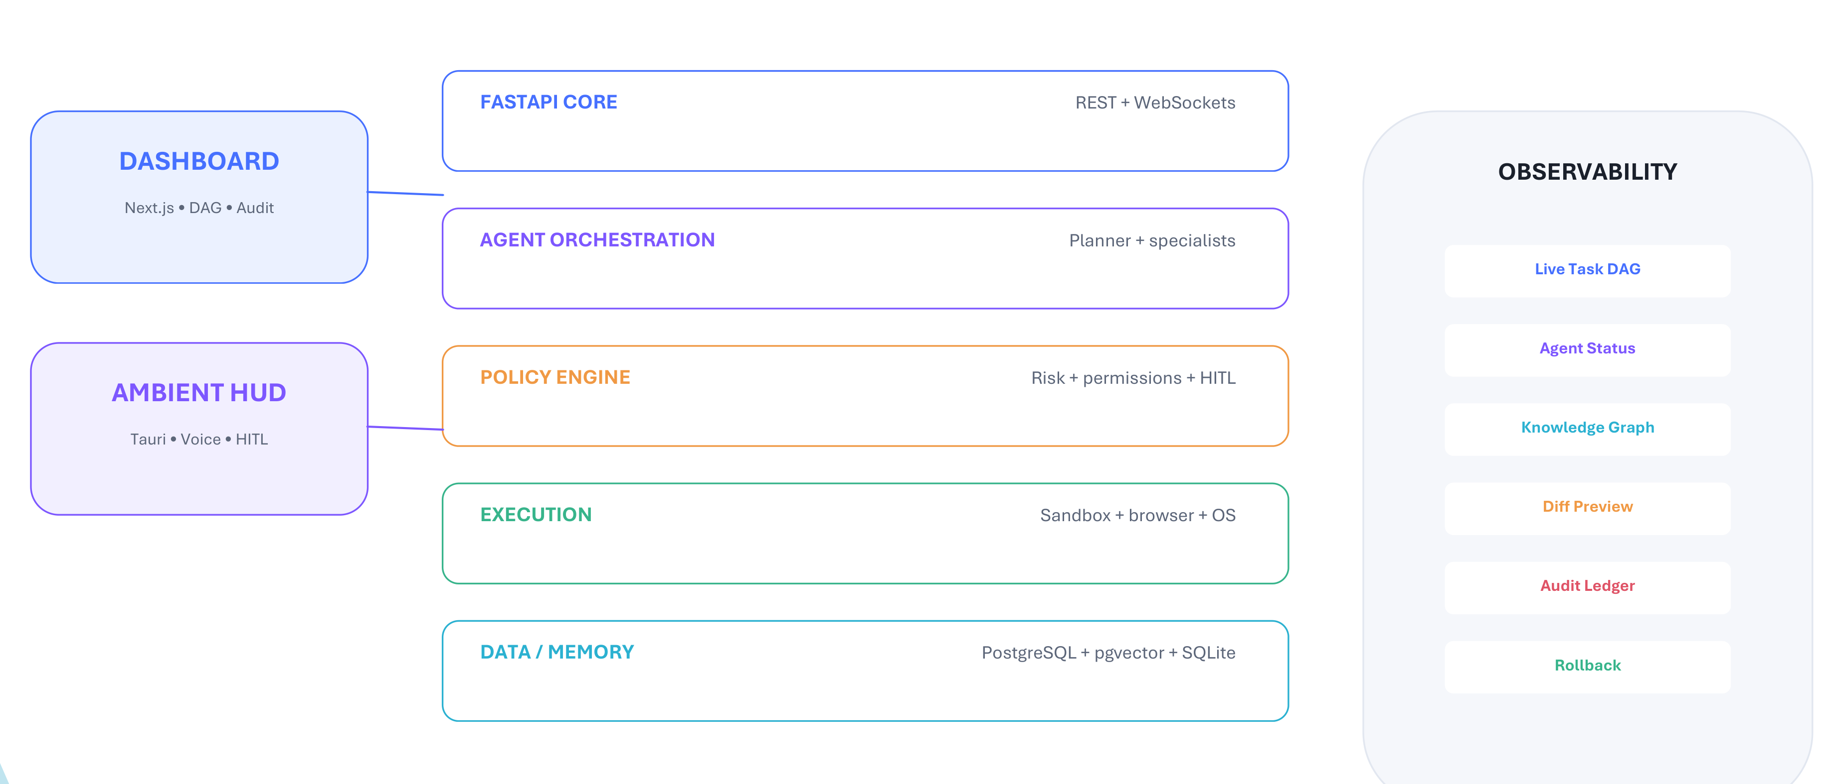
System Architecture
Decoupled multi-tier design separating reasoning, governance, and execution
CORE ARCHITECTURAL HIGHLIGHTS:
• Dual Interaction Surfaces: Next.js 14 Dashboard (Web) + Tauri Rust Ambient HUD (Spotlight Overlay)
• Air-Gapped Trust: Reasoning models have ZERO direct shell access; all operations pass through Policy Engine.

Slide 5
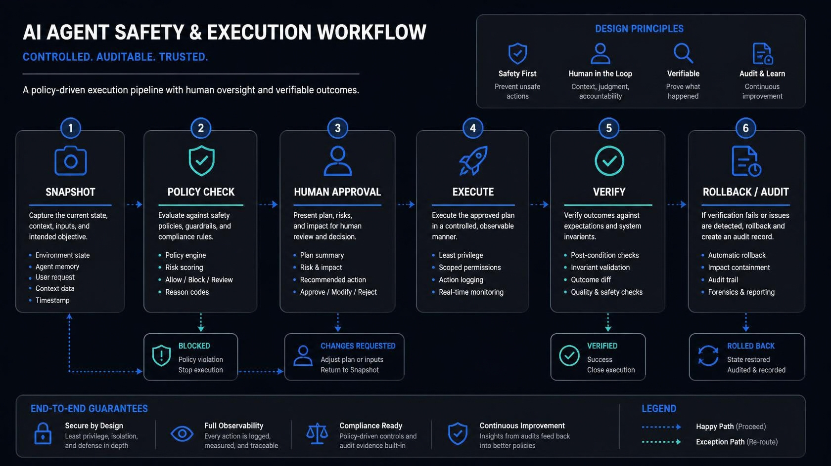
AI Agent Safety & Execution Workflow
The 6-step deterministic pipeline: Snapshot ➔ Policy ➔ Approval ➔ Execution ➔ Verification ➔ Rollback
KEY WORKFLOW INVARIANTS:
1. Pre-execution snapshots capture SHA-256 hashes BEFORE mutation | 2. Policy Engine halts on HIGH/CRITICAL actions
3. Git-style unified diffs eliminate ambiguity | 4. Invariant verification triggers dynamic replanning or 1-click rollback.

Slide 6
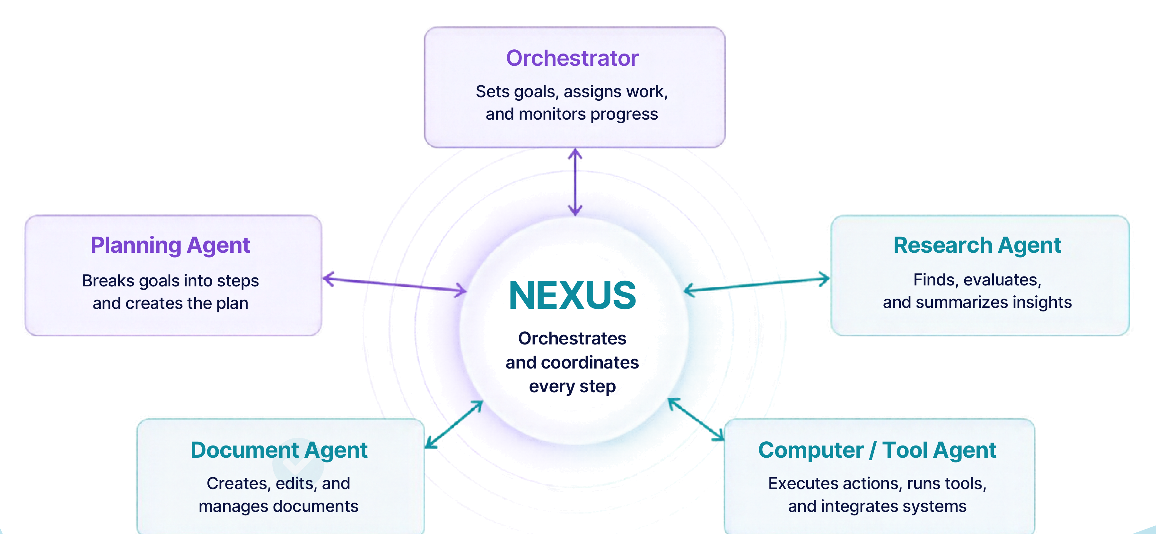
Multi-Agent Orchestration & Self-Correction
Specialist agents collaborating via Directed Acyclic Graphs with Phase 15 self-healing
AUTONOMOUS SELF-HEALING ENGINE (PHASE 15):
• ErrorClassifier: Identifies runtime errors (TIMEOUT, SYNTAX_ERROR, COMMAND_NOT_FOUND)
• DAGPatcher: Dynamically splices recovery steps into the active plan with strict replan budgets to avoid loops.

Slide 7
AI Models Used in NEXUS
Provider-agnostic intelligence unified behind Pydantic v2 structured outputs
Google Gemini
Anthropic Claude
OpenAI
Local / Ollama
gemini-1.5-pro / 2.0-flash
Primary Reasoning & Multimodal
• 1M+ token context window for full-repo indexing
• Native screenshot and document vision analysis
• Fastest token throughput for sub-second responses
claude-3-5-sonnet
Task Planning & Code Synthesis
• Top-tier DAG plan synthesis & tool accuracy
• Deep comprehension of negative constraints
• Exceptional Python/TypeScript code generation
gpt-4o / o1 reasoning
Mathematical & Algorithmic Logic
• Multi-step algorithmic verification
• High reliability in JSON schema conformance
• Comparative benchmark evaluation baseline
Llama 3 / Mistral / DeepSeek
Private & Offline Execution
• Zero cloud telemetry for sensitive corporate data
• Runs on local workstation GPU/CPU
• Cost-free development and offline fallback
STRUCTURED OUTPUT & TOKEN LEDGER GUARANTEE:
• Every model response is strictly parsed and validated against Pydantic v2 schemas—guaranteeing 0% JSON syntax failures.
• Token & Cost Ledger: Real-time calculation of input/output token costs across every execution step.

Slide 8
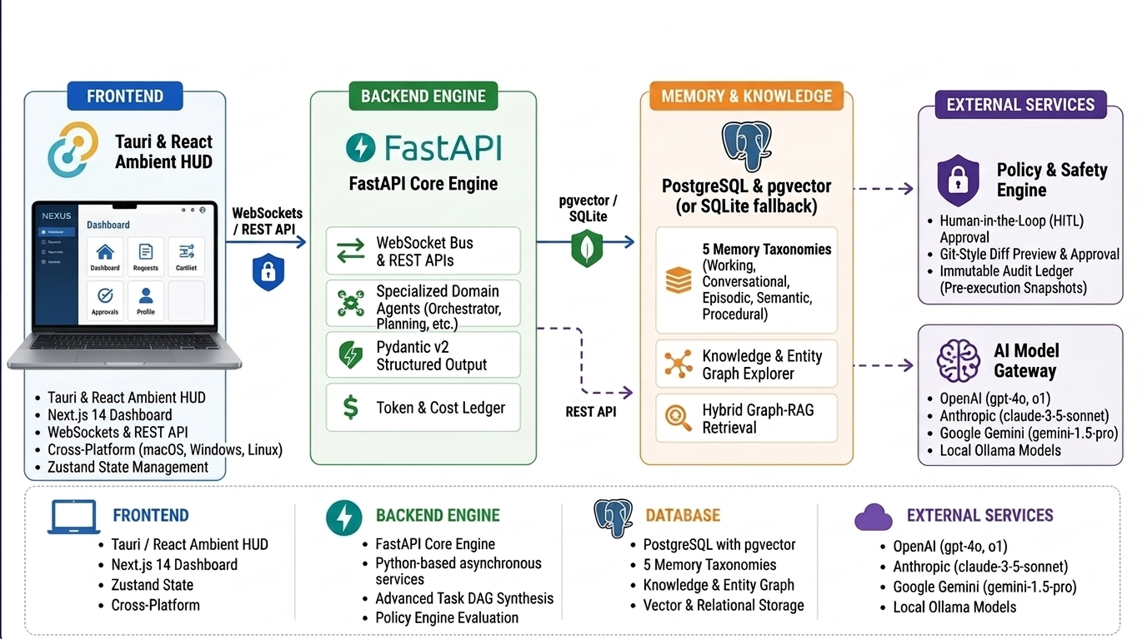
Technology Stack
Modern full-stack architecture built on a high-performance Python core
FULL-STACK RIGOR & AUTOMATION:
• Frontend: Next.js 14, React 18, TypeScript 5.4, Tailwind CSS | Desktop: Tauri 1.5 (Rust core, <100ms launch latency)
• Backend: FastAPI, SQLAlchemy 2.0, Alembic, PostgreSQL + pgvector | Testing: 194 passing Pytest automated test suites.

Slide 9
Policy Engine & 1-Click Rollback
Deterministic safety governance and instant state reversion
4-Tier Risk Matrix (Air-Gapped Governance)
Reversibility & 1-Click Rollback
• LOW (Autonomous): Read-only inspection, file reading, system metrics. Runs automatically without user interruption.
• MEDIUM (Session Grant): Non-destructive scripts, running pytest test suites. Authorized via session-scoped permission.
• HIGH (Mandatory HITL): Modifying project code, external browser clicks. Requires interactive git-style diff approval.
• CRITICAL (Immediate Confirm): Destructive deletes ('rm -rf'), dropping tables. Direct confirmation required; NEVER cached.
✔ Pre-Execution SHA-256 Snapshots: Captures exact byte copies before any tool modifies or deletes a workspace file.
✔ Live Unified Diff Previews: Approval modals display exact green (+) additions and red (-) deletions.
✔ State Drift Detection: Halts rollback safely if target files were modified by an external process.
✔ 1-Click State Restoration: Restores original file contents and directory structures cleanly with one click.
✔ Append-Only Audit Ledger: Every prompt, decision, tool run, and token cost is permanently saved to an immutable database log.

Slide 10
Demerits & System Limitations
Academic transparency: Key trade-offs and engineering constraints
1. Multi-Step Latency
2. External Irreversibility
3. OS Platform Gating
4. Web DOM Layout Drift
Coordination Overhead
• Decomposing tasks into DAGs and policy checks adds 1.5 - 3s latency compared to raw prompt chatbots.
• Multi-turn self-reflection loops can increase end-to-end task execution time.
Network & API Boundaries
• Filesystem mutations are 100% reversible; however, external network calls (sent emails, webhooks) cannot be undone.
• Requires strict HIGH/CRITICAL classification for all external mutating calls.
Permissions & Accessibility
• Deep desktop control requires explicit macOS Accessibility (AXIsProcessTrusted) and Screen Recording permissions.
• Cross-platform parity on Windows & Linux requires containerized subprocess adapters.
Browser Automation Fragility
• Playwright browser automation can experience selector failures if third-party web apps deploy sudden UI changes.
• Mitigated by combining text matching with accessibility tree resolution.

Slide 11
Future Scope & Engineering Roadmap
Advancing toward ubiquitous, safe agentic computing
Phase 16: Academic Benchmark Suite
Multimodal Vision Screen Perception
Formal Ablation Experiments
• Standardized benchmark test harness across software engineering, sysadmin, and research tasks.
• Formal ablation studies: Baseline LLM vs. RAG vs. Memory-RAG vs. Full Agentic NEXUS.
• Quantitative evaluation of Task Success Rate, Latency, Cost ($), and 0.0% Safety Violations.
Vision-in-the-Loop Desktop Control
• Expands beyond accessibility trees to real-time multimodal screen vision perception.
• Enables navigation of custom HTML Canvas applications, legacy desktop GUIs, and CAD software.
Full Cross-Platform Parity
Hardware-Gated Approvals
Linux & Windows Native Subsystems
• Linux integration via Wayland / X11 and native D-Bus system bus.
• Windows support via UI Automation APIs and sandboxed PowerShell execution.
Cryptographic Touch ID / WebAuthn
• Touch ID and WebAuthn hardware security keys to sign CRITICAL-tier actions.
• Eliminates stolen-session risks during production cloud deployments and irreversible actions.

Slide 12
Conclusion & Key Takeaways
The synthesis of autonomous capability and uncompromised user safety
“Give AI the ability to act — without giving up control.”
Capability + Control + Observability + Reversibility = Trustworthy Agentic AI
Proven Engineering Rigor
True Agentic Operating System
Safe by Architectural Design
✔ 15 completed development phases backed by a formal constitution.
✔ 194 automated unit and integration tests passing.
✔ Strict Pydantic v2 and TypeScript static type validation.
✔ Beyond text generation: natively drives terminals, browsers, and desktop apps.
✔ Dynamic DAG replanning and self-correction to recover from failures.
✔ Dual surfaces: Analytical Web Cockpit + Lightweight Ambient HUD.
✔ Air-gapped Policy Engine enforcing 4-tier risk classification.
✔ Git-style unified diffs eliminate ambiguity during approvals.
✔ 1-click snapshot restoration guarantees protected user workspaces.

Slide 13
Thank You!
Questions & Answers
NEXUS: Agentic AI Operating System
Department of Computer Science & Engineering • RVSCET, Jamshedpur
Group A5: Pushkar Raj (073) • Chandan Kr. Sah (074) • Prince Tiwari (075) • Shruti Kumari (076)
Under the guidance of: Sulekh Kumar (Assistant Professor, CSE)

