Slide 1
Simple Linear Regression

Slide 2
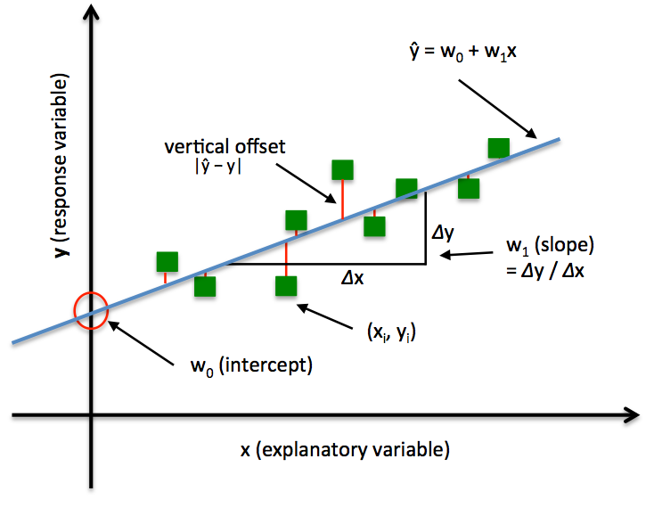

Slide 3
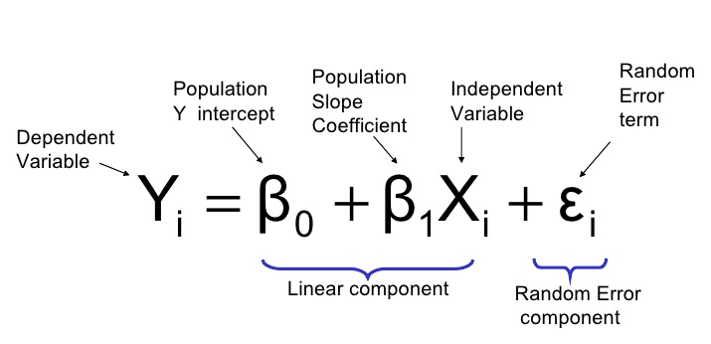
Formula

Slide 4
Example
Bill | Bill Amount | Tip Amount
1 | 34 | 5
2 | 108 | 17
3 | 64 | 11
4 | 88 | 8
5 | 99 | 14
6 | 51 | 5
Mean | 74 | 10

Slide 5
Example
Bill | Bill Amount Xi | Tip Amount Yi | (Yi-Y) | (Yi-Y)ˆ2 | (Xi-X) | (Xi-X)ˆ2 | (Xi-X) * (Yi-Y)
1 | 34 | 5 | -5 | 25 | -40 | 1600 | 200
2 | 108 | 17 | 7 | 49 | 34 | 1156 | 238
3 | 64 | 11 | 1 | 1 | -10 | 100 | -10
4 | 88 | 8 | -2 | 4 | 14 | 196 | -28
5 | 99 | 14 | 4 | 16 | 25 | 625 | 100
6 | 51 | 5 | -5 | 25 | -23 | 529 | 115
Sum | 444 | 60 |  | 120 |  | 4206 | 615

Slide 6
Final Equation
Formula :: Y = β0 + β1* X
β1 = (Xi-X)*(Yi-Y)/ (Xi-X)ˆ2
615 / 4206 = 0.1462
β0 = Y - β1 * X
= 10 - (0.1462 * 74) = -0.8188
Final equation is ::
Y = -0.8188 + (0.1462) * X

Slide 7
Example
Bill | Bill Amount Xi | Tip Amount Yi | Yip | (Yi-Yip) | (Yi-Yip)ˆ2
1 | 34 | 5 | 4.1505 | 0.8495 | 0.7217
2 | 108 | 17 | 14.9693 | 2.0307 | 4.1237
3 | 64 | 11 | 8.5365 | 2.4635 | 6.0688
4 | 88 | 8 | 12.0453 | -4.0453 | 16.3645
5 | 99 | 14 | 13.6535 | 0.3465 | 0.1201
6 | 51 | 5 | 6.6359 | -1.6359 | 2.6762
Sum | 444 | 60 |  |  | 30.075

Slide 8
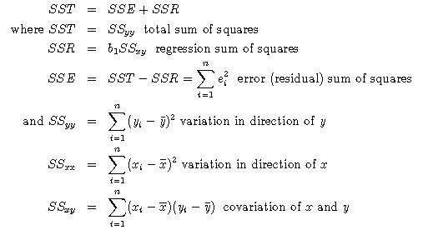
SST, SSR ,SSE
SST :: Total sum of squares
SSR :: Sum of squares due to regression
SSE :: Sum of squared errors
For Our example ::
SST = 120
SSE = 30.075
SSR = SST-SSE = 89.925

Slide 9
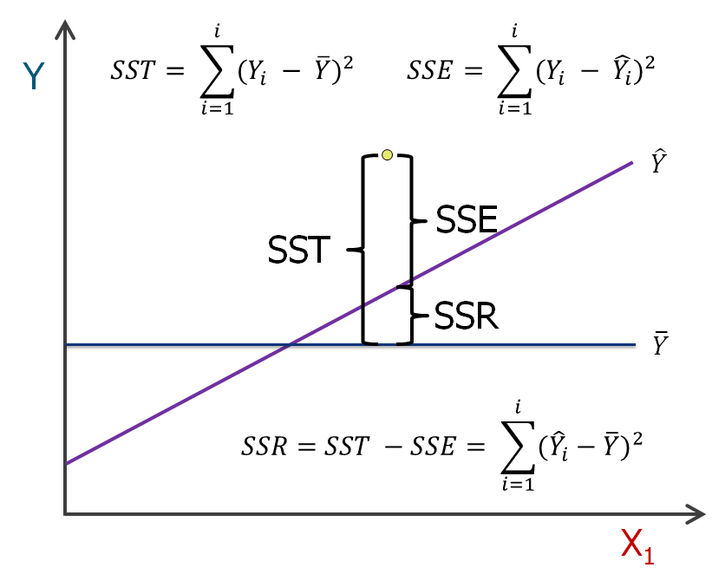
SST, SSR, SSE

Slide 10
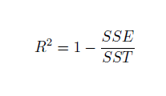
R-Square
R-squared is a statistical measure that’s used to assess the goodness of fit of our regression model.
R-squared can take value between 0 and 1 where values closer to 0 represent a poor fit while values closer to 1 represent a perfect fit .
R-squared will be maximum when SSE/SST will be minimum.
In order for SSE/SST to be minimum SSE should be minimum.
Now SSE will decrease as we add more explanatory variables to our model. This is because as we add more explanatory variables to our regression model ,our regression model will fit the data points better and hence sum of squared error will reduce. Hence R-squared will increase even when the variable is not significant to our model.

Slide 11
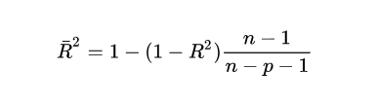
Adjusted R-Square
Adjusted R-squared simply penalizes the model for adding more useless variables.
n=no of data points
p=no of independent variables used in the model
R-squared tells you how well your model fits the data points whereas Adjusted R-squared tells you how important is a particular feature to your model.

