Slide 1

XZORBIT
Group 37
BY x-SOCIETY:
AYUSH JHA
PUSHKAR SINGH
ANSHUMAN BEHURA
MARIO JUDE

Slide 2
Problem Statement & Our Approach:
Traditional LMS platforms are fragmented, generic, and not optimized for college workflows.
Students face poor UI/UX, limited interactivity, and lack of unified systems.
Faculty struggles with course management and real-time progress tracking.
XZORBIT bridges this gap with a single, unified platform tailored for colleges.

Slide 3
Key Features Overview:
Admin Panel: User/course management, announcements, analytics dashboard.
Faculty Panel: Upload content, assignments, quizzes; track student progress.
Student Panel: Enroll in courses, access lectures, take quizzes, view grades.
Bonus: Push notifications, real-time chat, plagiarism detector.

Slide 4
Tech Stack & Architecture:
Frontend: HTML & CSS
Backend: LAMP
Database: MySQL to store user data
Authentication: JWT

Slide 5
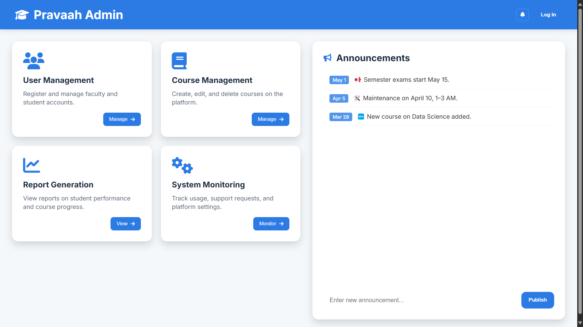
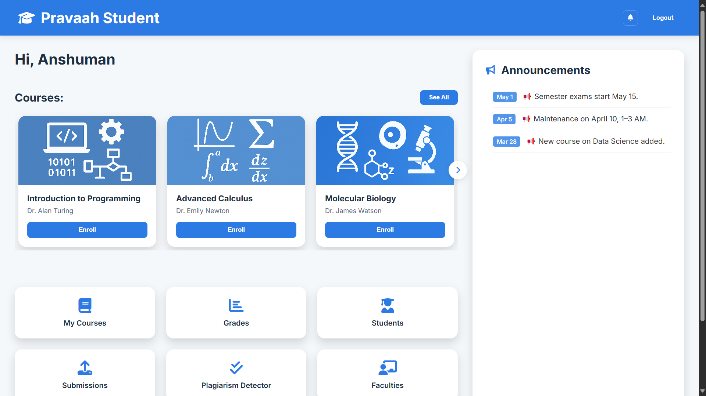
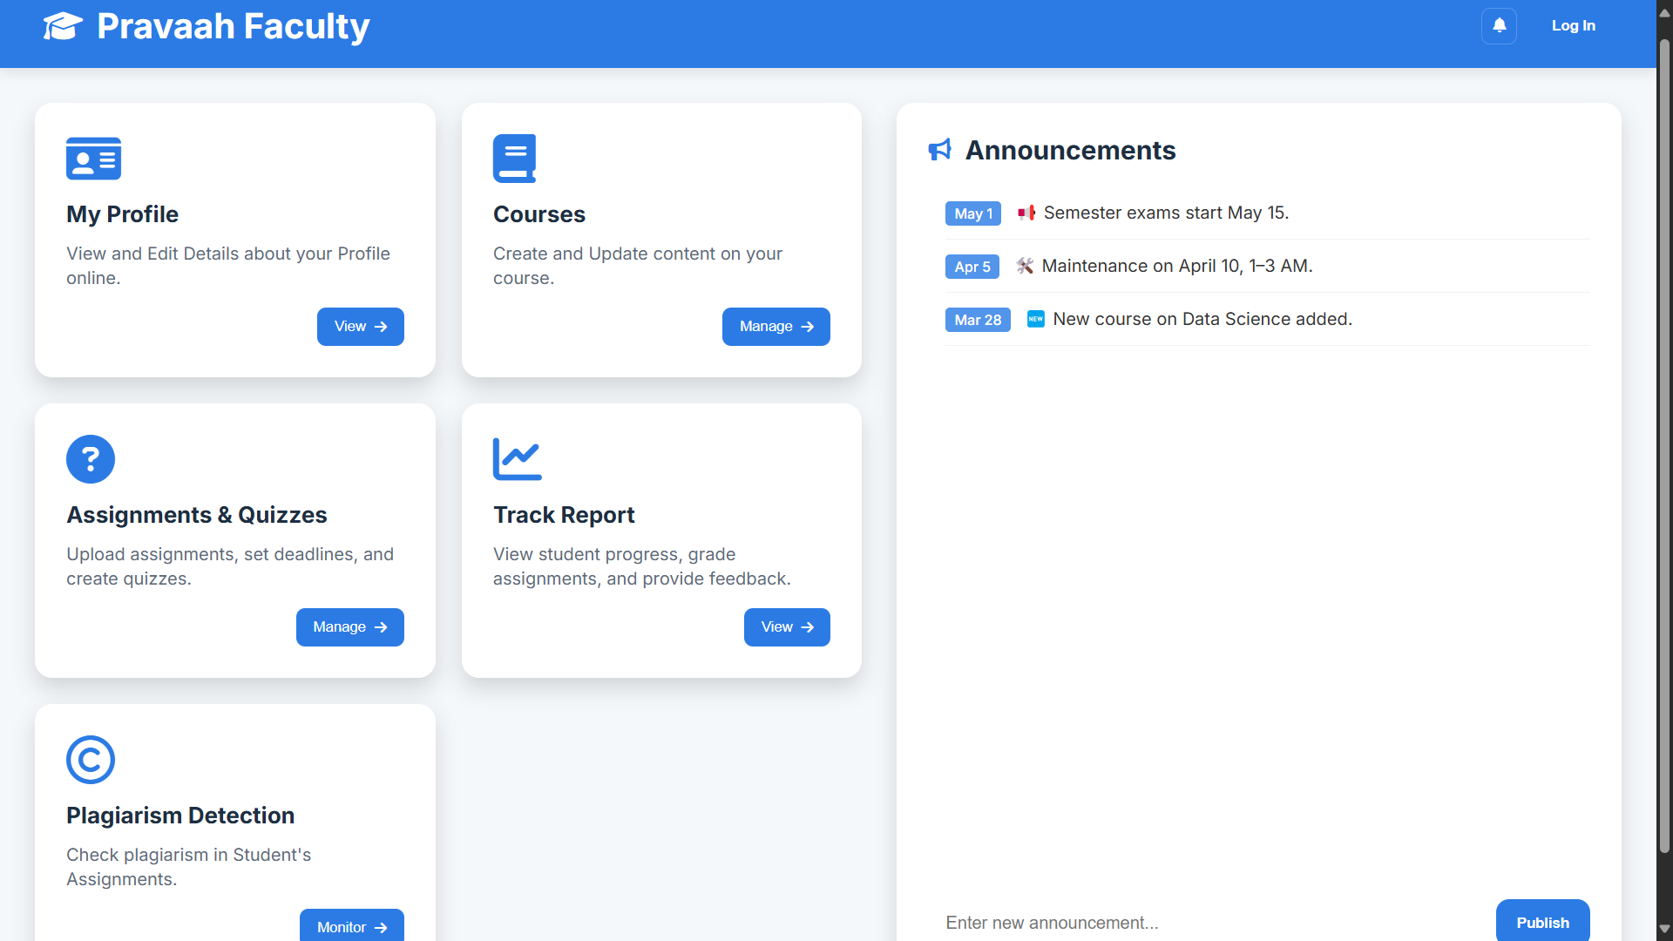
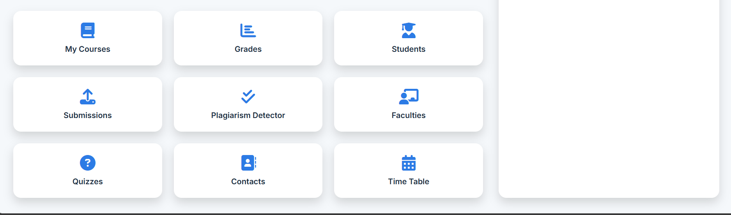
SCREENSHOTS:
ADMIN PORTAL
STUDENT PORTAL
FACULTY PORTAL

