Slide 1
Capstone Project
Airbnb booking analysis
By-
PUSHKAR SRIVASTAVA
RAHUL PANDEY

Slide 2
INTRODUCTION SUMMARY
In this project we are analyzing on airbnb data of 2008
This dataset has around 49,000 observations in it with 16 columns and it is a mix between categorical and numeric values
which describes information regarding the Airbnb property listings, host, location, property type, price, minimum nights, number of reviews, and availability.
Our goal here is to perform an exploratory data analysis on the Airbnb NYC dataset, which could help in understanding the story the dataset entails.

Slide 3
PROBLEM STATEMENT
Explore and analyze the data to discover key understandings (not limited to these) such as :
What can we learn about different hosts and areas?
What can we learn from predictions? (ex: locations, prices, reviews, etc)
Which hosts are the busiest and why?
Is there any noticeable difference of traffic among different areas and what could be the reason for it?

Slide 4
CLEANING OF DATA
We will start our exploratory data analysis by first taking a look at our data.Analyzing the provided variables and if there is any need of cleaning the dataset.Four of the sixteen variables have inconsistency in its value(name,host_name,last_reviews,reviews_per_month)name, host_name and last_review will not be useful to the analysis as they have more then 20 percent data missing so they can be droped.reviews_per_month column has nan values which must be replaced by zeros in order to make our data meaningful

Slide 5
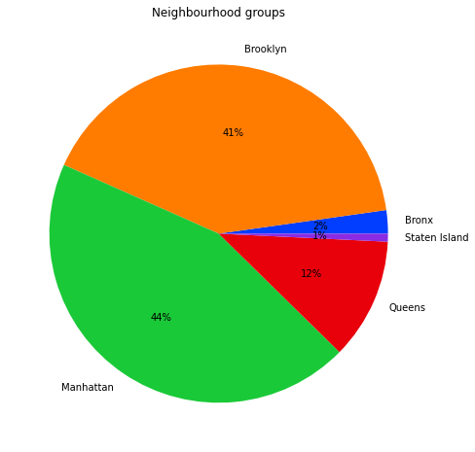
NEIGHBOURHOOD GROUP AND ITS LISTING INSIGHTS
Manhatten has highest number of listing
About 44.3% followed by brooklyn
Of 41 percent ,state island has least number
Of listing less than 1 percent

Slide 6
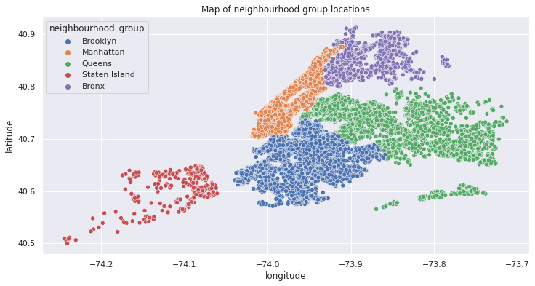
MAP OF NEIGHBOURHOOD GROUP LOCATION

Slide 7
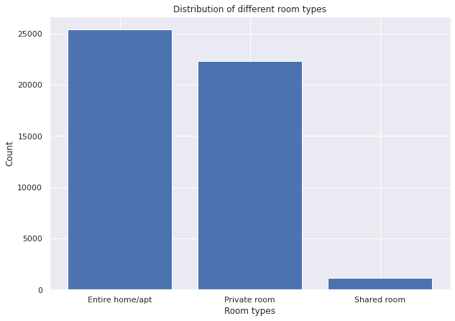
DISTRIBUTION OF DIFFERENT TYPE OF ROOM

Slide 8
Listing of entire home/appartment is the highest followed by private rooms and at last comes shared rooms.

Slide 9
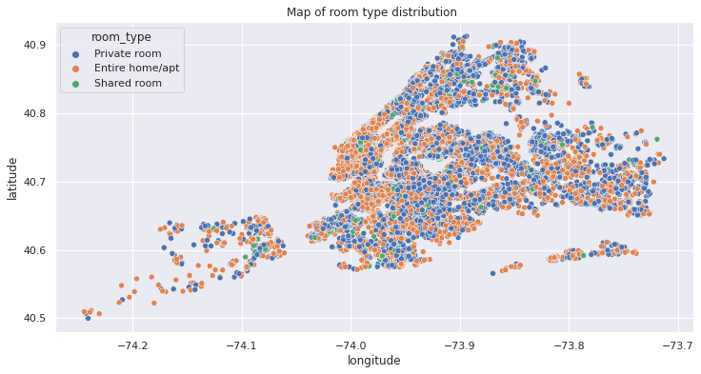
MAP OF ROOM TYPE DISTRIBUTION

Slide 10
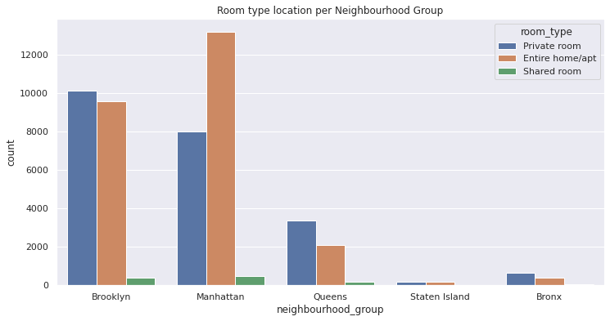
ROOM TYPE IN EACH NEIGHBOURHOOD GROUP

Slide 11
Listing of entire home/apartment is highest in Manhattan while Brooklyn has private room listing at the highest though entire home/apt listing is not too far behind.It can be observed that shared rooms have very less listing in each of the neighbourhood groups

Slide 12
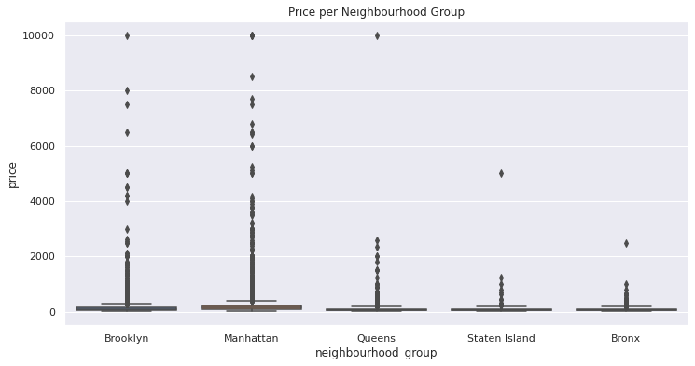
PRICE PER NEIGHBOURHOOD GROUP

Slide 13
From the above boxplot it can be observed that most of the listings in various neighbourhood groups are in lower range. For the proper analysis of the price attribute in various neighbourhood groups we have to divide our data set. One group can be of listing having higher value and a second group having lower values.Now the question is on what value the price variable must be divided? At first my thinking was to take median of the price attribute as the pivot but it would not have given a good analysis since the box plot seems skewed.Therefore we are taking highest median of price of Airbnb listing amoung the neighbourhood groups.

Slide 14
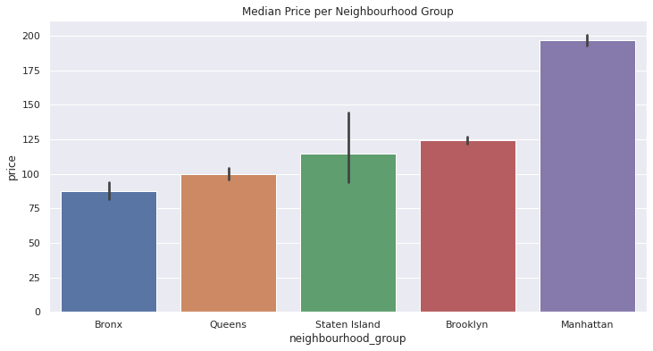
MEDIAN PRICE PER NEIGHBOURHOOD

Slide 15
Manhattan have some really expensive proprties.Median price range in Manhattan is around 175-180.Pivot point for this analysis will be 175 dollars.

Slide 16
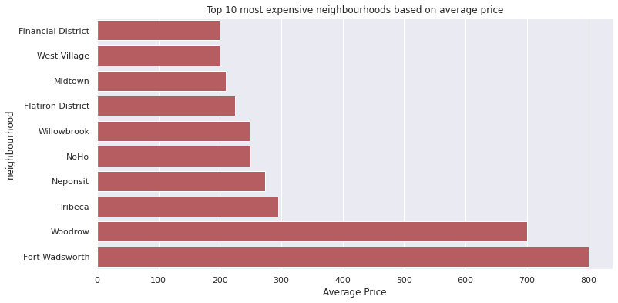
10 MOST EXPENSIVE NEIGHBOURHOOD BASED ON AVERAGE PRICE

Slide 17
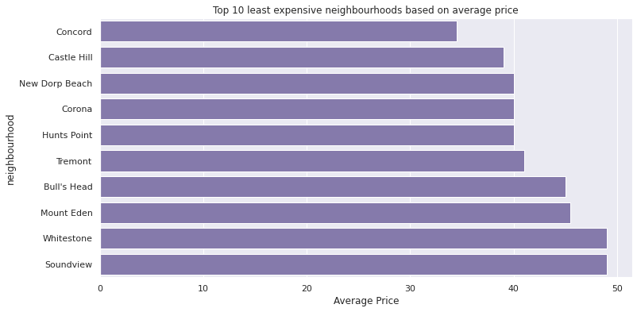
10 LEAST EXPENSIVE NEIGHBOURHOOD BASED ON AVERAGE PRICE

Slide 18
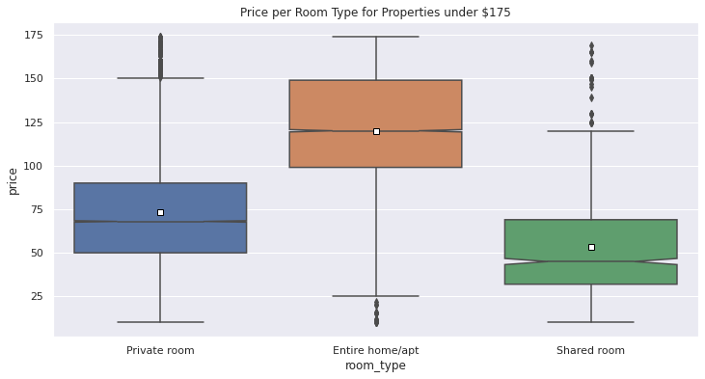
PRICE WITH TYPE OF ROOMS

Slide 19
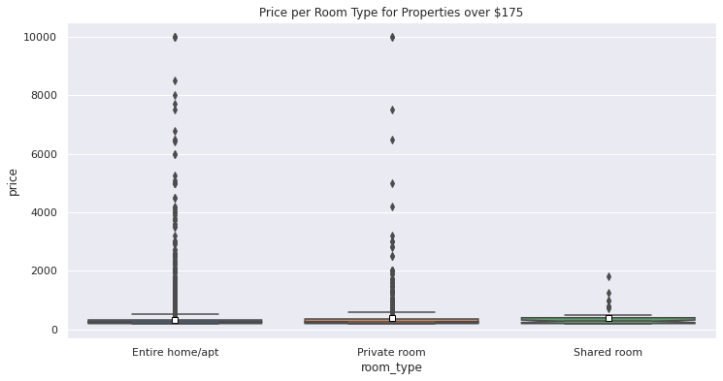
Most expensive
listing are of entire
home/apartment ,
then comes private
rooms and shared
rooms are the
cheapest.

Slide 20
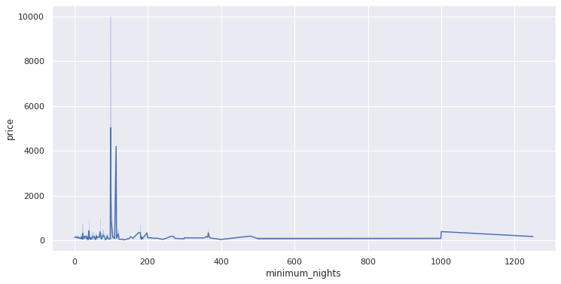
PRICE RELATION WITH MINIMUM NEIGHTS

Slide 21
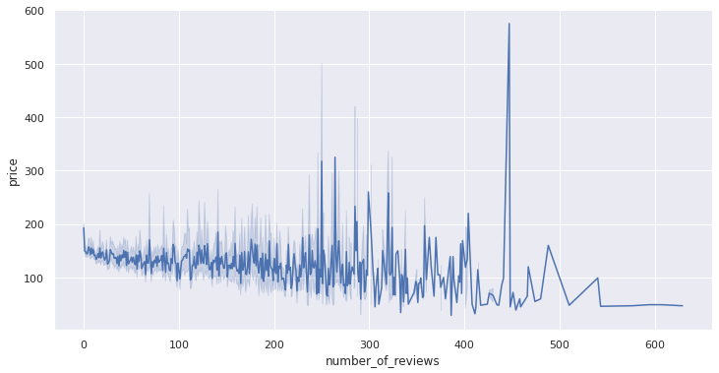
PRICE RELATION WITH NUMBER OF REVIEWS

Slide 22
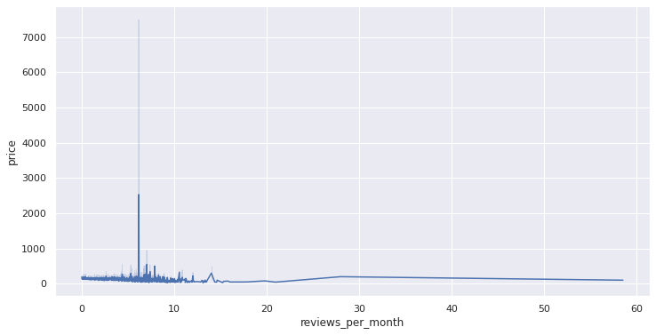
PRICE RELATION WITH REVIEWS PER MONTH

Slide 23
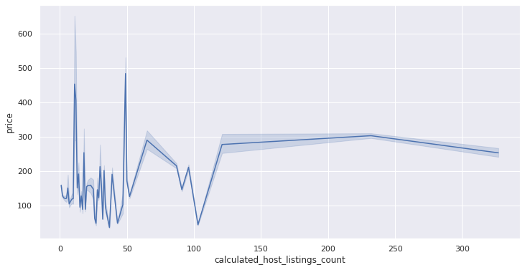
PRICE VS CALCULATED HOST LISTING COUNT

Slide 24
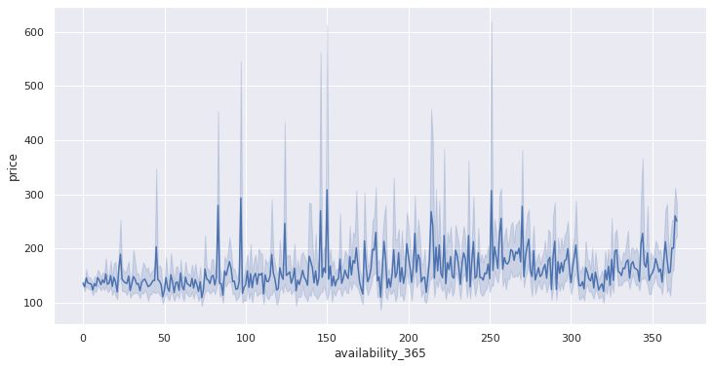
PRICE RELATION WITH AVAILABILITY

Slide 25
CONCLUSION
That's it! We reached the end of our study. Throughout the analysis, our goal was to investigate each variable and uncover as many hidden facts about the data as possible. Though it is also true that we spent the most time on the price variable and its relationship with other variables since most of the important information regarding traffic density and customer preference is correlated with price

