Slide 1
Nonlinear Control Design for Quadrotor
Course : AE630
Pushpanjali Kumari (180569)
Dr. Mangal Kothari, Dr. Abhishek

Slide 2
Introduction
Non-linear control design for quadrotors using dynamic inversion approach.
Quadrotor is under actuated system
two loop design structure for controller design – 1. inner loop - generates body rates - converted into angular rates - for stability 2. outer loop – translational dynamics is used
- thrust, pitch and role angle command - tracking purpose
Model Specification –
M = 1.8 kg; [Ixx, Iyy ,Izz] = [0.002 0.002 0.005];
X configuration

Slide 3
Steps -
Derived Kinematics & Dynamics of the system
Defined initial position (input) and final position(output)
Got output Thrust , pitch and roll angles
Feed Pitch, roll and user defined Yaw to the second order dynamical system based on error of attitude to output correcting moments
Feed Moments and Thrust to motor mixer to output pwm for each
This cycle goes on until convergence criteria is met.
.

Slide 4
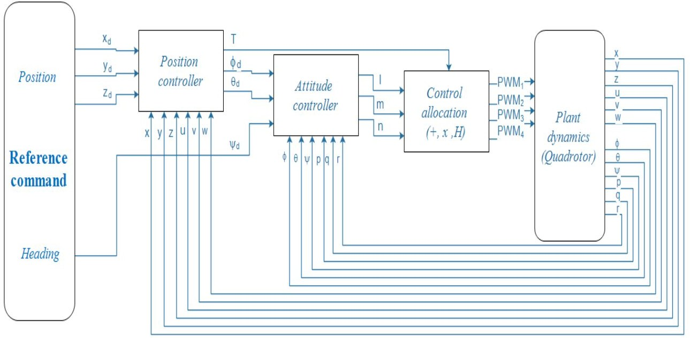
Block diagram -

Slide 5
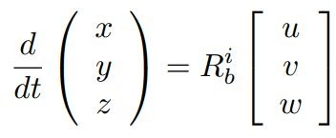
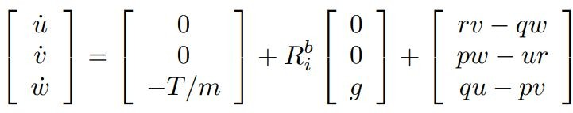
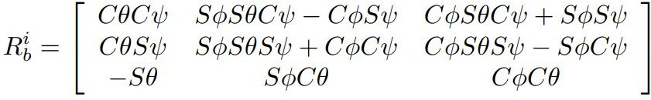
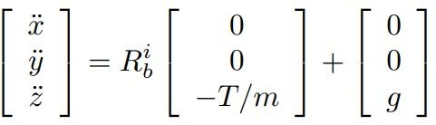
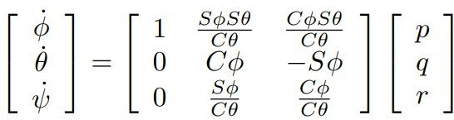
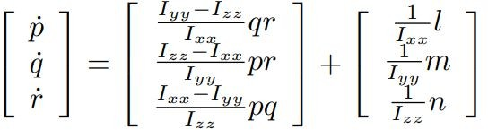
Kinematics and dynamics -
Kinematics
Dynamics
Notes:
relation between position and velocity, R – rotation matrix from body frame to inertial frame, relation between body angle rate and euler angle rate
Translational dynamics of quadrotor in body fixed frame, in inertial frame, assuming quadrotor to be symmetric about x and y axis, rotational dynamics

Slide 6
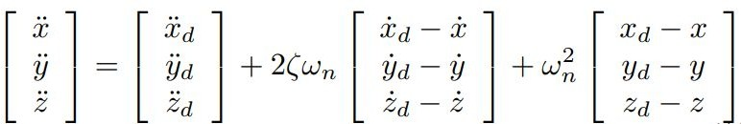
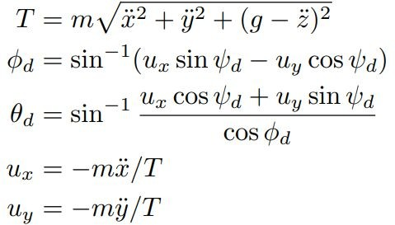

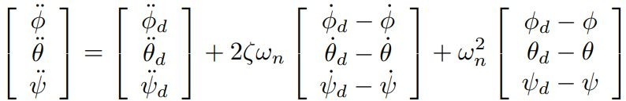


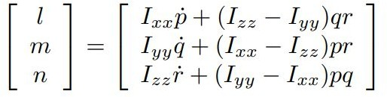
Outer loop (Position Controller):
Controls
X = [x, y, z, u, v, w, Phi, theta, psi, p, q, r] U = [T, l, m, n]
All as per standard notations
Control law:
Inner loop (Attitude Controller):
Notes:
E – tracking error = p – pd = current position – desired position, 1st order stable error dynamics, zeta – damping ratio, omega_n – natural frequency

Slide 7
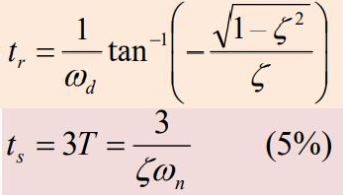
Results
Rise Time:
Position_gains (zeta, omega) : (0.8,0.7) Attitude_gains (zeta, omega) : (0.5, 4)
Settling Time:
position input - (1, 2, 10)
inertial frame with zero deg yaw
Initial state (0, 0, 0) position
(0, 0, 0) Euler attitude

Slide 8
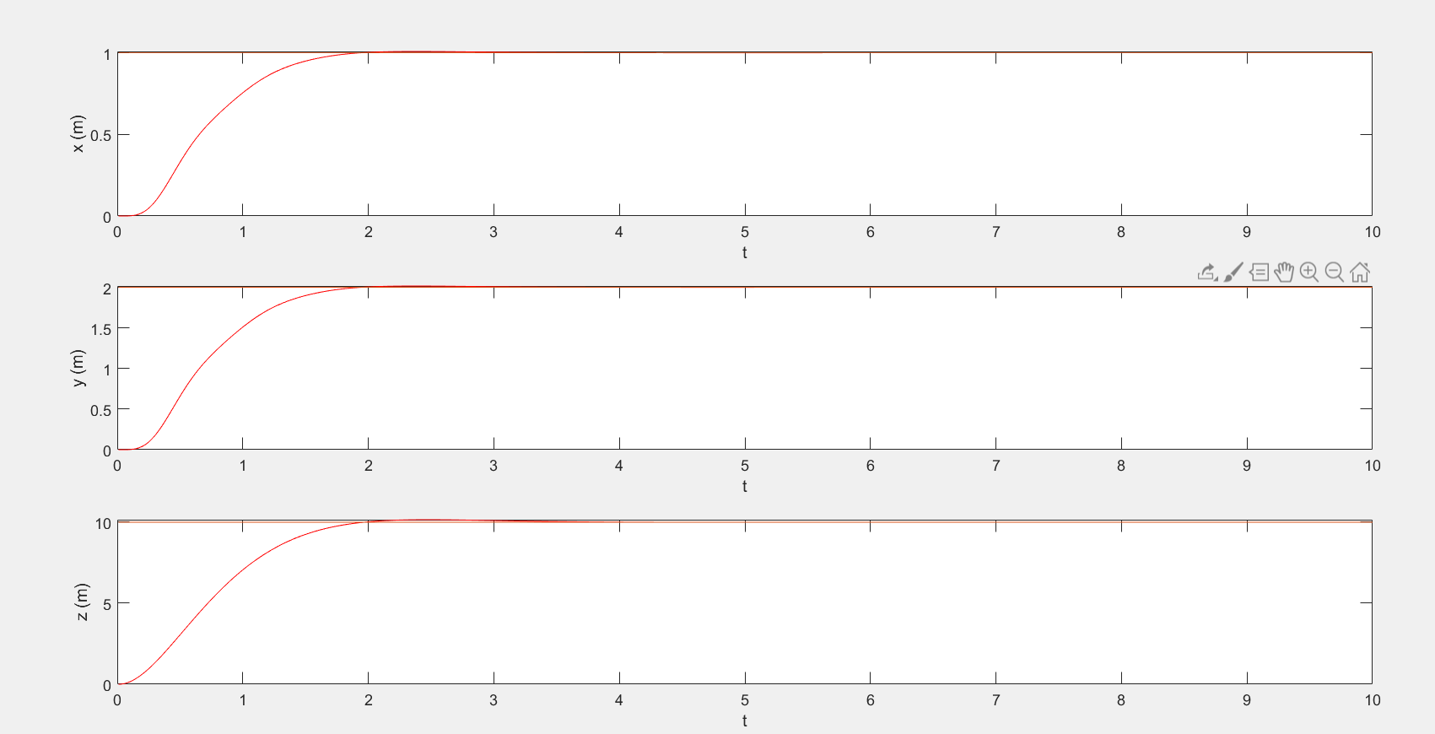
Results -

Slide 9
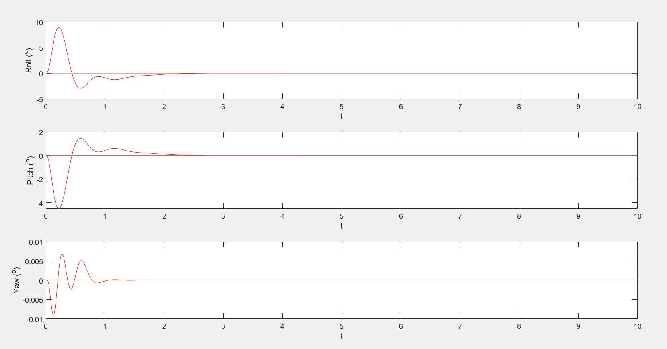
Results -

Slide 10
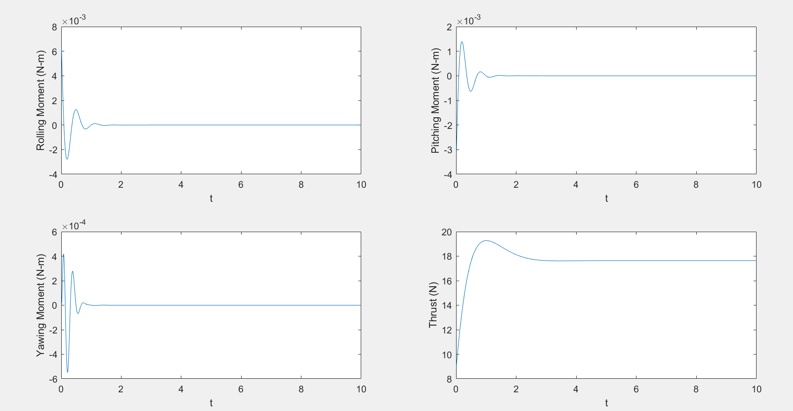
Results -

