Slide 1
Presentation
Securing Networks with Pfsense : A comprehensive Firewall Implementation
Presented by:
1.Mahesh Birajdar
2.Pushpak Kulkarni
Guide: Sushma Hattarki

Slide 2
Abstract
In today's digital age, web security has become a critical aspect for organizations to safeguard their sensitive data and systems from cyber threats. One popular solution for securing web traffic is using pfSense, an open-source firewall software that offers a range of features such as snort, captive portal, DHCP service, Squid and Squid Guard.

Slide 3
Introduction
In today's interconnected world, web security is of most importance for organizations to protect their sensitive data and prevent cyber attacks. One popular solution for securing web traffic is using pfSense, an open-source firewall software that offers a range of features such as snort, captive portal, DHCP service, Squid and Squid Guard. These features can help organizations detect and block potential security threats, control user access to the internet, filter web content, and improve network performance. In this way, pfSense provides a comprehensive approach to securing web traffic and creating a safer web environment for organizations.

Slide 4
Requirements
Hardware:
Machine With Minimum Requirement:
Processor: Intel Core i3 or equivalent processor with at least 2 cores
Memory: At least 4GB RAM for small to medium-sized organizations, and 8GB or more for larger organizations.
Storage: At least 20GB of free disk space on the hard drive or SSD.
Network Interface Cards (NICs): At least two NICs, one for the WAN and one for the LAN.
Virtualization Platform: VMware vSphere or VMware Workstation, with the appropriate licenses for the number of virtual machines required.

Slide 5
Software:
VM-ware Workstation
pfSense OS
Windows OS 10 or Latest
7-zip File Extractor

Slide 6
Why PfSense ?
Open-source: pfSense is an open-source software
Comprehensive security features
Easy to use
High performance

Slide 7






Block Diagram
Internet
Organization
PfSense
Router
Switch

Slide 8




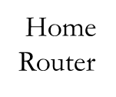
Project Set-Up
IP : 192.168.30.20
Subnet ID : 255.255.255.0
Gateway : 192.168.30.1
192.168.30.0
Host-Only
WAN
DAC
192.168.80.128/24
VMware Workstation
PfSense
IP
192.168.30.10
192.168.40.0
Host-Machine
IP : 192.168.40.20
Subnet ID : 255.255.255.0
Gateway : 192.168.40.1
Host-Only
DITISS

Slide 9
Captive Portal
With Captive Portal, organizations can control access to the internet, restrict access to certain websites, and monitor internet activity. pfSense allows the administrator to customize the Captive Portal page with the organization's logo, branding, and legal terms.
Captive Portal can be configured to authenticate users against an internal user database, or an external authentication server, such as LDAP or RADIUS. The DHCP service in pfSense can be configured to assign IP addresses to clients, and the Squid and Squid Guard components can be used to filter web traffic and block access to specific websites.

Slide 10
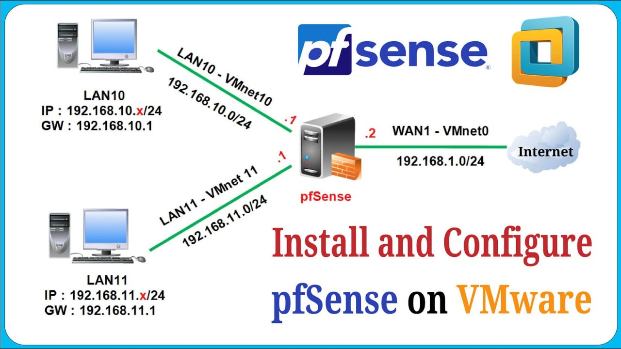

Slide 11
Snort (IDS/IPS)
Securing web traffic at the WAN interface 192.168.80.128 is crucial for organizations to prevent cyber attacks and protect sensitive data. One way to achieve this is by configuring snort using pfSense, an open-source firewall software. Snort is an intrusion detection system that monitors network traffic for potential security threats and alerts system administrators in real-time. By configuring snort on the WAN interface, organizations can detect and block potential security threats at the network perimeter, enhancing their overall security posture. In this way, pfSense provides a powerful and effective solution for securing web traffic at the WAN interface and protecting organizations against cyber threats.

Slide 12
Squid
Squid is designed to improve the speed and efficiency of web browsing by caching frequently accessed web pages and serving them from memory instead of fetching them from the internet every time a user requests them.

Slide 13
Squid-Guard
Squid-Guard is highly configurable, enabling administrators to define policies based on a wide range of criteria, including website URLs, domains, IP addresses, and keywords.
In addition to content filtering, Squid-Guard can also be used to authenticate users and restrict access to certain parts of the internet based on their identity, location, or device. This makes it a powerful tool for protecting the organization's network from external threats and enforcing internal policies.

Slide 14
Applications
Network security: pfSense's snort feature can detect and block potential security threats, ensuring that the organization's network is secure.
User access control: pfSense's captive portal feature allows organizations to control user access to the internet, ensuring that only authorized users can access the network.
Web content filtering: pfSense's Squid and Squid Guard features allow organizations to filter web content, preventing access to harmful or inappropriate websites.
Improved network performance: pfSense's DHCP service feature can improve network performance by ensuring that IP addresses are allocated efficiently.

Slide 15
References
https://docs.netgate.com/pfsense/en/latest/
https://www.snort.org/
https://docs.netgate.com/pfsense/en/latest/packages/cache-proxy/squidguard.html
https://docs.netgate.com/pfsense/en/latest/packages/snort/setup.html
https://dsi.ut-capitole.fr/blacklists/download/blacklists_for_pfsense.tar.gz

Slide 16
Thank You…

