Slide 1
WATER QUALITY MONITORING SYSTEM

Slide 2
PROBLEM STATEMENT
To detect the temperature and depth of water and ph value of water body
(eg. Lake) for analysis and prediction purpose using IOT and to send the data obtained to the cloud where the data can be monitored via a mobile application.

Slide 3
ABSTRACT
Since the water monitoring system is a critical implementation for the issue of marine life in the lake, with increase in the development of technology and advancement in the Internet of Things (IOT) environment, the real time water monitoring system is remotely monitored by the means of storing the data, transmission and processing. This slides presents a smart water monitoring with sensor interface device in internet of things. The smart water monitoring system consists of design board, sensors, Wi-Fi module and personal computer. It is programmed in high speed integrated circuit hardware description language and embedded c programming language. The proposed system collects the two parameters of water such as water level and temperature of water with high speed from various sensors using thing speak.

Slide 4
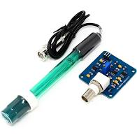
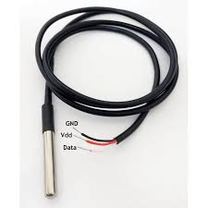
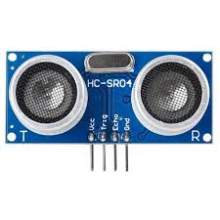
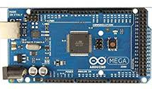
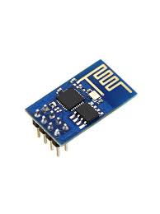
HARDWARE & SOFTWARE
COMPONENTS
HARDWARE COMPONENTS:
Waterproof Temperature sensor
Ultrasonic sensor
Wi-Fi module esp8266
Arduino mega 2560
Ph Sensor Module
SOFTWARE COMPONENTS:
Arduino IDE
Blynk Cloud
Blynk mobile app
4.

Slide 5
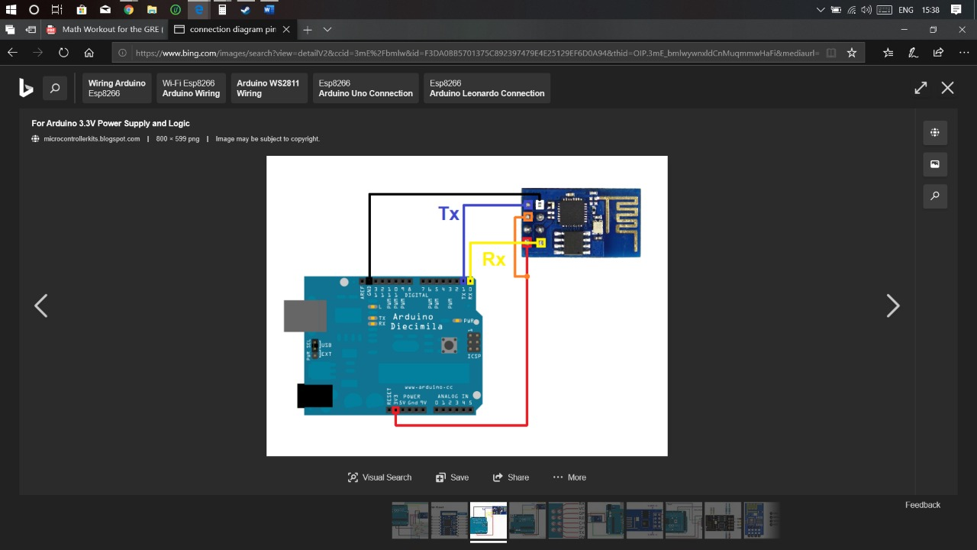
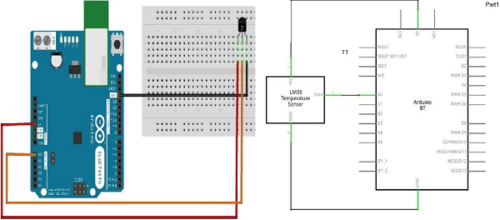
CIRCUIT DIAGRAM
Interfacing Arduino With Wifi Module
Interfacing Arduino With Waterproof
Temperature Sensor

Slide 6
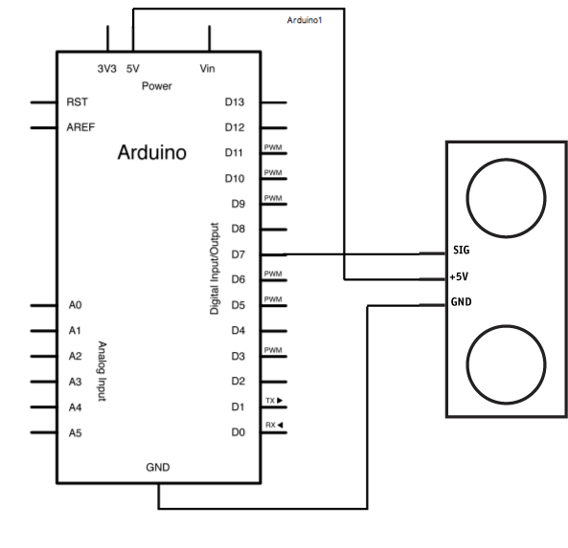
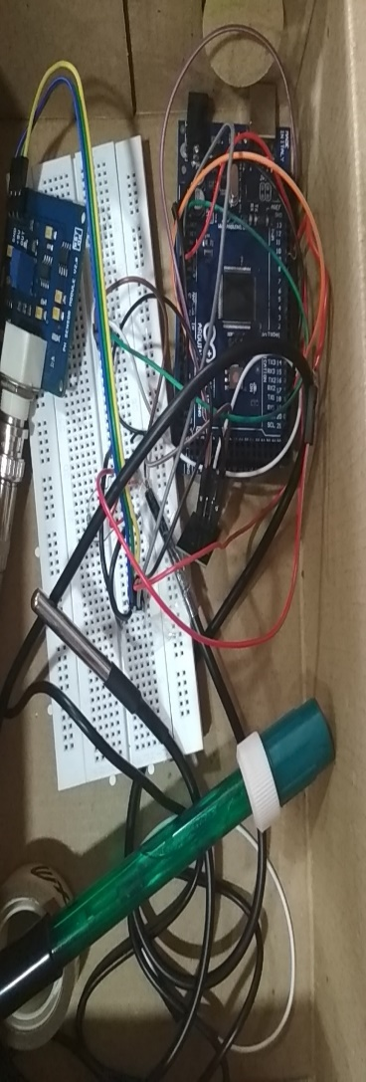
Project representation
Interfacing arduino with ultrasonic sensor
Fig5.3
(17)

Slide 7
WORKING
Temperature Sensor
Arduino Mega
2560
Internet
Wifi
Module-
ESP 8266
Internet
Ultrasonic Sensor
PH sensor module
Power Supply
Block Diagram

