Slide 1
IMDB MOVIES
Pushpanjali Gupta
Project Team ID: PTID-CDA-DEC-23-087

Slide 2
Dataset
1. Table “movies” of “project_movie_database”:-
ID: Unique Id for Movies
Original title: Movie name
Budget: Budget of the movie
Popularity: Popularity of the Movie
Release Date: Release date for the movies
Revenue: Revenue collected movie
Title: Initial title of the movie
Vote Average: Average IMDB rating

Slide 3
Vote Count: Number of Vote the movie got
Overview: Description of the movie
Tagline: Tagline of the Movie
UID: Unique ID for Movie
Director ID: Director ID
2. Table “directors” of “project_movie_database”:-
Name: Name of the Director
ID: Unique ID of the Directors
Gender: Gender of the Director
Department: Department of the Directors.

Slide 4
Perform the following Problem Queries:
Can you get all data about movies?
How do you get all data about directors?
Check how many movies are present in IMDB.
Find these 3 directors: James Cameron, Luc Besson, John Woo
Find all directors with name starting with Steven.
Count female directors.
Find the name of the 10th first women directors?
What are the 3 most popular movies?
What are the 3 most bankable movies?
What is the most awarded average vote since the January 1st, 2000?
Which movie(s) were directed by Brenda Chapman?
Whose director made the most movies?
Whose director is the most bankable?

Slide 5
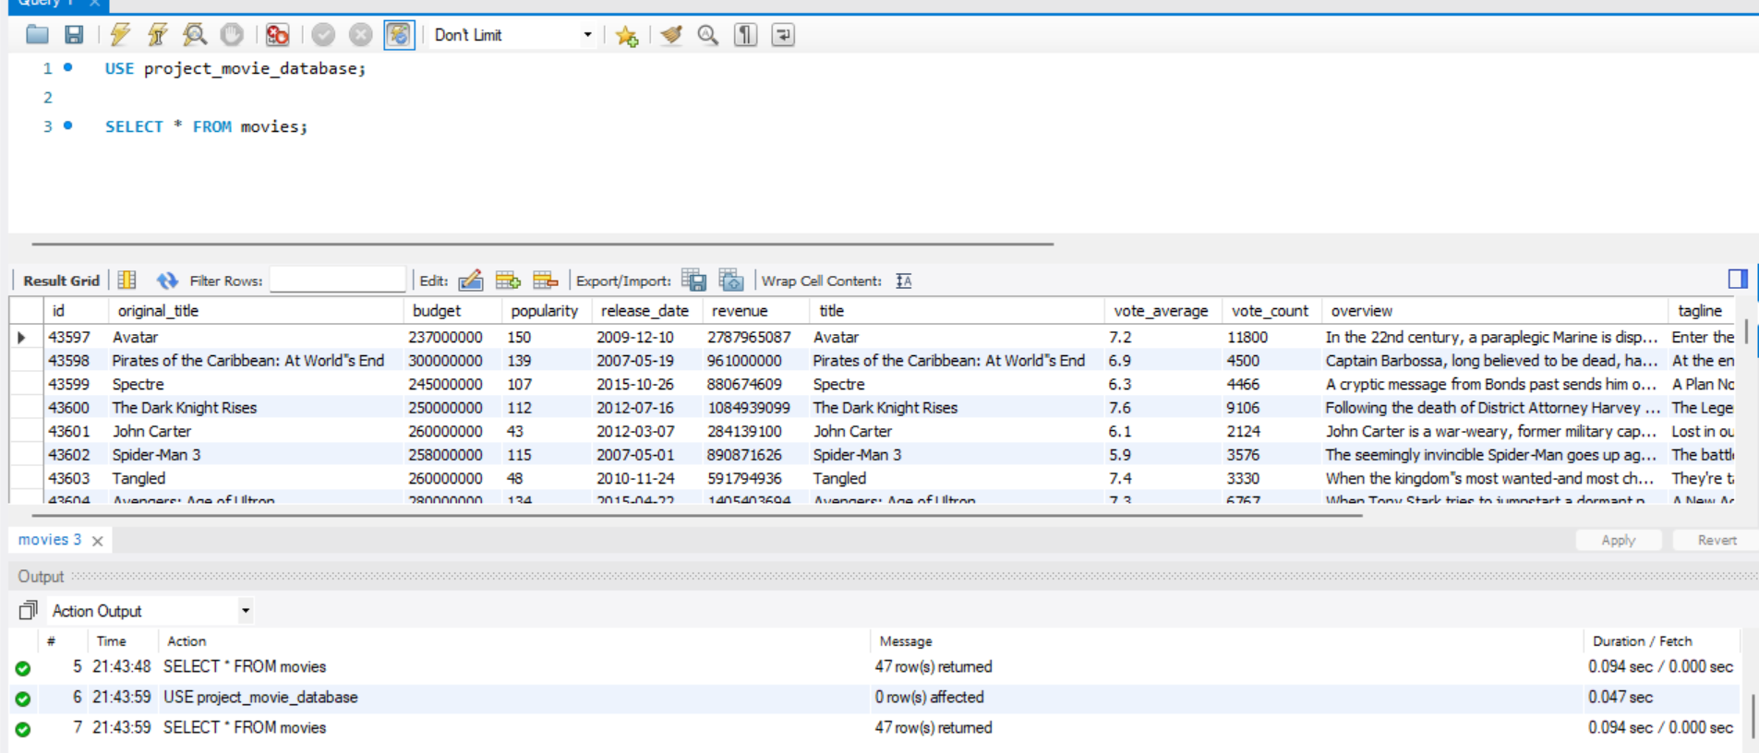
Get all data about movies

Slide 6
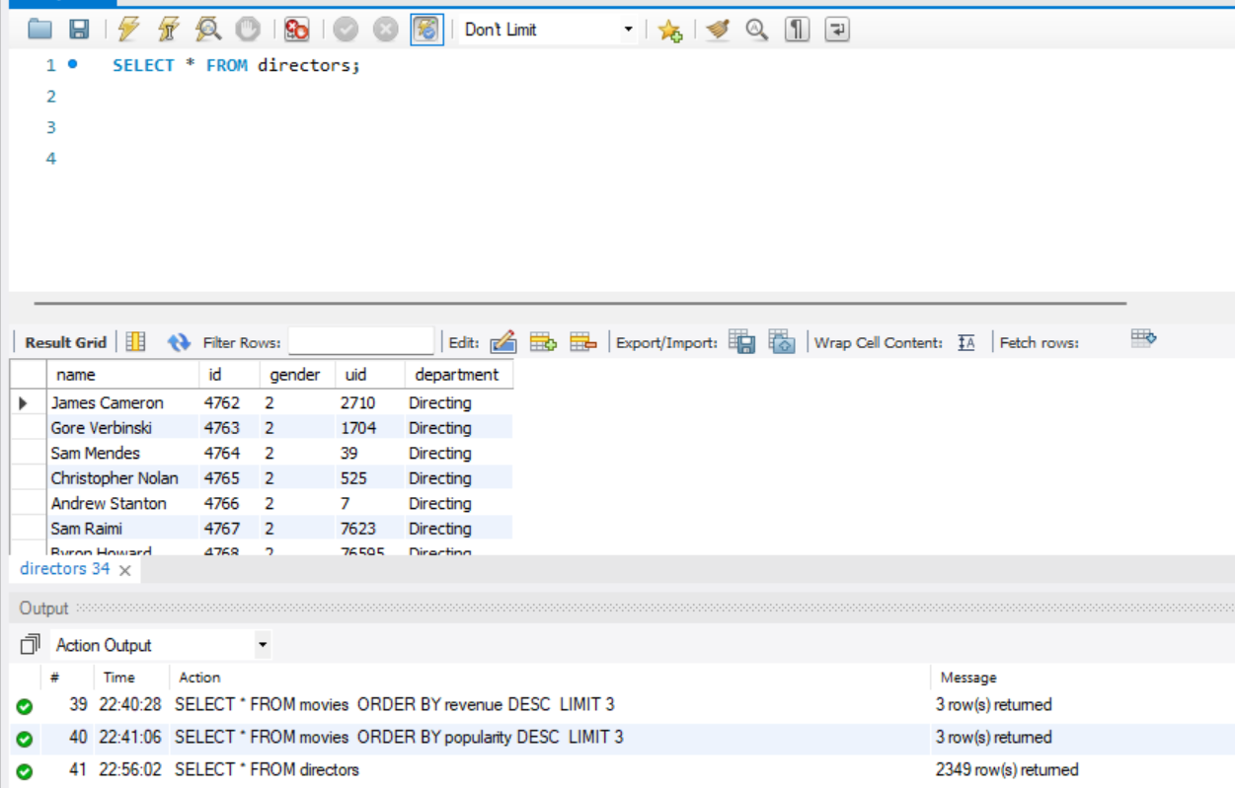
Get all data about directors

Slide 7
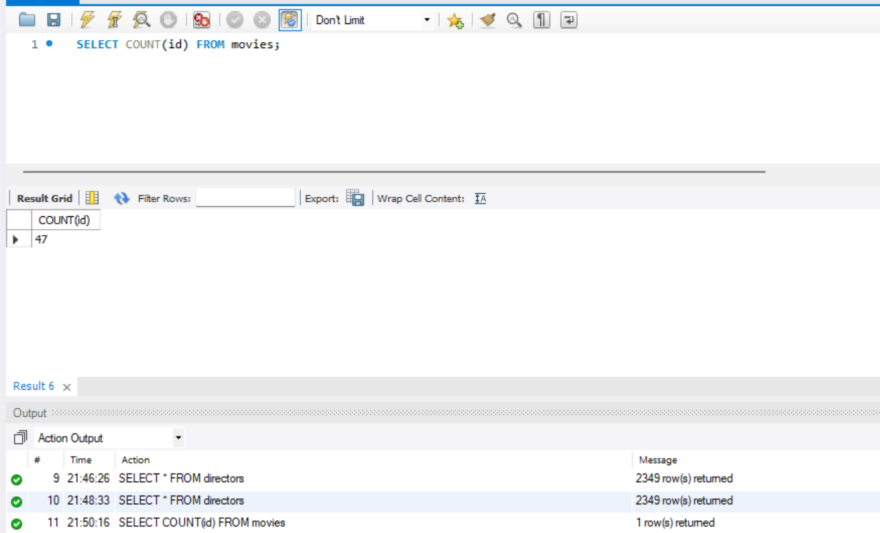
Check how many movies are there

Slide 8
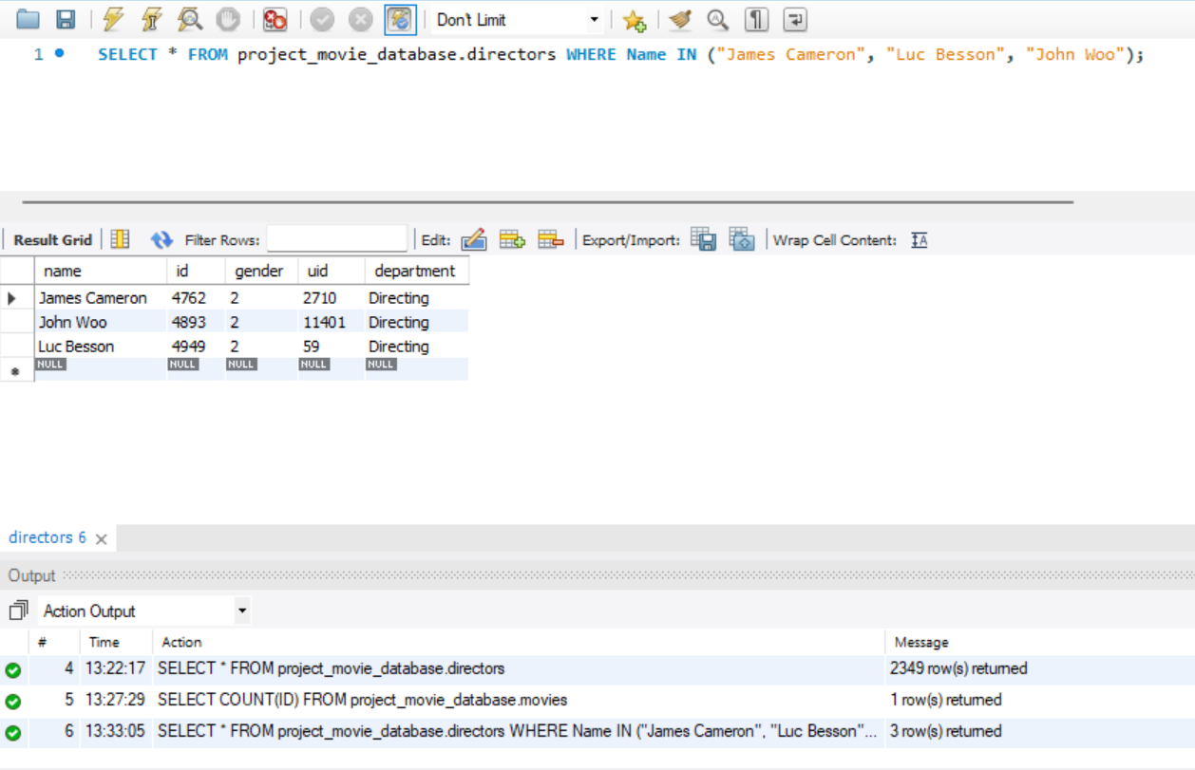
FIND these directors - James Cameron, Luc Besson, John Woo

Slide 9
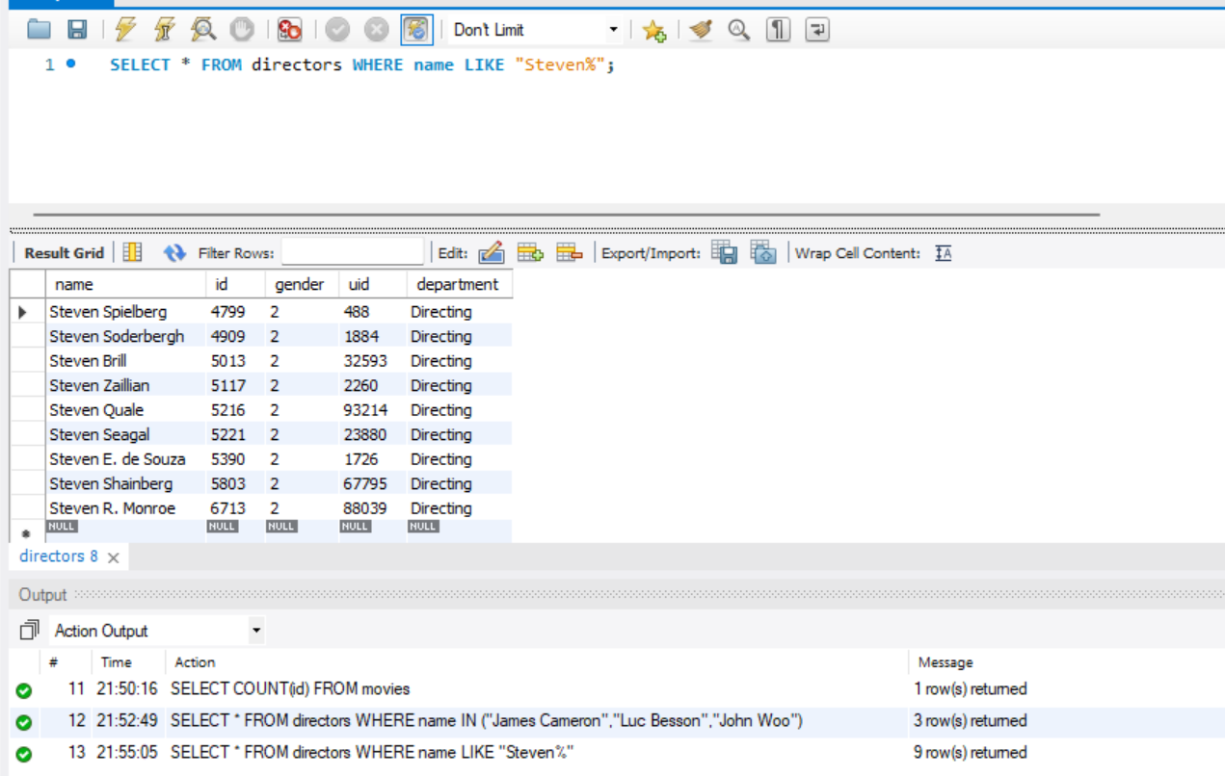
Find all directors with name starting Steven

Slide 10
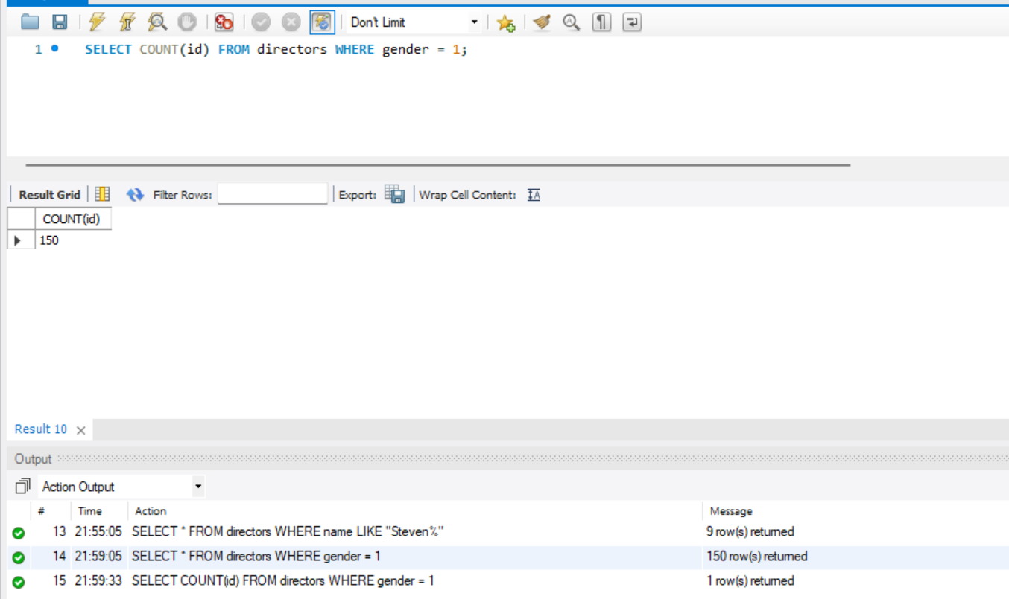
Count Female Directors

Slide 11
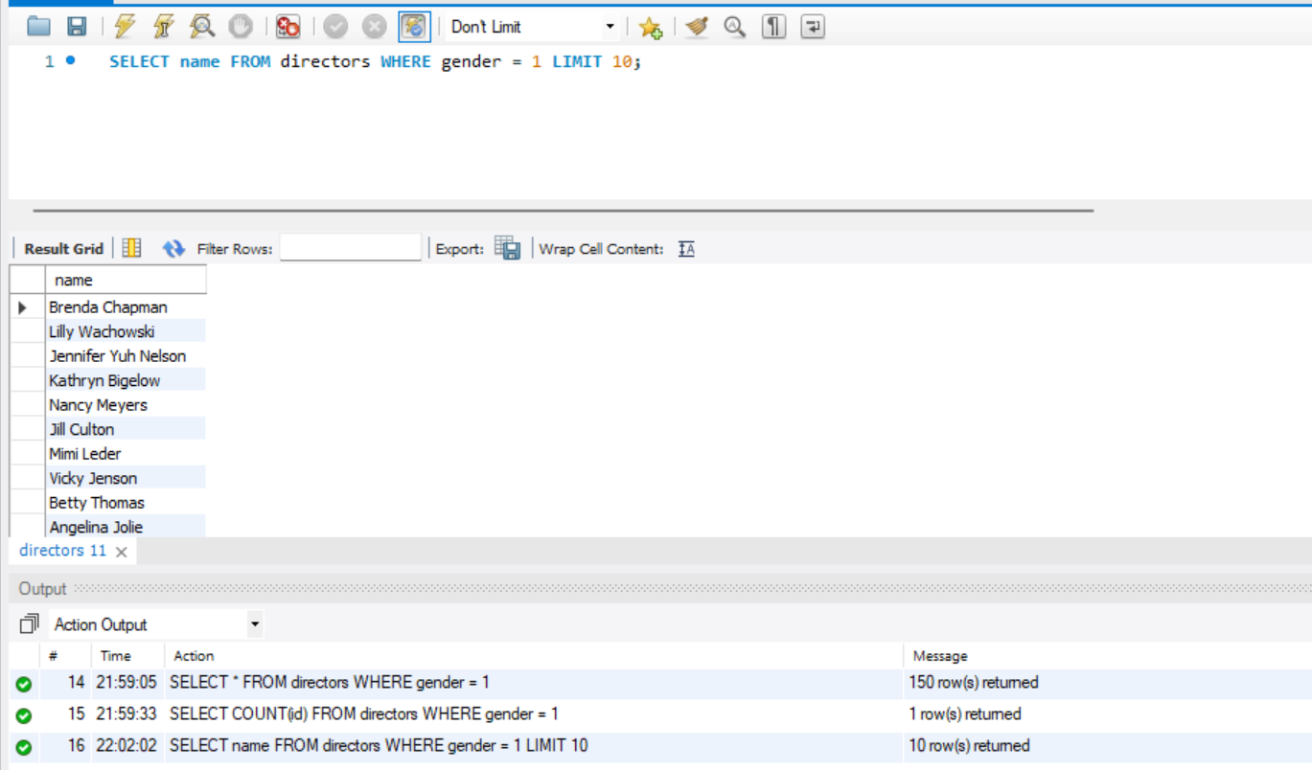
Find the name of the first 10 women directors

Slide 12
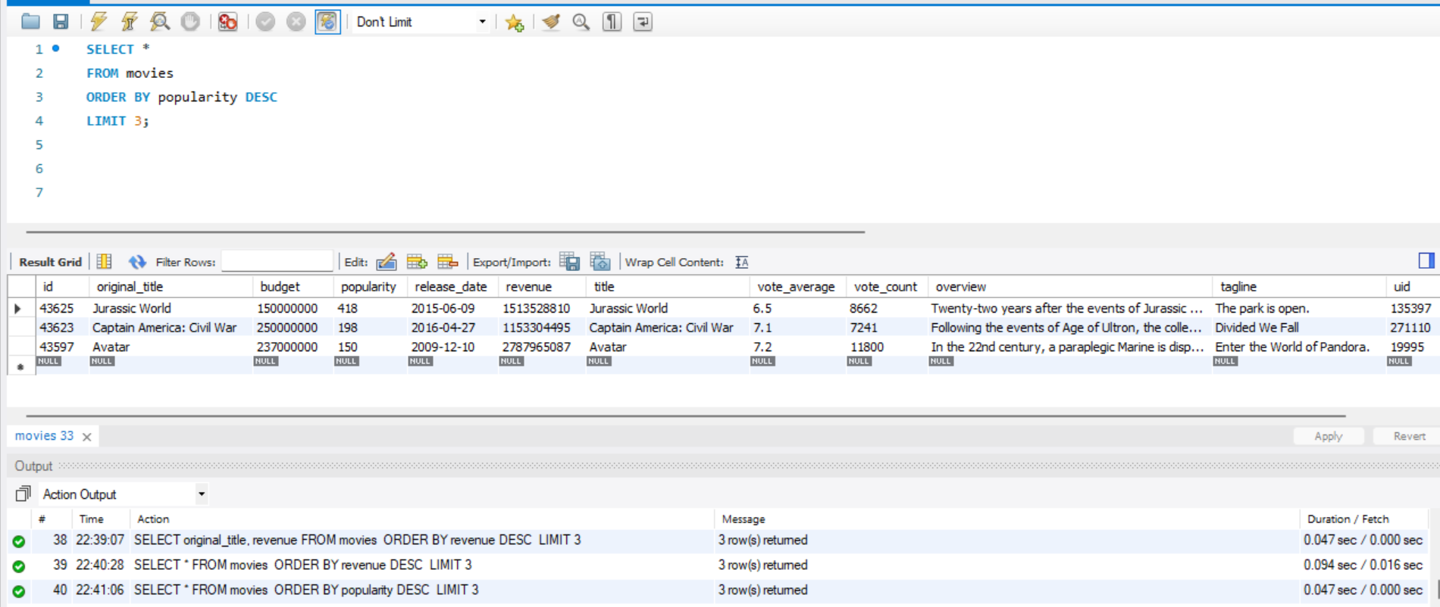
What are the 3 most popular movies

Slide 13
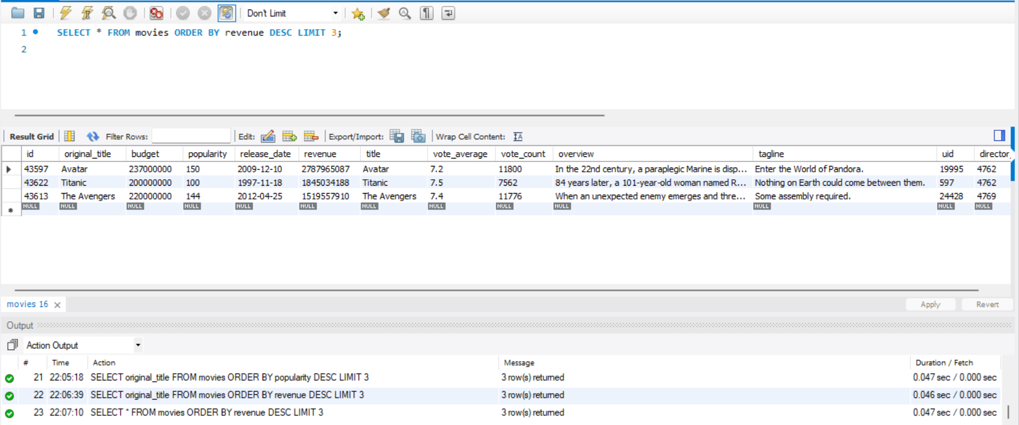
What are the 3 most bankable movies

Slide 14
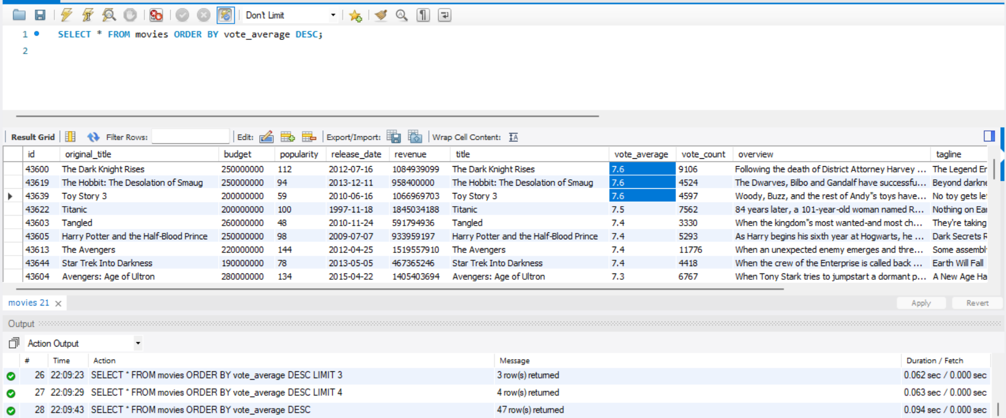
Most awarded average vote since Jan 1st 2000

Slide 15
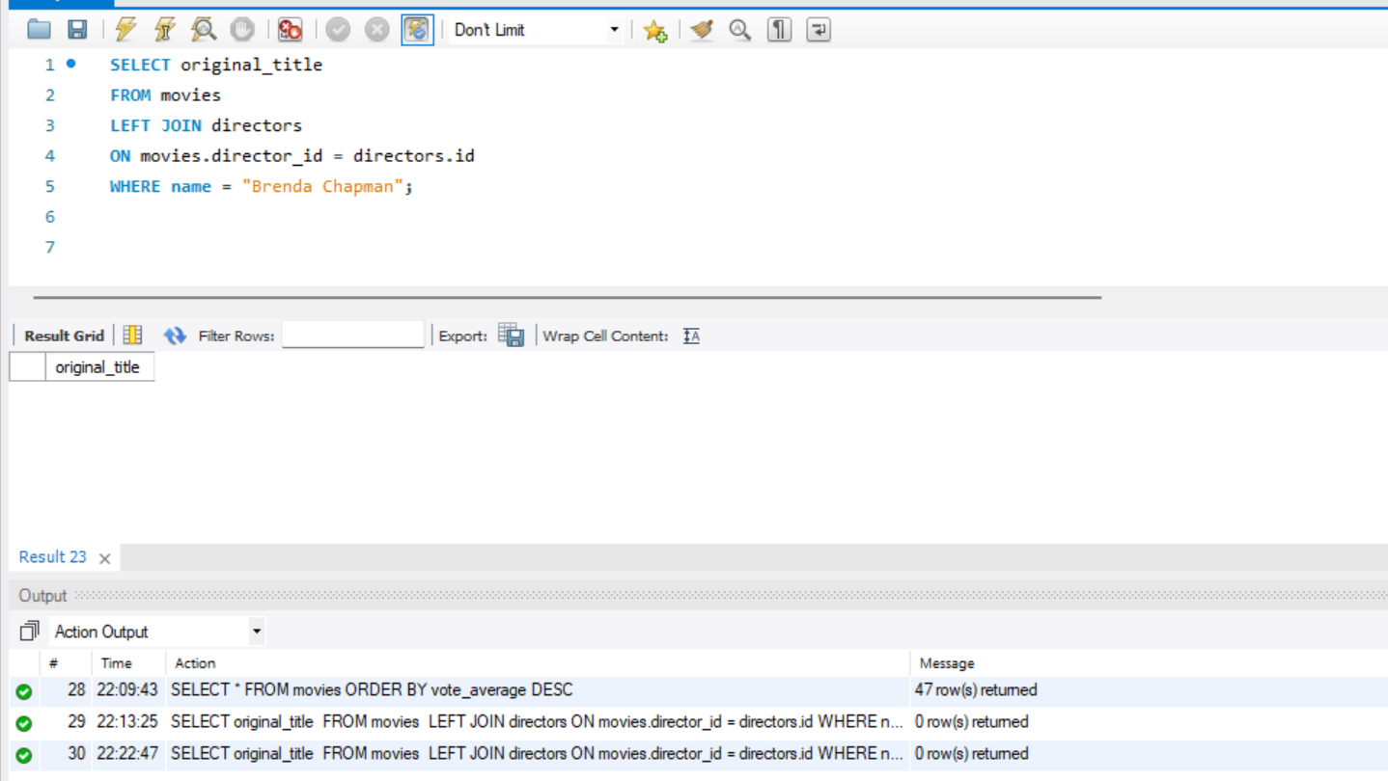
Movies directed by Brenda Chapman
There is no movie directed by Brenda Chapman.

Slide 16
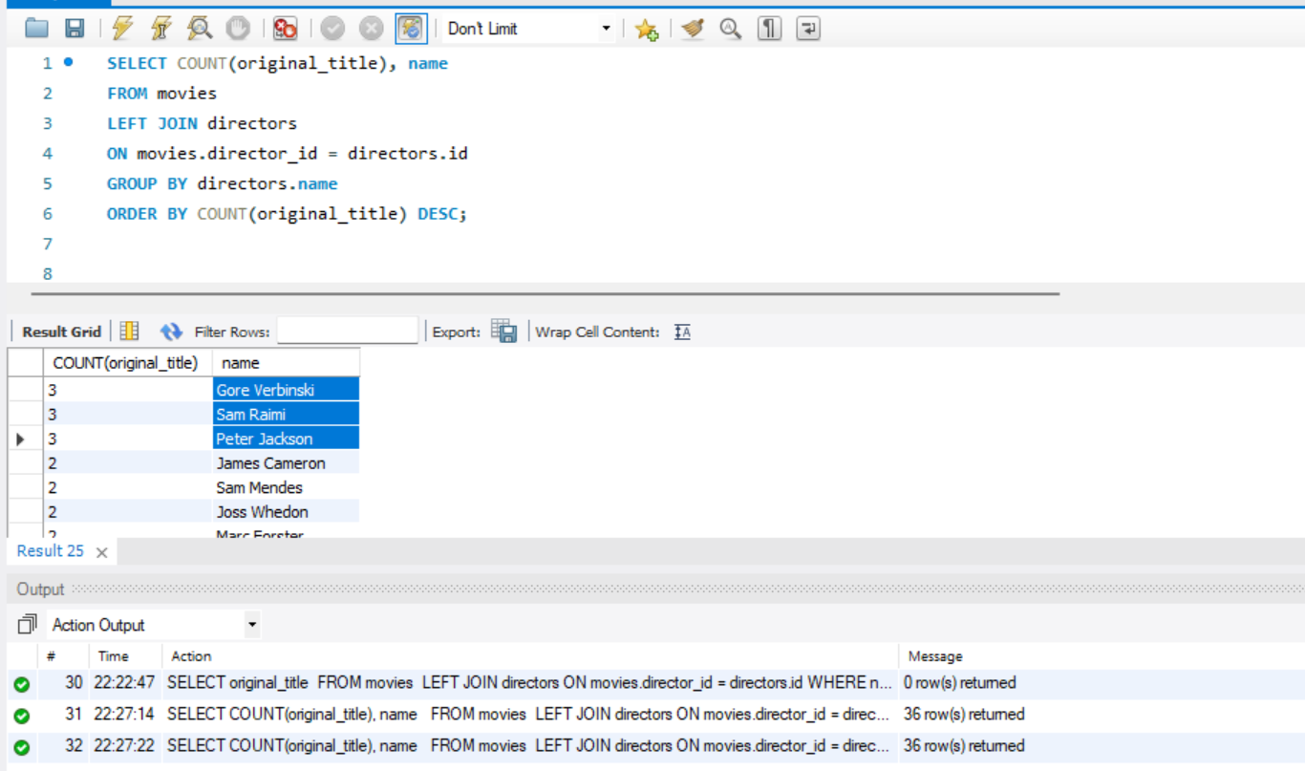
Which director made the most movies

Slide 17
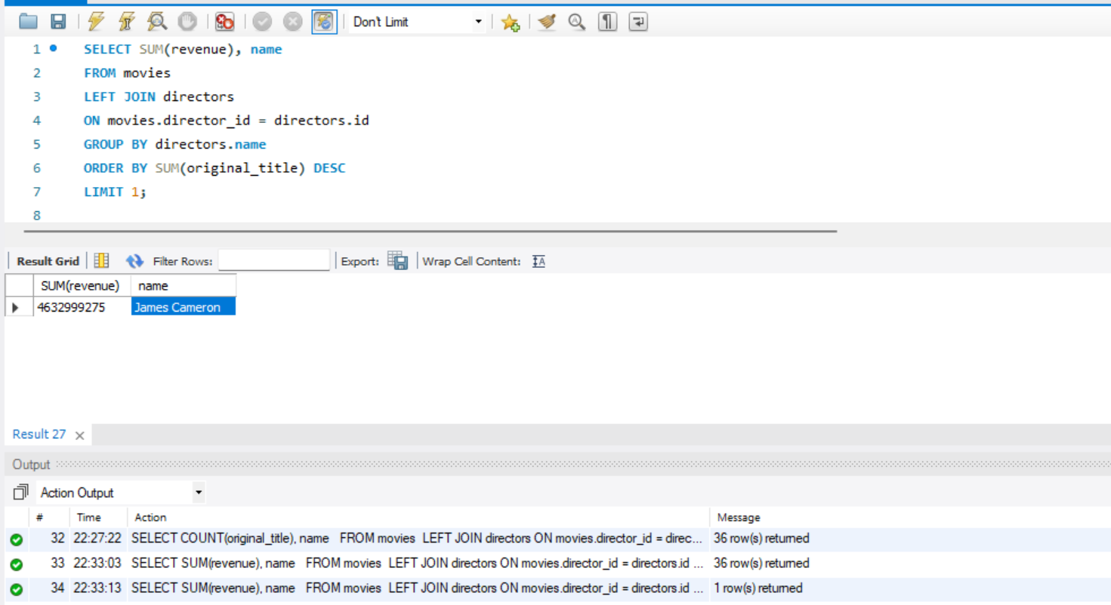
Which director is the most bankable

Slide 18
THANK YOU

