Slide 1

Decision-Making Application Using Data Structures
CSA0312- Data Structures
Presented By:
Papagari Pushpa Charitha

Slide 2
Introduction
Decision-Making Application
What is Decision Making?
Decision-making applications choose outcomes based on multiple conditions.
They evaluate different inputs before producing a result.
Used in AI systems, banking, healthcare, and online services.
The choice of data structure affects speed and efficiency.
Objective
Identify a suitable data structure.
Explain why it is effective for decision-making.

Slide 3
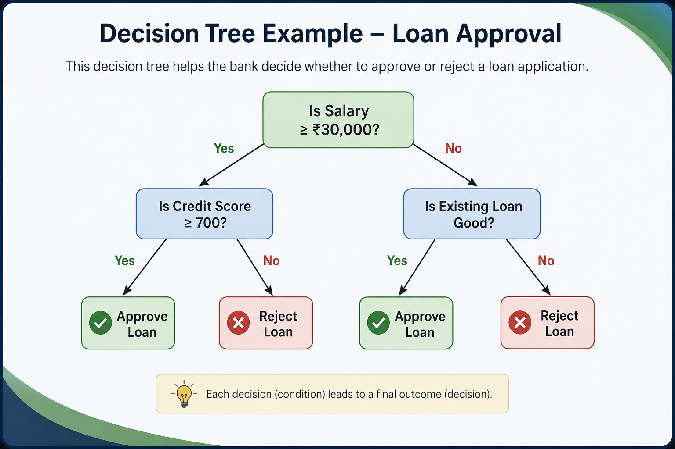
Suitable Data Structure – Decision Tree
Decision Tree
A Decision Tree is a hierarchical data structure where:
Root node represents the starting decision.
Internal nodes represent conditions.
Branches represent possible choices.
Leaf nodes represent the final outcome.
Why Decision Tree?
Easy to understand and visualize.
Handles multiple conditions efficiently.
Fast decision-making process.
Easy to modify and expand.

Slide 4
Applications
Loan Approval: Evaluates customer details to approve or reject loan applications.
Medical Diagnosis: Assists doctors in identifying diseases based on symptoms and test results.
Fraud Detection: Detects suspicious financial transactions using predefined decision rules.
E-commerce: Recommends products based on customer preferences and purchase history.
Student Admission: Selects eligible candidates based on marks and admission criteria.
Artificial Intelligence: Classifies data and makes predictions for intelligent systems.
Traffic Management: Optimizes traffic flow by analyzing road and vehicle conditions.
Customer Support: Guides users to the correct solution through automated decision paths.
Insurance Claims: Determines claim approval based on policy conditions and documents.
Employee Recruitment: Shortlists candidates based on qualifications, skills, and experience.

Slide 5
Observation
Decision Trees simplify complex decision processes.
They improve accuracy by evaluating every condition.
They are scalable and easy to update.
Suitable for both simple and complex applications.
Widely used in intelligent decision-support systems.

Slide 6
Conclusion
Decision Trees are an effective data structure for decision-making applications.
They classify outcomes by evaluating conditions one at a time.
Their hierarchical structure makes decisions faster and more organized.
They improve readability, maintainability, and scalability.
Decision Trees are widely used in AI, healthcare, finance, and business applications.
Choosing the right data structure leads to better performance and accurate decision-making.

Slide 7
THANK YOU..

