Slide 1


Slide 2
[Hackathon Challenge-2024] Data Organization and Image Classification for FactoryNet Dataset Rahul Pushparajan Arizona State University

Slide 3
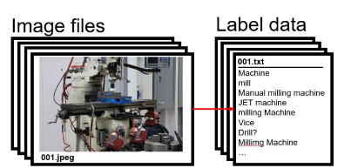
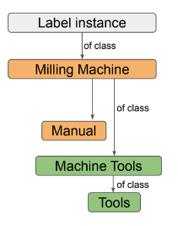
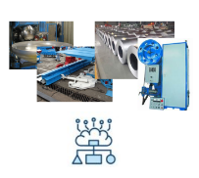
Challenge Overview
Cleanup and Organize the Data
FactoryNet Dataset Version 2
(Unsanitized, Non curated)
Image Classification

Slide 4

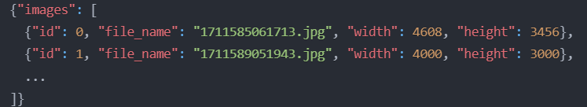
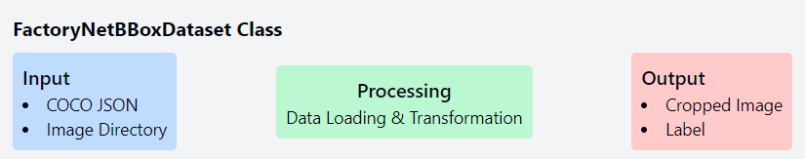
Data Preprocessing
Created COCO format dataset from raw image and CSV files
Implemented FactoryNetBBoxDataset class for efficient data loading
Note: Each bbox is localized and moved as a new image with label as instance['category_id']

Slide 5
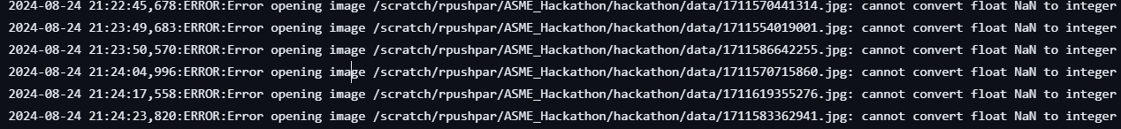
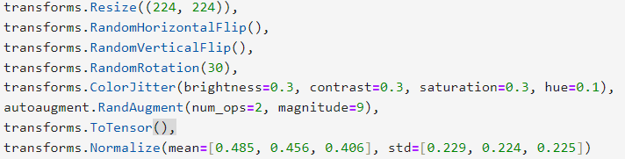
Data Preprocessing
Exceptional Dataset annotation : bbox having a NaN value → image_error.log
Applied data augmentation techniques:
Random flips, rotations, color jitter
RandAugment for additional diversity

Slide 6

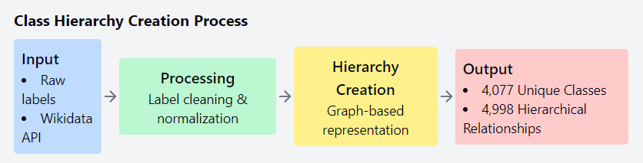
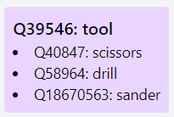
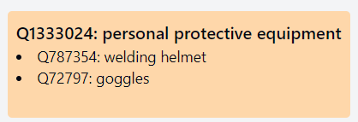
Class Hierarchy Creation
Utilized Wikidata API to create a hierarchical structure of classes.
Implemented functions to clean and normalize labels.
Created a graph-based representation of class relationships.
Sample Class
Structure

Slide 7

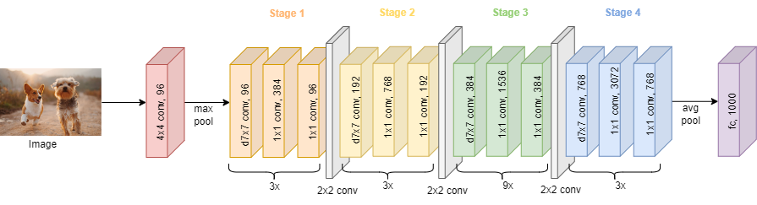
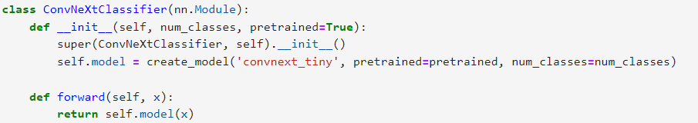
Model Architecture
Used ConvNeXt Tiny architecture, optimized for efficiency and performance
Implemented ConvNeXtClassifier class with pretrained weights

Slide 8
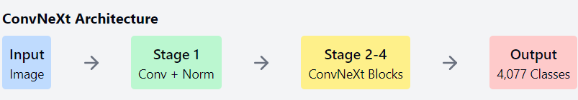
Model Architecture
Adapted the model for multi-class classification with 4,077 classes
Note: Attempted other vision models like Swin base pretrained with imagenet, and EfficientnetV2,
but were thrown as an overkill showing a strong overfitting. Future plan includes to try make a balanced dataset and include methods like ensemble technique
to reduce overfitting.

Slide 9

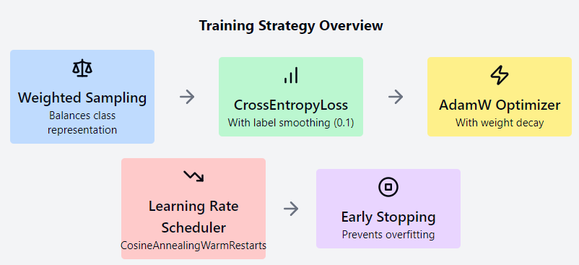
Training
Implemented weighted random sampling to handle class imbalance.
Used CrossEntropyLoss with label smoothing (0.1) to prevent overfitting.
Optimizer: AdamW with weight decay for regularization.
Learning rate scheduler: CosineAnnealingWarmRestarts for better convergence.
Implemented early stopping to prevent overfitting.

Slide 10

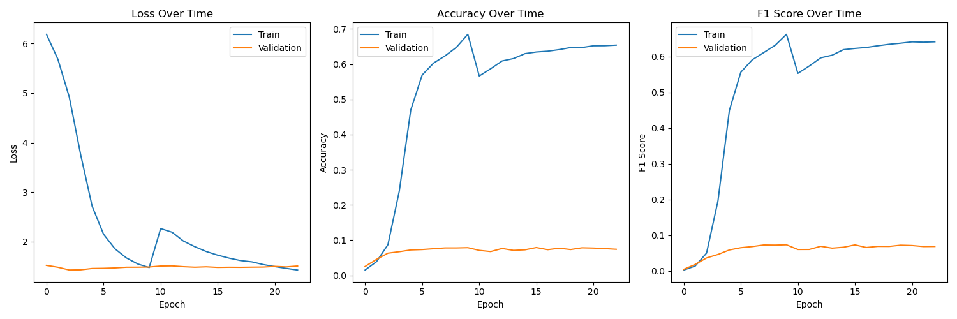
Results and Evaluation

Slide 11
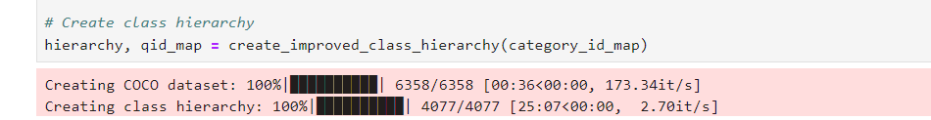
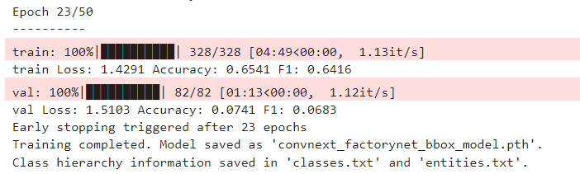
Results and Evaluation
Loss Reduction
Training loss decreased significantly from ~6 to ~1.5, indicating successful learning.
Accuracy and F1 Score Improvement
Both metrics show substantial increase, reaching ~65% for training data.
Validation scores stabilized around 8%, suggesting room for further optimization.
Model Convergence
Training metrics stabilized after about 15 epochs, indicating efficient learning.
Gap between training and validation performance suggests potential overfitting.

Slide 12

Conclusion and Future Work
Successfully organized and structured the FactoryNet dataset
Created a robust classification model capable of handling 4,077 classes
Future improvements:
Fine-tuning hyperparameters for better performance
Exploring more advanced architectures (e.g., Vision Transformers, ensemble technique)
Implementing multi-label classification to handle overlapping classes
Identifying a better approach to develop a more appropriate ontology for the class hierarchy.
Credits
The Sol Supercomputer at Arizona State University
Doi : 10.1145/3569951.3597573
Jennewein, Douglas M. et al. "The Sol Supercomputer at Arizona State University." In Practice and Experience in Advanced Research Computing (pp. 296–301). Association for Computing Machinery, 2023.
“FactortNet Dataset”
Digital Manufacturing Research Team
Air Force Research Laboratory (AFRL)
“A ConvNet for the 2020s”, 2022.
Zhuang Liu and Hanzi Mao and Chao-Yuan Wu and Christoph Feichtenhofer and Trevor Darrell and Saining Xie
https://arxiv.org/abs/2201.03545

Slide 13
Questions?

