Slide 1



Slide 2
Source of this Idea
Healthcare becomes very commercial and less service oriented
Many hospitals are run as corporate company, profit in mind
Many branded hospitals spend lot in advertisement
The real service minded hospitals need to rely on word of mouth
The idea is to spread the word of mouth and make the patient’s feedback more valuable.

Slide 3
What is my Idea?
This idea is about an app which helps in sharing information about the hospitals where the people went.
With the help in sharing of the info of the hospital, the users who want to go to the hospitals can easily have a reference of the hospital in their palm.
And it also helps in the understanding of how the hospital runs for the people living in villages.

Slide 4



How does it works?
It basically works like a shop:
You go to the shop
Ownership review post usage
You buy the product

Slide 5
How it is different from google review
Google review provides a free format to share the feedback but Salutem brings a structure to the feedback and it is exclusive for health care services
More reliable than Google review as the actual users of those services will be providing the feedback

Slide 6
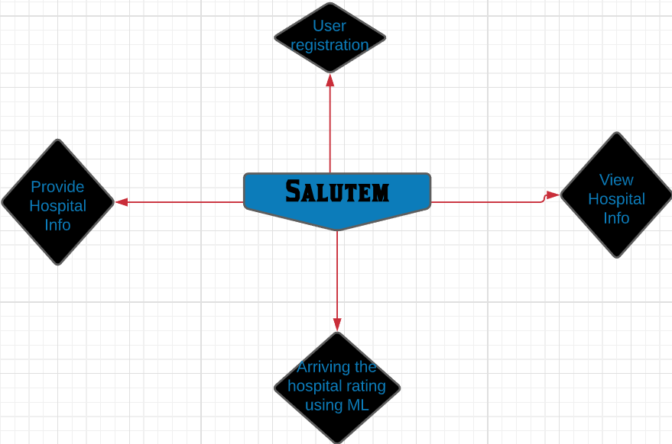
Similarly:
You go to the app And you get your data
You browse for your hospital

Slide 7
User registration
This is the part where we have register for using the apps like all apps. It is your wish to login but for providing the data of the hospital you went it is mandatory to login but it is not mandatory to login to view the data which they have provided.

Slide 8
Hospital Data
You can provide the following data using the app:
Availability of 24*7 emergency service: Yes / No
Availability of accident emergency service: Yes/No
Ambulance Availability: Yes/No
Blood bank availability: Yes/No
ICU Availability: Yes/No
Maternity ward availability: Yes / No
Number of beds:
Clean toilet facility: Rate 1 - 10
Room cleanliness: Rate 1 - 10
Doctor consultancy fees:
Specialist consultancy fees:
Registration fee:
Specially abled accessibility support: Yes/ No
Timing for OT:
Operation theatre availability: Yes / No
Accessibility to public transport: Yes / No

Slide 9
Arriving at the hospital rating using ML
Supervised learning algorithm is used
The model will be trained with the given set and used to arrive at the value
Automatically predicting ratings, for given aspects of a textual review, by assigning a numerical score to each evaluated aspect in the reviews.
Linear Regression. Naive Bayes. Support Vector Machines will be used.
It will give a suggestive rating based on the various feedback received from users.

Slide 10
Why do we need this app?
I can give you some points on why do we need this app:
We can use this in app in times like these as it helps in the finding of hospitals
nearby and cheap with the route to it.
It is also a user friendly and by user friendly I mean you can choose which language your comfortable with and with how much data you use.
By collaborating with many like minded service people the app can help the people to get :
Non branded but less costly medicine alternative for the same composition
Providing details on various social welfare schemes
Providing details on various community healthcare drives in the locality

Slide 11


Slide 12
Live prototype
https://narenpushparaj.wixsite.com/salutem

Slide 13
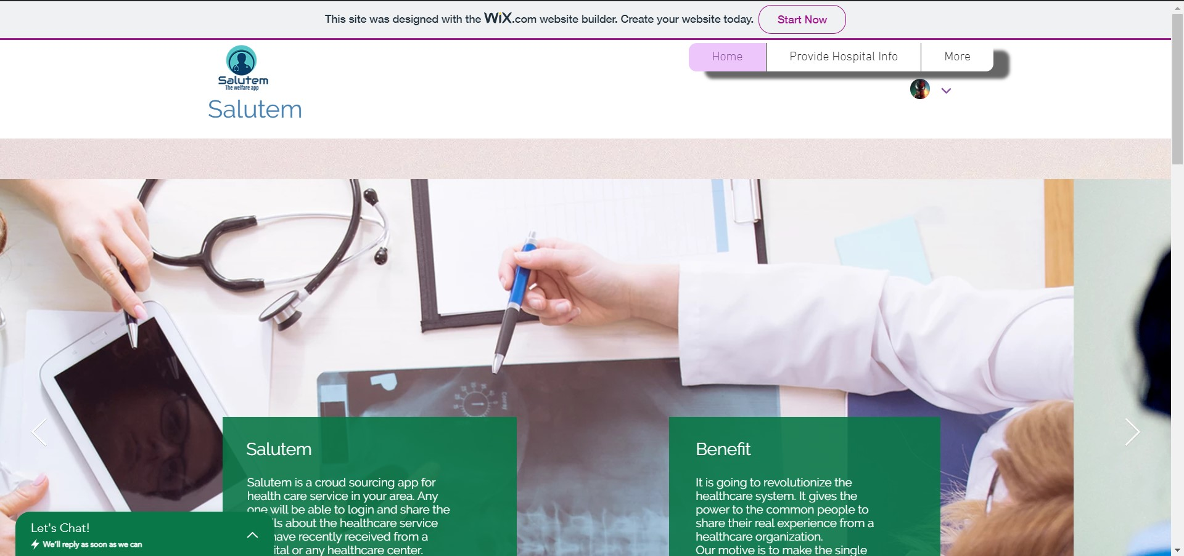
Home page
Navigation bar
Our logo
This is home
page
We have chat box for the user to directly contact us.
Our uses and our beneifits

Slide 14
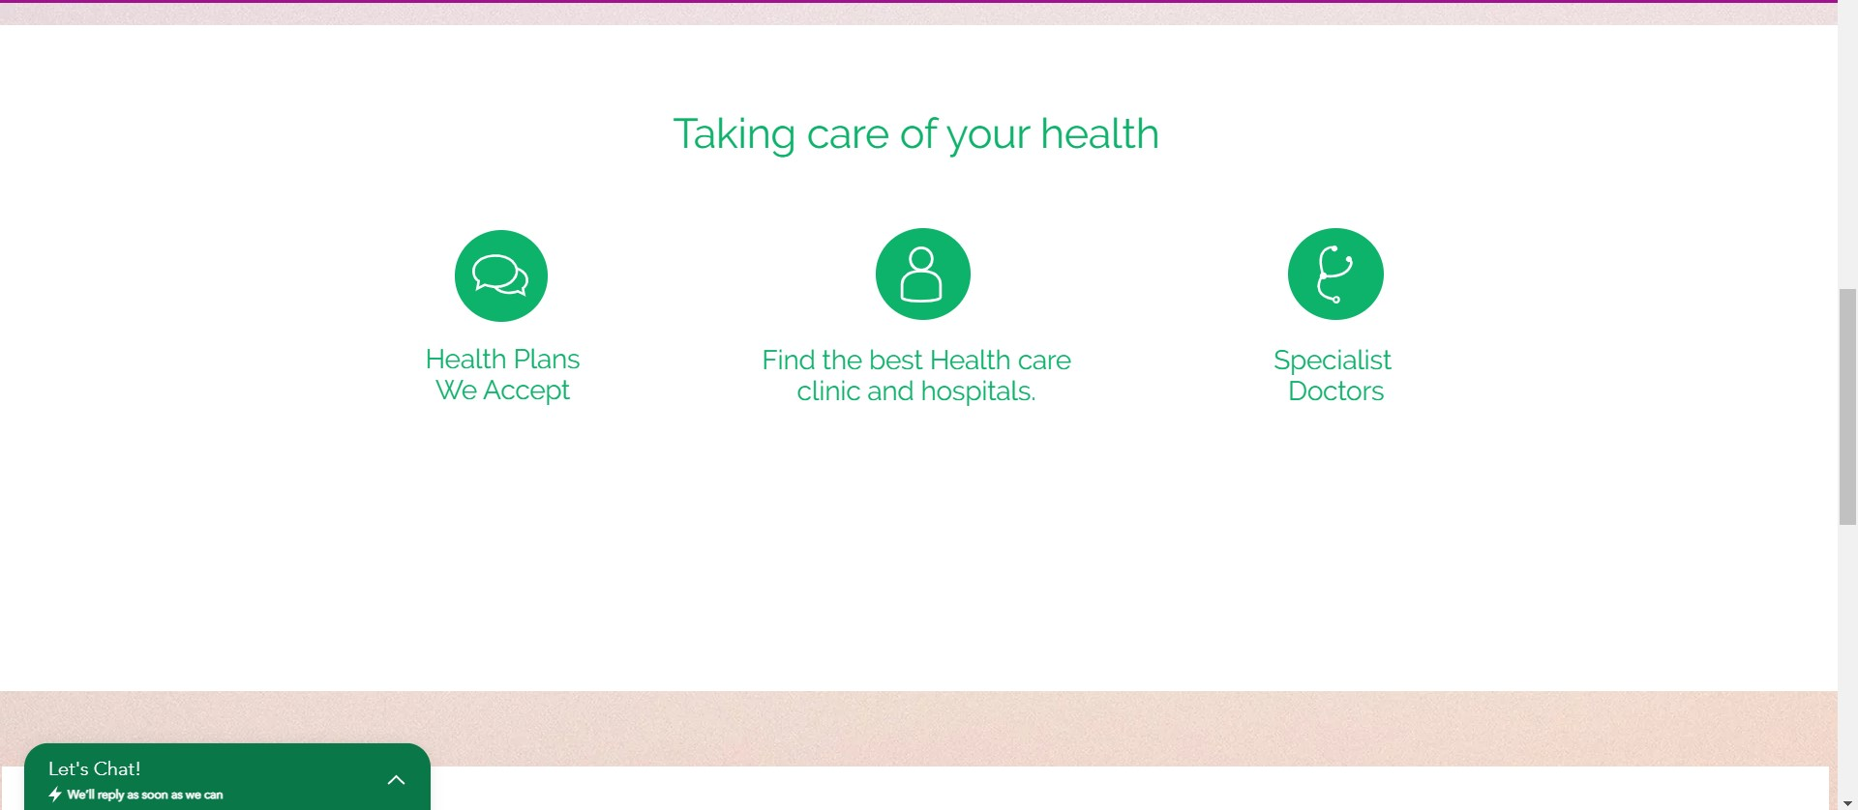
Home page cont...
Here I have just shown what we will do.

Slide 15
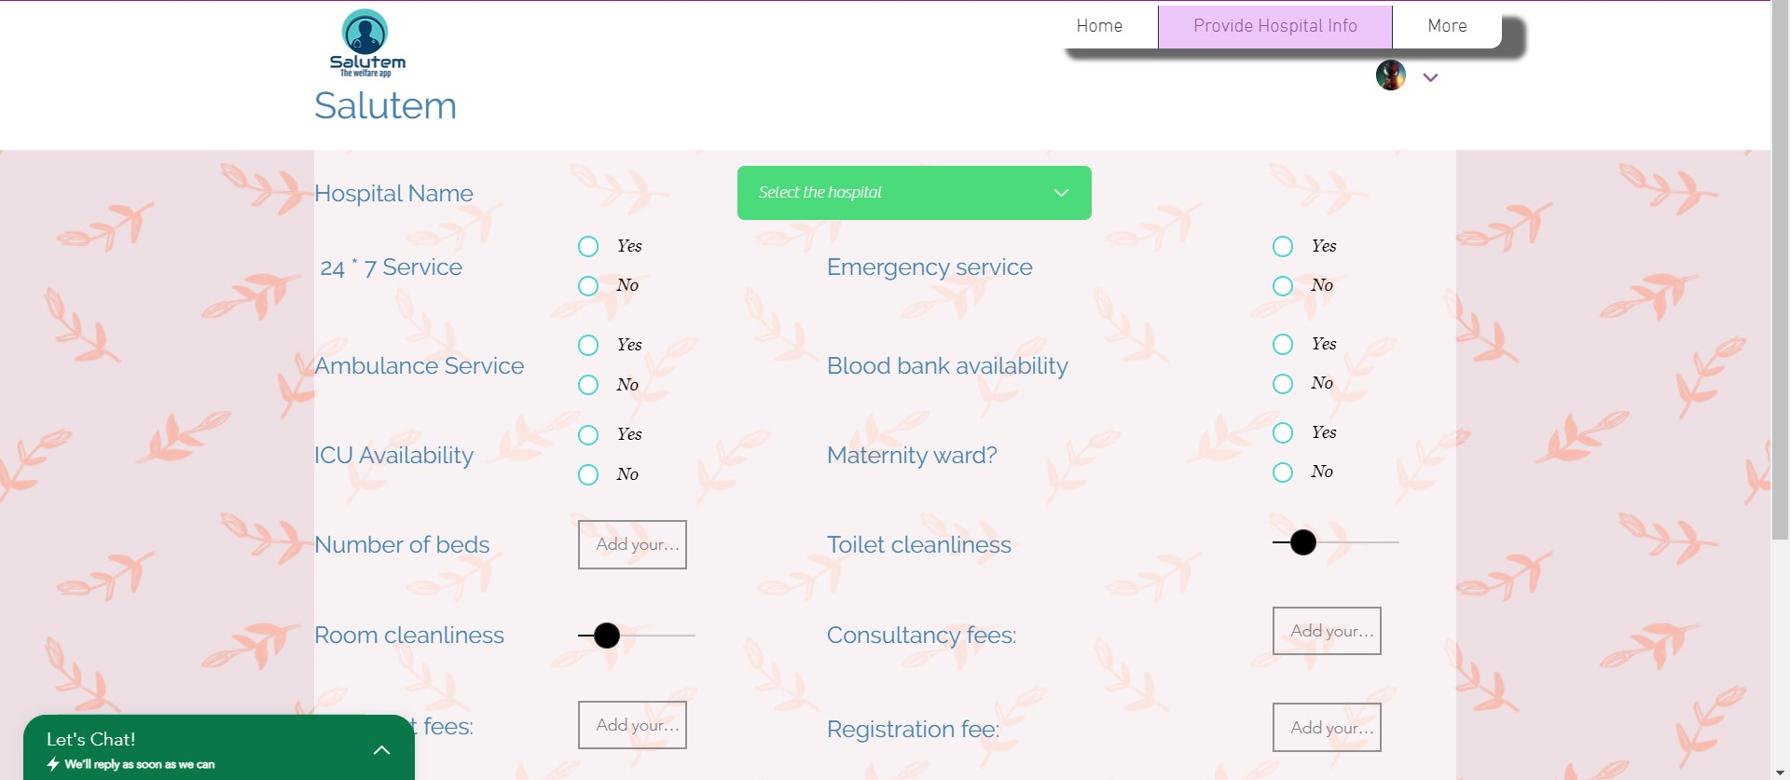
Provide Info page:
The area where you enter the input area for the data given in the hospital data

Slide 16
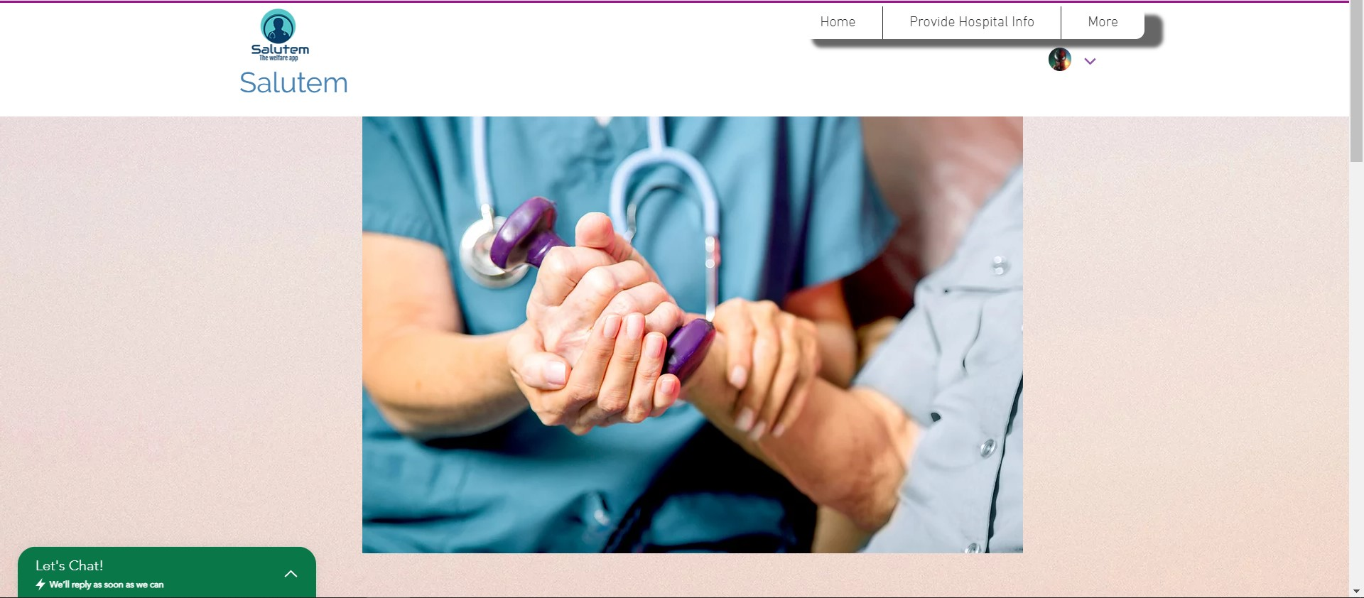
Community service page
THis is the page where the various community health services happening in the location will be listed.

Slide 17


