Slide 1

Snapshotting in HDFS for HOPS
MSc Thesis – Pushparaj
Supervisor: Prof. Luís Veiga
Notes:
Snapshot
means capturing the state of the storage system at an exact point in time and is used to provide full
recovery of data when lost

Slide 2
Motivation
Introduction
Software Upgrades
Rollback from Errors

Slide 3
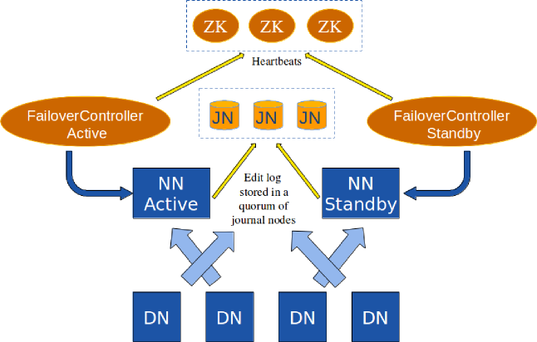
HDFS Architecture
Background
ZK: Zoo Keeper
NN: Name Node
DN: Data Node

Slide 4
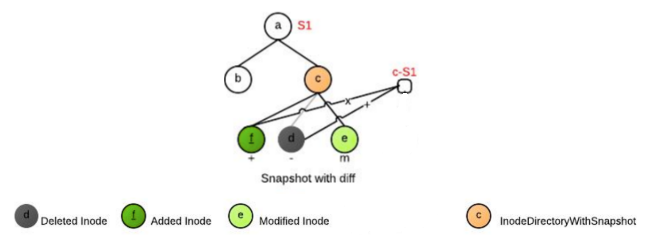
Snapshots in HDFS
Background

Slide 5
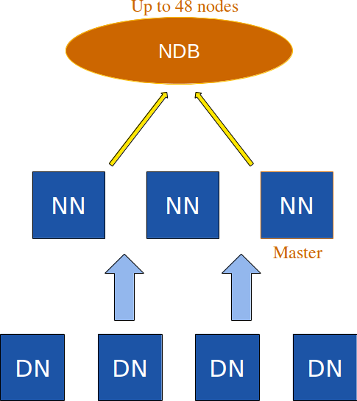
HOP-HDFS
Background
NN: Name Node
DN: Data Node

Slide 6
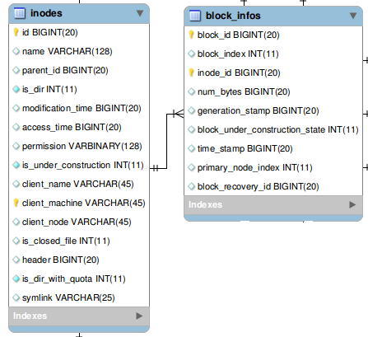
HOP-HDFS
Background

Slide 7
Design Goals
Time to take Snapshot—O(1)
Scale for Tera-bytes of metadata
Efficient Rollback
Low Space Overhead on Snapshot metadata

Slide 8
Solutions
Read-Only(RO) Snapshots
RO Root Level Single Snapshot
  Specific for Rollback on Software Upgrades
RO Nested Snapshots
  General Purpose file/directory level multiple/nested Snapshots.

Slide 9
Read-Only Root Level Single Snapshot(ROSS)
Solution
isDeleted
0 ==> inode is not deleted.
1 ==> inode deleted after Root Level snapshot was taken.
status
0 ==> inode was created before taking Snapshot.
2 ==> inode created before taking snapshot but modified after that.
3 ==> inode was created after taking snapshot.
Notes:
Explain the rules here itself.

Slide 10
RollBack
Solution
For INodes:
Delete from inodes where status='Modified' or status='New'
Update inodes set isDeleted=0 where id>0 and isDeleted=1
Update inodes set id = -id, parent id = -parent id where id<0
For Blocks:
Delete from Block Info where status='Modified' or status='New'
Update Block Info set block id = -block id, inode id = -inode id where id<0
Delete from Block Info where block id<0

Slide 11
Rollback -Implementation
Solution
Take subTreeOpLock on root
Take read-lock on all rows
Task1
  Delete inodes with status=2 or Status=3
Task2
  Set isDeleted=0 for inodes isDeleted=1 and id>0
Task3
  Update inodes set id=-id, parent_id=-parent_id where id<0;
  Deleted inodes where id<0;

Slide 12
Read-Only Nested Snapshots
Solution
SNAPS
C-List
D-List
M-List
MV-List
MV-In-List
inode_Id | Snapshot_Id | User | Time
inode_Id | Time | Created_Inode_Id
inode_Id | Time | Deleted_Inode_Id
inode_Id | Time | Modified_Inode_Id | Original_Row
inode_Id | Time | Modified_Inode_Id | Original_Row
inode_Id | Time | Moved_In_Inode Id

Slide 13
RO-Nested Snapshots(RONS)
Solution
Block-Info C-List
Block-Info M-List
inode_Id | Block_Id | Time
inode_Id | Block_Id | Time | Original_Row

Slide 14
RO-Nested Snapshots
Solution
How to determine whether an inode is in any snapshot ? Ex: /A/B/C/ Is C in any Snapshot?

Slide 15
RONS-Join Time
Solution
JoinTime(JT): The time this inode joined its present path from root. Ex:/A/B/C
Snapshots(C)=
  Snapshots on nodes in path after JT(C).

Slide 16
RONS-Join Time
Solution
Id | Snap_Id | Time
A | SA1 | 3
/
JT:1
A
JT:2
B
JT:4

Slide 17
RONS-Join Time
Solution
Id | Snap_Id | Time
A | SA1 | 3
A | SA2 | 6
B | SB1 | 7
/
JT:1
A
JT:2
B
JT:5

Slide 18
RO-Nested Snapshots
Solution
Snapshots in which B is present
  Snapshots taken on B ={SB1}
  Snapshots taken on /[Root] after JT(B) &JT(A)={}
  And Snapshots taken on A after JT(B)={SA2}
/
JT:1
A
JT:2
B
JT:5
Id | Snap_Id | Time
A | SA1 | 3
A | SA2 | 6
B | SB1 | 7

Slide 19
Move B to A
Solution
/
JT:1
Id | Snap_Id | Time
A | SA1 | 3
B | SB1 | 6
/ | S/1 | 7
{/:7}
A
JT:2
B
JT:4
C
JT:5
E
JT:8

Slide 20
Move B to A
Solution
Id | Snap_Id | Time
A | SA1 | 3
B | SB1 | 6
/ | S/1 | 7
/
JT:1
A
JT:2
InodeSnapshotMap Table
B
JT:9
Inode_Id | Belongs_to_Inode_Id | StartTime | EndTime
B | / | 7 | 7
C | / | 7 | 7
C
JT:5
E
JT:8

Slide 21
Listing files in a directory
Solution
Void ls(int stime, int id){
  children={Get children whose parentId=id};
  children = children - { children deleted before stime} -{ children created after stime} - {children moved_in after stime};
  children = children + {children moved-out after stime};
  modified-children = { children modified after stime};
  For-each children if it is modified first then moved then print former.
  }

Slide 22
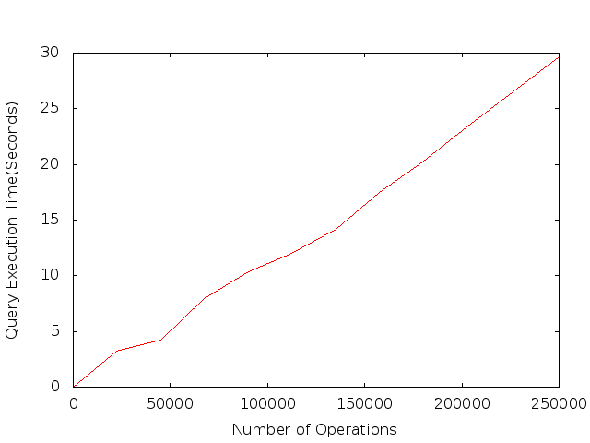
Evaluation-Nested Snapshots

Slide 23
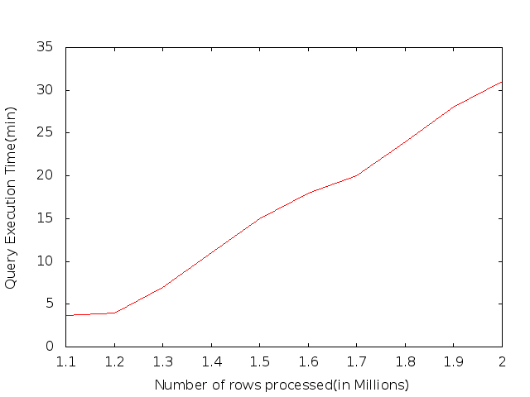
Rollback on MySql Server

Slide 24
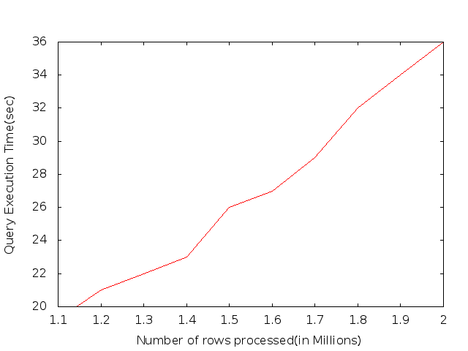
Rollback With ClusterJ

Slide 25
Conclusion
Efficient Root Level Snapshot.
Efficient Nested Snapshot design.

Slide 26
Future Work
Implementing Nested Snapshots
Integrating RO Root Level Single Snapshot and RO Nested Snapshot solutions

Slide 27
Thank You

