Slide 1
Snapshotting in HDFS for HOP
Notes:
Snapshot
means capturing the state of the storage system at an exact point in time and is used to provide full
recovery of data when lost

Slide 2
Introduction
Definition of Snaphot
Big Data Systems & Enterprise-Grade Storage Systems.

Slide 3
Use-Case Scenarios
Software Upgrades
Rollback from Errors
Hot Backups
Managing Real-time Data Analysis

Slide 4
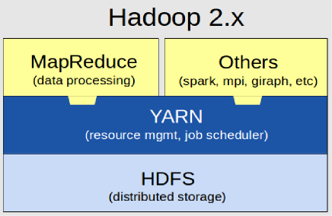
Hadoop

Slide 5
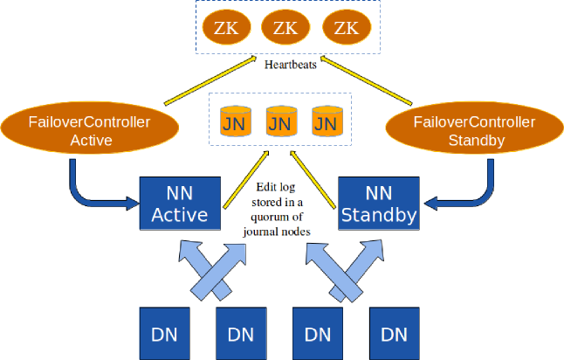
HDFS v2 NameNode Primary/Secondary Replication Model

Slide 6
Limitations
Still Multi-Readers,Single-Writer, Whole NameSystem lock.
Secondary NameNode takes >10 sec to server fully.
DataNodes need to know the primary NameNode by using a Zookeeper service which requires atleast three nodes.

Slide 7
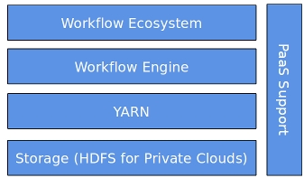
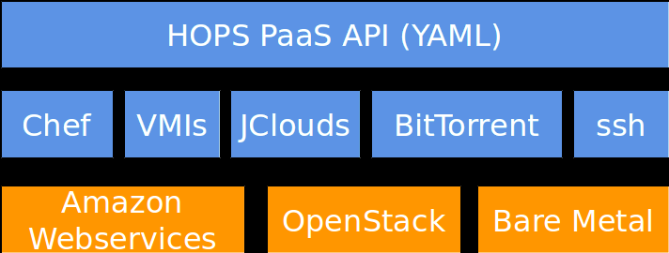
Hadoop Open Platform as Service

Slide 8
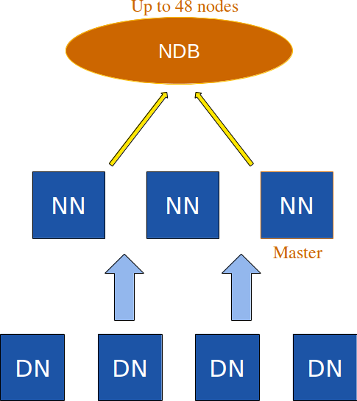
HOP-HDFS

Slide 9
Entity-Relation Diagram for NameNode state in Hop-HDFS

Slide 10
Hop-Hdfs Operations

Slide 11
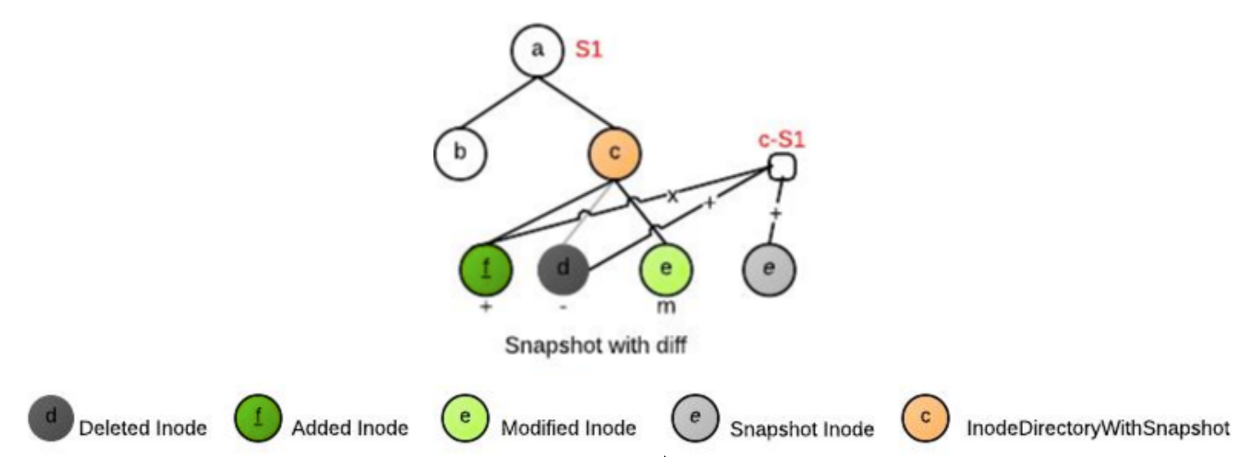
Related Work: Apache Vesrion 2

Slide 12
Related Work: Apache Vesrion 2
Operational costs
○ Modification of a file/directory is O(log (diff size))
○ Access time for current files and directories is unchanged
○ Access time for snapshot files and directories has additional cost of O(log (diff size))
Storage costs - Proportional to the unique modifications since the snapshot is taken - O(M)

Slide 13
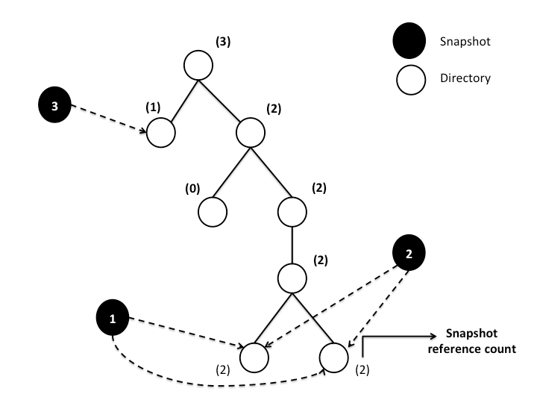
Related Work: Facebook

Slide 14
Related Work: Facebook
Selective Copy-On Appends
Copy-On Write
Appends followed by Truncate
Use Pointers Otherwise.
Overhead of building Snapshot tree
Time to take Snapshot Scales linearly.

Slide 15
Challenges
Time to take Snapshot—O(1)
Scale for TeraBytes of Meta-Data(HDFS)
Efficient Roll-Back
Low Sapce OverHead on Snapshot meta-data

Slide 16
Solution
Read-Only(RO) Snapshots
RO Nested Snaphots
General Purpose file/directory level multiple/nested Snapshots.
RO Root Level Single Snashot
Specific for RollBack on Software Upgrades

Slide 17
Read-Only Root Level Single Snapshot(ROSS)
isDeleted
0 ==> Inode is not deleted.
1 ==> Inode deleted after Root Level snapshot was taken.
status
0 ==> Inode was created before taking Snapshot.
2 ==> Inode created before taking snapshot but modified after that.
3 ==> Inode was created after taking snapshot.
Notes:
Explain the rules here itself.

Slide 18
Deletion of Directories
atomic{
Set isDeleted=1 for this directory
}
Process the children in depth-first manner.
If file status=3,
atomic{
permanently delete blocks
delete the inode row.
}
Atomic constrcut to guarantee consistency of meta-data incase of namenode failure.

Slide 19
Roll Back
For INodes:
Delete from INodes where status=2 or status=3
Update INodes set isDeleted=0 where id>0 and isDeleted=1
Update INodes set id = -id, parent id = -parent id where id<0
For Blocks:
Delete from Block Info where status=2 or status=3
Update Block Info set block id = -block id, inode id = -inode id where id<0
Delete from Block Info where block id<0

Slide 20
Implementation-RollBack
Take subTreeOpLock on root
Take read-lock on all rows
Task1
Delete Inodes with status=2 or Status=3
Task2
Set isDeleted=0 for inodes isDelered=1 and id>0
Task2
Update inodes set id=-id, parent_id=-parent_id where id<0;
Deleted inodes where id<0;

Slide 21
Implementation-RollBack
Task1, Task2, Task3 are executed on thread pool with batch size 100,000
Failure Handling:
Insert row with Task Id , NameNode Id,status
If( status=InProgress && Namenode is dead)
Leader assigns the task to another namenode.
Since Task1, Task2, Task3 are Idempotent, progress is guaranteed.

Slide 22
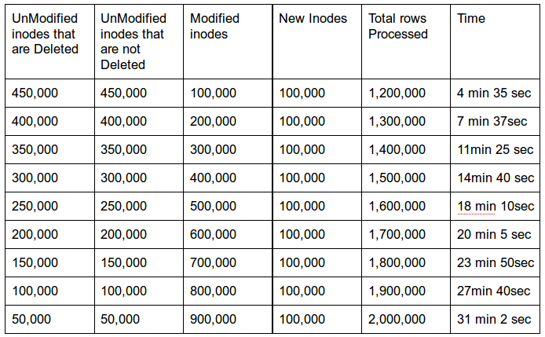
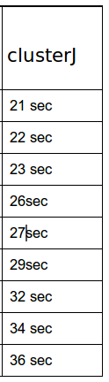
Evaluation-RollBack
MySQl Server

Slide 23
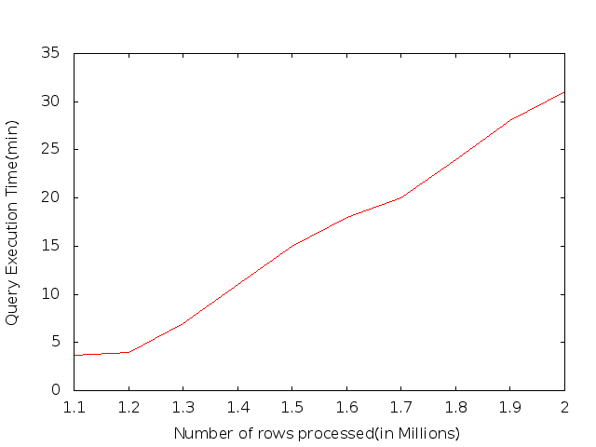
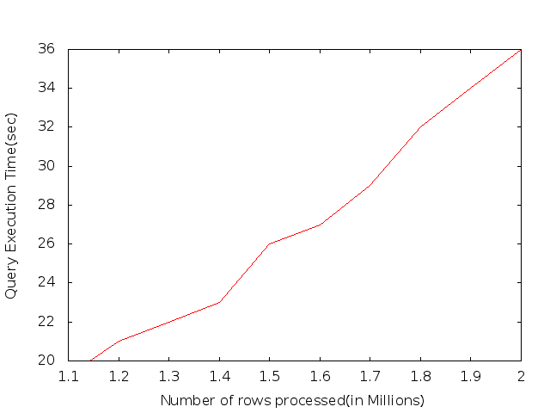
RollBack(MySql vs ClusterJ)

Slide 24
Read-Only Nested Snapshots
SNAPS
C-List
D-List
M-List
MV-List
MV-In-List
Inode_Id | Snapshot_Id | User | Time
Inode_Id | Time | Created_Inode_Id
Inode_Id | Time | Deleted_Inode_Id
Inode_Id | Time | Modified_Inode_Id | Original Row
Inode_Id | Time | Modified_Inode_Id | Original Row
Inode_Id | Time | Moved_In_Inode_Id

Slide 25
RO-Nested Snapshots(RONS)
Block-Info C-List
Block-Info M-List
Inode_Id | Block_Id | User | Time
Inode_Id | Block_Id | Time | Original Row

Slide 26
Algorithm for listing files in a directory
Void ls(int stime, int dirId){
children={Get children whose parentId=id};
children = childen - { children deleted before stime} -{ children created after stime} - {children moved_in after stime};
children = children + {children moved-out after stime};
modifiedChildren = { children modified after stime};

Slide 27
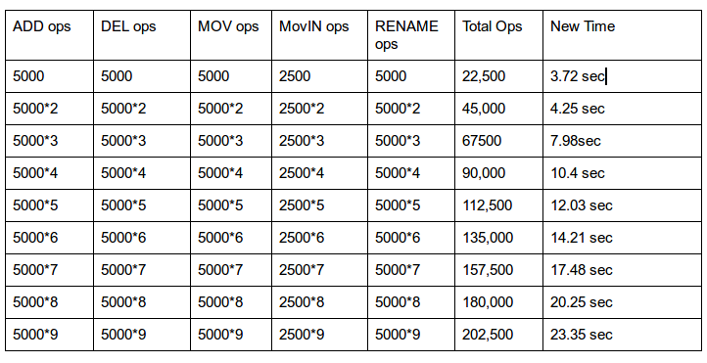
Evaluation-Nested Snapshots

Slide 28
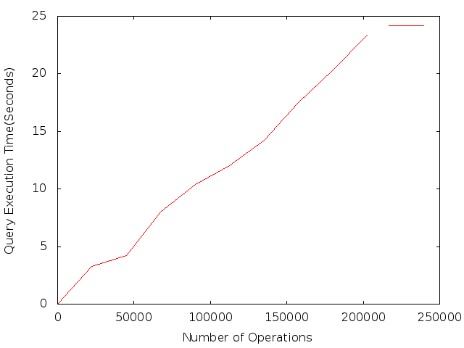
Evaluation-Nested Snapshots

Slide 29
Future Work
Evaluating & Implementing Nested Snapshots
Integrating RO Root Level SingleSnapshot and RONetsted Snpashot solutions

Slide 30
Thank You

