Slide 1
HDFS Snapshots
Pushparaj
Master Thesis Student

Slide 2
User scenarios
Protection against user errors
BackUp
Experimental/Test Setups

Slide 3
Solutions
Root level single snapshot
General purpose nested snapshots

Slide 4
Implementation
Persist state with Copy-On-Write
Save state in Tables @ NDB cluster.
Time to take Snapshot O(1)
Time to revert back O(no.of modifications)

Slide 5
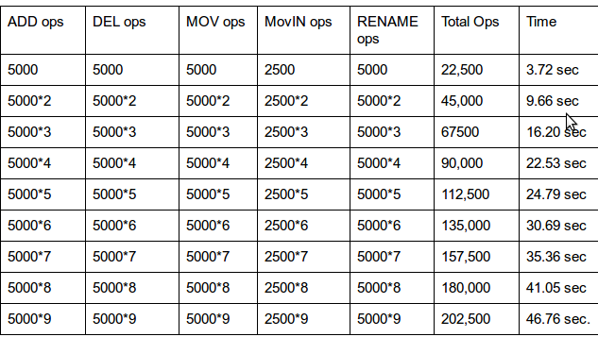
Micro-Benchmarks
(Nested Snapshots)

Slide 6
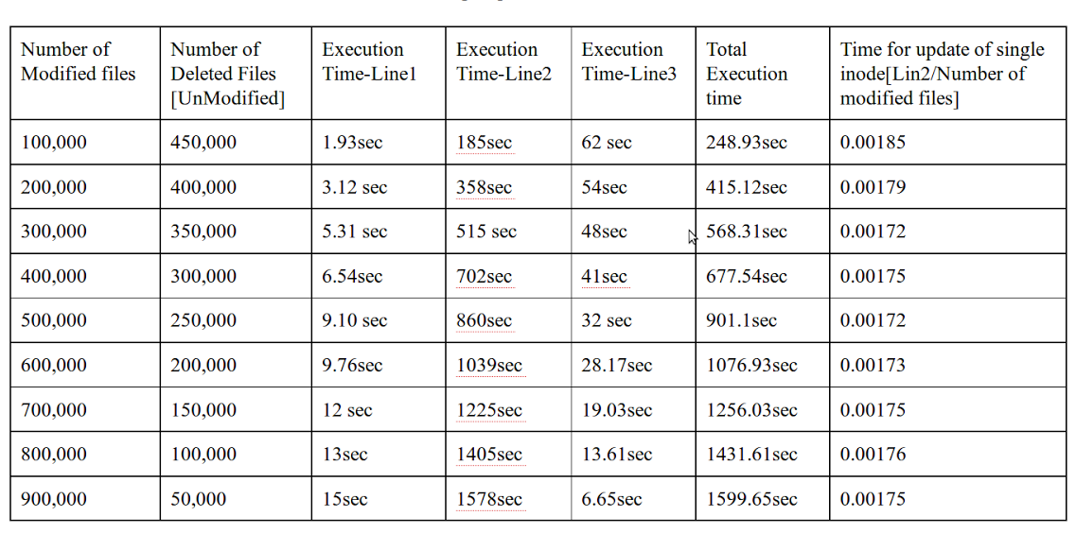
Micro-Benchmarks
(Root Level Single Snapshot)

Slide 7
Thank You

