Slide 1
Privacy for the Personal Data Vault
Tamás Balogh
Supervisor : Asst. Prof. Ricardo Chaves
1 / 24

Slide 2

Christian Schaefer
Notes:
This thesis work has been developed together with Ericsson

Slide 3
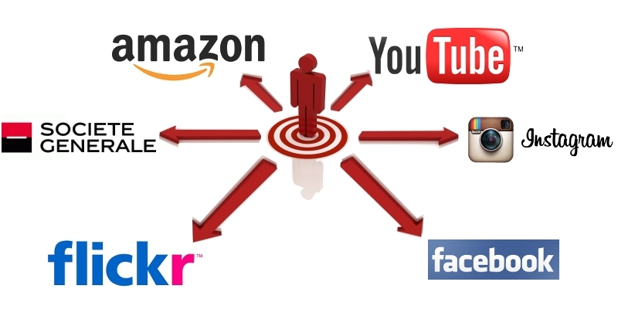
Personal Data Vault (PDV) ^{[1]}
http://myprofile-project.org/thesis/presentation/?full#7
3 / 24
Notes:
The way how we interact in today’s world online is by governed in large percentage by transactions on personal user data. We share more and more information about every aspect of our lives. During these interactions we come in contact with many different service providers depending on the context.
(photos on FB, videos on YouTube, favorite books on amazon, address on banking site)
As a result of this, Service Providers collect immense amounts of user data. A couple of things that are unsatisfactory about this current model:
Lock-in
All the data and content that we generate and submit to these SPs are becoming locked in into their system with little to no description on how data is treated. Migration or termination is often impossible
Lack of control at fine granularity
SPs offer a limit amount of control over user data.
Fragmentation
Information becomes fragmented and inconsistent since these providers are often asking for same user data, but are not communicating between themselves

Slide 4
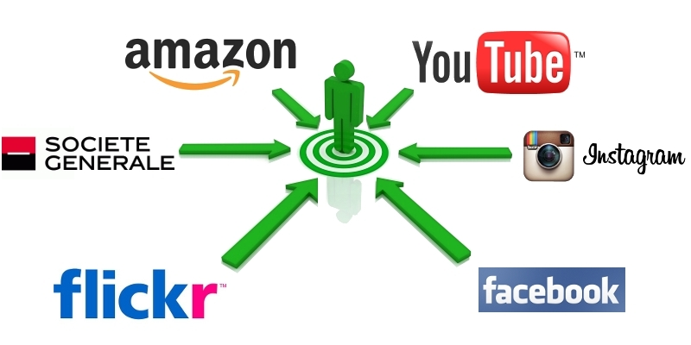
Personal Data Vault (PDV)
4 / 24
Notes:
The PDV envisions a different model, that is based around use-centricity.
Every person is associated with its PDV.
Its goal is to bring data and control under a single entity (PDV) controlled by the user, rather than scatter it around to many independent providers.
By unifying the source of the personal data it tackles the problems of: lock in, lack of control, fragmentation

Slide 5
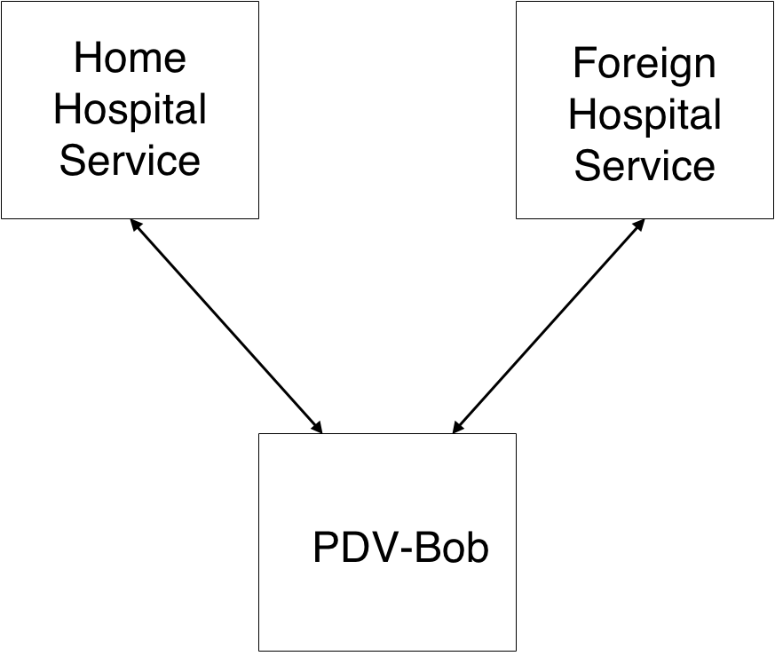
Personal Data Vault (PDV)
Healthcare Scenario
Notes:
Healthcare is a often discussed in privacy related research
scenario
Hospital Services both have local copies of PHR kept in PDV -> privacy issues
!no explicit awareness / control over data copies!
An example can be envisioned in the Healthcare Scenario. The Healthcare scenario is a widespread use case that is often discussed in privacy and security related research.
Imagine an individual (Bob) who has a PDV (PDV-Bob).
Bob is registered with its Home Hospital Service where he does all his usual health checkups. The results of these checkups are then kept in PDV-Bob.
Imagine Bob going on a vacation and suffering an accident and has to be taken to the Foreign Hospital to immediate care. The Foreign Hospital Service can interrogate Bobs’ previous health record, before administering a drug with potential side effects.
By having a PDV, Bob can make sure that authorized entities can access to its data. (for example, only doctors) (Foreign Hospital Service can only gain access to PDV-Bob, if he was previously authorized to). The PDV model, however, offers only weak guarantees with regards to data privacy. (Once the Foreign Hospital Service has a copy of Bob’s Personal Health Record, he can freely operate on it)
This raises important privacy concers.

Slide 6
Privacy ^{[2]}
AWARENESS
CONTROL
TRUSTWORTHINESS
6 / 24
Notes:
There are three main aspects of privacy that are worth addressing:
Awareness refers to the knowledge that users have about how their shared data is being treated.
Control refers to the manners in which a user can manipulate previously shared data.
Trustworthiness refers to the trust which is put into entities operating on shared data to treat them according to rules and not abuse them.

Slide 7
Goal
HOW TO PROVIDE PRIVACY GUARANTEES IN A SYSTEM WITH PDVs?
7 / 24

Slide 8
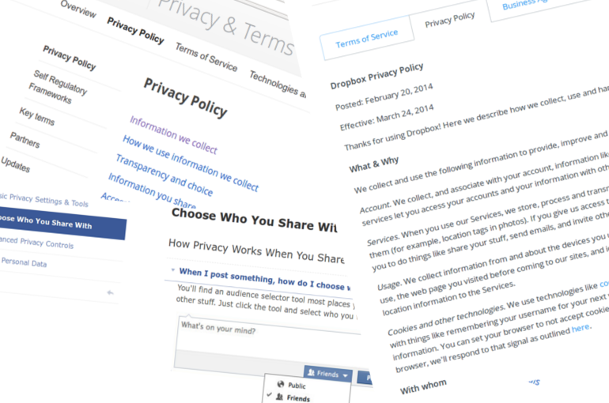
I Agree….
Notes:
Today, when it comes to privacy we are presented with a one sided model, where service providers present a take-it-or-leave-it offer to users.
Privacy Policies are the main tools which regulate how collected user data is handled, and it’s completely controlled by the service providers.
More recently, they also provide some multiple choice options by which a finer granularity of control is advertised, although these options are also under the control of the service providers.
Privacy Policies are too static and ambiguous. Need a better model.

Slide 9
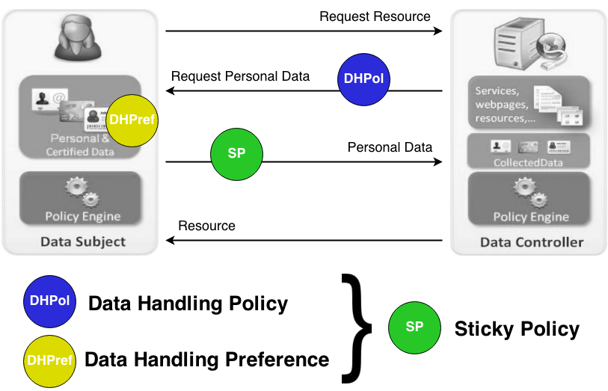
PrimeLife Policy Language ^{[3]}
Notes:
- PrimeLife research in privacy
- actors: DC and DS
- DHPol + DHPref = SP (obligations, purpose of usage)
- scenario
- good two-sided model, but lack of technical enforcement: !users are still unaware/don’t control existing data copies!
PrimeLife is a European research project focusing on many aspects of privacy protection.
One of its contributions, the PrimeLife Policy Language is based on three simple elements: DHPol, DHPref and Sticky Policy.
DHPol : the data collector’s (data requester, service provider) way of expressing how shared data is going to be treated
DHPref : is the data subject’s (which is usually the entity getting requested for data, in many cases a PDV) preference in how shared data should be treated,
Sticky Policy is a combination of these two, which satisfies both data collector and subject.
It is called Sticky Policy because it’s a policy specifically formulated for a single shared user data that accompanies the user data and ensures the correct usage of it.
In the diagram we can observe a common interaction between a DS and DC. The DS requests to resource, but the DC is only willing to give the resource in exchange for some personal data. When the DC makes its request for personal data, he also attaches a DHPol with it. The Data Subject then matches the DHPol with his DHPref and creates a suitable SP. The SP is the sent together with the personal data, before the resource itself is returned.
This model alleviates the problems of the one sided privacy model. It does not, however, specify how the technical enforcement of this model can be carried out.

Slide 10
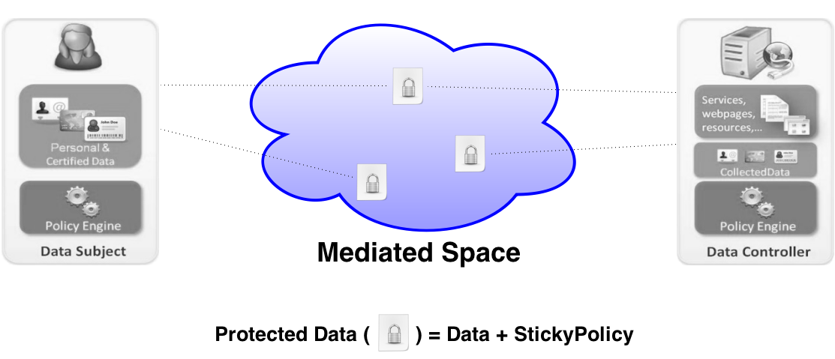
Mediated Privacy
Notes:
In order to have awareness/control we need to keep track of data copies in the mediated space.
host for PD
Link to copies
We propose a privacy enforcement model called the Mediated Privacy.
We introduce the concept of a mediated space where shared user data objects live. These user data object are PD pieces which envelope Data + Sticky Policy.
Through the use of the MP, both DS and DC are keeping live references for the share PD.

Slide 11
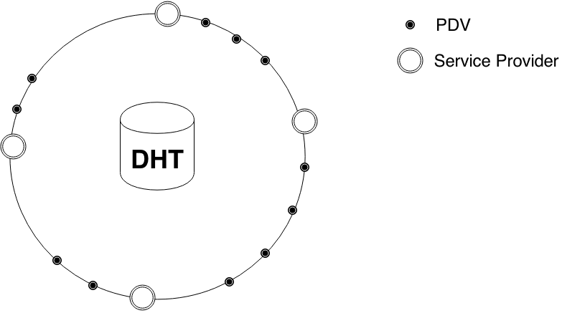

Business Ring ^{[4]}
Mediated Privacy
Notes:
- Chord-like DHT
LookupKey – PD
The idea of a Mediated Space is captured by a DHT with PDVs and Service Providers being part of the system alike.
We present a Chord-like ring representation of a DHT for simplicity. A DHT is a simple key-value store with a large keyspace that is divided into keyspace slices among the nodes of the system. Every node of the system is responsible for the keyspace slice lying between himself and its predecessor.
PD objects are then getting inserted into this DHT under a certain lookup key.
We call this DHT based mediated space a Business Ring

Slide 12
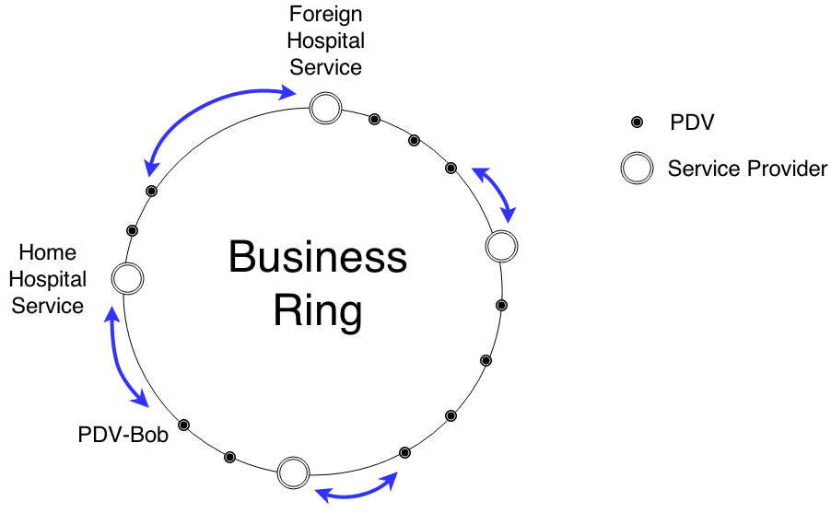
Business Ring
Mediated Privacy
Notes:
- Business ring: defined business model on PHR, or healthcare
Both HHS and FHS have a local copy
this explains how awareness of data copies is provided, but not how control over it is enforced
Business Rings are formulated around existing business models.
For example the business model around Personal Health Records presented before can have a Business Ring as such:
- with the both Hospital Services being part of it,
- as well as PDV-Bob being part of it
When PDV-Bob shares his previous PHR with the Foreign Hospital Service he simply inserts it into the BusinessRing, such that the FHS can retrieve it from there.
The question is, how to choose the hosting lookupkey.
The only logical entity to host the requested PHR is the FHS (or data requester) itself. We argue that he is bound to receive the data anyway.
One of the major differences btw a regular DHT and a Business Ring is the uneven keyspace assignment. Since user data objects are hosted by service providers, their keyspace becomes more valuable, as shown by the blue arrows.

Slide 13
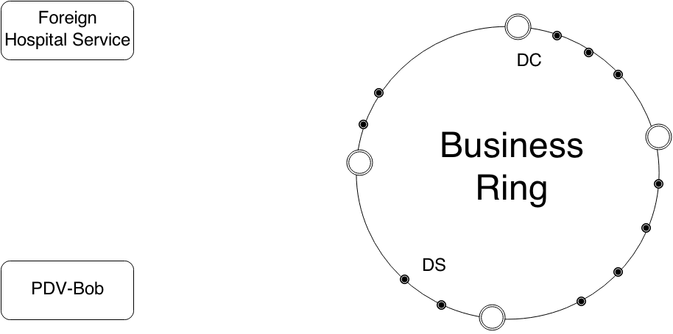
Business Ring
Mediated Privacy
13 / 24
Notes:
For a better control we employ the sticky policy paradigm
how is the data sharing carried out and control enforced?
DS / DC roles

Slide 14
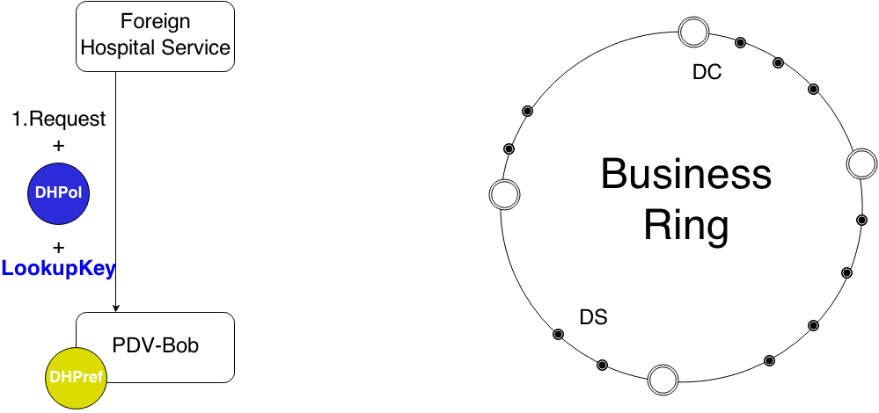
Business Ring
Mediated Privacy
14 / 24
Notes:
Request
DHPol (purposes: emergency , research)

Slide 15

Business Ring
Mediated Privacy
Notes:
Ask for information of the DC through the ring:
- This provides different measures of trust based on which DS can decide either to continue or not the interaction

Slide 16
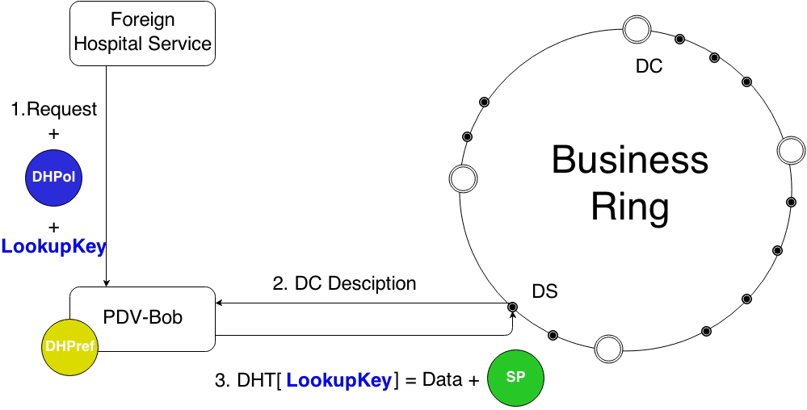
Business Ring
Mediated Privacy
16 / 24
Notes:
If the DC find the DC trustworthy:
SP = DHPref (emergency)

Slide 17
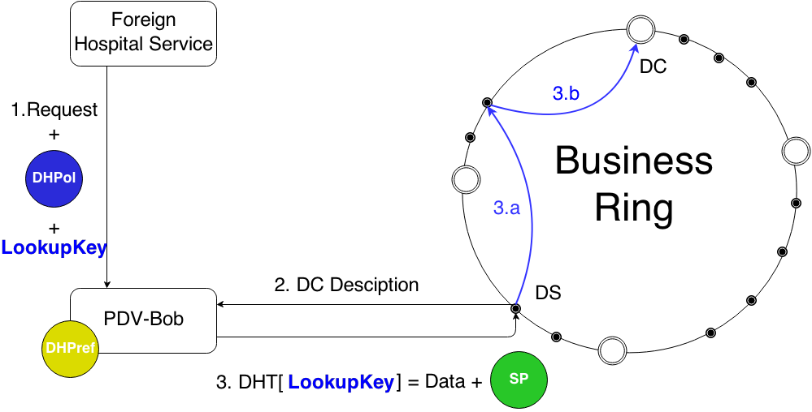
Business Ring
Mediated Privacy
17 / 24
Notes:
Internal insert, allow for internal tracking
PD is inserted under the physical node of DC

Slide 18

Business Ring
Mediated Privacy
Notes:
Ack
note: no data transfer outside the shared medium

Slide 19
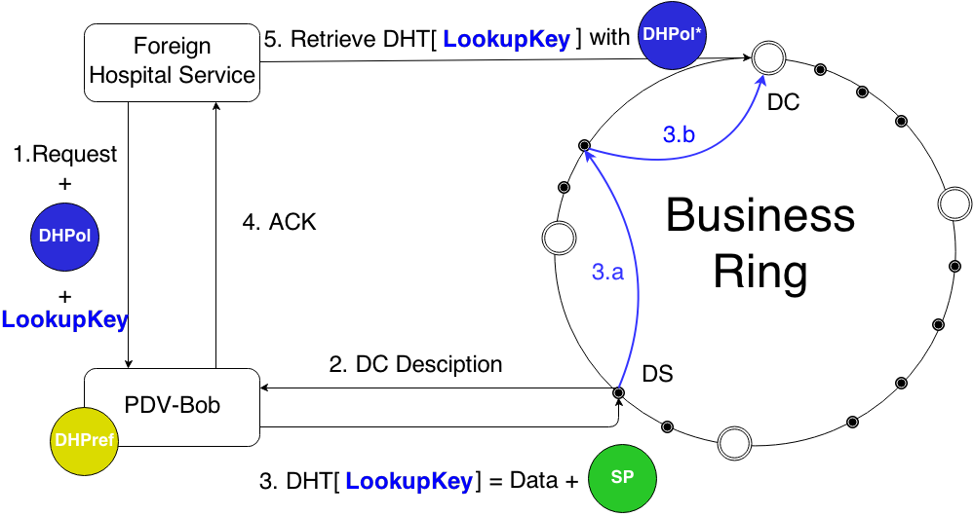
Business Ring
Mediated Privacy
Notes:
Retrieve with DHPol* (emergency OR research)

Slide 20
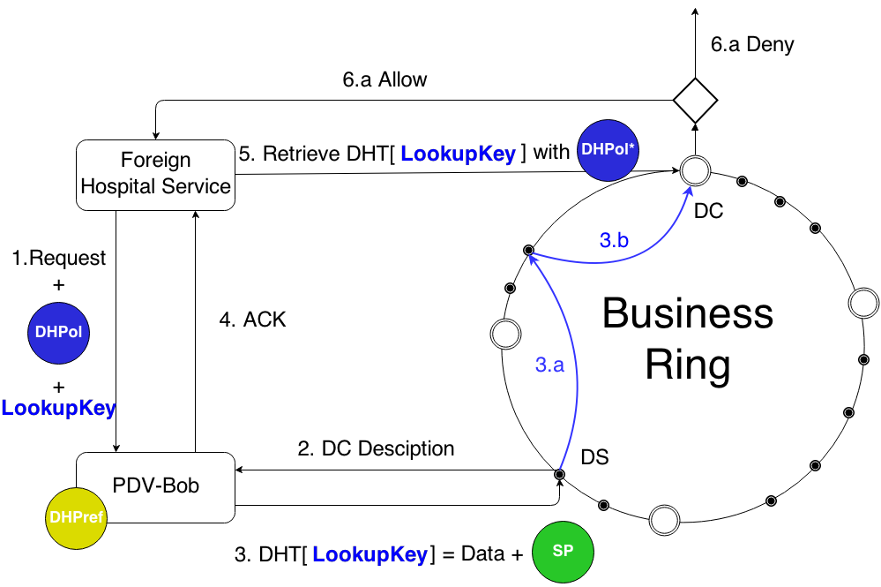
Business Ring
Mediated Privacy
20 / 24
Notes:
Deny OR Allow
Both DC and DS know the LookupKey
DC has to know in order to retrieve it
DS has to know in order to maintain control over it.

Slide 21
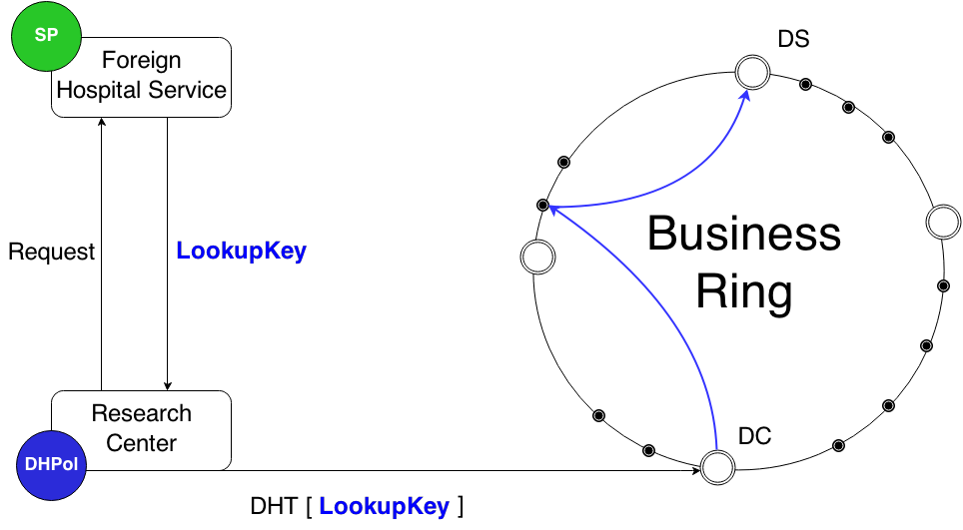
Data Forwarding
Mediated Privacy

Slide 22
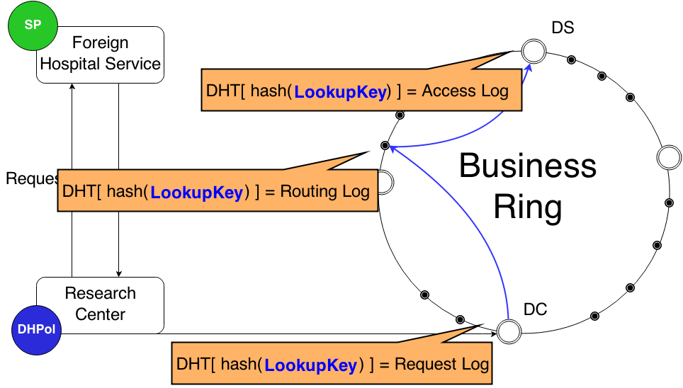
Logging
Mediated Privacy

Slide 23
Experimental Results
Evaluation based on existing work
most feasible
least tamper resistant
Prototype
Notes:
We carried out an evaluation of our proposed model, comparing it with solutions proposed from existing work
(the existing privacy enforcement solutions are reliant on software verification and TTP)
- We found that the MP is the most feasible since it comes with the least amount of assumptions and prerequisites. (Existing solutions often requires special HW – TPM, multiple TTPs, or a strict architectural design)
- We also found that MP is the most vulnerable for tampering since the lack of verifiable software. We can only observe how nodes behave in the system through their interaction in the Business Ring. Although some thought has been put into observing node behavior inside the Business Ring and banning malicious nodes based on consensus.
Moreover, we also developed a prototype of the MP model which uses the PPL extension of the XACML language
The Demo includes two PDVs and two Service Providers to simulate cases of data forwarding.

Slide 24
Conclusions
Mediated Privacy
two-sided privacy
mediated space
continuous control over data copies
feasible
prototype
22 / 24

Slide 25
References
[1] Markus Sabadello. Startup technology report. 2012. doi: http://pde.cc/2012/08/str201201/.
[2] Prof. Dr. Dr. h.c. Johannes A. Buchmann. Internet Privacy : Options for adequate realisation. Springer Berlin Heidelberg, 2013.
[3] Dave Raggett (W3C) Slim Trabelsi (SAP), Gregory Neven (IBM). Report on design and implementation. PrimeLife, 2011. URL http://primelife.ercim.eu
[4] R. Steinmetz and K. Wehrle. Peer-to-Peer Systems and Applications. Lecture Notes in Computer Science / Information Systems and Applications, incl. Internet/Web, and HCI. Springer, 2005. ISBN 9783540291923.
23 / 24
Notes:
We propose a privacy enforcement model called the Mediated Privacy.
We introduce the concept of a mediated space where shared user data objects live. These user data object are PD pieces which envelope Data + Sticky Policy.
Through the use of the MP, both DS and DC are keeping live references for the share PD.

Slide 26
Questions?
Thank You!
24 / 24
Notes:
We propose a privacy enforcement model called the Mediated Privacy.
We introduce the concept of a mediated space where shared user data objects live. These user data object are PD pieces which envelope Data + Sticky Policy.
Through the use of the MP, both DS and DC are keeping live references for the share PD.

