Slide 1

Data Science Training
Session 1

Slide 2
Requirements for DS roles
Programming knowledge
Data modelling and evaluation
Data Visualization and reporting
Probability and Statistics
Machine Learning techniques
Relational Database

Slide 3
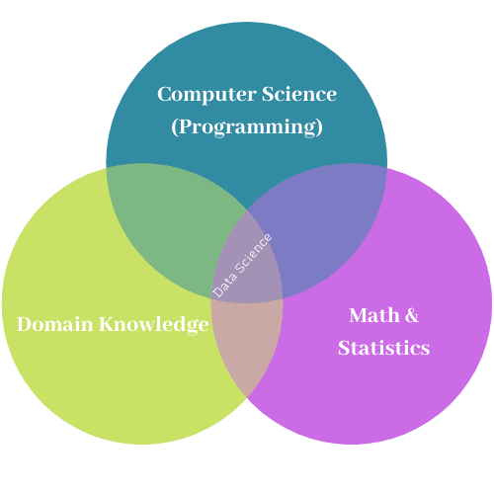
What is Data Science?

Slide 4
Data Science Parts
Perception – getting insights from the data
Planning –
Finding all possible solutions
Finding the best possible solution among all solutions
Action
Result

Slide 5
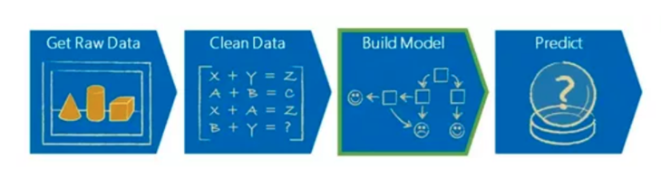
Machine Learning Process

Slide 6
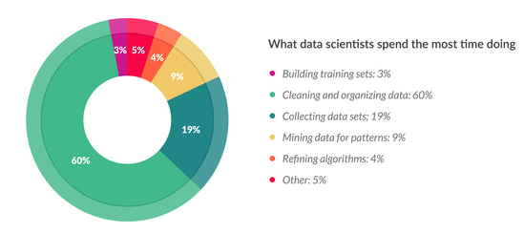
Typical day for a data scientist

