Slide 1
CAPSTONE PROJECT:- Cricket Win Prediction
Presented by:-
Pushpendra Tawar

Slide 2
AGENDA
INTRODUCTION
DATA PREPARATION
EXPLORATORY DATA ANALYSIS
MODEL BUILDING
MODEL TUNNING
MODEL SELECTION
CONCLUSION
RECOMMENDATION

Slide 3
INTRODUCTION
Main aim is to create Machine Learning models which correctly predicts a win for the Indian Cricket Team.
Developing a model to extract and provide actionable insights and recommendation.
PROBLEM STATEMENT
BCCI has contracted an external analytics consulting firm to assist with its data analytics. In this partnership, strategic changes are made to make India win by extracting actionable insights from historical match data. Objective is to build Machine Learning models that correctly predict wins for the Indian Cricket Team. The next step is to extract actionable insights and recommendations from the model.
India will also play the following 10 matches in the next 10 days. It is important to predict the outcome of the matches, and if you get a loss, suggest some changes, and re-run your model until you get a win. The same strategy cannot be used throughout the series, as opponent will become accustomed to it and come up with their own counter strategy. As such, for all the below 5 matches, you must suggest unique strategies to help India win. There should be suggestions that correspond with the variables in the dataset. Be sure to carefully consider whether these suggestions could be implemented. Total no. of matches will be 5, out of that 1 test match with England in England, it would be day match in rainy season,2 T20 and 2 ODI matches with Australia and Shri Lanka in India, all these matches will be day and night matches. It will be winter season at the time of match.

Slide 4

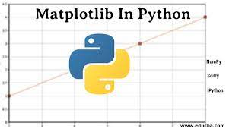

WORKFLOW & TOOLS
Workflow
Environment & Tools Used
Data Collection
Data Exploration
Data Cleaning
Data Preprocessing
Model Building
Model Evaluation

Slide 5
DATA & VARIABLES DESCRIPTION
Total 2929 matches result for all three format (T20, ODI, Test) have taken for this case study.
We have total 23 variable present in the dataset in which 3 datatypes are given float64(9), int64(4), object (10). We have ‘Result’ as target variable.
Variables | Description
Game_number | Unique ID for each match
Result | Final result of the match
Avg_team_Age | Average age of the playing 11 players for that match
Match_light_type | type of match: Day, night or day & night
Match_format | Format of the match: T20, ODI or test
Bowlers_in_team | how many full time bowlers has been player in the team
Wicket_keeper_in_team | how many full time wicket keeper has been player in the team
All_rounder_in_team | how many full time all rounder has been player in the team
First_selection | First inning of team: batting or bowling
Opponent | Opponent team in the match
Season | What is the season of the city, where match has been played
Audience_number | Total number of audience in the stadium
Offshore | Match played within country or outside of the country
Max_run_scored_1over | Maximum run scored in 1 over by team
Max_wicket_taken_1over | Maximum wicket taken in 1 over by team
Extra_bowls_bowled | Total number of extras bowled by team
Min_run_given_1over | Minimum run given by the bowler in one over
Min_run_scored_1over | Minimum run scored in 1 over by team
Max_run_given_1over | Maximum run given by the bowler in one over
extra_bowls_opponent | Total number of extras bowled by opponent
player_highest_run | Highest score in the match by one player
Players_scored_zero | Number of player out on zero run
player_highest_wicket | Highest wickets taken by single player in match

Slide 6
DATA PREPARATION
Missing Value Treatment
Any data entry which have a null in any of the predictors was not consider in building the model.
Label Encoding& Feature selection
Convert the categorical variable into numerical by using dummy encoding
Outlier Treatment
Treated the outlier for ‘Avg_team_Age’ variable as there are some invalid entry present in the variable
For other variable outlier seems to be real value.
Scaling & Data Imbalance
Result, Match format, Match light..etc.
Feature selection done using Filter technique (Chi Square Test)
Scaling performed before fitting KNN model to reduce the variation.
Perform
Synthetic Minority over sampling Technique to overcome from Imbalance data issue.

Slide 7
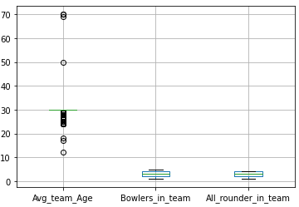
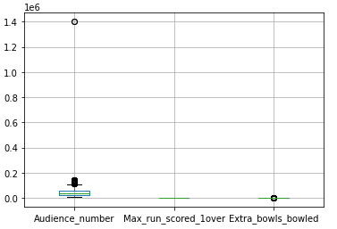
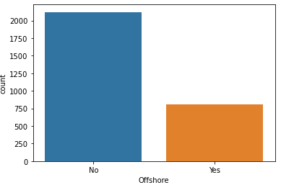
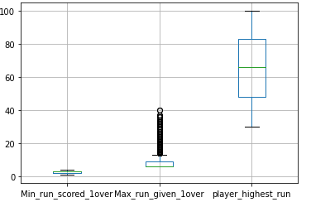
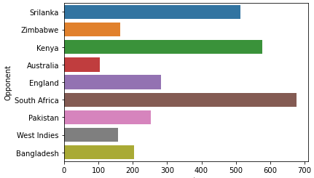
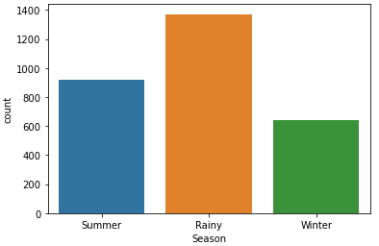
Insight:-
Around 72% of matches are played in India and only 28% are played out off India.
Most of the matches are played in Rainy Season.
Majority of the matches are played against South Africa (676).
There are some outliers present in the predictors such as Avg_team_age, max_run_over, audience_number.
Around 71% ODI Matches are played in Day light.
Exploratory Data Analysis- Univariate

Slide 8
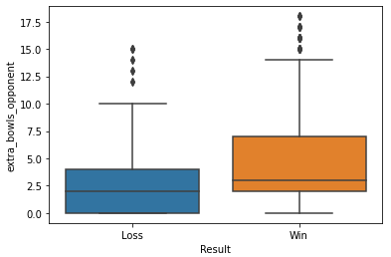
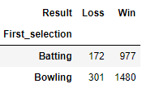
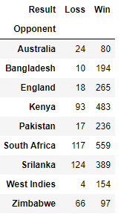
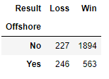
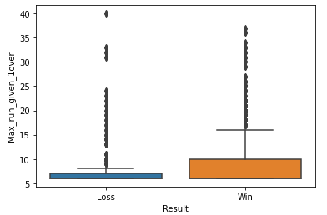
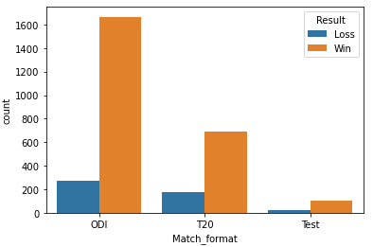
Insight:-
During the bowling contest, the team won 51% Matches while Batting 33%.
Extra ball bowled by the opponent increases winning opportunities for the team.
On average, 19% of the time when playing outside the country, and 65% when playing within the country, team manage to win.
Team has won 57% of ODI matches and 24% of T20 matches.
Inexperienced team (young player) has the higher chances to lose the match
Exploratory Data Analysis- Bivariate

Slide 9
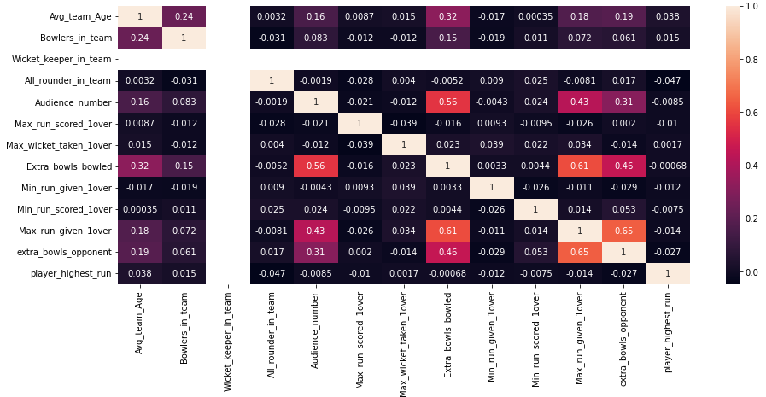
Insight:-
Can see multicollinearity among some variable.
Extra bowl opponent is highly correlated with maximum run given an over.
We can also see negative correlation between extra bowl bowled and all rounder in team.
Exploratory Data Analysis- Multivariate

Slide 10
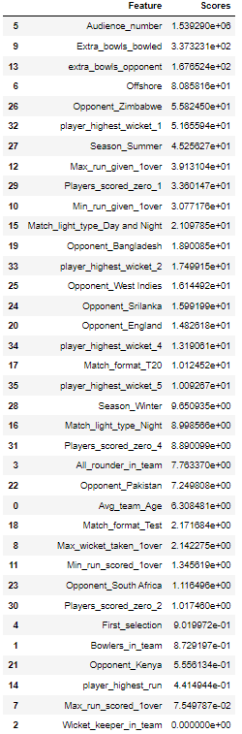
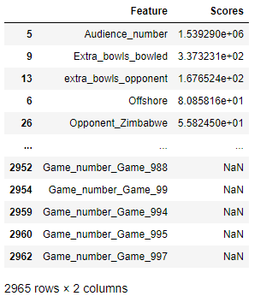
FEATURE SELECTION
Chi-square test is used to determine the relationship between the predictor and target variable.
In Feature selection, we aim to select the features which are highly dependent on the target variable.
Higher the chi-square value indicate that the feature is more dependent on the target variable and can be select for model training.
Chi-square score for Game number is null. So, we eliminate non significant variable Game number.
After second iteration we find Wicket keeper as non significant variable as per chi-square test and same we can in the heat map. So, both the variable have been eliminated to train our model with remaining predictor.
Variables
Result
Avg_team_Age
Match_light_type
Match_format
Bowlers_in_team
All_rounder_in_team
First_selection
Opponent
Season
Audience_number
Offshore
Max_run_scored_1over
Max_wicket_taken_1over
Extra_bowls_bowled
Min_run_given_1over
Min_run_scored_1over
Max_run_given_1over
extra_bowls_opponent
player_highest_run
Players_scored_zero
player_highest_wicket
Target
Variable
Eliminating Game number
Eliminating Wicket keeper in team

Slide 11
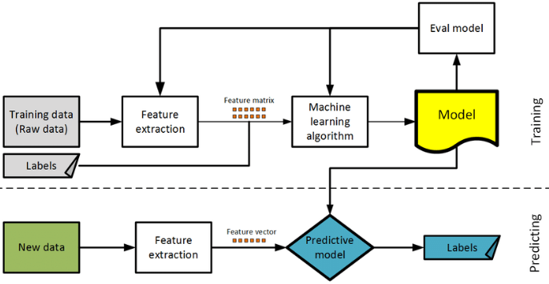
Model Selection
Target variable –Result is categorical in nature.
For this case study following classification model will be used:
Logistic Regression
Linear Discriminant Analysis (LDA)
KNN
Decision Tree (CART)
Random Forest
Naïve Bayes
ANN
Ensemble (Bagging , ADA Boosting, Gradient Boost)
Evaluation Parameters
Accuracy
Recall
Precision
F1-score
Correctly classified point in test data and total number of points in the test data
The ratio of total positive predicted by the model to the total actual positive.
Out of the total positive, what percentage are predicted positive
It is the harmonic mean of precision and recall. It takes both false positive and false negatives into account

Slide 12
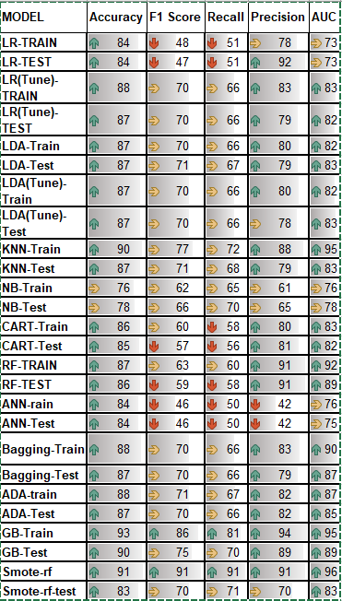
Model Evaluation
All model except Gradient Boost model is giving 90% Accuracy and 70% of recall.
In this case our most important matrix is Recall because we must predict winning for the Indian team and must reduce the false predicted records.
Model Selected:
Gradient Boosting is an ensemble technique.
It sequentially add the misidentified predictors and under-fitted predictions to the ensemble, ensuring the errors identified previously are corrected.
Gradient Boost Model has less False ‘+ve’ and False ‘-ve’ for both win and loss Classes. Compare to other model it has Higher Precision, Recall and Accuracy for both Train and Test.

Slide 13
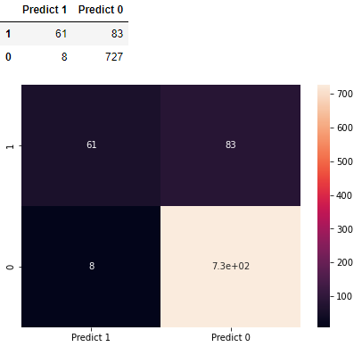
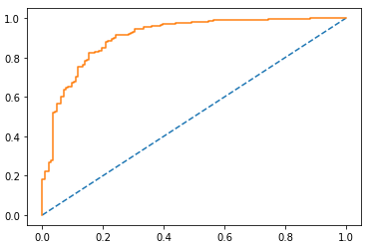
Model Evaluation Gradient Boost on Test Data
For test data set we got 90% Accuracy and 70% Recall.
We received very less false positive rate for this model.
MODEL | GB-Test
Accuracy | 90
F1 Score | 75
Recall | 70
Precision | 89
AUC | 89

Slide 14


In the first batting situation, the team wins 33% of the time and loses only 0.06% of the time.
In the first bowling situation, team wins 51% of the time and loses 10% of the time.
When playing in daylight, winning chances increase by 60%.
In ODIs, the team has won 1666 games out of 1935.
Playing with more than 2 all-rounder in a team increases winning chances by more than 50%.
Team won 1201 matches in Rainy condition out off 1371.
Its show Rain helps bowler to get some extra advantage in his bowling.
Out off 2121 matches India only loos 227 Matches while playing within the country.
India has a high probability of winning at home Ground

Slide 15
Try to collect more some more predictor, like total score, bowling style etc for better Model.
Try to add more than 3 all rounder in the team that will improve the team performance
If team opt for bowling first with an Avg team age of 30, with 4 bowlers in the team has higher chance to win against England in test match in Rainy season in England .
If team opt for bowling first with an Avg team age of 30, minimum 3 bowlers in the team, scoring average 15 runs per over has higher chance to win against Australia in T20 match in Winter season in India.
If team opt for Batting first with an Avg team age of 30, with 3 bowlers in the team and at least one player should score century has higher chance to win against Sri Lanka in ODI match in Winter season in India.

Slide 16
THANK YOU

