Slide 1
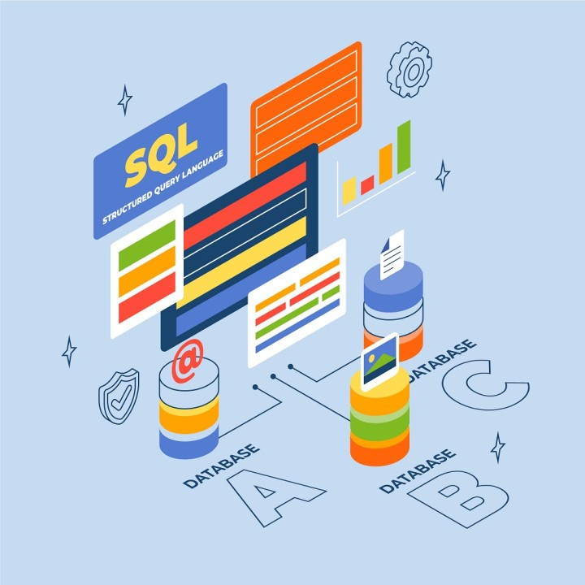


Slide 2


PROJECT REPORT
ON
"OWNERS AND CARS
POLITICIAN AND PARTY
MACHINE AND PART”
Report Submitted To
Seven Mentors Institute, Pune
2024-25
Submitted By
Pushpendra Dhamanya
DATE-17/04/2024

Slide 3
CERTIFICATE
This is to Certify that the Projects called
“OWNERS AND CARS
POLITICIAN AND PARTY
MACHINE AND PART”
Analysis Using A SQL.
The Bonafide work carried out by Pushpendra Dhamanya at SEVEN MENTOR INSTITUTE, PUNE under the guidance of SQL Course Tutor Mr. Sagar Gade Sir and this project report leads the career path by exploring SQL Concepts.
DATE-17/04/2024
DATE-17/04/2024

Slide 4
DECLARATION
I hereby declare that, The project entitled is an outcome of my own efforts Under the guidance of Mr. Sagar Gade Sir. The project is submitted to the Seven Mentor Institute Pune. For the partial
fulfilment of the “Structure Query Language Course” .
I also declare that this project report as not been previously submitted to any other institute.
DATE-17/04/2024

Slide 5
INDEX
SR. NO. | Particulars
1. | Acknowledgement
2. | Technology/Tools
3. | Diagrams
5. | Explanation
6. | Conclusion
7. | Future Scope

Slide 6
ACKNOWLEDGEMENT
The completion of any project is always due to the efforts from numerous people. So, no project would be considered complete without a word of acknowledge for all those who contributed to the project.
I’m sincerely thankful to our Training Institute ‘Seven Mentor’ for
their valuable timely help.
I would like to take this opportunity to express our deep since of humbleness as well as our sincere, earful and proud gratitude to our project Guide Mr. Sagar Gade Sir..

Slide 7
TECHNOLOGY USED IN PROJECT
“A Relational Model of Data for Large Shared Data Banks was a paper which was published by the great computer scientist E.F. Codd in 1970.”
The IBM researchers Raymond Boyce and Donald Chamberlin originally developed the SEQUEL (Structured English Query Language) after learning from the paper given by
E.F. Codd. They both developed the SQL at the San Jose Research laboratory of IBM Corporation in 1970.
SQL tutorial provides basic and advanced concepts of SQL. Our SQL tutorial is designed for both beginners and professionals.
SQL (Structured Query Language) is used to perform operations on the records stored in the database, such as updating records, inserting records, deleting records, creating and modifying database tables, views, etc.
SQL is not a database system, but it is a query language.
Suppose you want to perform the queries of SQL language on the stored data in the database. You are required to install any database management system in your systems, for example, Oracle, MySQL (workbench 8.0 CE), MongoDB, PostgreSQL, SQL Server, DB2, etc.
The latest support for working with MySQL is version number v5.8. It contains many essential changes, including new features added and removed, fixed bugs and security issues, etc. This version contains the release history from MySQL 8.0 to MySQL 8.0.21. It is available from April 2018 and ends the support in April 2026.
When you are going to install MySQL in your system, you must have to choose the version and distribution format to use. You can install MySQL in two ways, where first is a development release, and the second is General Availability (GA) release. The development release provides the newest feature and is not recommended to use in production. The General Availability (GA) release, also known as production or stable release, is mainly used for production. Therefore, you must have to decide the most recent General Availability release.
SQL manages a large amount of data, especially if there is a lot of data that is being written simultaneously and there are too many data transactions.
SQL is designed for a specific purpose: to query data contained in a relational database. SQL is a set-based, declarative programming language, not an imperative programming language like C or BASIC. However, extensions to Standard SQL
add procedural programming language functionality, such as control-of-flow constructs.

Slide 8
SQL stands for Structured Query Language
SQL lets you access and manipulate databases
SQL became a standard of the American National Standards Institute
(ANSI) in 1986, and of the International Organization for
Standardization (ISO) in 1987
SQL can execute queries against a database
SQL can retrieve data from a database
SQL can insert records in a database
SQL can update records in a database
SQL can delete records from a database
SQL can create new databases
SQL can create new tables in a database
SQL can create stored procedures in a database
SQL can create views in a database
SQL can set permissions on tables, procedures, and views
An RDBMS database program (i.e. MS Access, SQL Server, MySQL)
To use a server-side scripting language, like PHP or ASP
To use SQL to get the data you want
Some of The Most Important SQL Commands:
SELECT - extracts data from a database
UPDATE - updates data in a database
DELETE - deletes data from a database
INSERT INTO - inserts new data into a database
CREATE DATABASE - creates a new database
ALTER DATABASE - modifies a database
CREATE TABLE - creates a new table
ALTER TABLE - modifies a table
DROP TABLE - deletes a table
CREATE INDEX - creates an index (search key)

Slide 9
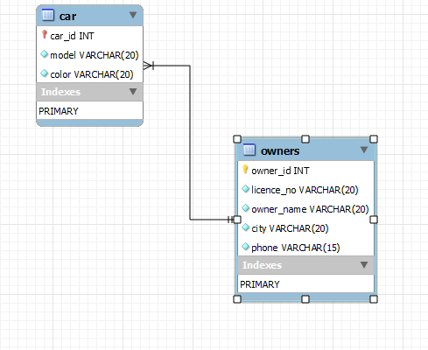
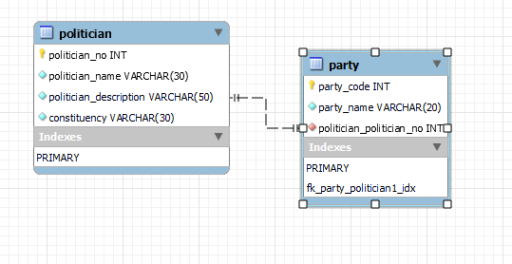
DIAGRAMS
Fig-1:M Relationship Diagram for Car and Owner Details.
Fig-2: Relationship Diagram for Politician and Party Detail.

Slide 10
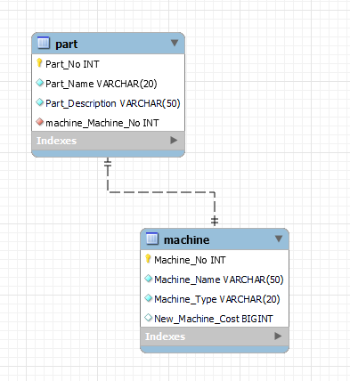
Fig-3: Relationship Diagram for Machine and Part Details.

Slide 11
EXPLANATION
Case study 1:-
Perform query on a Owner and Car dataset creating relation between them
Find the name of the Owner of “zen” and “indica”.
Insert a record in a car relation.
List all model and Owners who having color “black”.
List all the information of all cars in pune.
I have taken some entries in owners and some entries in car table. I two column similar in both table owner_id and car_id for KEYS.I made
owner_id as Primary Key in owner table and car_id as Foreign
Key on the car table on the references of owner_id from first table
Syntax for owner Table-
create table owners(
owner_id int not null,
licence_no varchar(20) not null,
owner_name varchar(20) not null,
city varchar(20) not null,
phone varchar(15) not null,
PRIMARY KEY (owner_id));

Slide 12
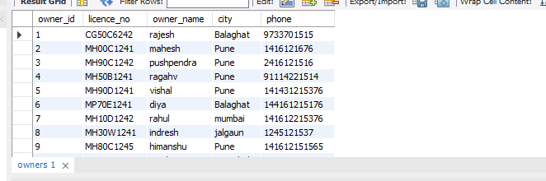
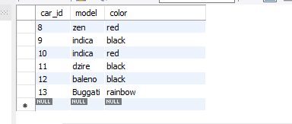
Syntax for Car Table-
create table car(
owner_id int primary key,
car_no varchar(10) not null,
model varchar(20) not null,
color varchar(10) not null,
foreign key(owner_id) references owners(owner_id));

Slide 13
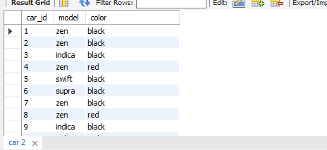
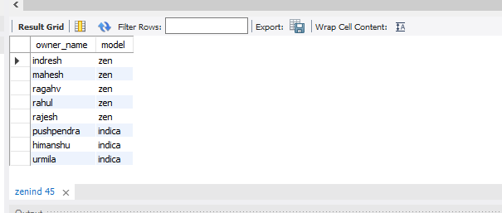
Query-1
I had selected owner_name from 1st table and model from 2nd
Table used where condition (owner_id=car_id) I also IN operator
Because I have to show the multiple car owner name in table.
syntax
select owner_name,model
from car,ownerswhere
car_id=owner_id and
model in("zen","indica")order by owner_name asc;
Result

Slide 14
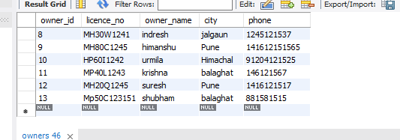
Query-2
According to query 2nd I had to Insert record in both table so I
Entered owner record first in owner table than car record in car
Table with the help of INSERT INTO Command.
Syntax-
Insert into owners(owner_id,licence_no,owner_name,city,phone)
values (13,"Mp50C123151","shubham","balaghat","881581515");
insert into car(car_id,model,color)
values (13,"Buggati","rainbow");

Slide 15
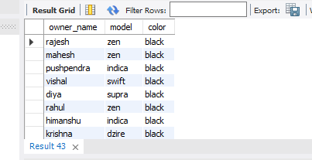
Query-3
According to query 3rd I had to print Owner name who Own’s black model car.
Syntax-
select owner_name,model,color
from car,owners
where car_id=owner_id and color="black";

Slide 16
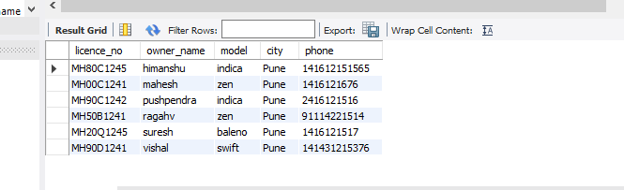
Query-4
According to query 4th I had to print all information related to Car belongs from Pune city.
Syntax-
select licence_no,owner_name,model,city,phone
from car,owners
where car_id=owner_id and city="pune“
order by owner_name asc;

Slide 17
Case study 2:-
Perform query on a Politician and Party dataset creating relation between them
Find the Politician of the party “NCP”.
Count the No. of Politician having the political description as “Member of Parliament”.
Give the party name of the “Dr Amol Kolhe”.
Print total No. of Politician in each party for “Pune” constituency.
I have taken some entries in Politician and some entries in Party table. two column similar in both table politician_no and party_code for KEYS.I made politician_no as Primary Key in politician table and party_code as Foreign Key on the car table on the references of politician_no from first table.
Syntax for Politician Table-
create table politician(
politician_no int ,
politician_name varchar(50) not null,
Politician_description varchar(50) not null,
Constituency varchar(50) not null
PRIMARY KEY (politician_no));

Slide 18
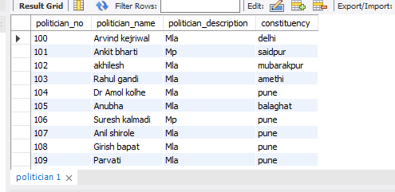
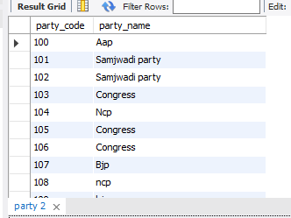
Syntax for Party Table-
CREATE TABLE party(
party_code int PRIMARY KEY,
party_name varchar(20) not null
FOREIGN KEY(party_code ) REFERENCES politician
(politician_no);

Slide 19
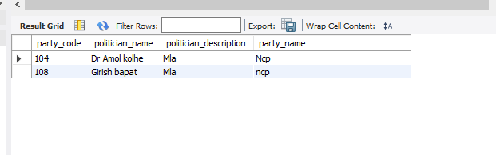
Query-1
On 1st query I had to show all politician information who belongs to NCP party.
Syntax
Select party_code,politician_name,politician_description,party_name
from politician,party
where party_code=politician_no and
party_name="Ncp";

Slide 20
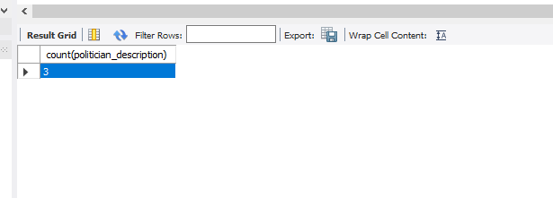
Query-2
According to query 2 I have to count the politician having politician description as “Member of Parliament”. I had taken some entering of “Mp” at the time of Entries.
Syntax-
select count(politician_description)
from politician
where politician_description="MP"
group by politician_description
having count(politician_description);

Slide 21
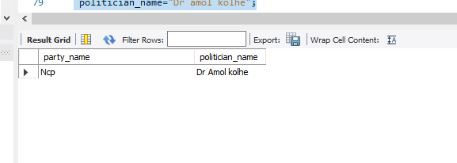
Query-3
According to query 3rd I had to show the party name of following
Politician.
Syntax-
select party_name,politician_name
from politician,party
where politician_no=party_code
and politician_name="Dr amol kolhe";

Slide 22
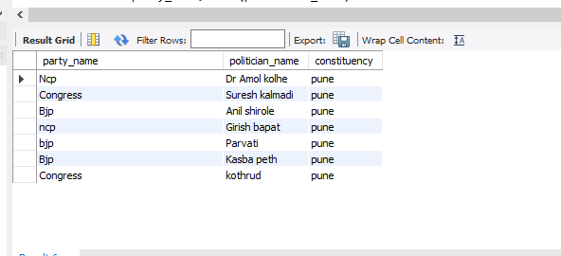
Query-4
According to query 4 I had to the Politician party wise whose constituency in Pune.
Syntax-
select party_name,politician_name,constituency
from party,politician
where party_code=politician_no and
constituency="Pune";

Slide 23
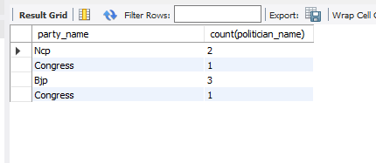
Query-5
According to query 5 I had to show the total no of politician in each party whose constituency in Pune.
Syntax-
select party_name,count(politician_name)
from party,politician
where party_code=politician_no and
constituency="Pune"
group by party_name,politician_description
having count(politician_name);

Slide 24
Case study 3:-
Perform query on a Machine and Parts dataset creating relation between them
1. Increase the Cost of Machine by 6%.
2. List all the Machines whose Cost>100000.
3. Delete all the machine’s having particular “WHEEL”
I have taken some entries in Machine and some entries in part table. Two similar column in both table I have chosen for Primary Key.
Syntax for Machine Table-
CREATE TABLE machine(
Machine_No int PRIMARY KEY,
Machine_Name varchar(50) not null,
Machine_Type varchar(20) not null,
Machine_Cost bigint not null);

Slide 25
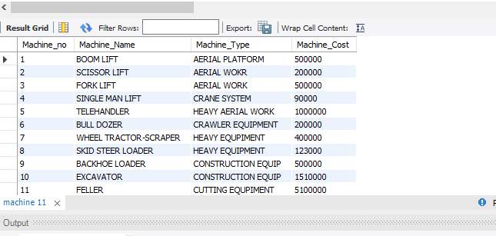
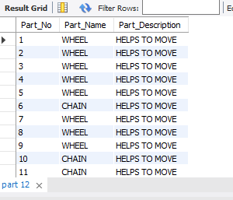
Syntax for Part Table-
CREATE TABLE part(
Part_No int primary key,
Part_Name varchar(20) not null,
Part_Description varchar(50) not null);

Slide 26
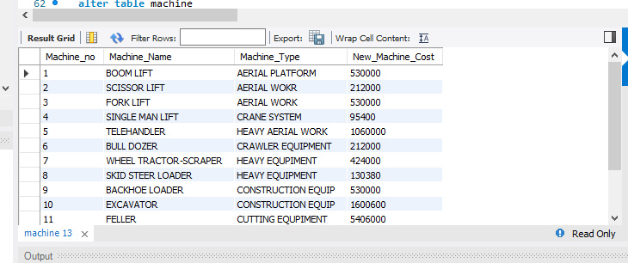
Query-1
On 1st query I had to increase the cost price of machine by 6%
For I had two option
Update the column on the basis of condition
Create new column and update it on the basic of old column and condition
Syntax
alter table machine
add column New_Machine_cost bigint;
update machine
set New_Machine_cost=Machine_Cost+(Machine_Cost*6)/100;
SelectMachine_no,Machine_Name,Machine_Type,New_Machine_Cost
from machine;
Syntax
alter table machine
add column New_Machine_cost bigint;
update machine
set New_Machine_cost=Machine_Cost+(Machine_Cost*6)/100;
SelectMachine_no,Machine_Name,Machine_Type,New_Machine_Cost
from machine;

Slide 27
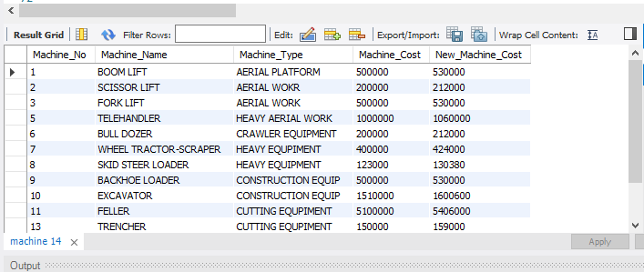
Query-2
According to query 2nd I had to return all the machine whose cost is greater than 100000.
Syntax-
select * from machine
where machine_cost>100000;

Slide 28
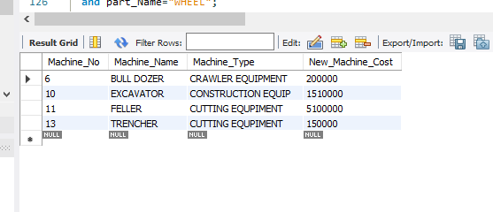
Query-3
According to query 3rd I had to delete the machine who has wheels. For that I had to access the data of second table part.
For deletion of machine according to query I used delete command with joins
Syntax-
delete machine
from machine,part
where machine.Machine_No=part.Part_No
and part_name="WHEEL“
OR
delete machine
from machine
inner join part
on machine.Machine_No=part.Part_No
where part_Name="WHEEL";

Slide 29
CONCLUSION
This module has presented all the basic hurdles to using and understanding SQL. You should understand, play with, and feel comfortable with these statements because you will use them constantly when you work with an SQL database system.
You will be using the SELECT statement in extracting the information needed for the class project. It's the core of most of the work you will be doing with SQL.
It would be a good idea to review this module before continuing. From here, we will build on the SELECT statement and show how you can do more advanced database queries. The balance of the language is built on the INSERT, SELECT, UPDATE, and DELETE statements.
SQL statements let you perform simple tasks with a database such as creating a new table or inserting a record. By combining many SQL statements into a script, you can perform elaborate procedures such as creating and initializing a database from scratch. It describes the benefits of using scripts to create databases and discusses some of the issues that you should understand before writing those scripts.

Slide 30
FUTURE SCOPE
SQL Server Integration Services (SSIS): This service helps you with the integration of multiple databases, database objects and entities as per your requirement.
Microsoft SQL Server: This is the most difficult yet intriguing job for SQL developer where he has to work on server performance, integrity as well as server
maintenance. This is one of the highly paid SQL Developer skills where developers get attractive remuneration and other opportunities too.
Analytical skills: Developers must analyse and understand the needs of the user and then design the software accordingly to meet those needs.
Creativity: Developers must be creative enough to find new solutions to conventional problems.
Detail-oriented: Developers usually work on several parts of an application or system simultaneously and therefore
must be able to focus and pay attention to even the minute details.
Interpersonal skills: Developers must be able to work in harmony with others who help in developing and creating successful software.
Problem-solving skills: Since developers are in charge of software from beginning to end, they should be capable of solving problems that may occur along the design process.
Communication skills: Developers must be capable of giving able to give clear instructions to their teammates. They should also be able to explain to their customers how the software works and answer any queries that arise

