Slide 1

IILM UNIVERSITY, GREATER NOIDA
COURSE COMPLETION PRESENTATION
Introduction to Modern AI
A Free Course by Cisco Networking Academy
Cisco Networking Academy (NetAcad) | Apply AI Learning Collection
Pushpendra Singh
Roll No. 2410030810 | B.Tech CSE (AI/ML)
Completed 18 June 2026

Slide 2





ABOUT THE STUDENT
Candidate Profile
ROLL NUMBER
Pushpendra
Singh
2410030810
INSTITUTE
IILM University, Greater Noida, U.P.
B.Tech – Computer Science &
Engineering (AI/ML)
PROGRAMME
B.Tech CSE (AI/ML), Batch 2024–2028
COURSE
Introduction to Modern AI
COMPLETION DATE
18 June 2026
Introduction to Modern AI • Pushpendra Singh

Slide 3



ABOUT THE PROGRAM
Cisco Networking Academy & Apply AI
Cisco Networking Academy is Cisco's global IT and digital-skills education program, delivering free courses to millions of learners through its NetAcad platform. As part of its “Apply AI” learning collection, it designed “Introduction to Modern AI” to give beginners a practical, hands-on introduction to using modern AI tools in everyday and professional life.
Global & Free
Apply AI Collection
NetAcad Platform
Free, self-paced digital-skills training delivered to learners worldwide.
Part of a hands-on series built for practical, real-world AI use.
Structured video lectures and interactive exercises, no coding required.
Introduction to Modern AI • Pushpendra Singh
03

Slide 4




PROBLEM STATEMENT
Turning AI Awareness Into Practical Skill
AI tools have become widely available, but many learners understand AI only at a surface level and lack structured, hands-on practice – particularly in areas such as computer vision, machine translation, and writing effective chatbot prompts.
This course addressed that gap — a practical, hands-on path through modern AI:
→
→
→
Learn Concepts
Explore Vision & Translation
Master Prompting
Apply & Assess
Introduction to Modern AI • Pushpendra Singh
04

Slide 5






COURSE OBJECTIVES
What the Course Set Out to Achieve
AI Fundamentals
Computer Vision
Machine Translation
Understand how modern AI works and where it is useful.
Explore image recognition through a hands-on photo app.
Use an online translator to see AI-driven translation in action.
Prompt Engineering
Multi-Tool Practice
Open-Ended Project
Learn to write clear, effective prompts for AI chatbots.
Hands-on use of 10+ AI tools including ChatGPT, Gemini, Claude.
Apply prompt-engineering skills in a self-directed project.
Introduction to Modern AI • Pushpendra Singh
05

Slide 6




TECHNOLOGIES & TOOLS
The Toolkit Behind the Course
NetAcad
ChatGPT
Gemini
Claude
Learning platform
Chatbot practice
Chatbot practice
Chatbot practice
Meta AI
Google Translate
Hugging Chat
NotebookLM
Chatbot practice
Machine translation
Chatbot practice
AI note-taking
Introduction to Modern AI • Pushpendra Singh
06

Slide 7

COURSE STRUCTURE
From First Concepts to Applied AI Skill
Foundations Layer
Core AI concepts: what AI is, how it works, and its everyday uses.
↓
Applied AI Layer
Hands-on practice with computer vision and machine translation tools.
↓
Chatbot Layer
Prompt-writing techniques practiced across 10+ popular AI chatbots.
↓
Project Layer
An open-ended project applying prompt-engineering skills learned.
↓
Assessment Layer
Course assessment leading to the award of the Certificate of Completion.
Introduction to Modern AI • Pushpendra Singh
07

Slide 8

METHODOLOGY
The Course Learning Journey
MODULE 1
MODULE 2
MODULE 3
FINAL
Introduction to Modern AI
Chatbots & Prompt Engineering
Open-Ended Project
Course Assessment
AI fundamentals, computer vision, and machine translation basics
Techniques for effective prompts, practiced across 10+ AI tools
Self-directed project applying prompt-engineering skills
Final assessment leading to the Certificate of Completion
Introduction to Modern AI • Pushpendra Singh
08

Slide 9

EXPECTED OUTCOMES
Skills & Capabilities Gained
Ability to explain, in practical terms, how modern AI systems work
Hands-on familiarity with computer-vision and machine-translation applications
Practical skill in writing clear, effective prompts for AI chatbots
Working experience with multiple leading AI tools, including ChatGPT, Gemini, and Claude
A completed open-ended project demonstrating applied prompt-engineering skills
Successful completion of the course assessment and award of the Certificate of Completion
Introduction to Modern AI • Pushpendra Singh
09

Slide 10
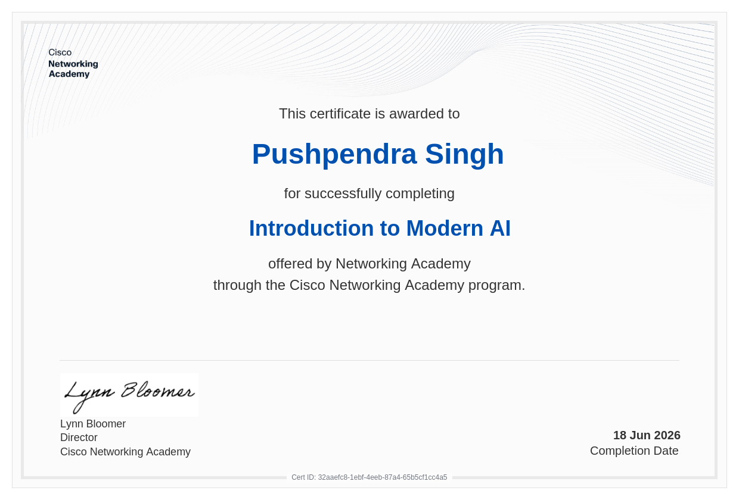


CERTIFICATION
Successfully Completed
ISSUED BY
Cisco Networking Academy
CERTIFICATE ID
32aaefc8-1ebf-4eeb-87a4-65b5cf1cc4a5
COMPLETION DATE
18 June 2026
COURSE
Introduction to Modern AI
Introduction to Modern AI • Pushpendra Singh
10

Slide 11
Thank You
Introduction to Modern AI | Cisco Networking Academy
Pushpendra Singh
Roll No. 2410030810 | IILM University, Greater Noida

