Slide 1
Statistical Methods in Research
Microsurgery Study
Final Project Report
May 4, 2018
Compiled By:
Hosein Neeli (1541673); Bharat Verma (1639951) ; Pushpendra (1639812)
(Team 11)
Guided By:
Prof. Dr. Ioannis Pavlidis; George Panagopoulos (TA)

Slide 2
Introduction
We studied 22 medical students, participated in a longitudinal study regarding the relationship of sympathetic stress arousal and skill in learning micro-surgical tasks.
One way to evaluate stress is using perinasal perspiration measurement. This method has been applied by Methodist hospital to assess effect of stress on performance of Microsurgery students in two delicate tasks of cutting and suturing.
For this experiment each subject had to pay five visits, lasting one hour each, in order to practice microsurgical cutting and suturing in an inanimate simulator. In their first visit, and after signing an informed consent, the subjects completed a NASA-TLX questionnaire, and a trait anxiety inventory(TIA) form. At the end of their last visit they completed a post-study questionnaire.
In this project, we analyze given data of Methodist hospital and describe the relevance of stress and several other parameters to performance of the students.
In this study, we have analyzed the effect of stress to the performance of 15 out of 22 medical surgery students in two separate tasks of cutting and suturing. We considered only those 15 candidates for whom we received all the required performance related information.

Slide 3
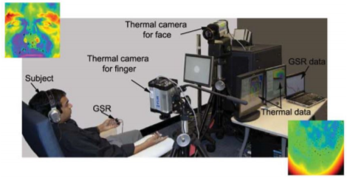
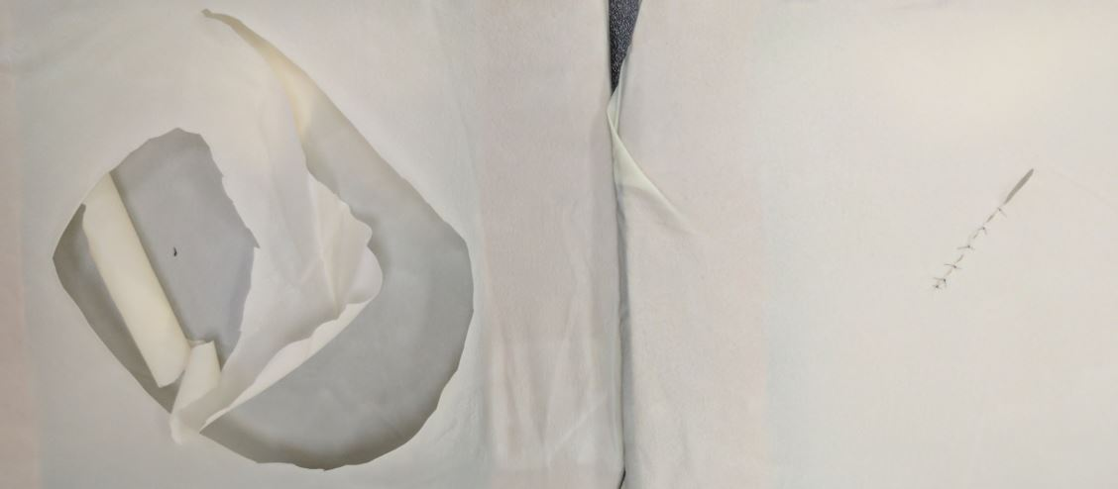
Task Performed By Each Subject
Tasks performed by each subject in each of the five sessions:
• Baseline task
• Cutting task
• Cutting questionnaire
• Suturing task
• Suturing questionnaire

Slide 4
Questionnaire For Measuring Task Difficulty
The Student Questionnaire instrument features six sub scales measuring different aspects of the subjects’ perceptions regarding task difficulty. These sub scales are:
• Effort
• Mental Demand
• Physical Demand
• Frustration
• Performance
• Temporal Demand

Slide 5
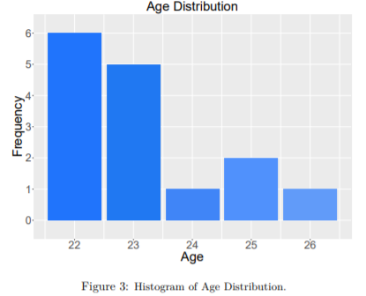
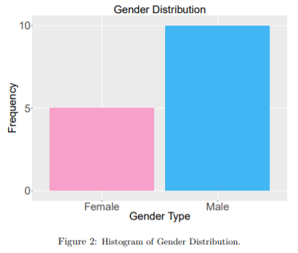
Distribution Of Subjects On Basis Of Age & Gender

Slide 6
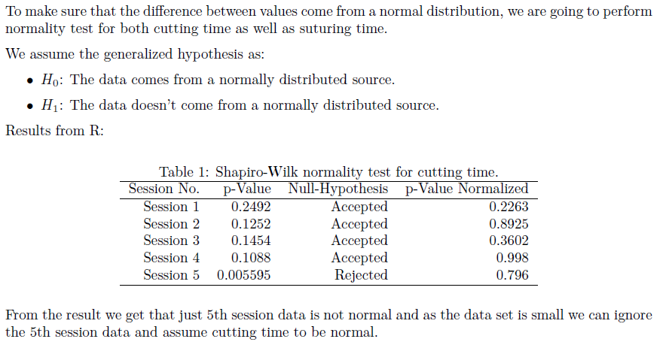
Processing Data and Analysis
Significance level: As it is medical field so in this study of analysis, we consider the α value as 0.01 in all test.
Normality Test of Data: Performed Shapiro-Wilk normality test for cutting time, suturing time and perspiration values.
To make sure that the difference between values come from a normal distribution, we are going to perform normality test for both cutting time as well as suturing time.
We assume the generalized hypothesis as:
H0: The data comes from a normal distributed source.
H1: The data doesn’t come from a normally distributed source.

Slide 7
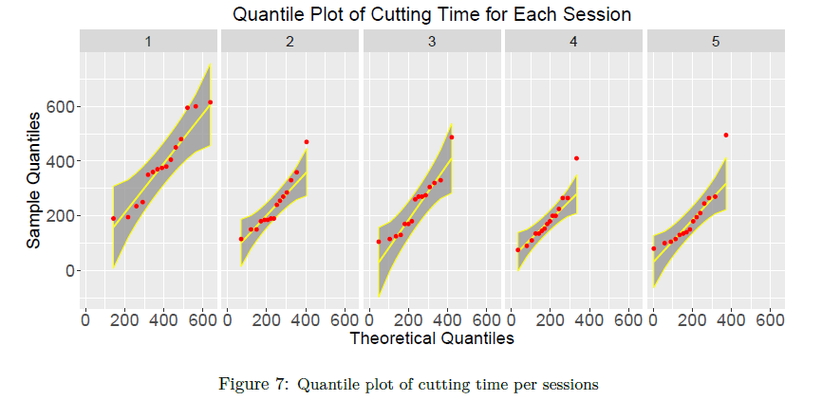
Quantile Plot For Cutting

Slide 8
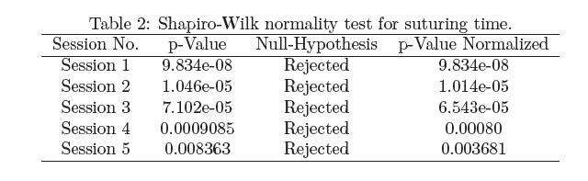
Suturing Time Normalization
From the result we get that the suturing time is not all normal in any of the sessions. So to normalize it we used square root and this makes it better but still not normal.

Slide 9
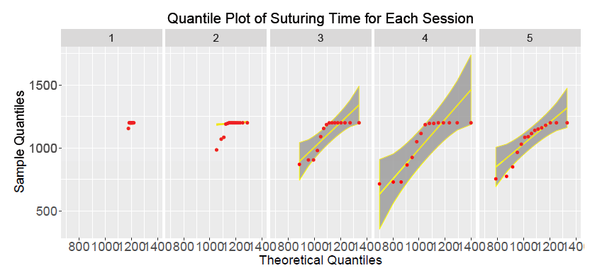
Quantile Plot For Suturing

Slide 10
Normalization Of Perspiration For Linear Regression Model
Subtract the Cutting/Suturing perspiration from Baseline
We get some negative values in part(1), to remove all negative numbers we find the minimum negative number in (1) and add it to every element in this set.
Due to adding the minimum number we get some zero values, to make it working with log we added 0.001.

Slide 11
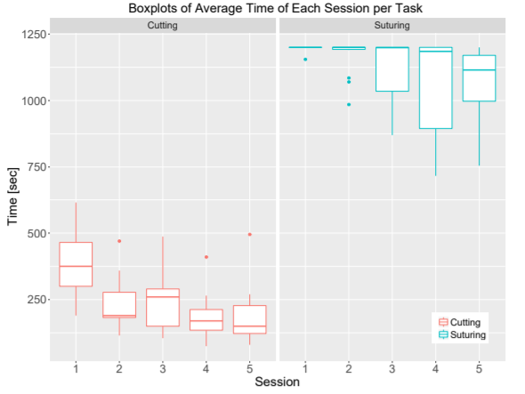
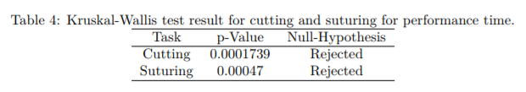
Time versus Session Analysis - Original

Slide 12
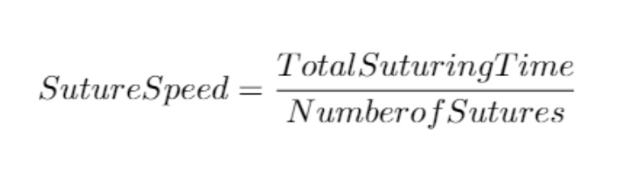
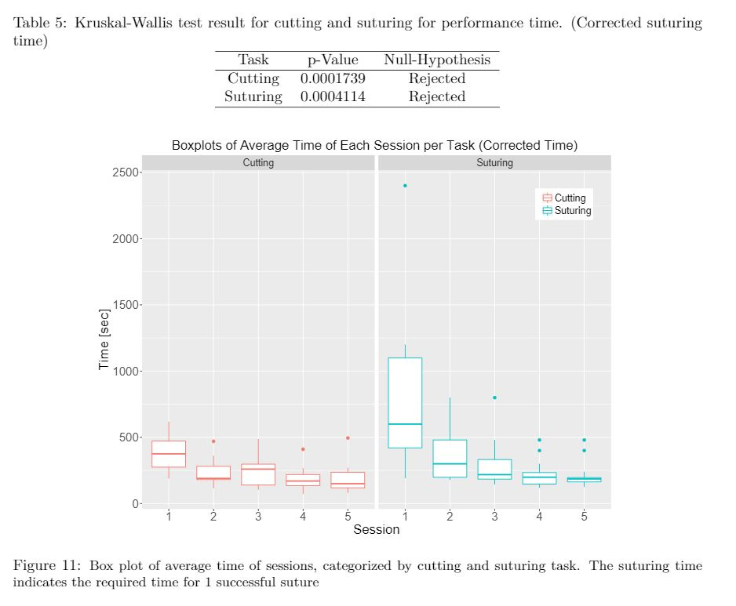
Time versus Session Analysis - Redefined

Slide 13
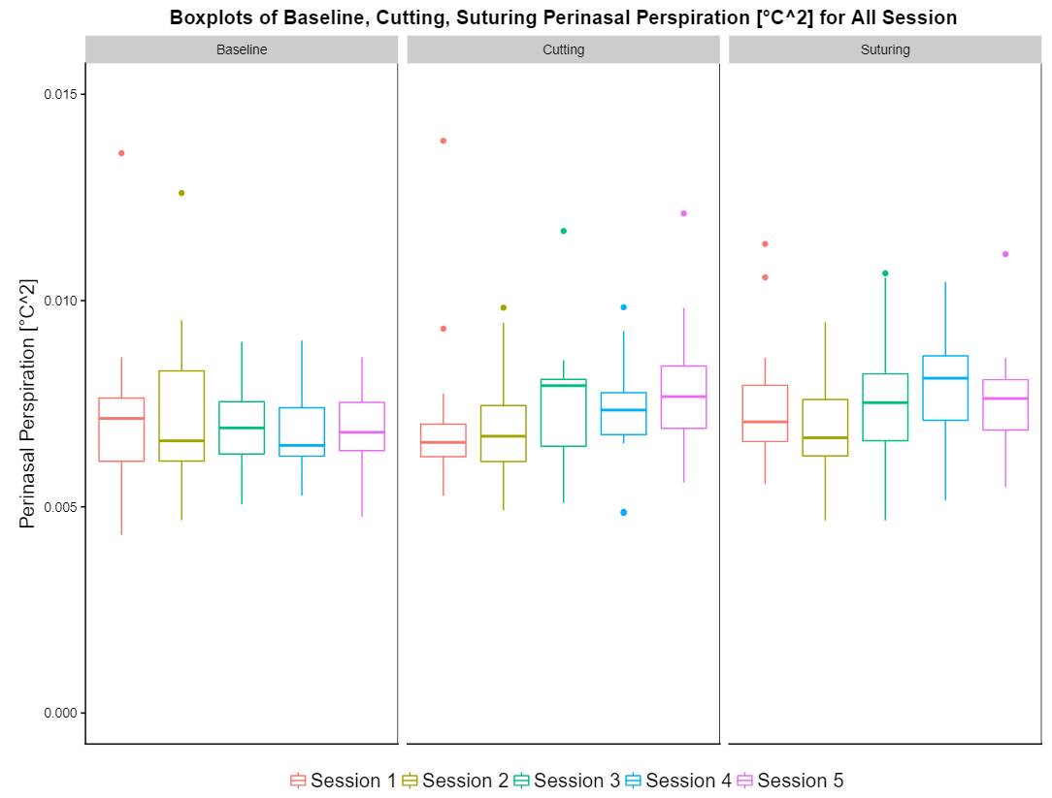
Perinasal Perspiration Analysis

Slide 14
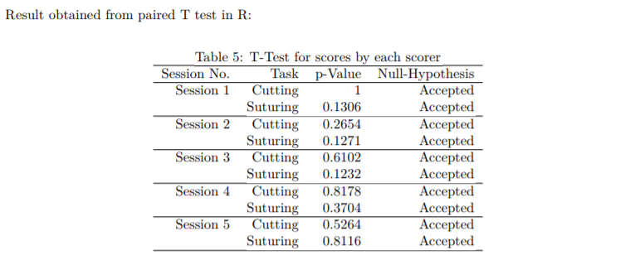
Surgeon Comparison
We form the generalized hypothesis as:
H0: The means of the scores graded by two scorers are not significantly different.
H1: The means of the scores graded by to scorers are significantly different.
From the above result we get that all of the hypothesis in each task and for each session are accepted.

Slide 15
Task Score Analysis
In section we analyze accuracy score of the subjects in cutting and suturing. We define the generalized hypothesis as:
• H0: There is no significant change between the average score of the subjects during the experiment session. (µScoreOfSession1 = µScoreOfSession2 = µScoreOfSession3 = µScoreOfSession4 = µScoreOfSession5)
• H1: There is significant change of average score of the subjects at least between two (or more) experiment session. (µScoreOfSession1 != µScoreOfSession2 != µScoreOfSession3 != µScoreOfSession4 != µScoreOfSession5)

Slide 16
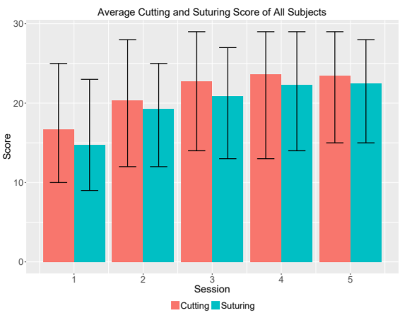
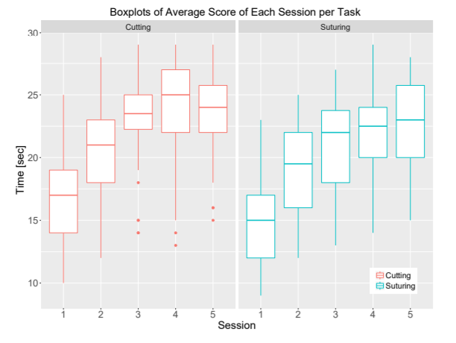
Task Score Analysis

Slide 17
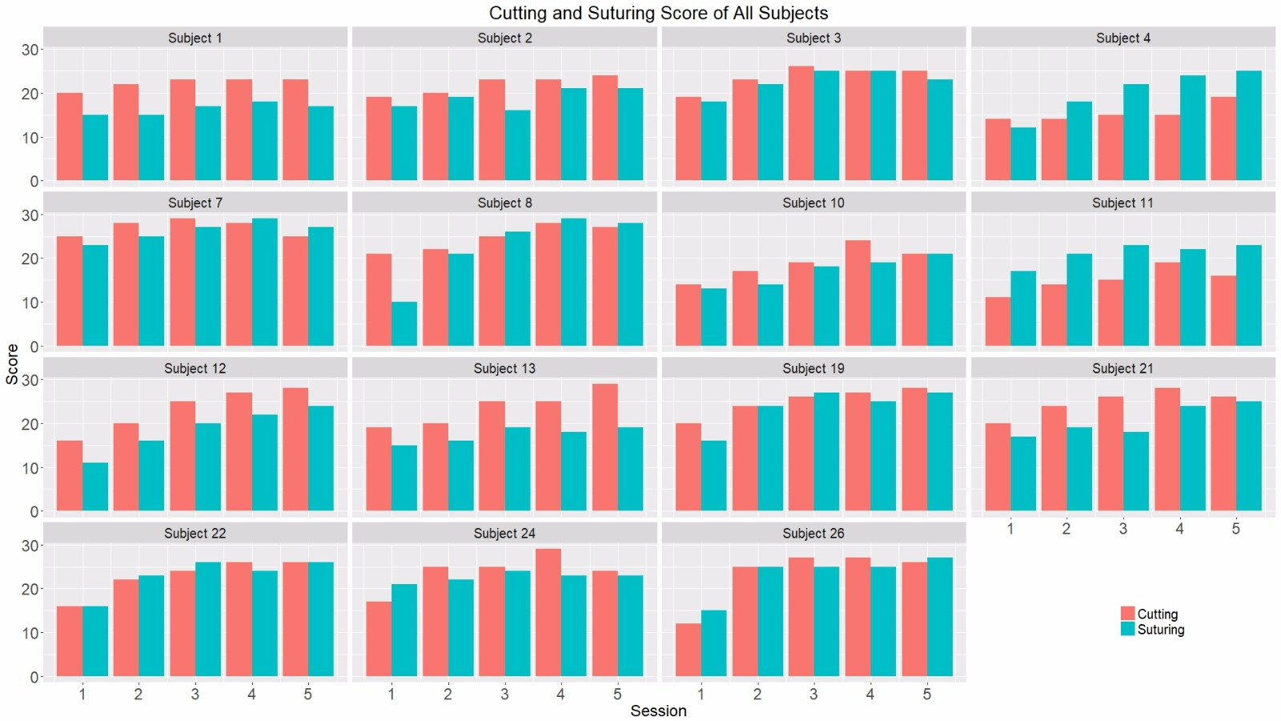
Task Score Analysis

Slide 18
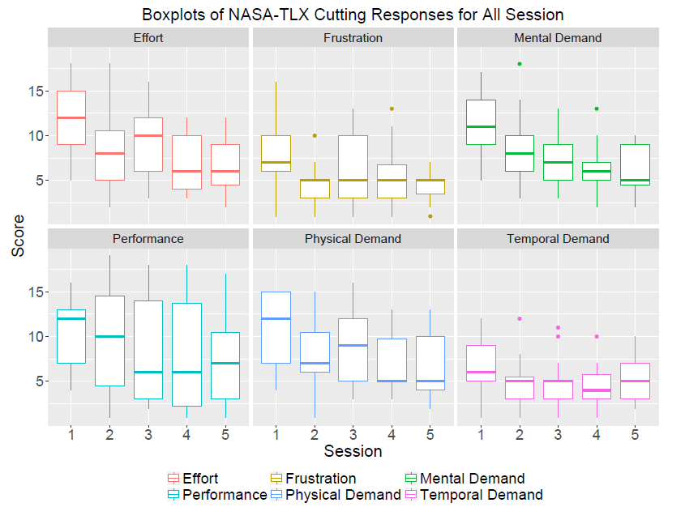
Nasa-TLX Questionnaires Results Analysis
This data is collected as part of feedback from all subjects. We are going to analyze from this information if there is any significant progress made during sessions.

Slide 19
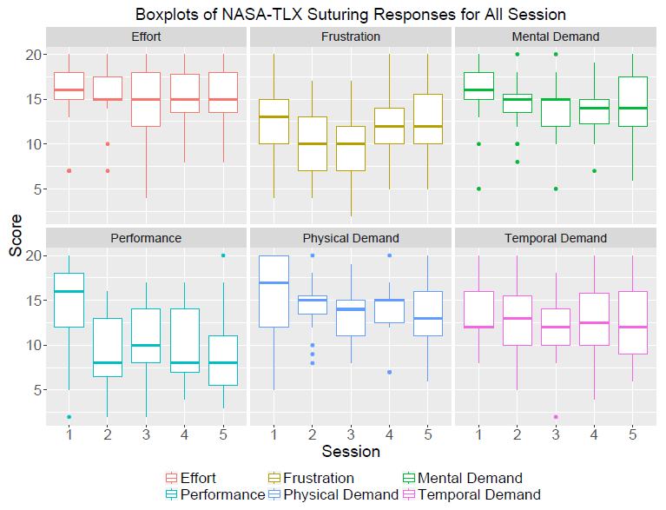
Nasa-TLX Questionnaires Results Analysis

Slide 20
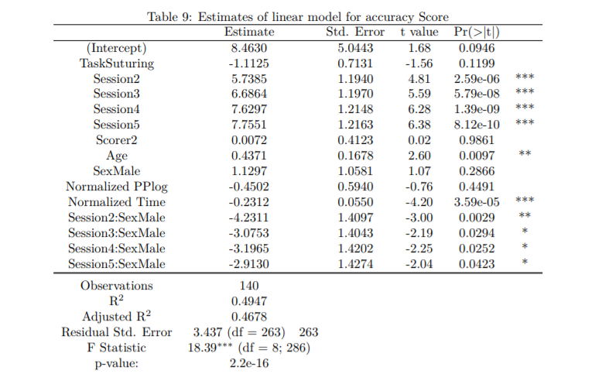
Estimation of Score by other Parameters
LM(Score ˜ Task + Session + Perspiration + Scorer + Age + Sex + Time + Session ∗ Sex)
Significant effect: Session, Age, Time and Interaction

Slide 21
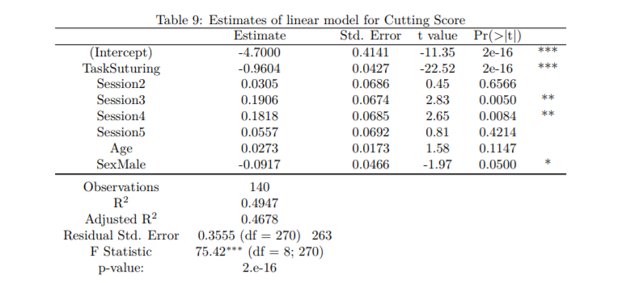
Estimation of Stress by other parameters
LM(Stress(PP) ˜ Session + Task + Age + Sex)
From the coefficient of the model we can see that the task has very significant effect on stress rather than cutting task.
In addition, Session 3 and 4 have slight effect on stress. These two sessions should be reviewed to find out what was the cause of stress in those two sessions.

Slide 22
Discussion
We recommend the following:
• The order of task in experiment must be randomized. This will help us analyze if there is any impact of cutting on suturing or reverse.
• The proportion of males and females should be statistically equal. Using this we can better find out if there is any impact of sex on the experiment.
• More information must be revealed to us in order to form and infer our linear regression in a better way.
• The given dataset has missing data at many places, if it can be avoided we could more confident and consistent in our analysis.

Slide 23
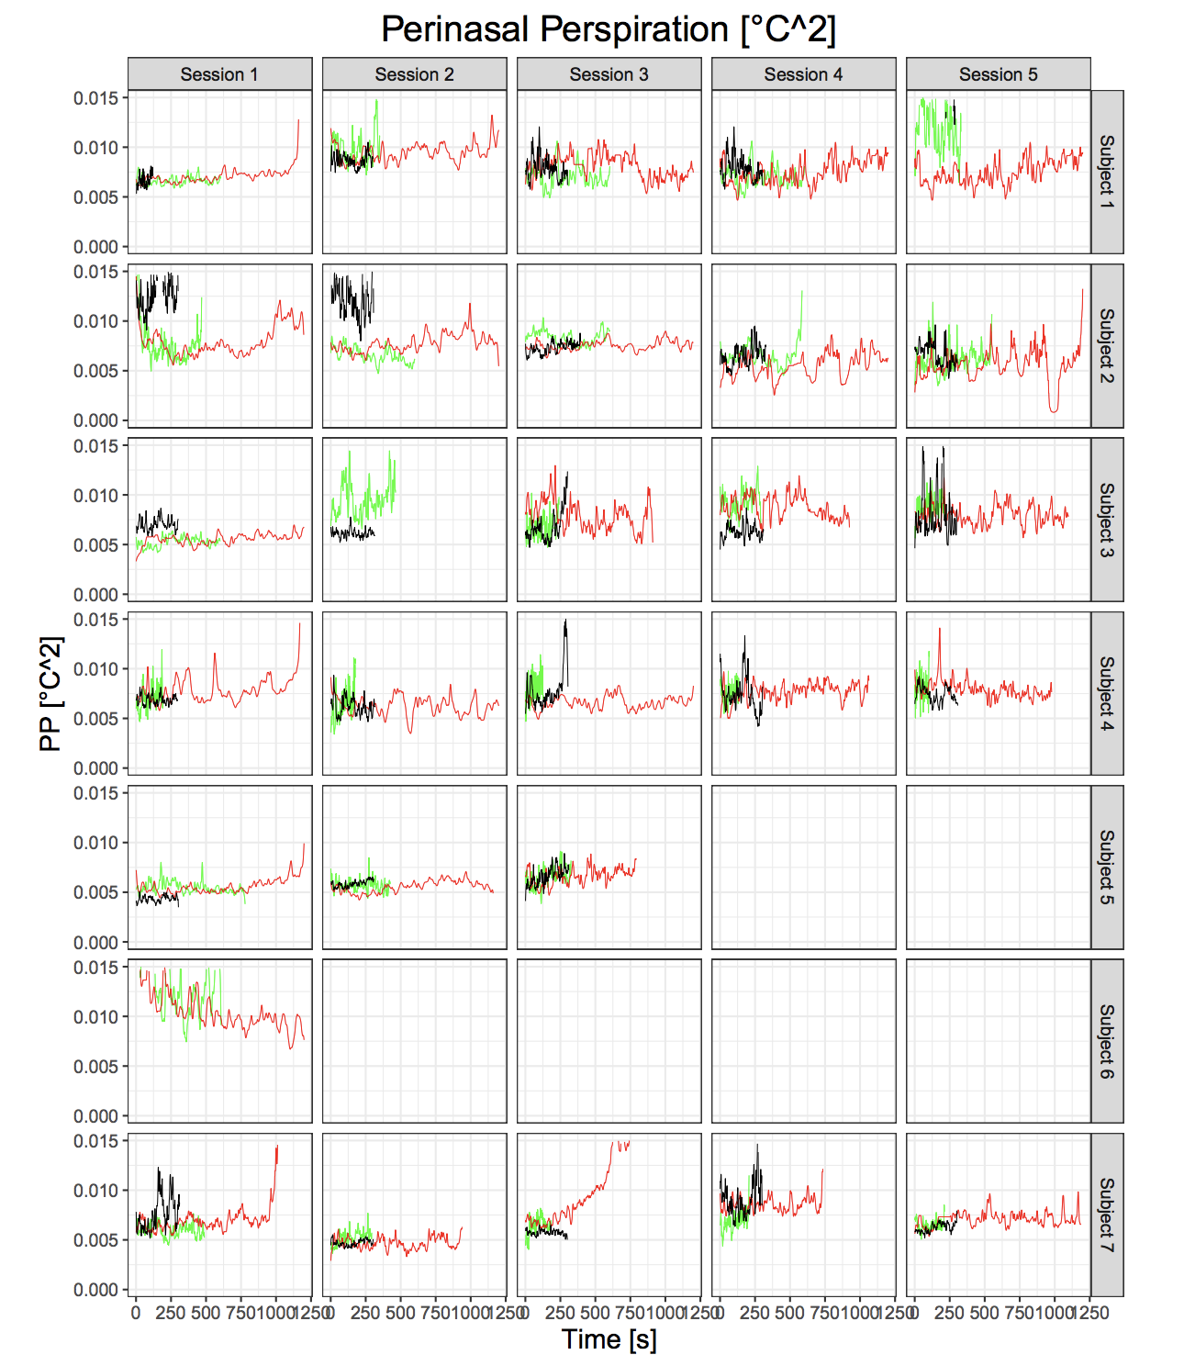
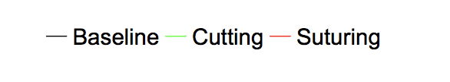
Quality Control

Slide 24
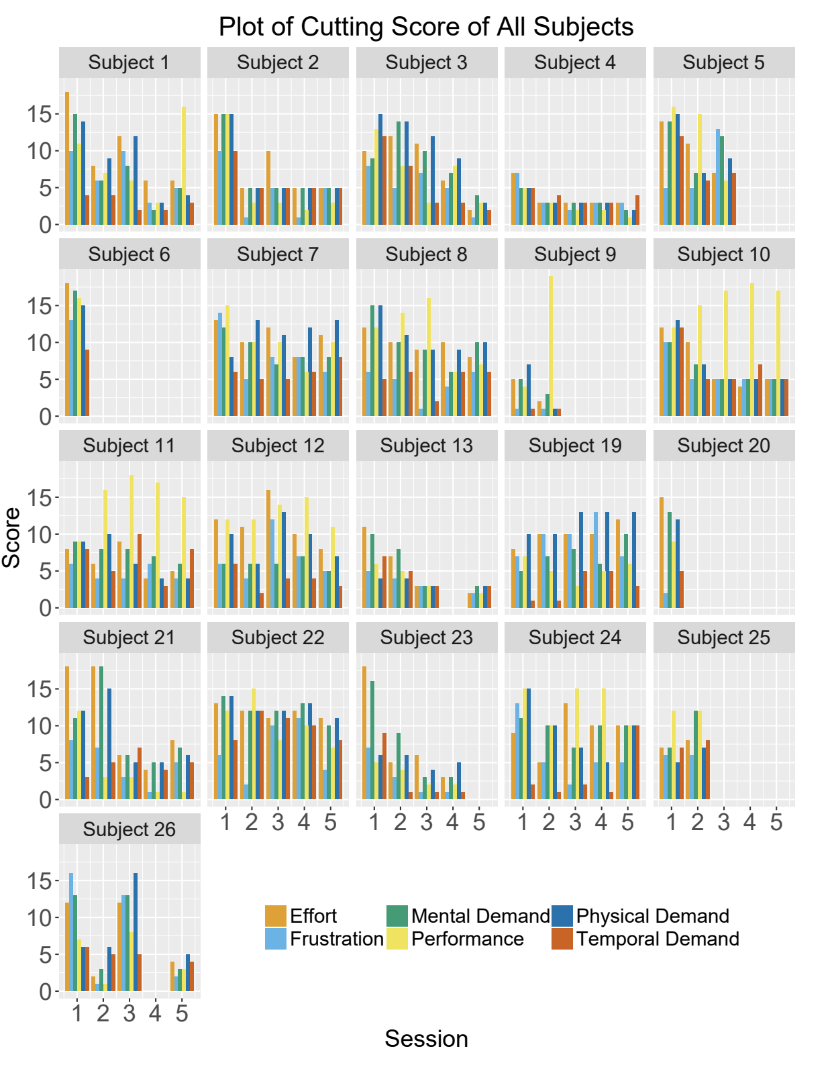

Slide 25
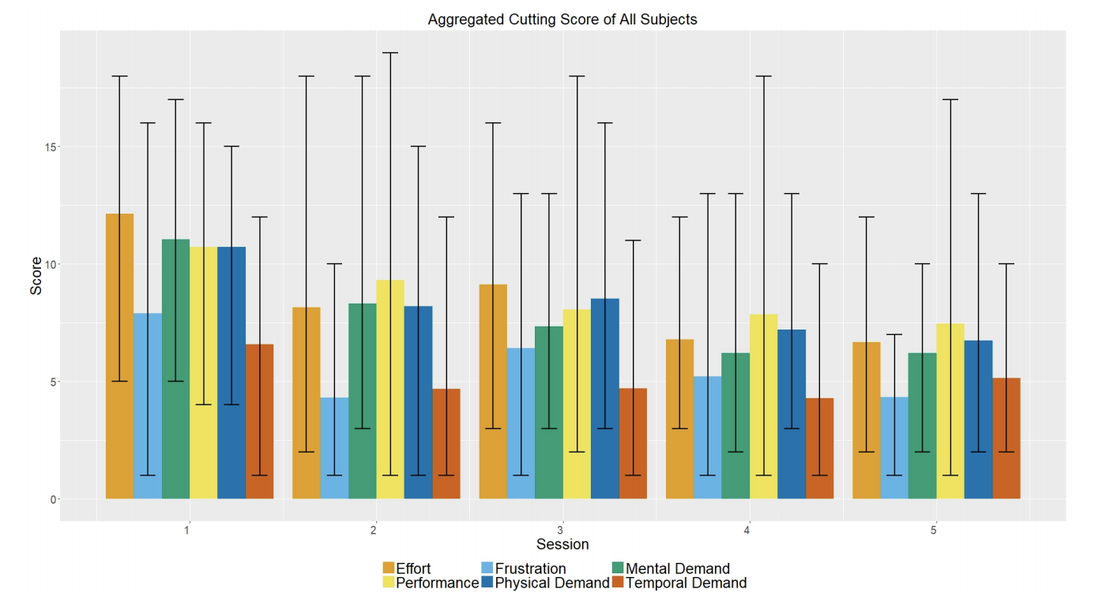
NASA-TLX Response Values

Slide 26
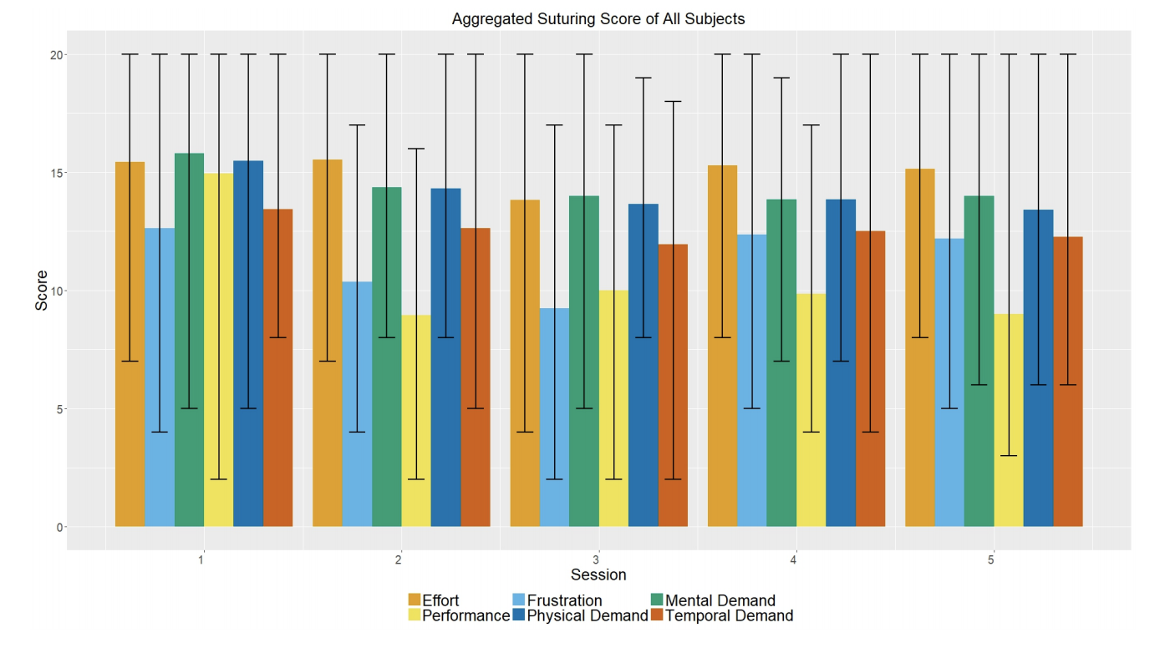

Slide 27


Slide 28


