Slide 1
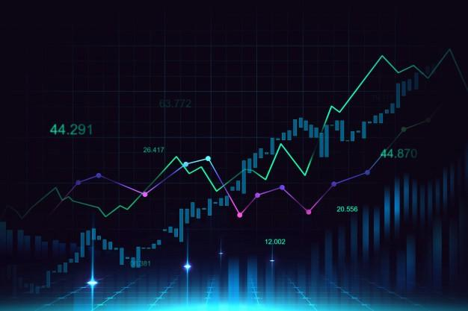
Name - Pushpendra dhakar
Dept. DSE
Roll number - 19229
Stock Market Prediction and analysis Using Machine Learning(ML) Algorithms

