Slide 1

Sprint-1 Keyword Search for research papers
Ankur Rajaram Hingmire
Pushpendra Yadav
Vedant Balasaheb Ban
Paramjyothi Sai Yashwanth Reddy
Venkatesh Prabhakar Gunake

Slide 2

Index
1. Introduction
2. Purpose
3. Applications
4. Data Flow Diagram
5. System feature and Requirements
5.1 Functionality
5.2 Non-Functional Requirement
6. Testcases and Results
7. Conclusion

Slide 3
1.Introduction
Intended Audience: -This document is intended to be read by, Client.
Intended Use:
Development Team
Maintenance Team
Clients
Aim:-
The aim of this document is to gather, analyze and give an in-depth insight into the complete Keyword Search for Research paper application by defining the problem statement in detail. The detailed requirements of the Keyword Search for Research Paper application is provided in this document.

Slide 4
2. Purpose
The purpose of this application is to find the research papers which contain a particular given keyword.
This application can be very helpful to people for finding information by using specific keyword.
This application displays all research papers containing “keyword” attribute = given keyword.
So, with this application it will fetch Numerous research papers as results, which contains the keyword that we have searched.

Slide 5

3. Application
This Keyword search application can be useful to find out project ids and project titles for a specific keyword.
The purpose of this program is to help other researchers find a paper related to keyword when they are conducting a search on the topic.
This application will take various research paper filenames and it will filter a keyword and show in which research papers that keyword is appearing.
This can be very useful to filter out various research papers with same keyword in them.

Slide 6
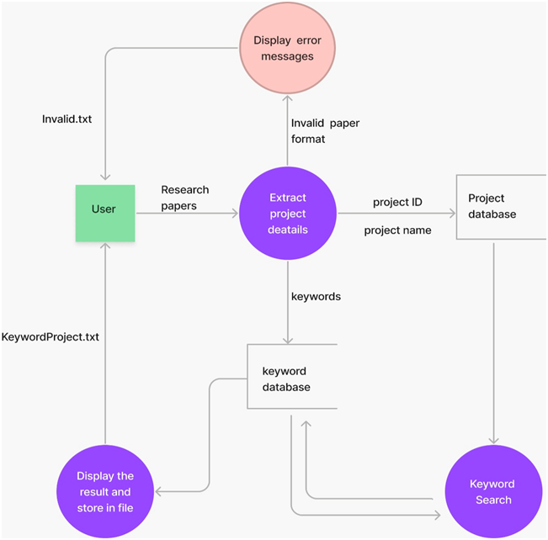
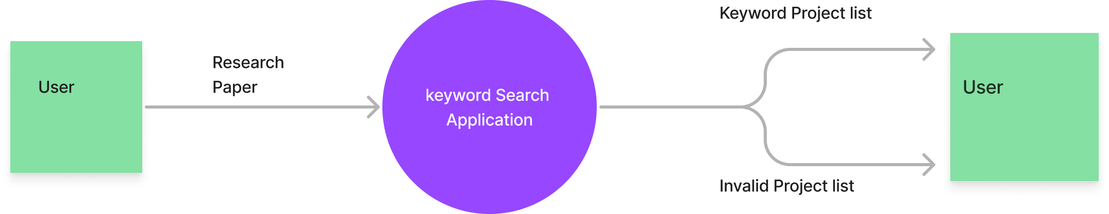
4. Data Flow Diagram
DFD level 1
DFD level 0

Slide 7
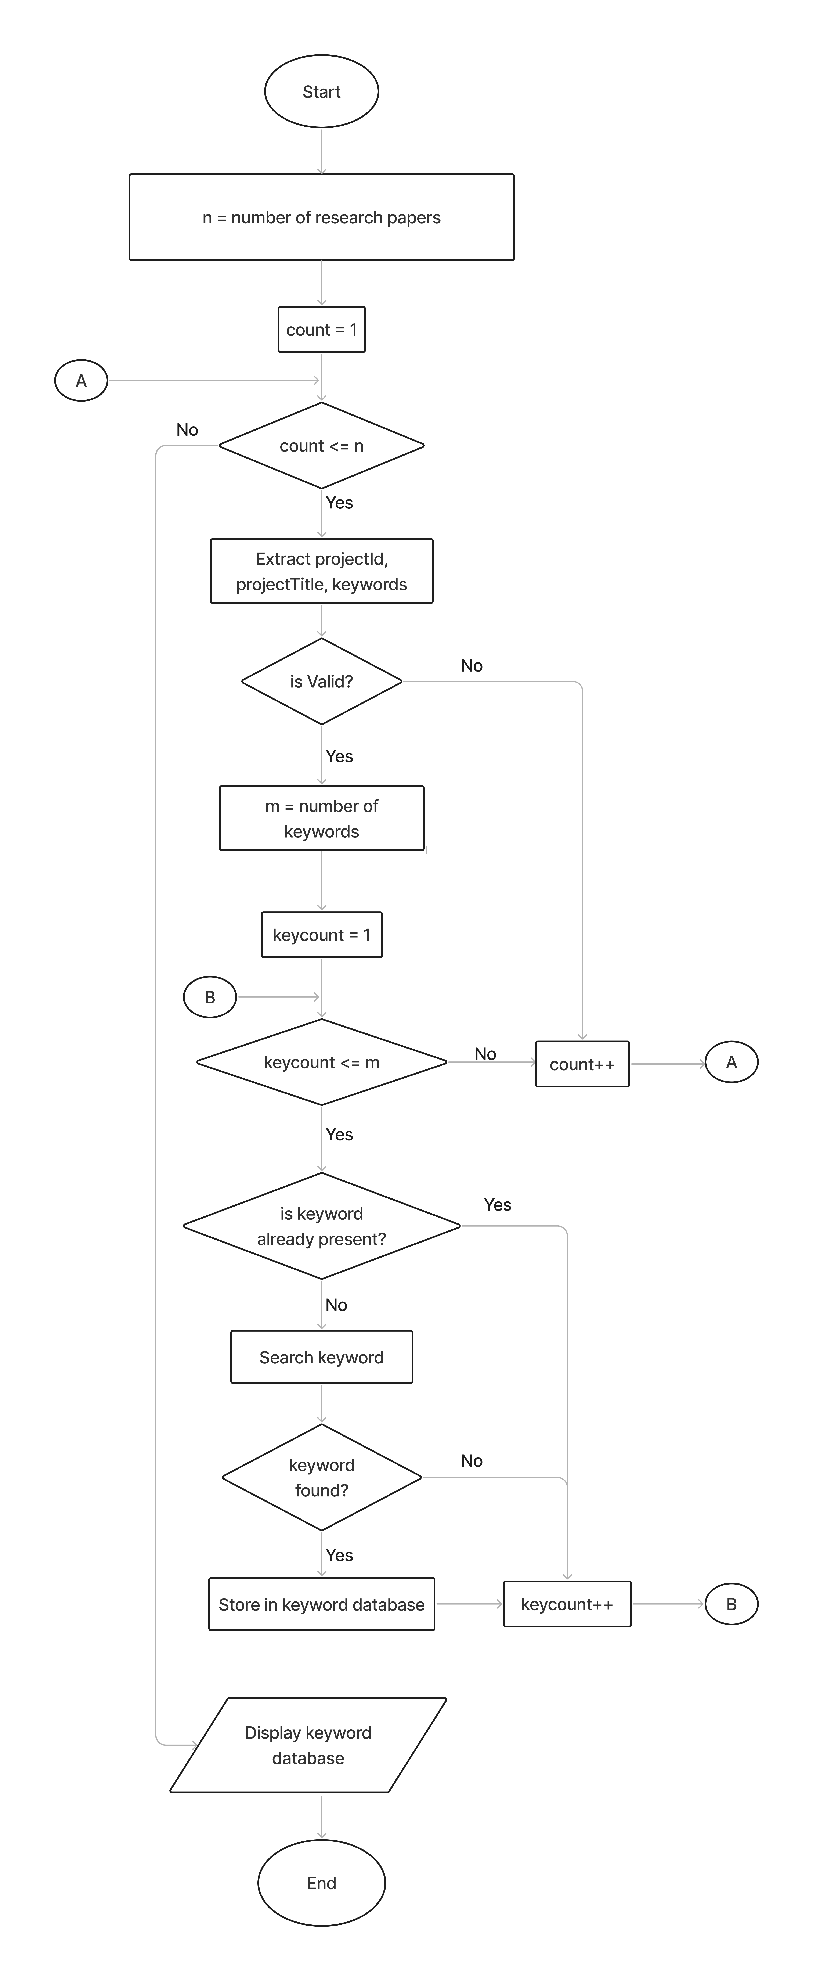
Flow Diagram

Slide 8
3. System feature and requirement
Functionality
File_Parsing
File_Validation
Display_Invalid_Files
Extract_Project_Detail
Store_Result
Keyword_Search
*Underline words are link to code. Ctrl + click

Slide 9
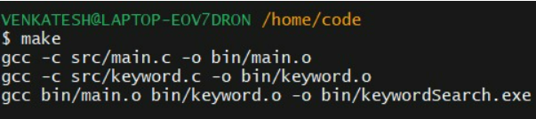
3.2 Non-Functional Requirements:
Tools to be used:
Make file : It aids in simplifying building program executables.
Makefile for the Total Application
C Unit : To automate testing to test unit function
Github Link for Unit Test Report
Github link for CUnit Folder

Slide 10
3.2 Non-Functional Requirements:
Pthread Library :
Basically POSIX threads are used to allow concurrent processes. Here, In this application threads are used to process multiple input files.
Valgrind: to detect memory leak
Final Valgrind Report Link
The Final version of application gives Multi-file multi directory solution with two step compilation process.

Slide 11
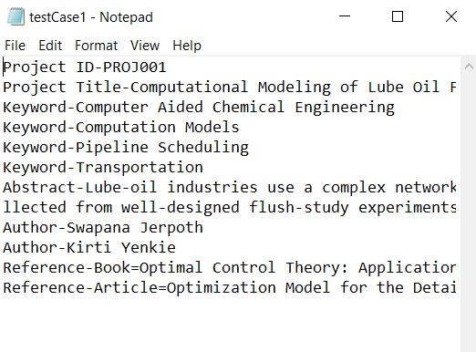
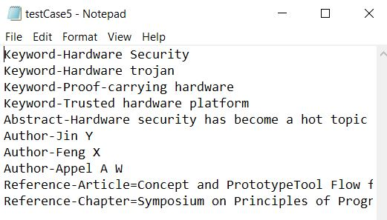
6. Testcases and Results
Valid Research Paper
Invalid Research Paper

Slide 12
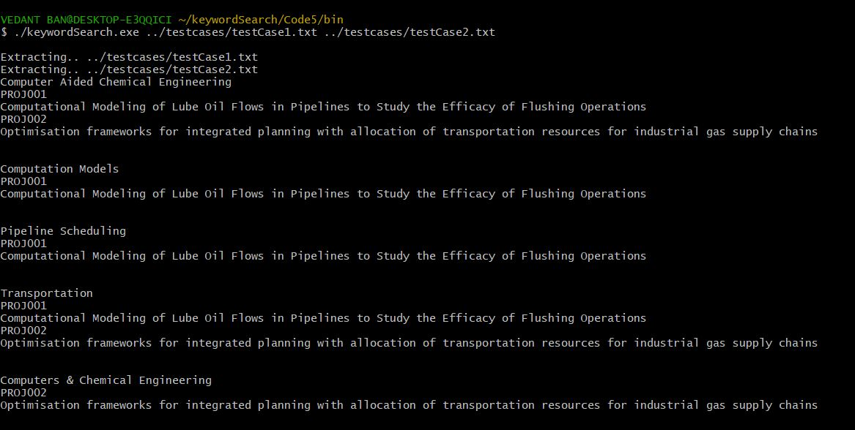
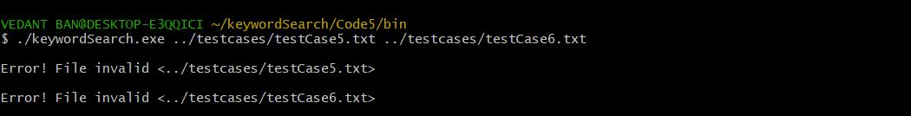
Result for Testcase 1:
Result for Testcase 2:

Slide 13
7. Conclusion

Slide 14

THANK YOU!!!

