Slide 1

P-207 GROUP-4 Presenting
Resume Classification
Project Mentor
Mr karthik muskula
Presented By
Mr Sourav chittaranjan parui
Mr Rupak Dipak Mondal
Mr balaji Pamidi
Mr Manoj j
Mr Pushpendra Raj
Mr Ganesh Singh
Mr Abhishek R Chinchole
Mr Lokesh B S

Slide 2
Business Problem:
Objective:
The document classification solution should significantly reduce the manual human effort in the HRM. It should achieve a higher level of accuracy and automation with minimal human intervention

Slide 3



Data Preprocessing
Exploratory data analysis (EDA)
Project Architecture / Project Flow
Model Deployment
Model Building/ Evaluation
Data Scrapping
Understanding Data

Slide 4






Tools Used In Our Project

Slide 5
Exploratory Data Analysis (EDA) & Feature Engineering

Slide 6
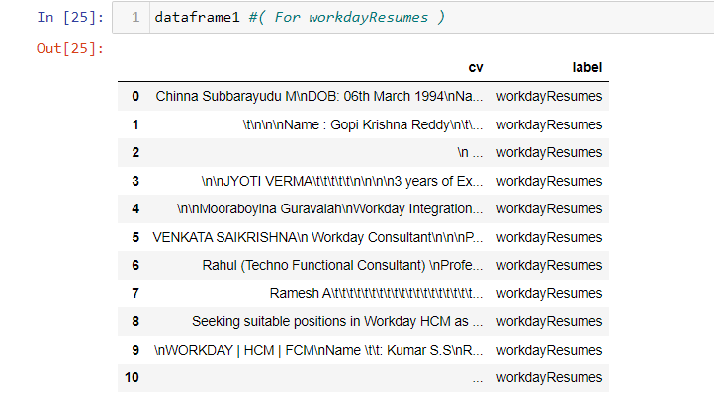
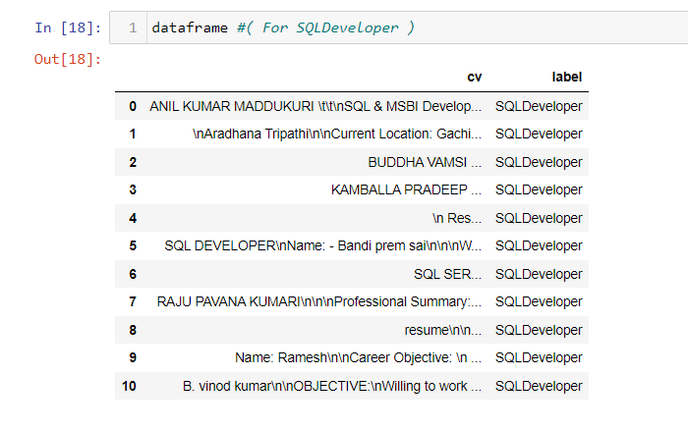
Data set details
We Have Given 4 Folders From That We Have Scrapped The Data, So We Have Separately Scrapped Every Data From The Folders
Preview of Scrapped Data From Different Folders

Slide 7
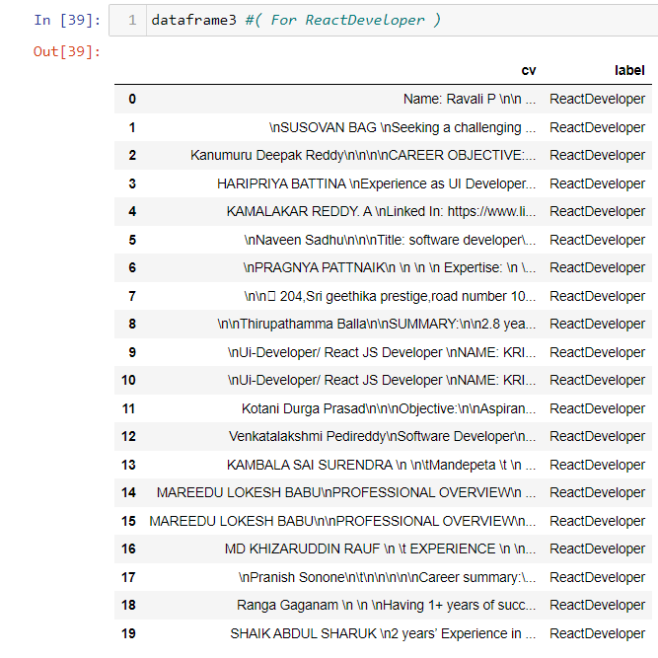
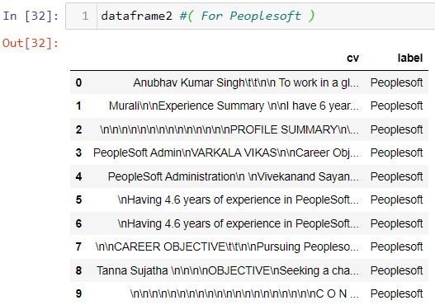
Data set details

Slide 8
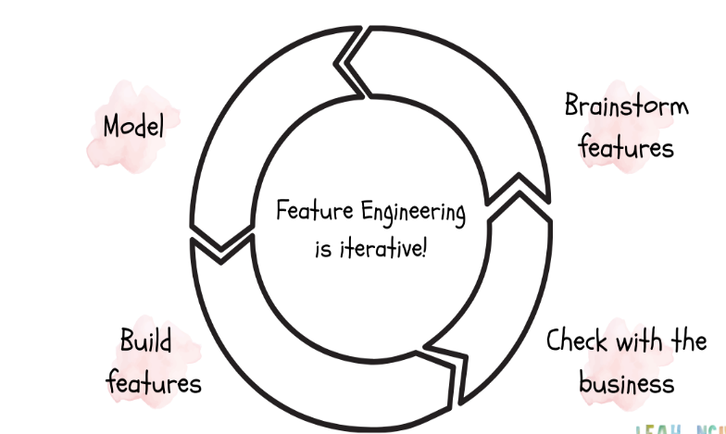

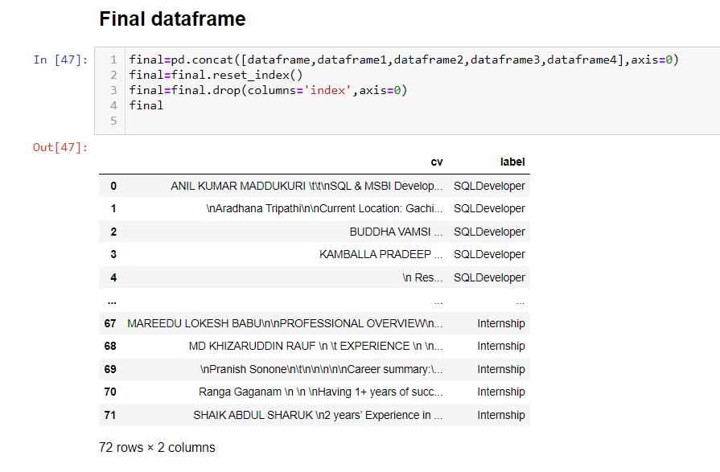

Feature Engineering
We Have Concatenated All The Data Frame To Make Our Final Dataframe

Slide 9



Exploratory Data Analysis (EDA)

Slide 10
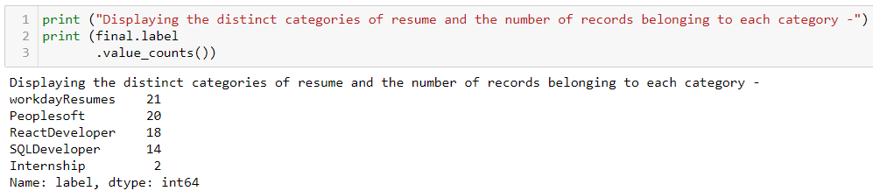
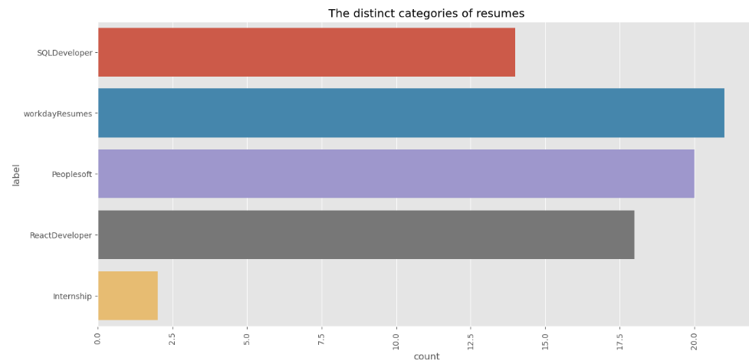
EDA
Value count of Final Dataset

Slide 11
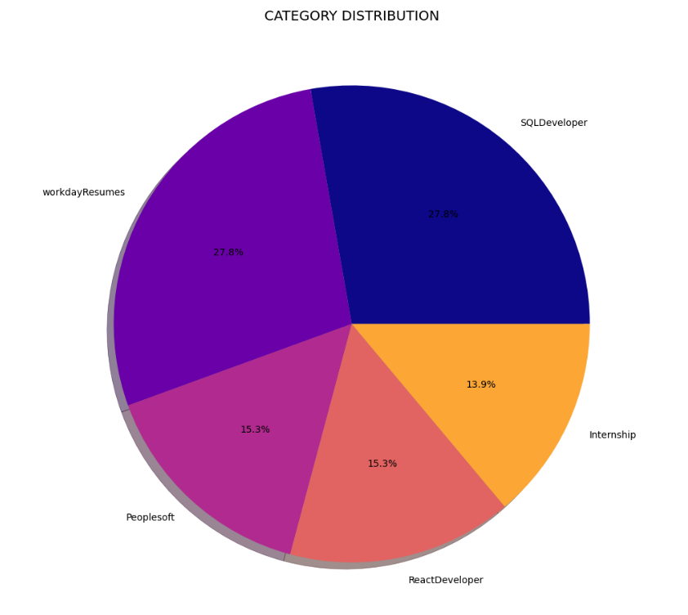
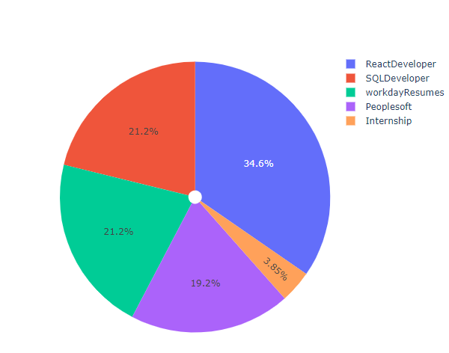
EDA

Slide 12
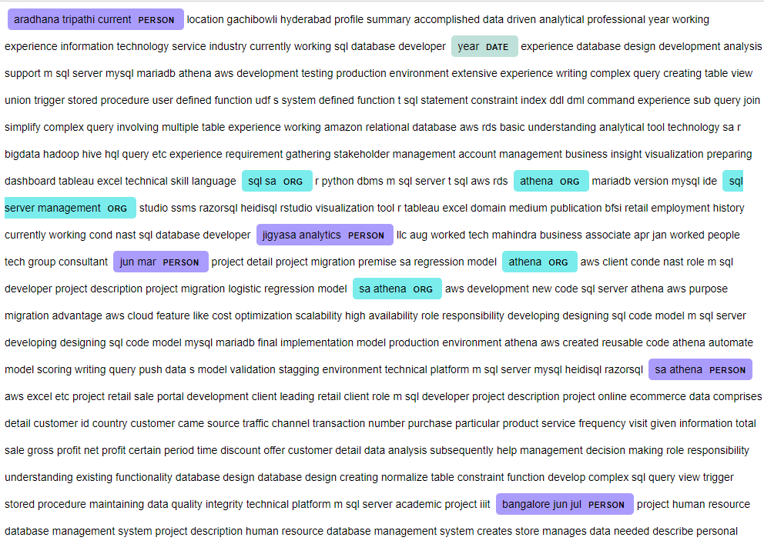
Name Entity Recognition

Slide 13
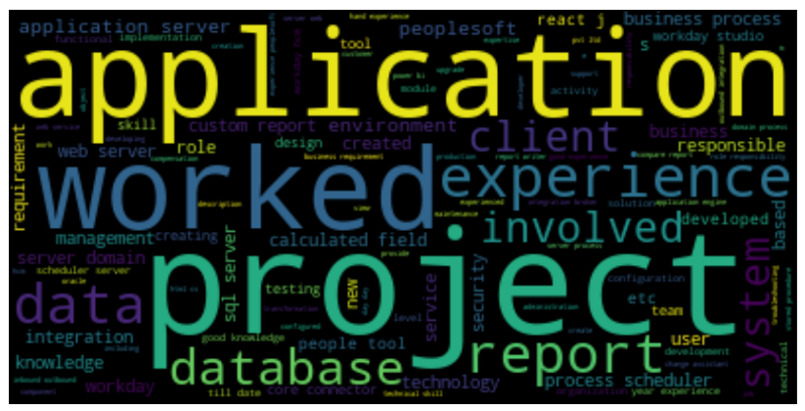
WordCloud

Slide 14
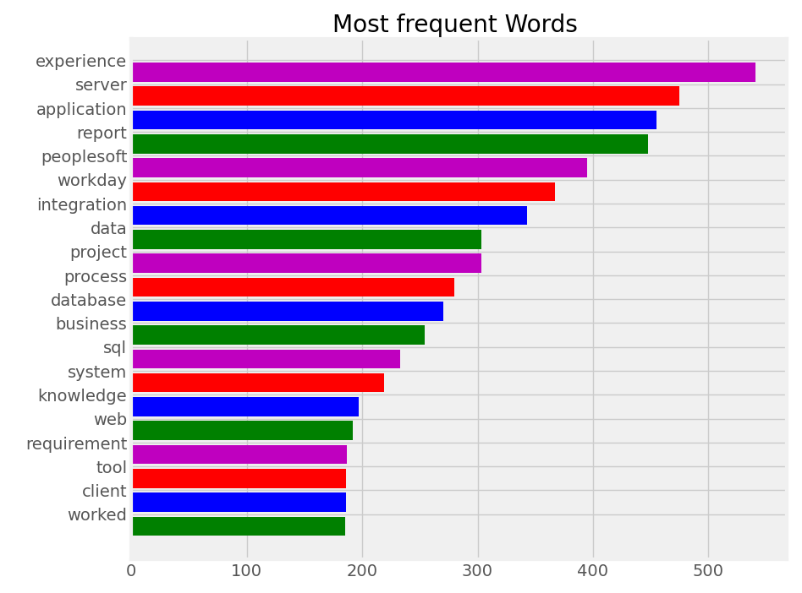
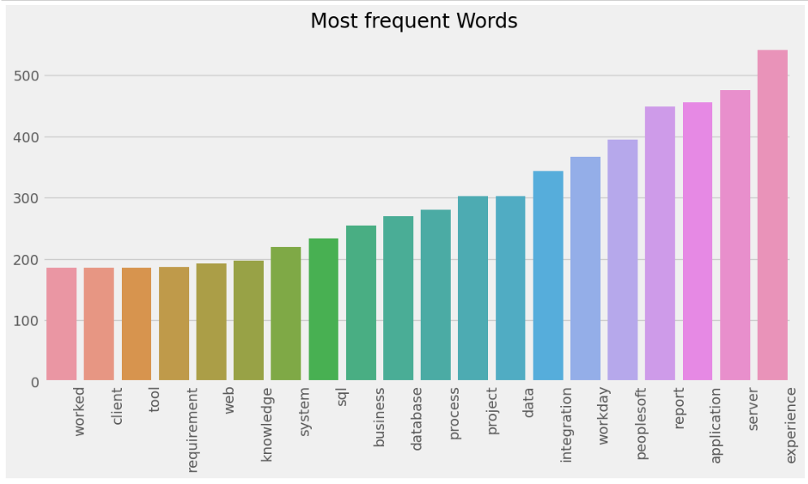

Slide 15

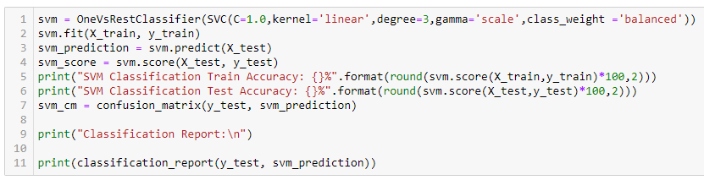
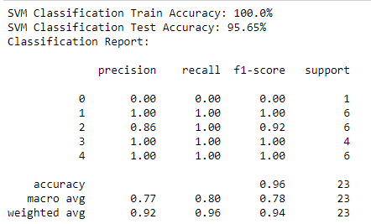
Template for Model results presentation
Model – SVM (Support Vector Machine)
Data Partition details

Slide 16
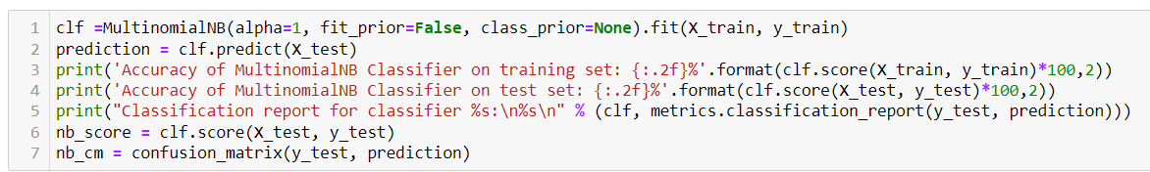
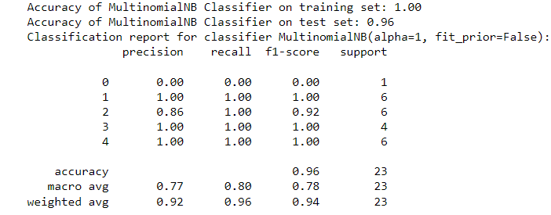
Template for Model results presentation
Model – Naive Bayes Classifier
Data Partition details

Slide 17
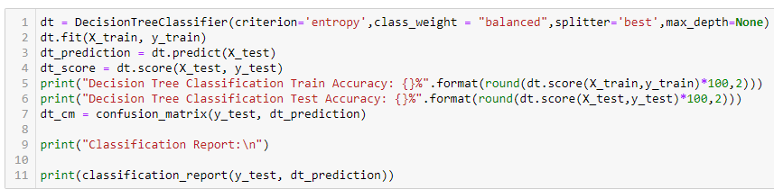
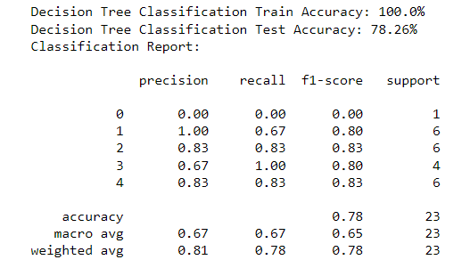
Template for Model results presentation
Model – Decision Tree Classifier
Data Partition details

Slide 18
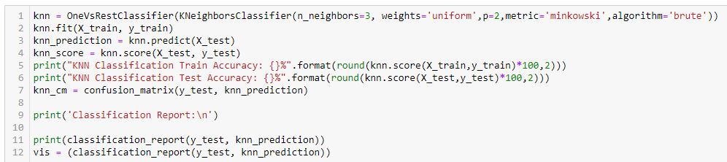
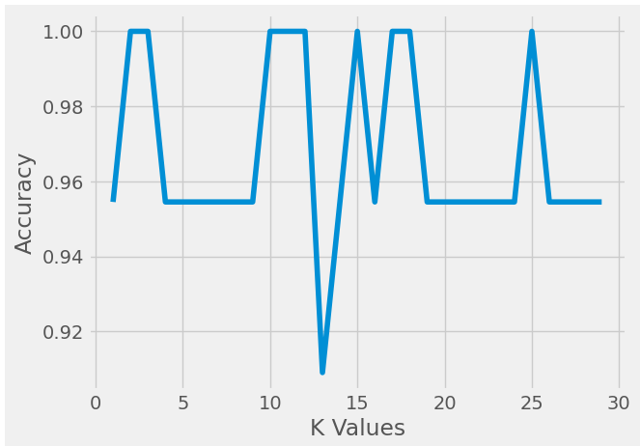
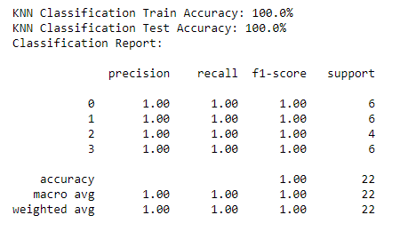
Template for Model results presentation
Model – KNN Classifier
Data Partition details

Slide 19
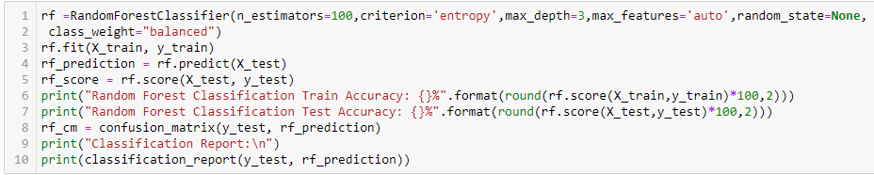
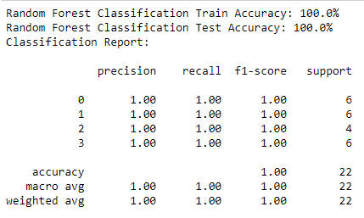
Template for Model results presentation
Model – Random Forest Classifier
Data Partition details

Slide 20
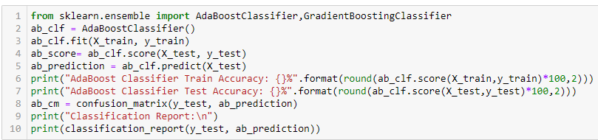
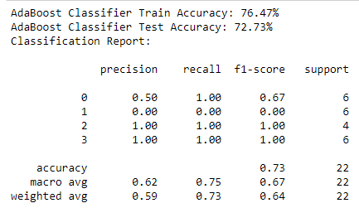
Template for Model results presentation
Model – AdaBoost Classifier
Data Partition details

Slide 21
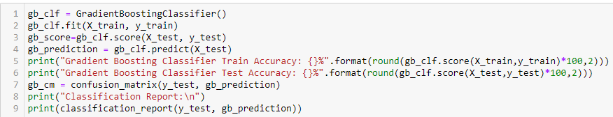
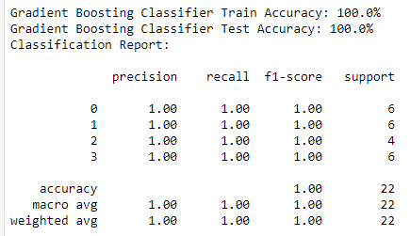
Template for Model results presentation
Model – Gradient Boosting Classifier
Data Partition details

Slide 22
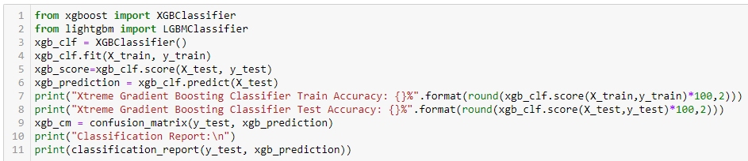
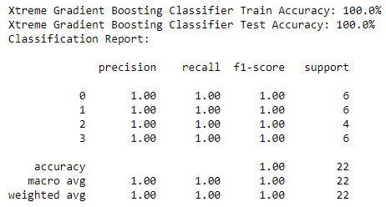
Template for Model results presentation
Model – xtreme Gradient Boosting classifier
Data Partition details

Slide 23
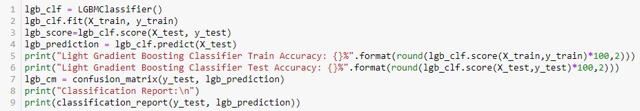
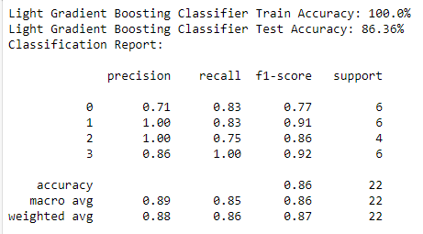
Template for Model results presentation
Model – Light Gradient Boosting Classifier
Data Partition details

Slide 24
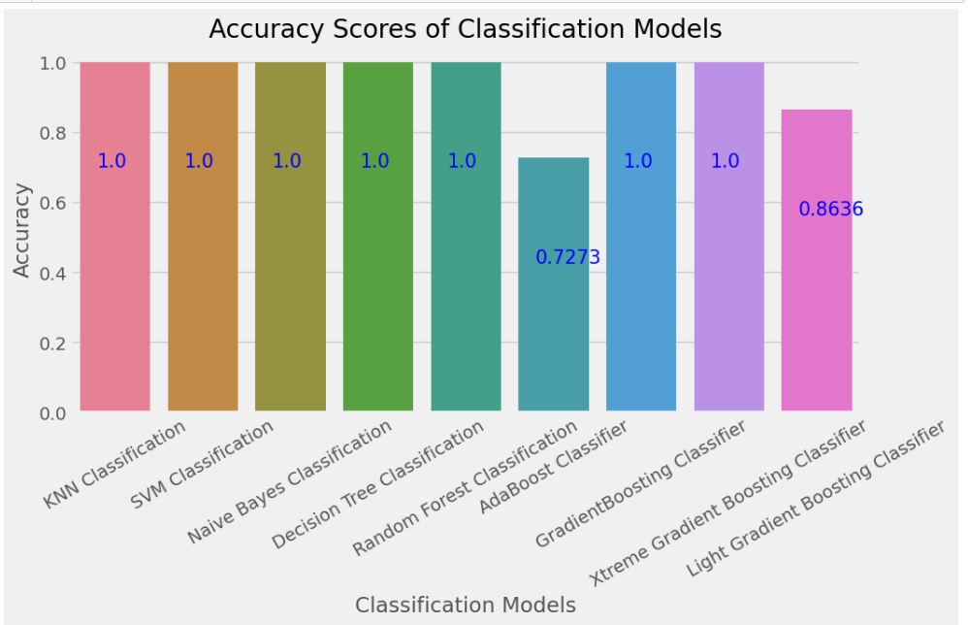
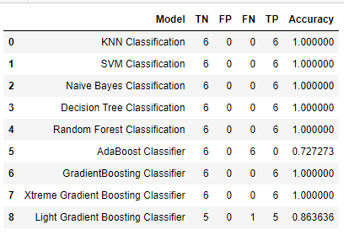
Finalizing Model
Among All the Models we have finalize KNN Classification For our Deployment

Slide 25
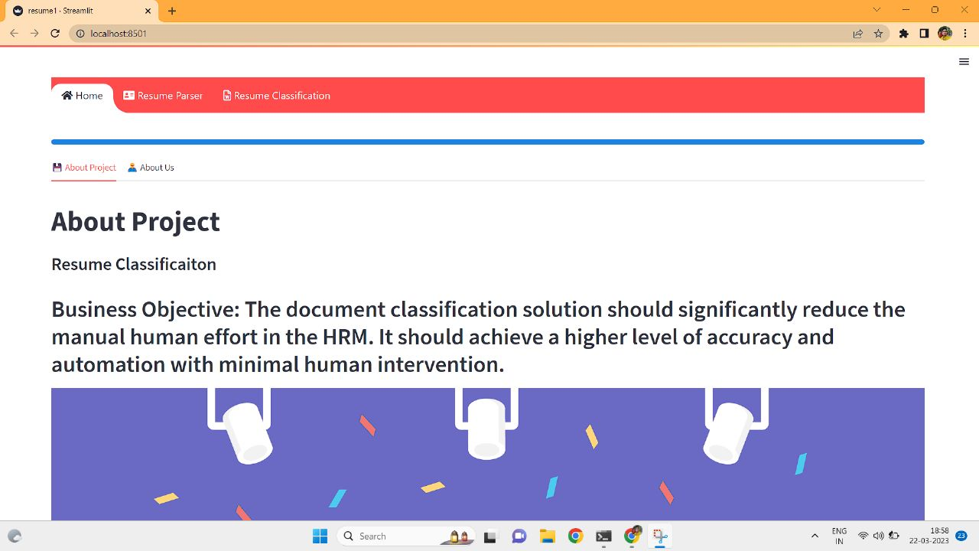
Model Deployment using Streamlit.
This Home Page of our Resume Classification Website Project
We have made 2 tabs in the top of our page RESUME PARSER & RESUME CLASSIFICATION

Slide 26
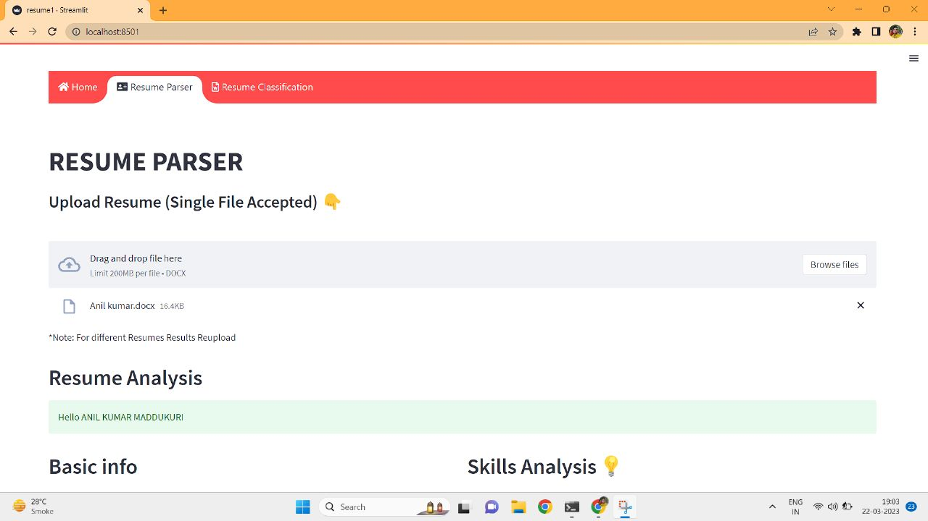
Model Deployment using Streamlit.
In RESUME PARSER tab We have to upload any One Resume Then Our Website will Analyse the data

Slide 27
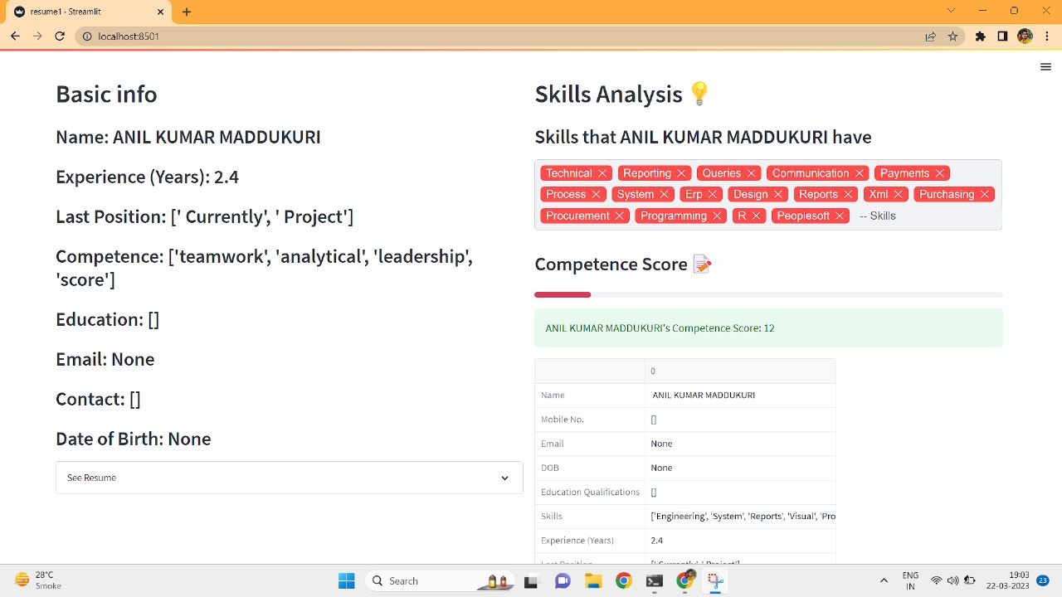
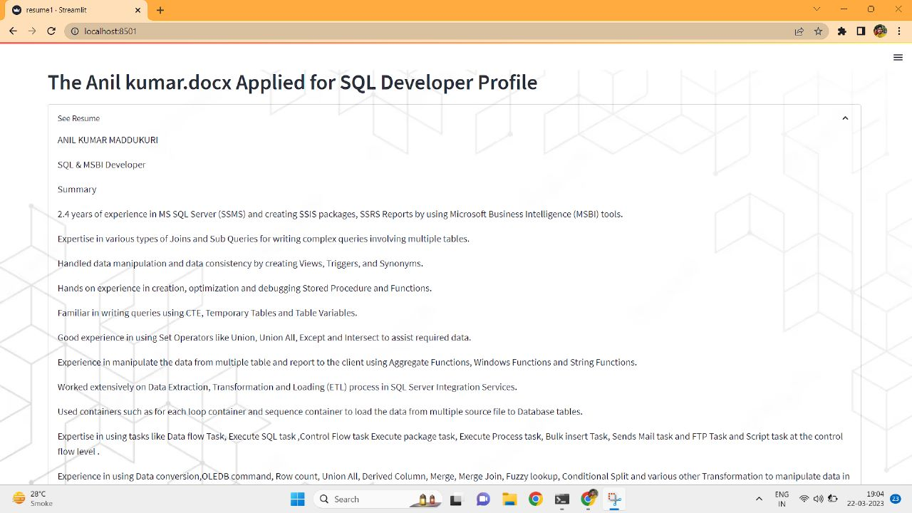
Model Deployment using Streamlit.
Below Basic Info and other Information Full Resume will be Displayed
After Uploading a Resume In RESUME PARSER section Website will Display
Basic Information of that person & analysed Skills & Score of his/her Resume
After Clicking on See Resume Full Resume of that person is Displayed

Slide 28
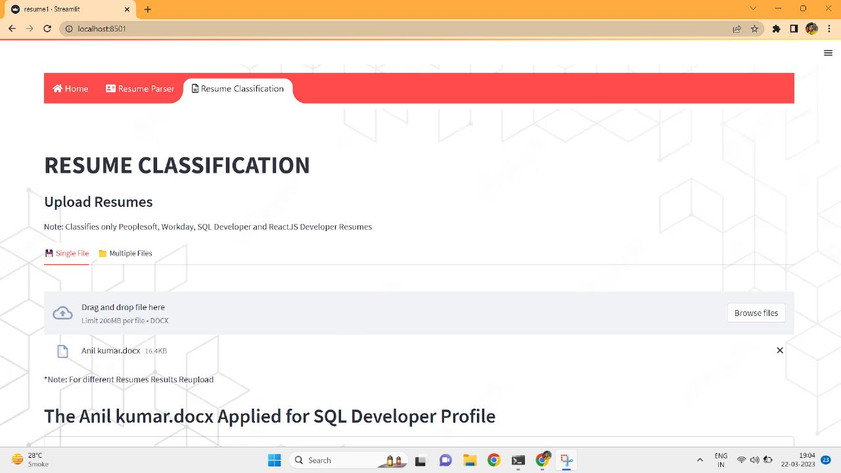
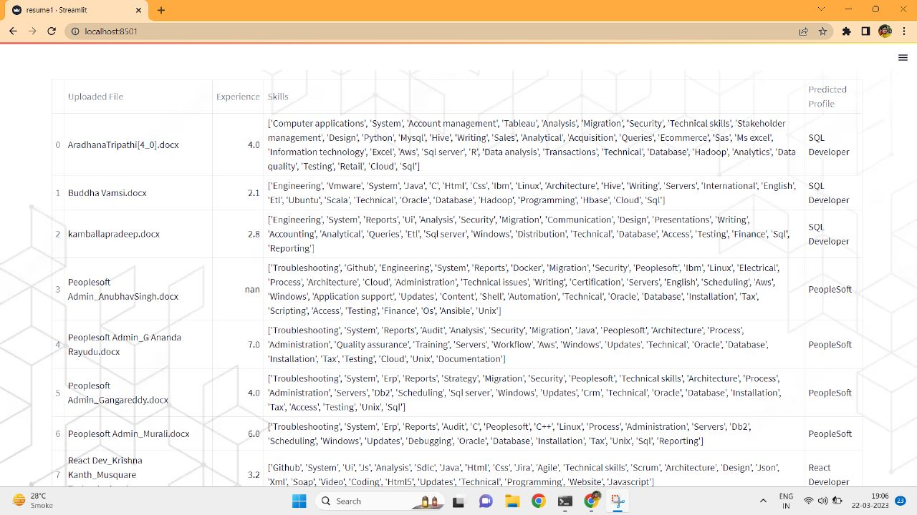
Model Deployment using Streamlit.
In RESUME CLASSIFICATION section we have 2 options of Single File & Multiple File uploading options.
After uploading multiple resumes
File Name, Experience Skills & Predicted profile are shown in a table format.

Slide 29
Challenges faced?
Got Many Errors & Difficulties In Scrapping Data From Resume folders.
We Faced Visualization Problems While Performing EDA specially in NER (Name Entity Recognition) Using Inbuilt Function of Spacy.
We got many confusions in Model building.
For finalizing model for deployment Almost from all the models we got very good accuracy so it was a little difficult to finalizing the model for deployment.
How did you overcome?
We Overcome All This Challenges By Discussion In Group Meeting & Taking New Ideas From Team Members.

Slide 30
Thank you

