Slide 1
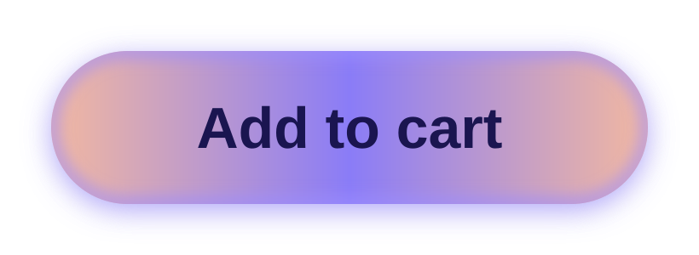
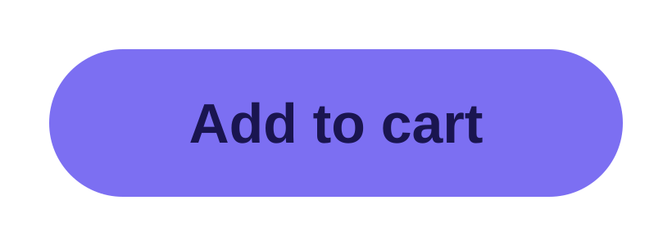
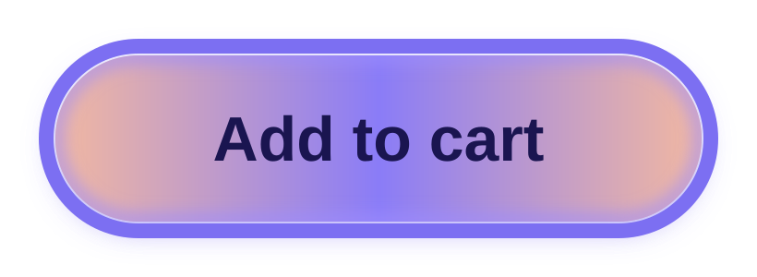
EXPERIMENTAL · FOUNDATION 1.12
AddToCartButton
Styles in
Jetpack Compose
Separate form from function: one style parameter for state-based, animated, themeable components.
Ram · 3-minute lightning talk
Adapted from “Building custom design systems with Jetpack Compose’s new Styles API” (droidcon)
Notes:
[0:00–0:10]
Quick one today: the new Styles API in Compose Foundation 1.12 — experimental, so now is the moment to try it and give feedback.
In three minutes: why it exists, how you use it, why it's fast, and when to pick a Style versus a Modifier.

Slide 2



WHY
Custom design systems fight component APIs
BEFORE · Jetsnack Button
Your design wants a gradient
Kotlin
Material’s FilterChip takes a single Color, not a Brush.
fun Button(
onClick: () -> Unit,
modifier: Modifier = Modifier,
shape: Shape = ButtonShape,
border: BorderStroke? = null,
backgroundGradient: List<Color> = …,
disabledBackgroundGradient: List<Color> = …,
contentColor: Color = …,
disabledContentColor: Color = …,
contentPadding: PaddingValues = …,
enabled: Boolean = true,
content: @Composable RowScope.() -> Unit,
)
So you hack around it
Transparent chip inside a Box, re-apply the shape, hand-roll pressed / selected logic.
…or fork the component
And lose Material’s accessibility, RTL and interaction-state defaults.
AFTER
style: Style = Style,
7 visual parameters → 1
Notes:
[0:10–0:35]
Apps increasingly want their own look, and most sit somewhere between full Material and fully custom.
Example from Jetsnack: a filter chip with a gradient. Material's chip only takes a single Color. So you make the chip transparent, wrap it in a Box with a gradient background, re-apply the shape, and re-implement pressed and selected yourself. It works, but it's messy and hard to debug. The other option is forking Material and losing its accessibility, RTL and interaction defaults.
Look at Jetsnack's own Button: seven visual parameters. Styles replace all of them with one standard parameter.

Slide 3
WHAT
A Style defines how a component looks
A specialized Modifier with built-in performance and reusability. It replaces visual parameters, not Modifiers.
1
Override
2
Reusable
3
Mergeable
Same property twice → last one wins.
Define once, pass to any styleable component.
Combine with Style(a, b) or a then b.
Style(buttonStyle, gradientStyle)
// gradient background wins
val buttonStyle = Style {
background(Color.LightGray)
shape(RoundedCornerShape(28.dp))
}
style = buttonStyle then gradientStyle
Modifier = additive
Style = override
.padding(32.dp).padding(top = 16.dp)
external padding 32 dp, then top 16 dp
top = 32 + 16 = 48 dp
top = last value = 16 dp
Notes:
[0:35–1:00]
So what is a Style? An interface that defines the appearance of a component — a specialized modifier that gives you performance and reusability for free. Important: it's not here to replace modifiers; it replaces the visual parameters.
Three fundamentals. Override: if a property is set twice, the last one wins. Reusable: define a style once and pass it anywhere. Mergeable: combine styles with Style(a, b) or "a then b".
The one that surprises people: with modifiers, padding 32 then top 16 adds up to 48dp on top. In a style, the later top padding overrides it — you get 16dp.

Slide 4
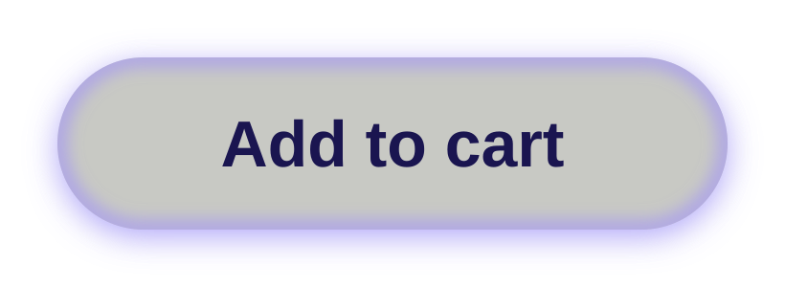
USAGE
Two ways to use Styles
1 · Make your component styleable
2 · Pass a style to a component
Kotlin
Kotlin
@Composable
fun GradientButton(
onClick: () -> Unit,
modifier: Modifier = Modifier,
style: Style = Style, // like modifier
content: @Composable RowScope.() -> Unit,
) {
val source = remember { MutableInteractionSource() }
val styleState = rememberUpdatedStyleState(source)
Row(
modifier
.clickable(source, indication = null,
onClick = onClick)
.styleable(styleState, style),
content = content,
)
}
val buttonStyle = Style {
background(Color.LightGray)
width(200.dp); height(50.dp)
shape(RoundedCornerShape(28.dp))
externalPadding(16.dp)
}
val gradientStyle = Style {
background(Brush.linearGradient(
listOf(LightOrange, LightPurple, LightOrange)))
dropShadow(…); innerShadow(…)
}
GradientButton(onClick = {},
style = Style(buttonStyle, gradientStyle)) { … }
Style(button, gradient)
Style(gradient, button)
Notes:
[1:00–1:30]
Two use cases. One: make your own component styleable. Under the hood Jetsnack's button is just a clickable Row. Add a style parameter defaulting to Style — just like you always add a modifier parameter — create a style state from the interaction source, and apply Modifier.styleable.
Two: use a component that has a style parameter. Here buttonStyle sets the base look, gradientStyle adds the gradient and shadows, and we merge them.
Order matters: both define a background, so whichever comes last wins. Flip them and you get a gray button that still has the shadows, because only the overlapping property is overridden.

Slide 5
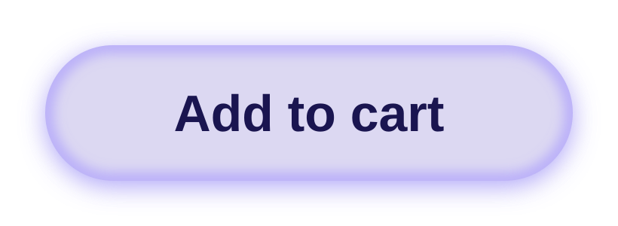
EXAMPLE
State-based styling and animation, built in
Kotlin
Button states
GradientButton(
onClick = {},
style = Style(buttonStyle, gradientStyle) {
pressed {
background(LightPurple)
}
hovered {
animate(tween(300)) {
background(Lavender)
innerShadow(Shadow(LightPurple,
offset = DpOffset((-6).dp, (-2).dp)))
}
}
focused {
border(8.dp, LightPurple)
}
}
) { Text("Add to cart") }
default
pressed
hovered
focused
No remember { }, no animate*AsState, no manual interaction tracking.
Notes:
[1:30–1:55]
Styling by interaction state is built in: default, pressed, hovered and focused — plus custom states, which are in the docs. Define all of them; your app may run on a phone, a TV with a D-pad, or a desktop with a mouse.
Add a block after Style(...): pressed gets a solid purple, hovered lavender, focused a border.
Wrap any property in animate and the transition between states is automatic — pass a spec like tween to tune it. All the state tracking and animate*AsState variables you used to write disappear.

Slide 6



PERFORMANCE
Faster by design
70%
2.3×
Where styles run
Composition
Layout
Draw
fewer allocations
faster to the next frame
skipped on style changes
Google benchmarks shown in the talk; details in the Styles docs.
Phase shifting
Reduced overhead
Lazy allocation
Targets layout and draw. Value changes trigger a redraw, not a recomposition.
One lambda application replaces a chain of modifier objects.
Animation resources are allocated only when an animation starts.
Notes:
[1:55–2:15]
Performance. In Google's benchmarks from the talk: about 70% fewer allocations and 2.3 times faster to the next frame.
Three reasons. Phase shifting: styles target layout and draw, so a changing value triggers a redraw instead of a recomposition. Reduced overhead: a single lambda instead of a chain of modifier objects. Lazy allocation: animation resources are only created when an animation actually starts.

Slide 7
COMPARE
Styles vs Modifiers
Feature
Modifier
Style
Goal
Low-level capabilities: behaviour, semantics, additive properties, complex layouts
High-level visuals: appearance, item sizing, themeable properties
Logic
Additive
Override
Theming
Lower level, not part of a theme
Reusable and themeable by design
Performance
Runs in all phases
Avoids recomposition by design
Animations
Separate animation primitives
Built in
Styles are built on top of Modifiers, not a replacement for them.
Notes:
[2:15–2:40]
Side by side. Modifiers are the low-level building blocks: behaviour, semantics, additive properties and complex layouts. Styles are a level above, for visual appearance, individual item sizing and themeable properties.
Modifiers add up; styles override. Modifiers aren't designed to live in a theme; styles are. Modifiers often run through every phase; styles avoid recomposition. And animation is built into styles.
Remember: styles sit on top of modifiers. They don't replace them.

Slide 8


DECIDE
When to reach for which
Choose a Style
Choose a Modifier
Override the defaults of an existing component
High-performance interaction-state animations
Define a theme-wide set of properties for a component
Add behaviour: clickable, gestures, semantics
Build a unique, one-off complex layout
You need additive properties
style = Style { pressed { … } }
modifier = Modifier.clickable { … }
Try it: foundation 1.12+ (BOM 2026.04.01+), opt in to ExperimentalFoundationStyleApi, read the Styles docs, and file feedback while the API is still changing.
Notes:
[2:40–3:00]
So: choose a Style to override a component's defaults, for high-performance interaction-state animations, or to define a theme-wide look for a component. Choose a Modifier to add behaviour like clickable or gestures, for one-off complex layouts, or when you need properties to add up.
To try it: Foundation 1.12, opt in to the experimental API, and use the docs and the styles agent skill. It's experimental, so feedback now actually shapes the API. Thanks!

