Slide 1
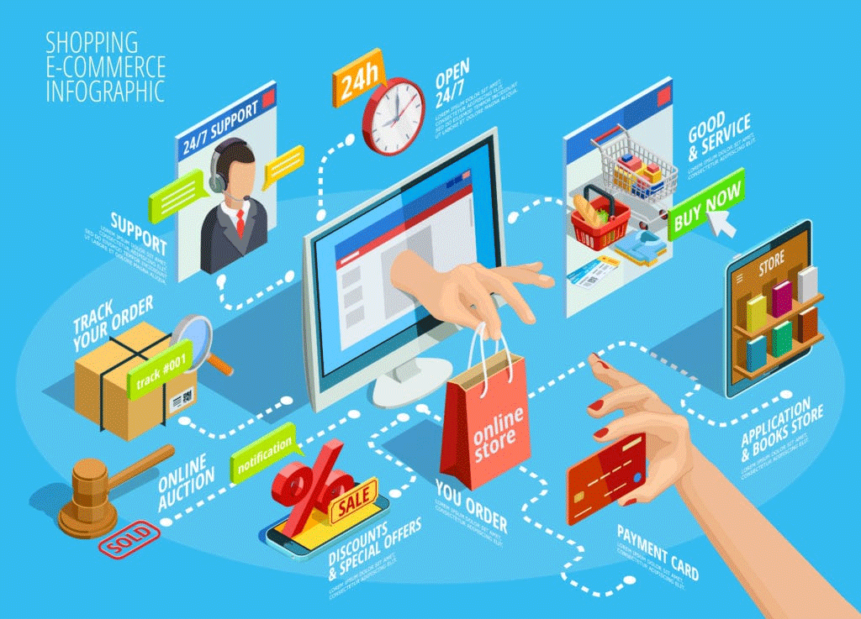
INTRODUCTION
“E-commerce” , a responsive website which provides a virtual store on the Internet where customers can browse the catalog and select products of their interest. This project aims to develop an user friendly online shopping E- commerce website for customers with the goal that it is very easy to shop your loved things from a extensive number of online shopping sites available on the web. With the help of this you can carry out an online shopping from your home. Here is no compelling reason to go to the crowed stores or shopping centers during festival seasons. You simply require a PC or a laptop and one important payment sending option to shop online. So, we design our website through different diagrams like Data Flow Diagram, ER diagram, General Use Diagram, Sequence Diagram and Class Diagram.
.
E-Commerce

Slide 2
OBJECTIVES
The objective is to manage Online Selling costs in a strategic way.
E-Commerce drives profitable growth by expanding customer reach, reducing cost-to-serve, and creating differentiated customer experiences.
Make consumers focus point and interact with them to give them an incredible experience.
E Commerce store can help in automate most of services and save time updating the status of sold goods, creating invoices, and more.
No reach limitations A seller with a physical store may only be able to reach a certain number of buyers but this case doesn’t apply here.
E- Commerce platform not only helps you to sell your goods but offers better services to your audiences like fast delivery, quick check-outs, better product information, and more .

Slide 3
TECHNOLOGY USED
HTML
CSS
JAVASCRIPT
PHP
SQL
BOOTSTRAP

Slide 4
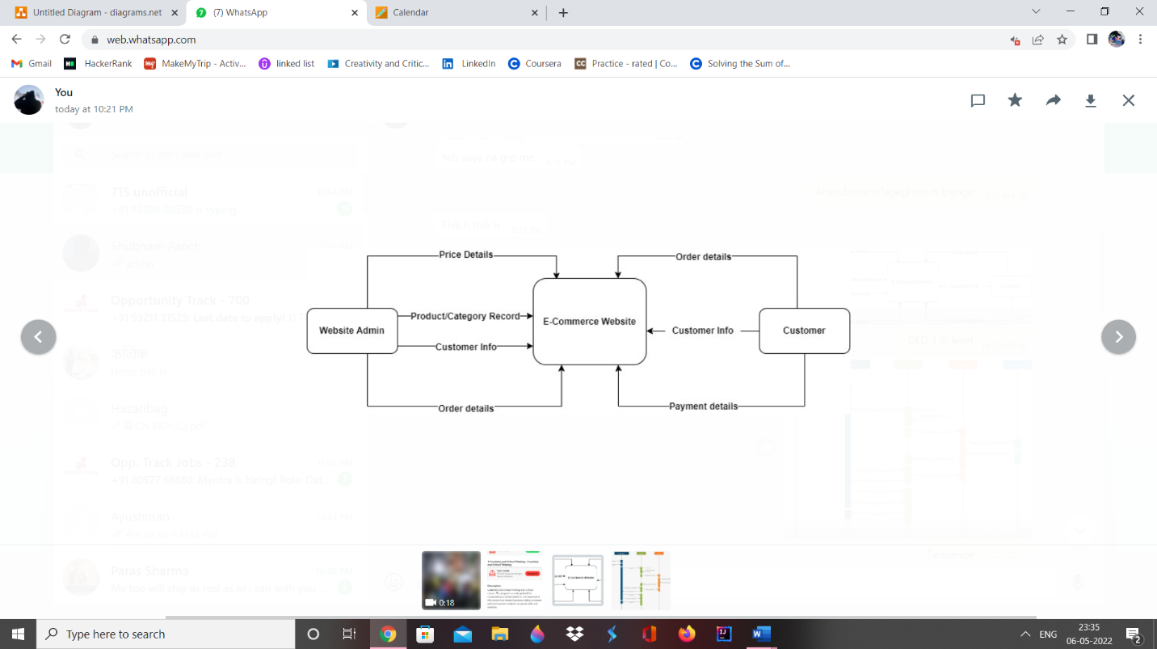
Designs i. Data Flow Diagram

Slide 5
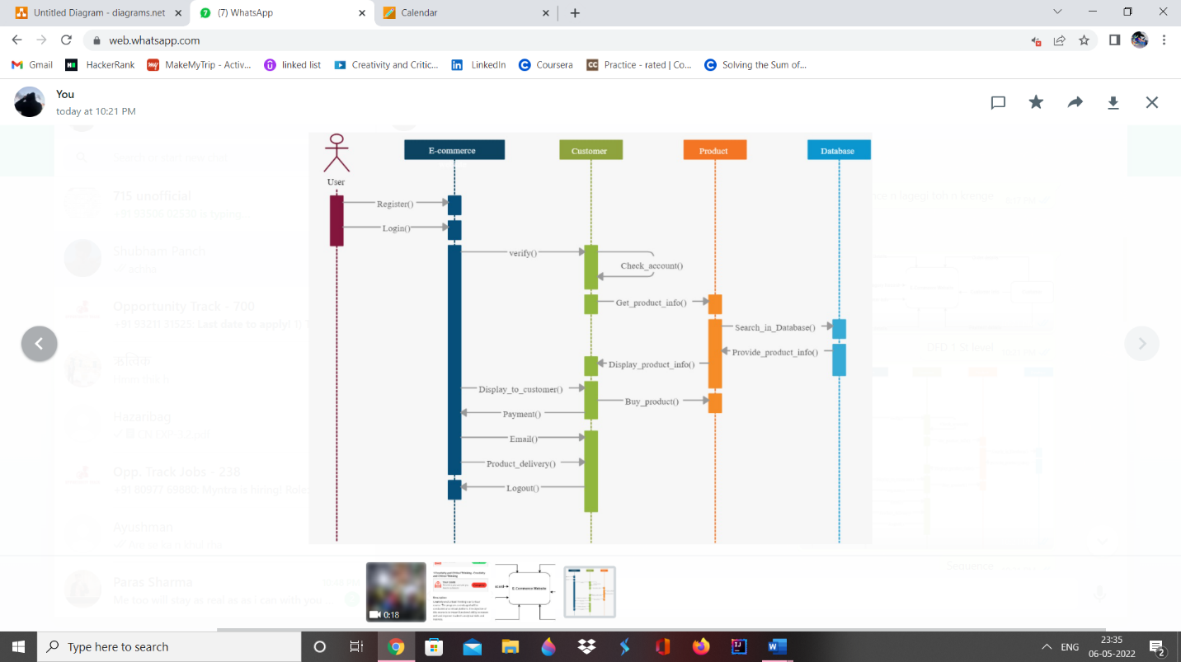
ii. Sequence Diagram

Slide 6
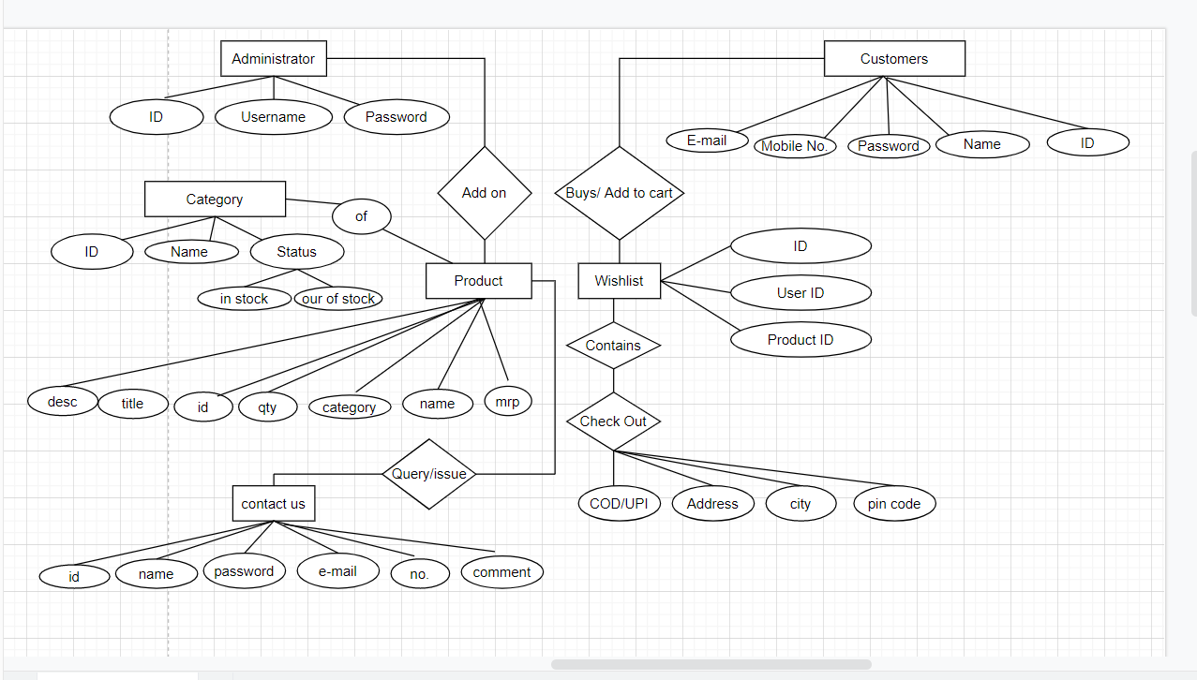
iii. ER Diagram

Slide 7
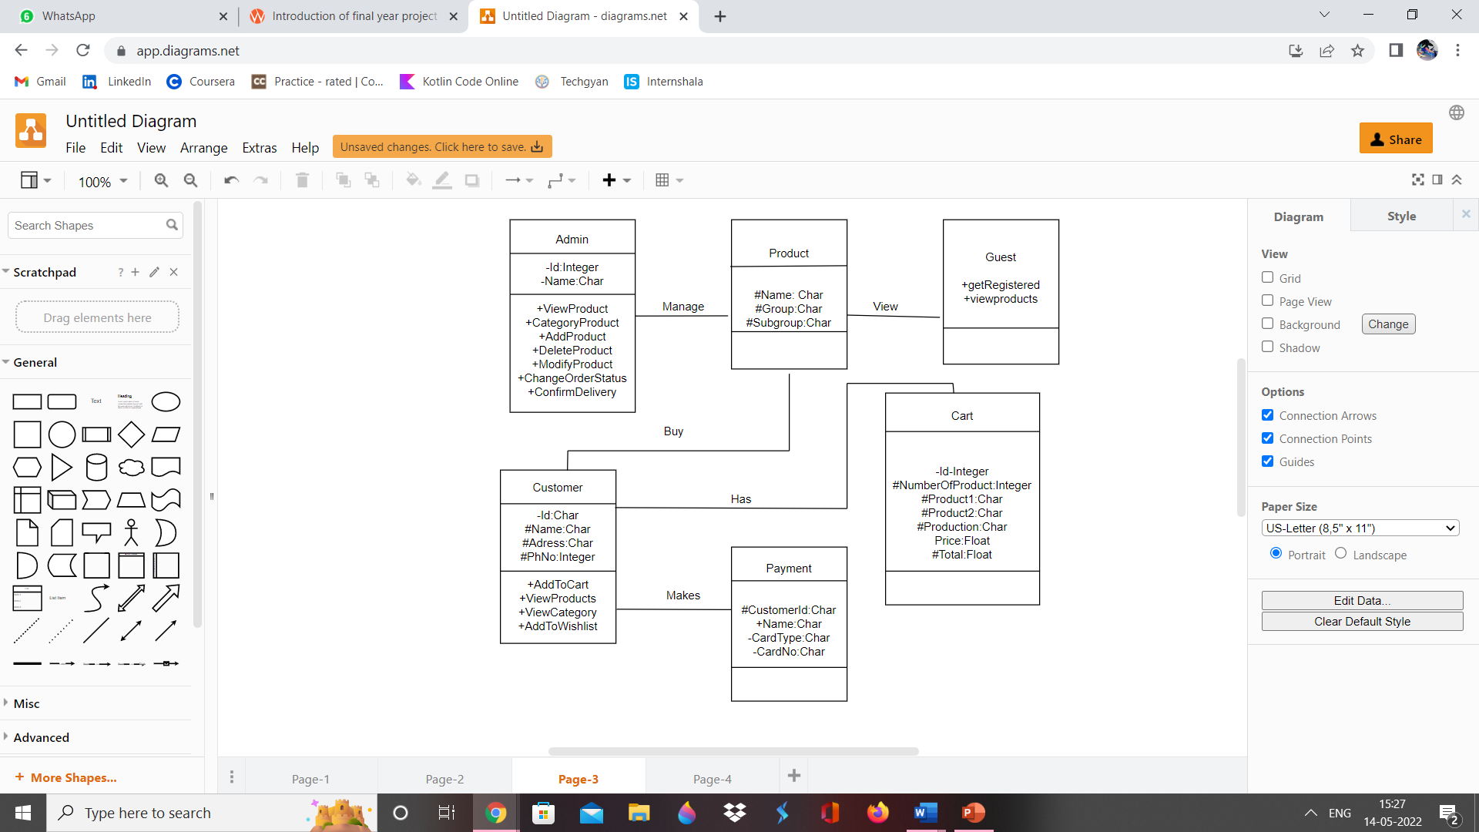
iv. Class Diagram

Slide 8
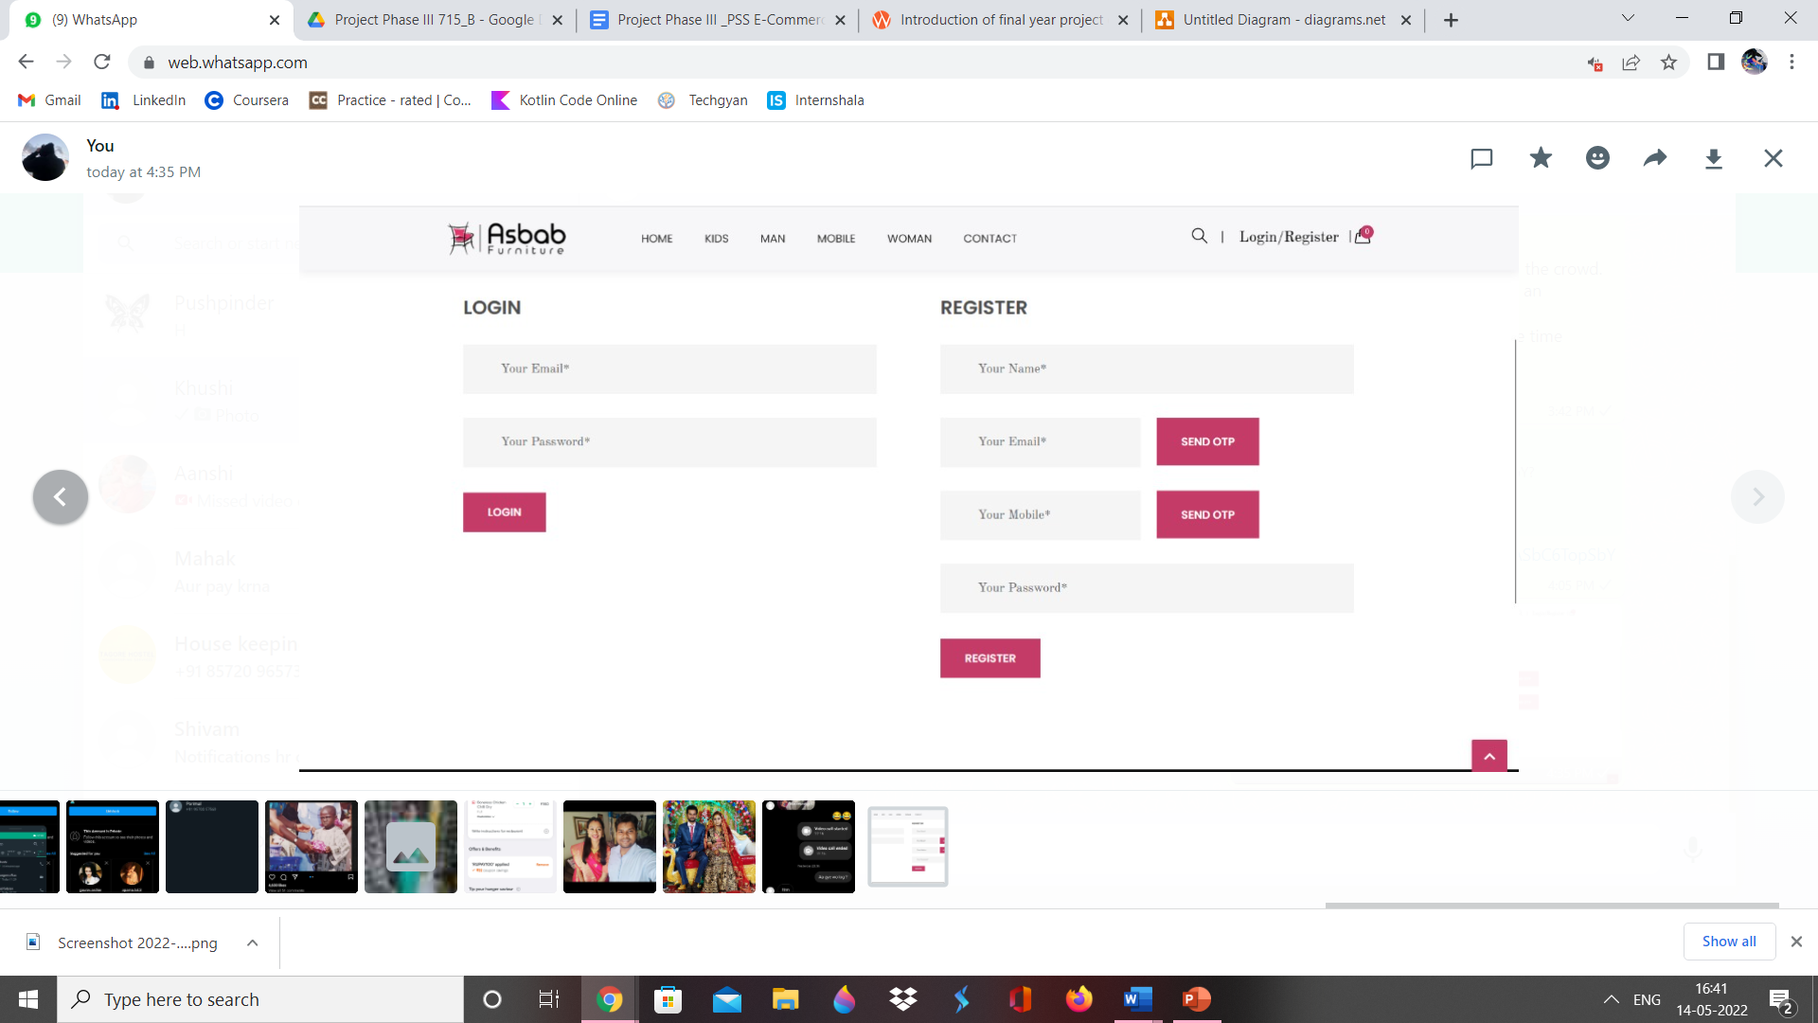
Screenshots: Login Page

Slide 9
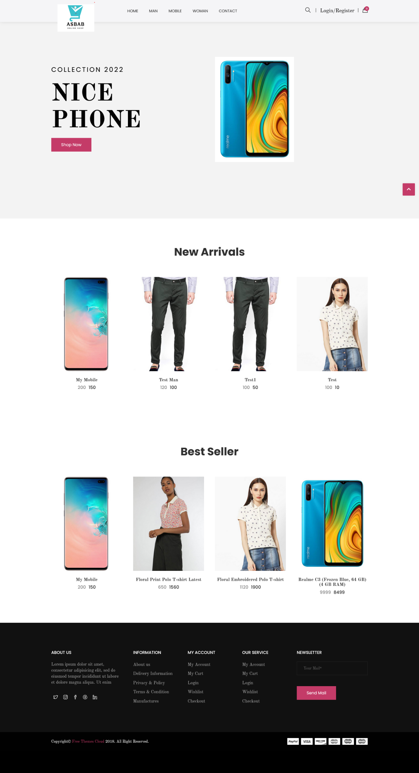
Home Page of Website

Slide 10
Outcomes
It gives access to a platform from where we can buy whatever we want
sitting at our home.
It provides wide range of product to choose from.
It provides flexibility to the customers.
Online payment will make it more easier for the customer to pay without any physical contact.
The product and services are available 24*7.
THANK
YOU

