Slide 1
More about CSS

Slide 2
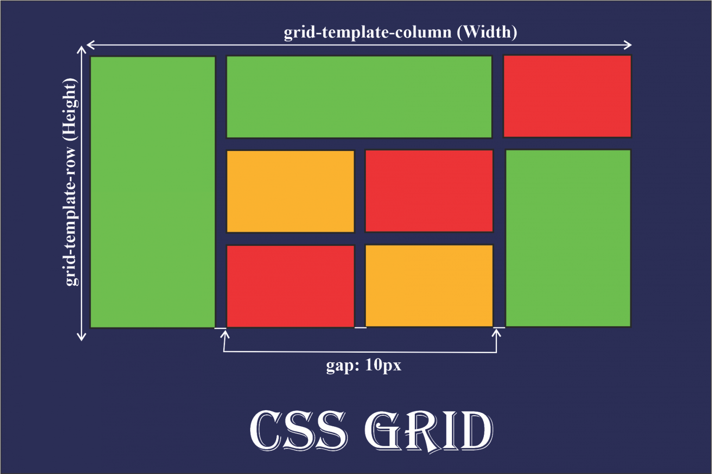

Slide 3
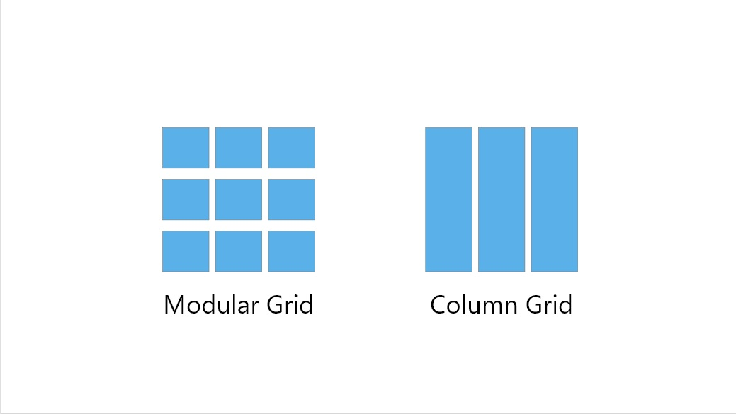

Slide 4
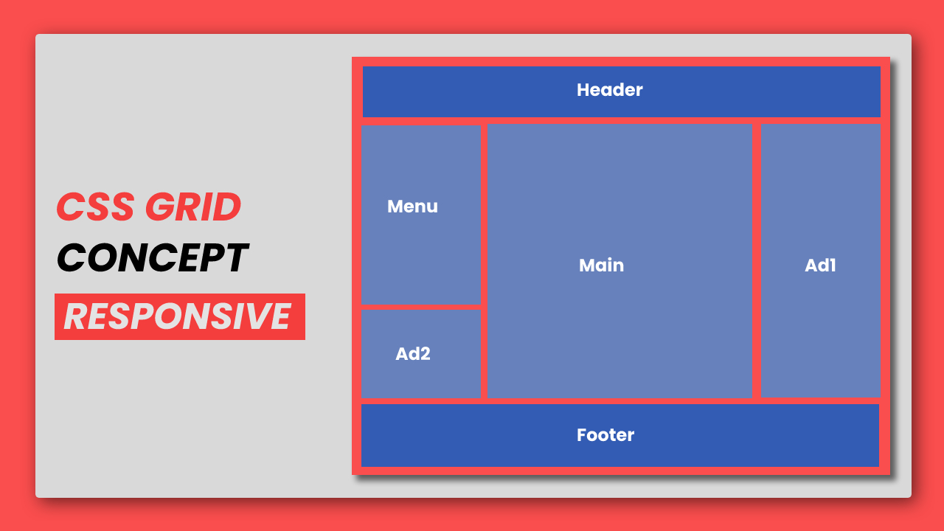

Slide 5
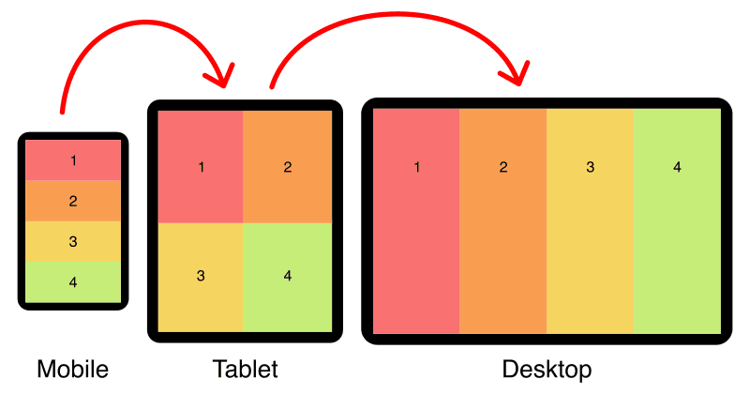

Slide 6
CSS Grid (2-D layout)
CSS Grid is a layout system in CSS used to arrange items (boxes) on a webpage in rows and columns.
Think of it like a chessboard or matrix where you can place elements inside different squares.
Why Do We Use Grid?
To make web layouts neat and clean.
To divide a webpage into structured sections.
To easily arrange content in multiple rows and columns.
It is responsive, meaning layout adjusts for mobile/tablet/computer automatically.

Slide 7
CSS Grid (2-D layout)
Term | Meaning | Example
Grid Container | The box that holds the grid items | A <div> with display: grid
Grid Items | Children (inner elements) inside the grid container | <div> inside the parent div
Rows | Horizontal divisions | Like rows in Excel
Columns | Vertical divisions | Like columns in Excel
Gap | Space between rows/columns | gap: 10px;

Slide 8
CSS Grid (2-D layout)
How to Create a Grid
Select a container.
Apply display: grid.
Define number of rows and columns using grid-template-columns and grid-template-rows.
.container {
display: grid;
grid-template-columns: repeat(3, 1fr); /* 3 equal columns */
gap: 10px;
}
1fr means equal flexible space.

Slide 9
CSS Grid (2-D layout)
HTML
<div class="container">
<div class="box">A</div>
<div class="box">B</div>
<div class="box">C</div>
<div class="box">D</div>
</div>
CSS
.container {
display: grid;
grid-template-columns: 1fr 1fr; /* 2 columns */
grid-template-rows: 100px 100px; /* fixed height rows */
gap: 10px;
}
.box {
background: lightcoral;
text-align: center;
padding-top: 30px;
}

Slide 10
CSS Grid (2-D layout)
Key Advantages of CSS Grid
Very easy for making structured layouts.
Reduces complexity (less CSS code needed).
Responsive design becomes simpler.
More control over spacing and alignment.

Slide 11
CSS Grid (2-D layout)
When to use
Two-dimensional layouts: rows and columns (complex page layout, dashboards, galleries).
Core concepts
display: grid;
Define columns/rows: grid-template-columns: 1fr 2fr; grid-template-rows: auto;
Place items with grid-column and grid-row or grid-area.
gap works for grid as well.

Slide 12
CSS Grid (2-D layout)
simple 3-column grid
<div class="grid">
<div>1</div><div>2</div><div>3</div>
<div>4</div><div>5</div><div>6</div>
</div>
<style>
.grid{ display:grid; grid-template-columns: repeat(3, 1fr); gap:10px; }
</style>

