Slide 1
React Fundamentals

Slide 2
Example: Change a Name on Screen
JavaScript – We control everything manually
<h3 id="name">Hello, Asha</h3>
<button onclick="changeName()">Change Name</button>
<script>
function changeName()
{
document.getElementById("name").innerText = "Hello, Riya";
}
</script>
Here you must tell JavaScript exactly where and what to change.
Here you must tell JavaScript exactly where and what to change.
React – Just change data, UI updates itself ✨

Slide 3
Frequent Reflow & Repaint → App Becomes Slow
Imagine you are decorating a room:
You move one small pillow
But instead, you are forced to rearrange the whole room again and again
React – Just change data, UI updates itself ✨
That’s what happens in traditional DOM:
Every small change makes the browser recalculate and redraw everything.
Here you must tell JavaScript exactly where and what to change.
<p id="text">Hello</p>
<button onclick="changeText()">Change</button>
<script>
function changeText() {
document.getElementById("text").innerText = "Hi";
}
</script>
Even this tiny change makes the browser repaint the screen again → slow for big apps.

Slide 4
Imperative UI Updates → Code Becomes Confusing
It’s like giving a robot step-by-step cooking instructions:
❌ Open fridge
❌ Take onion
❌ Chop slowly
❌ Turn on gas
❌ Put oil
❌ Stir…
Too many commands = confusion!
<p id="box">Welcome</p>
<script>
let box = document.getElementById("box");
box.style.color = "red";
box.style.fontSize = "20px";
box.style.backgroundColor = "yellow";
</script>
You have to manually control everything → code becomes messy.

Slide 5
UI Can Go Out of Sync with Data
Think of a school notice board:
Teacher updates marks in her notebook ✅
But forgets to update the notice board ❌
Students see wrong marks 😞
<input id="name" placeholder="Enter name">
<p id="show">Name will appear here</p>
<script>
let data = "";
function save() {
data = document.getElementById("name").value;
// UI is NOT updated here ❌
}
</script>
Data is changed
Screen is not updated → out of sync problem

Slide 6
Hard to Scale for Big Applications
Imagine managing:
2 students ✅ easy
200 students ❌ very difficult
Manual work becomes impossible.
Here you must tell JavaScript exactly where and what to change.
<ul id="list"></ul>
<script>
function addItem(text) {
let li = document.createElement("li");
li.innerText = text;
document.getElementById("list").appendChild(li);
}
</script>
Works for small list
Becomes difficult to manage for big apps ❌

Slide 7
Example: Change a Name on Screen
Traditional JavaScript says: “Do everything by hand”
React says: “Just change data, I’ll handle the screen
Here you must tell JavaScript exactly where and what to change.

Slide 8
Redraw + Rearrange + Recolor
Repaint (Re-Color 🎨)
When only colors or styles change.
Like:
Painting the wall a new color but furniture stays same.
Think of a webpage like a drawing notebook.
When you change something, the browser does these 3 things:
Rendering (First Draw ✏️)
This is when the browser draws the webpage for the first time.
Example:
Opening a new page = browser draws text, buttons, images.
Here you must tell JavaScript exactly where and what to change.
Reflow (Re-Arrange 📐)
When size or position changes, the browser recalculates layout.
Example:
You move a sofa in a room → you have to move the table and chair too.
DOM = Redraw + Rearrange + Recolor the full screen again and again

Slide 9
Diffing Algorithm and Reconciliation
Diffing Algorithm (Find the Difference Game)
React compares old screen with new screen and finds only the changes.
Like:
Finding difference between two similar pictures 🖼️.
Reconciliation 🎯 (Smart Update)
After finding differences, React updates only that small part of the page.
Like:
Only cleaning the dirty spot, not the whole room.
Here you must tell JavaScript exactly where and what to change.

Slide 10
Summary
Technology | What it does
DOM | Redraws & rearranges a lot ❌
React | Smartly updates only what changed ✅

Slide 11
Example: Change a Name on Screen
Problem | Simple Meaning
Frequent reflow & repaint | Screen redraws too much → slow app
Imperative UI updates | Too many manual steps
Out of sync UI | Data and screen don’t match
Hard to scale | Difficult for big apps
Here you must tell JavaScript exactly where and what to change.

Slide 12
Virtual DOM
What is Virtual DOM?
Think of Virtual DOM (VDOM) as a fake/temporary
copy of the real webpage kept in memory.
Real-life example:
Before painting your room, you first draw a small sketch on paper.
That sketch = Virtual DOM
Lightweight, In-Memory Copy of Real DOM
Instead of touching the real screen again and again, React works with a copy in memory.
Example:
A practice notebook before writing in the final book.
✅ Fast
✅ Safe
✅ Smart

Slide 13
Example: Change a Name on Screen
React Creates a New Virtual DOM for Every Change
Whenever:
You click a button
Type in input
Data changes
React makes a new version of that memory copy (VDOM).
Like:
Taking a new photo each time you change something 📸.
Here you must tell JavaScript exactly where and what to change.

Slide 14
Example: Change a Name on Screen
Diffing – Finding the Differences
React then compares:
Old VDOM and New VDOM
And checks:
What exactly changed?
Like:
Spot the difference game between two pictures.
Only Changed Parts Are Updated in Real DOM ✅
Instead of repainting the whole screen, React:
Updates only the button
Or only the text
Or only that small part
Like:
Cleaning only the dirty spot, not the whole room.
Here you must tell JavaScript exactly where and what to change.
React first thinks, then updates the screen

Slide 15
React Element Vs DOM Element
Think of this:
React Element = A drawing of a button on paper
DOM Element = The real button you click in the browser
How the Browser Works
When you open a website, the browser makes something called the DOM.
DOM = A tree of real items like:
Real Browser Screen
-------------------
<p>Hello</p>
<button>Click</button>
<div>Box</div>
These are actual visible things.

Slide 16
React Element
Now Where Does React Come In?
React does not directly change the real screen.
First, React creates a React Element in memory (like a plan).
Your React Code
↓
React creates a PLAN (React Element)
↓
React compares old plan vs new plan
↓
Then browser updates REAL screen (DOM)
Here you must tell JavaScript exactly where and what to change.

Slide 17
Example:
Step 1: You write React code
Jsx code
<h1>Hello</h1>
Step 2: React makes a React Element (in memory)
It looks like a small note to itself:
React thinking:
“Okay, show a H1 with text Hello”
This is not visible yet.

Slide 18
Example:
Step 3: Browser creates the Real DOM Element
Now the browser actually shows:
hello
on the screen.
Here you must tell JavaScript exactly where and what to change.

Slide 19
Summary
React Element | DOM Element
Invisible plan | Visible real thing
Stays inside React | Lives inside Browser
Cannot click | Can click
Just tells “what to show” | Actually shows it
Here you must tell JavaScript exactly where and what to change.

Slide 20
Summary
Real Life Easy Example
Thing | Meaning
Wedding card design | React Element
Printed wedding card | DOM Element
React Element is like instructions for the browser,
DOM Element is what the browser actually shows.

Slide 21
Code to Understand
React (Plan)
const element = <button>Click Me</button>;
Browser (Real)
const btn = document.createElement("button");
btn.innerText = "Click Me";
document.body.appendChild(btn);
React Element = THINKING
DOM Element = SHOWING

Slide 22

React
Before jumping into coding, let’s understand what React is:
✅ React is a JavaScript library used for building user interfaces.
✅ It helps create interactive and dynamic web applications.
✅ Developed at Facebook in 2011
Facebook did NOT create React in 2011.
✅ Facebook created React in 2013, and it was first used in Facebook’s News Feed in 2011 internally as an idea, not as React.
✅ It follows a component-based architecture, where UI is broken
✅ It is used to create Single Page Application.

Slide 23
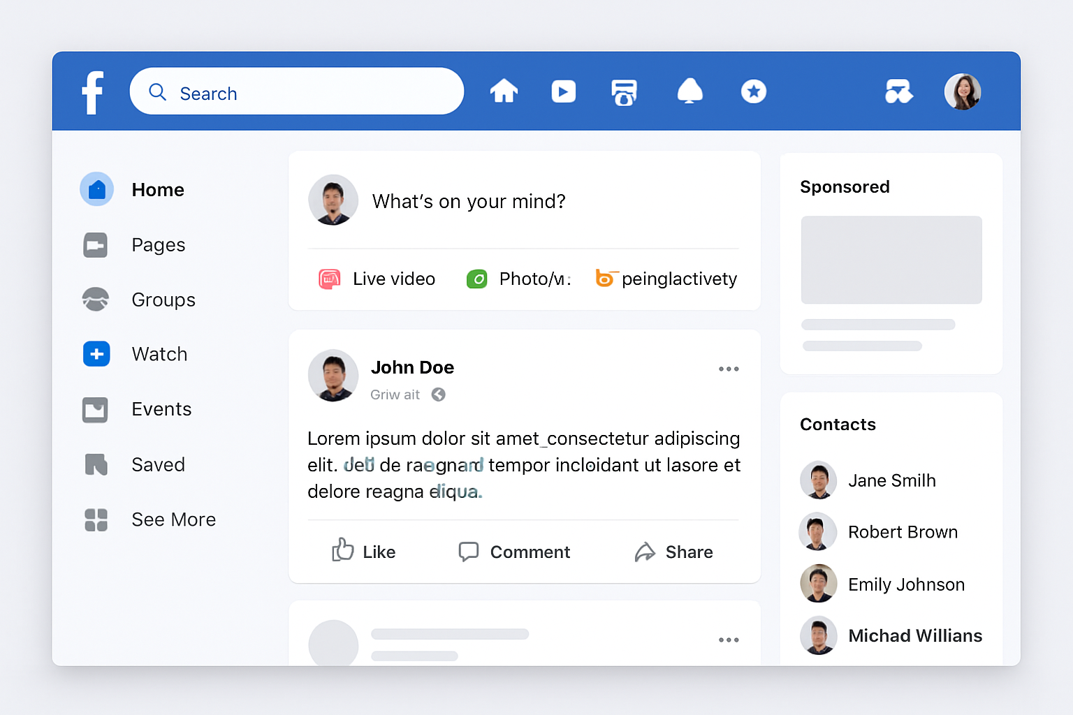
React

Slide 24
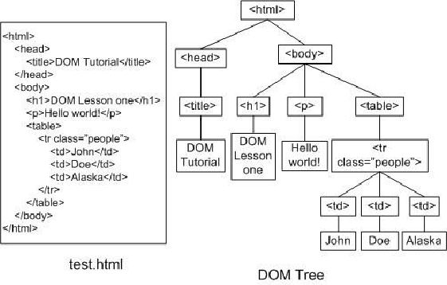
React

Slide 25

React
React has a simple Mental model
JS is cumbersome
JS is Error-prone
JS is Hard to maintain

